Slide 1

GASTROENTERITIS
OR
GASTRITIS
MR. DINESH SINGH
P.G. NURSING TUTOR
ROHILKHAND COLLEGE OF NURSING

Slide 2
OBJECTIVES
Introduction of the Peritonitis.
Define the Peritonitis.
Explain the causes of Peritonitis.
State the clinical manifestations of Peritonitis.
Elaborate the diagnostic evaluation of Peritonitis.
Discuss the management of Peritonitis.
Describe the prevention of Peritonitis.

Slide 3
INTRODUCTION
Gastroenteritis is inflammation of the gastrointestinal tract, involving the stomach, intestines, or both; usually resulting in diarrhea, abdominal cramps, nausea and possibly vomiting.
Gastroenteritis is frequently termed as “stomach flue” or “gastric flue”.

Slide 4
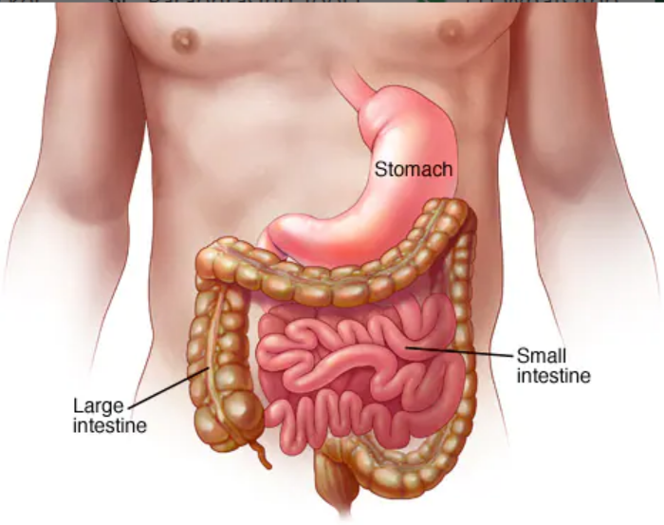
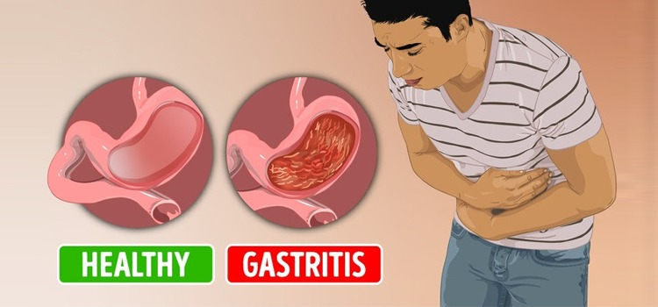
DEFINITION
Gastroenteritis: An inflammation of intestine and gastric mucosa is known as gastroenteritis.
Gastritis: it is an inflammation of mucous membrane of stomach.

Slide 5
ETIOLOGY
Bacterial infection
Eg. Salmonella, shigella, staphylococcus aureus, Bacillus cereus
Virus
Eg. Rotaviruses, Noroviruses, astrovirus, Enteric adenovirus
Excessive intake of alcohol
Excessive use of NSAID drug, Eg. Aspirin
Excessive intake of spicy food

Slide 6
CLINICAL MANIFESTATION
Nausea, vomiting
Abdominal discomfort
Hiccupping
Anorexia
Diarrhea or watery stool
Stool with blood
Abdominal cramps
Weight loss/ headache
Heart burn after eating
Epigastric tenderness
Dehydration
Hematemesis
Sour Taste

Slide 7
DIAGNOSTIC EVALUATION
History collection
By signs and symptoms
Endoscopy
Biopsy with histologic examination are performed
Serologic testing to detect the presence of H.pylori.

Slide 8
MANAGEMENT
Antibiotics, Eg. Amoxicillin Tetracycline or Clarithromycin
Antacids, Eg. Aluminium hydroxide.
Proton pump inhibitor, Eg. Lansoprazole, Omeprazole
H2-Blocker, Eg. Ranitidine
Antiemetic Eg. Domperidone
Antimicrobial Eg. Metronidazole

Slide 9
SUMMARY

Slide 10
REFERENCES
Lwis. Dirksen. Heitkemper. Textbook of medical surgical nursing, second south asia edition, volume1.
Brunner and suddarth’s textbook of medical surgical nursing 13th south Asian edition, volume 2 page no. 1532 to 1533.
Panwar K.P. medical surgical nursing, 4th edition, AITBS publishers, India, page no.133-134

Slide 11


