Slide 1
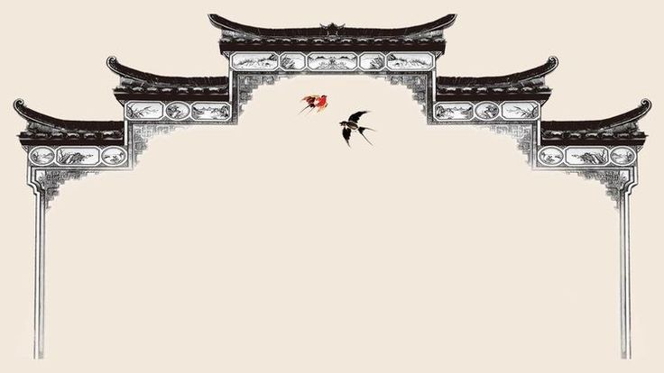

JAUNDICE
MR. DINESH SINGH
P.G. NURSING TUTOR
ROHILKHAND COLLEGE OF NURSING

Slide 2
OBJECTIVES
Introduction of the Jaundice.
Define the Jaundice.
Explain the causes of Jaundice.
State the clinical manifestations of Jaundice.
Elaborate the diagnostic evaluation of Jaundice.
Discuss the management of Jaundice.
Describe the prevention of Jaundice.

Slide 3
INTRODUCTION
Jaundice is condition produced when excess amounts of bilirubin circulating in the blood stream dissolve in the subcutaneous fat (the layer of fat just beneath the skin), causing a yellowish appearance of the skin and the whites of the eyes.

Slide 4
DEFINITION
Jaundice is a yellow discoloration of body or skin due to alteration of bilirubin metabolism.
Bilirubin level exceeds (increase) upto 3 times than normal.
Normal value 0.3-1.2 mg/dl

Slide 5
TYPE / CAUSES
Haemolytic (prehepatic) Jaundice: it is due to breakdown of RBCs that leads to increase unconjugated bilirubin level in blood. Liver functions are normal.
Causes
Blood transfusion reaction
Haemolytic anaemia
Sickle cell crisis
Gallbladdder stones

Slide 6
CONTI…
Hepatocellular jaundice: it is due to dis-functioning of liver cells.
Causes
Infection- Hepatitis virus
Drug or chemical toxicity

Slide 7
CONTI…
Obstructive Jaundice: it is due to obstruction in bile duct that leads to altered secretion of bile. It is of two types.
Extra hepatic obstruction: due to blockage in bile duct. E.g., Gall stone, tumor.
Intra hepatic cholestasis: it occurs due to blockage or swelling in intra hepatic duct.

Slide 8
CLINICAL MANIFESTATION
Yellowish skin and sclera
Light gray or clay colored (alcoholic) stool
Itchy skin
Nausea
Prothrombin time increase
Lack of appetite
Tea colored urine.

Slide 9
DIAGNOSTIC EVALUATION
Physical examination
Increase level of serum bilirubin (>0.4 mg/100 ml) conjugated.
Increased indirect (unconjugated) serum bilirubin values (>0.8 mg/100 ml).
Absence of bilirubin in urine.
Reduced fetal urobilinogen (<40 mg/24 hr) because it does not reach in intestine.
Prolonged prothrombin time (> 40 seconds)

Slide 10
MANAGEMENT
Only treatment of causes is necessary or supportive treatment.
Antihistamines drugs (for itching) Example: Levocitrizine 5mg, Avil 25mg
Sedatives for restlessness and irritability Example: Lorazepam, Diazepam
Vit. K and B-complex
Purgative enema if constipation
Antibiotics
Antipyretics

Slide 11
DIETARY MANAGEMENT
Advice to patient for restrict fat intake
Provide high protein diet.
High carbohydrate diet
Provide plenty of fluids, juices
Give glucose water

Slide 12
NURSING MANAGEMENT
Provide comfort to patient
Avoid bed sores to patient
Maintain fluid and electrolyte balance to patient
Maintain output-input chart.
Provide psychological support to patient
Give health education.

Slide 13
SUMMARY

Slide 14
REFERENCES

Slide 15


