Slide 1



Slide 2
HYDROCELE
MR. DINESH SINGH
P.G. NURSING TUTOR
ROHILKHAND COLLEGE OF NURSING

Slide 3
OBJECTIVES
Introduction of the .
Define the .
Explain the causes of .
State the clinical manifestations of .
Elaborate the diagnostic evaluation of .
Discuss the management of .
Describe the nursing management of .

Slide 4
INTRODUCTION
Hydrocele is an abnormal fluid collection in the scrotum between the visceral and parietal areas of the tunica vaginalis.

Slide 5
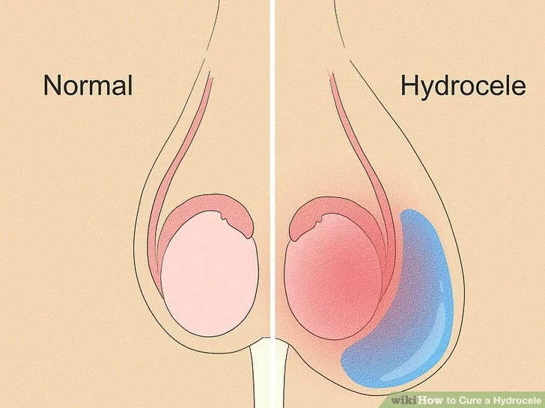
DEFINITION
Hydrocele is a collection of fluid around one or both testicles and cause swelling of scrotum or groin area.
It commonly occurs in men older than 40 years.

Slide 6
ETIOLOGY
Causes of hydrocele is unknown.
Inflammation of infection of the epididymis or testicles.
In rare cases, may be caused by cancer of testicle or left kidney.
Men over the age of 40.

Slide 7
CLINICAL MANIFESTATION
Swelling of scrotum
Pain sometime
Redness of scrotum
Feeling of pressure at base of penis present.
Testicular torsion
infertility

Slide 8
DIAGNOSTIC EVALUATION
History taking
Physical examination
Transillumination: it is a test used to identify abnormalities in an organ or body cavity. The test is performed in a dark room, with a bright light shined at a specific body part to see structures beneath the skin
Ultrasound of scrotum done to rule out presence of fluid
Blood test done to rule out infection.

Slide 9
MEDICAL MANAGEMENT
Hydroceles usually improve without any treatment within the first year of life. An operation is usually only advised if the hydrocele persists after 12-18 months of age.

Slide 10
SURGICAL MANAGEMENT
Aspiration/Surgical Drainage:
It is treated by aspirating the fluid and injecting a sclerosing drug such as hydrochloride into the scrotal sac.
Incision of Tunica Vaginalis:
An incision made through the wall of the scrotum down to the distanced Tunica Vaginalis.
The sac is resected or after being opened, is sutured together to collapse the wall.

Slide 11
CONTI…
Hydrocelectomy:
Excision of the tunica vaginalis to withdraw the fluid collection from it.
The operation for a hydrocele involves making a very smell cut in the lower tummy (abdomen) or the scrotum. The fluid is then drained from around the testicle (testis). The passage between the abdomen and scrotum will also be sealed off so the fluid cannot reform in the future. This is a minor operation and is performed as a day case, so does not usually involve an overnight stay in the hospital.

Slide 12
COMPLICATION
Haematoma in the loose scrotal tissue
Testicular tumor
Inguinal hernia

Slide 13
NURSING MANAGEMENT
A pressure dressing is applied on the scrotum which is elevated.
The patient should be observed carefully for any symptoms of Hemorrhage and bleeding may not be external.
The patient needs a scrotum is elevated on a pillow or bride dressing.
Scrotum is elevated on a pillow or dressing.

Slide 14
SUMMARY

Slide 15
REFERENCES

Slide 16


