Slide 1


Slide 2


Slide 3

APPENDICITIS
MR. DINESH SINGH
P.G. NURSING TUTOR
ROHILKHAND COLLEGE OF NURSING

Slide 4
OBJECTIVES
Introduction of the Appendicitis.
Define the Appendicitis.
Explain the causes of Appendicitis.
Enlist the pathophysiology of Appendicitis
State the clinical manifestations of Appendicitis.
Elaborate the diagnostic evaluation of Appendicitis
Discuss the management of Appendicitis.
Describe the complication of Appendicitis

Slide 5
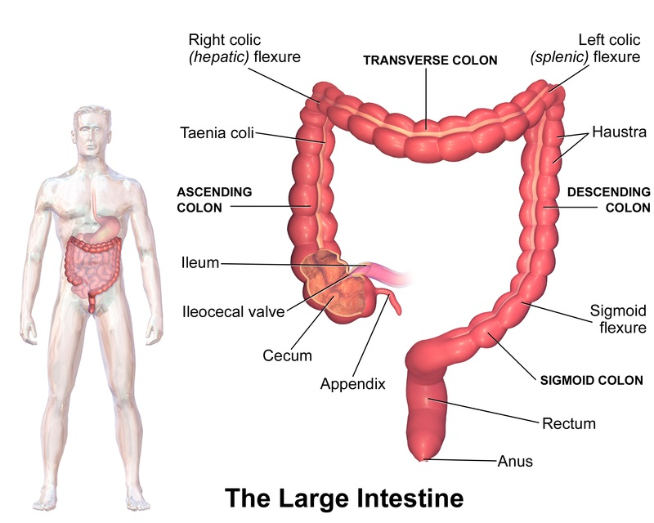
INTRODUCTION
Structure of Appendix: The appendix or vermiform appendix is a muscular structure attached to the large intestine in the human body. It is a narrow tube resembling a worm and is named after the Latin word "vermiform" which means ‘worm-shaped’. The appendix is usually located at the lower right side of the abdomen.

Slide 6
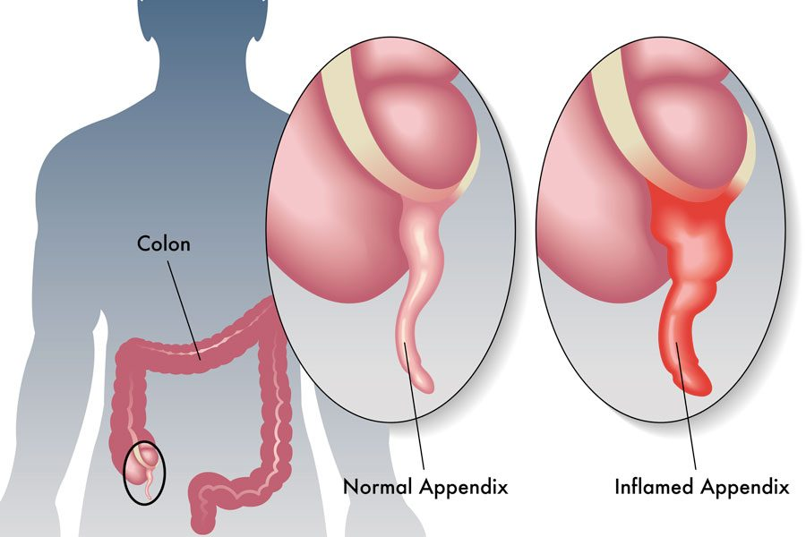
DEFINITION
It is an acute inflammation of vermiform appendix (a small, finger like appendage attached to cecum just below the ileocaecal valve).

Slide 7
CAUSES
Most common in abdominal surgery
Infection
Obstruction of faecal matter
Lymphoid hyperplasia (increase number of normal cells)
Inflammation of colon

Slide 8
PATHOPHYSIOLOGY
Due to infection or faecal stone and obstruction
Obstruction in appendix lumen
Increase intra-luminal pressure
Disturb blood supply
Edema or swelling in appendix
Rupture of appendix

Slide 9

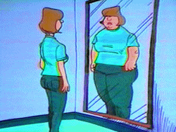
CLINICAL MANIFESTATION
Abdominal pain in right lower quadrant area.
Anorexia

Slide 10


Conti….
Nausea/ vomiting
Fever

Slide 11
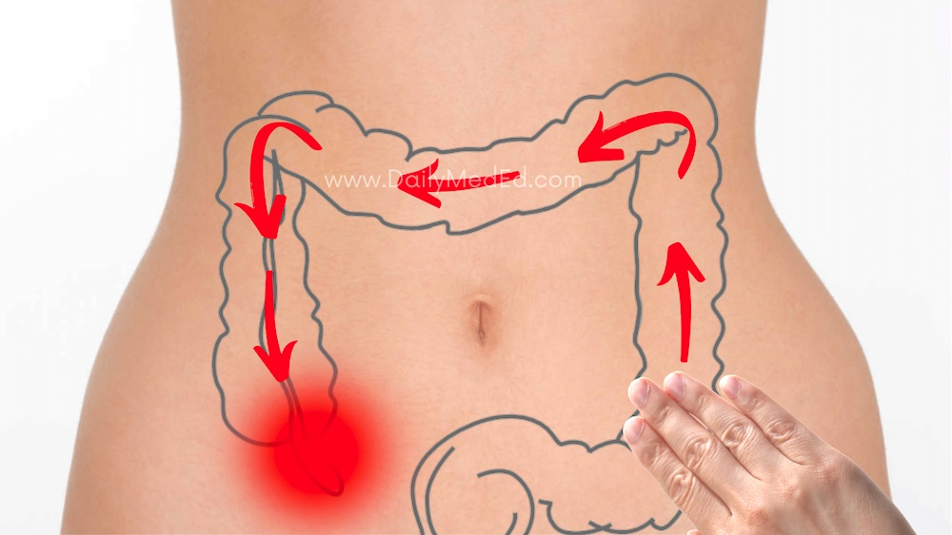

Conti….
Rosing’s sign
Constipation

Slide 12
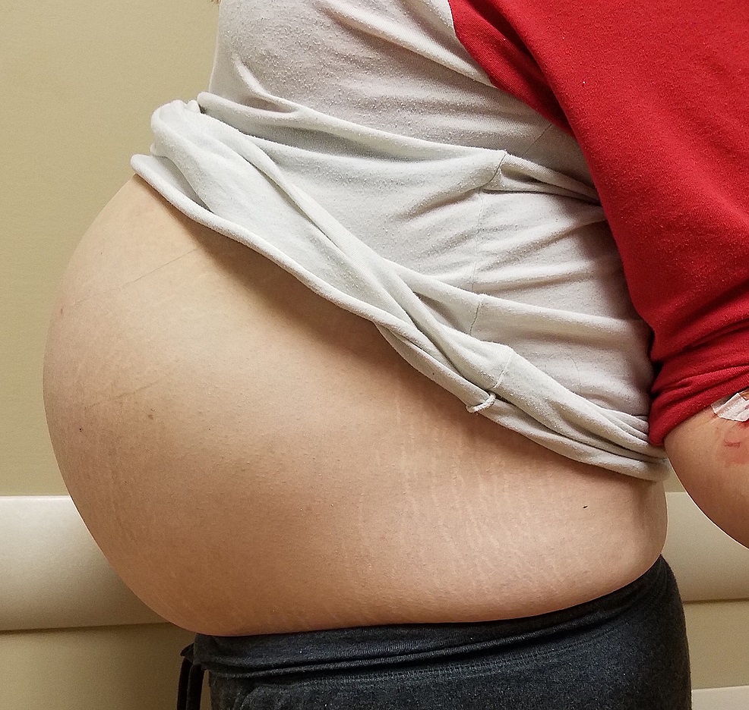

Conti….
Abdominal distension
Frequency of urination

Slide 13
DIAGNOSTIC EVALUATION
History Collection
Physical Examination
Blood Studies- WBC increases
Urinalysis
Ultrasound- Visualize tubular structures & cysts
Magnetic resonance imaging
X-ray

Slide 14
MANAGEMENT
Antibiotic therapy Eg. Cephalosporin
Anti inflammatory drugs Eg. Metrogyl
Analgesics
Administer IV Fluid
Ice bag therapy
Comfortable position

Slide 15
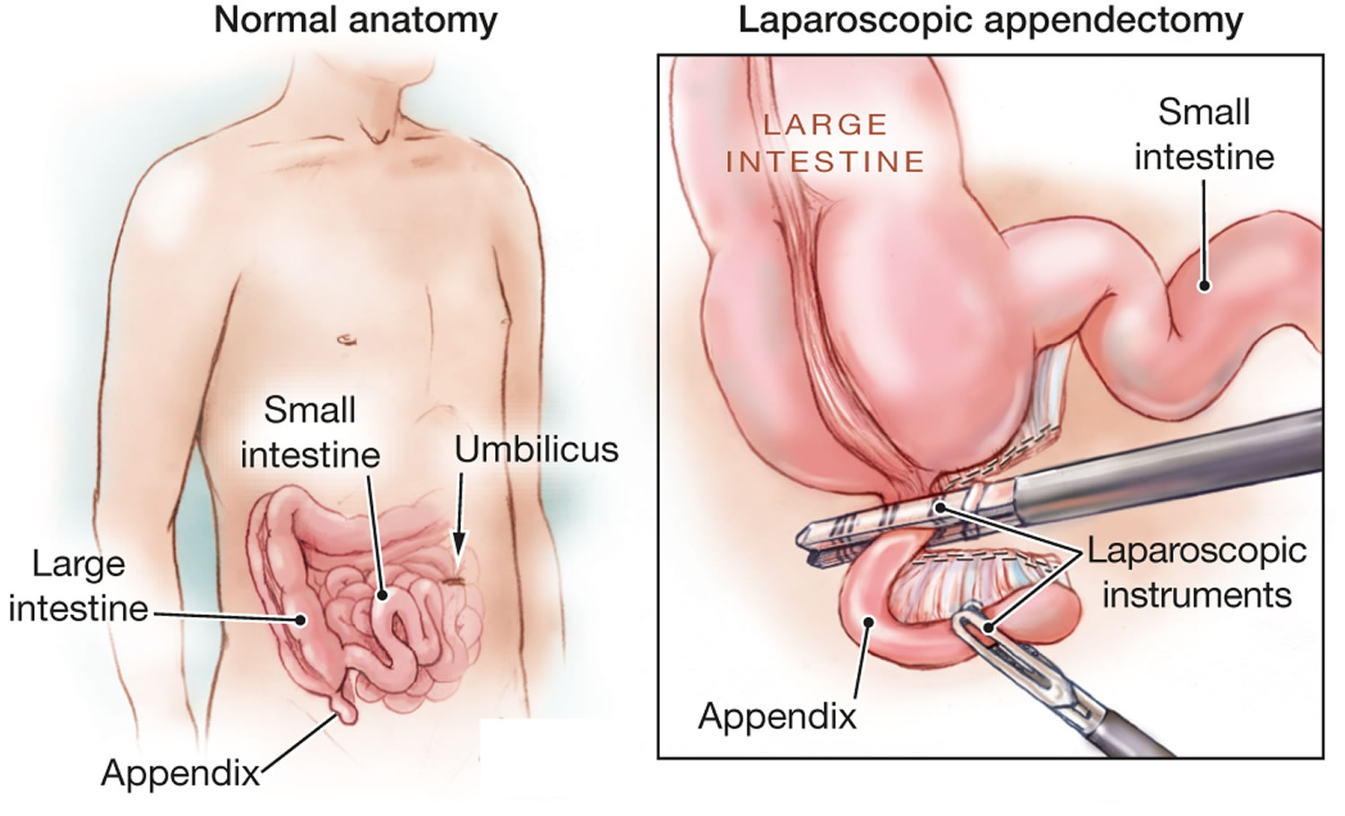
SURGICAL MANAGEMENT
Appendectomy: Surgical removal of Appendix from the abdomen.

Slide 16
COMPLICATIONS
Perforation
Abscess
Peritonitis

Slide 17
SUMMARY

Slide 18
REFERENCES
Brunner and Suddarth’s “textbook of medical-surgical nursing” “10th edition, published by “Suzanne C. Smeltzer Brenda Bare”.
PR Ashalatha, G. Deepa “textbook of Anatomy and physiology” Fourth edition” published by “Jaypee Brothers.
Linda S. Williams, Paula D. Hopper “textbook of Medical Surgical Nursing” “Third edition” Published by F.A. Davis 2007.
Priscilla LeMone, Karen Burke, Gerene Bauldoff “textbook of Medical Surgical Nursing” “Fifth edition” “published by Julie Levin Alexander”.
Lewis Dirksen Heitkemper Bucher, textbook of medical surgical nursing second south Asia edition, volume 1.

Slide 19


