Slide 1

ADDISON’S DISEASE
MR. DINESH SINGH
P.G. NURSING TUTOR
ROHILKHAND COLLEGE OF NURSING

Slide 2
OBJECTIVES
Introduction of the Peritonitis.
Define the Peritonitis.
Explain the causes of Peritonitis.
State the clinical manifestations of Peritonitis.
Elaborate the diagnostic evaluation of Peritonitis.
Discuss the management of Peritonitis.
Describe the prevention of Peritonitis.

Slide 3
INTRODUCTION
Addison's disease, also called adrenal insufficiency, is an uncommon illness that occurs when the body doesn't make enough of certain hormones. In Addison's disease, the adrenal glands make too little cortisol and, often, too little of another hormone, aldosterone.

Slide 4
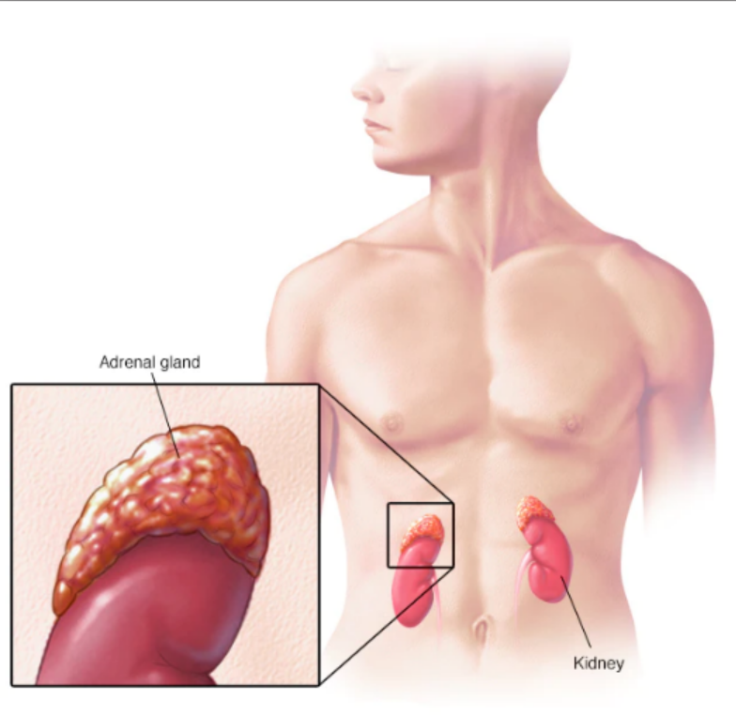
DEFINITION
Lack of glucocorticoid and mineralocorticoids hormone production by adrenal cortex is called Addison’s disease.

Slide 5
CAUSES
Unknown but some other causes are:
T.B.
Syphilis (Sexual transmitted infection)
ACTH inhibitors drugs
Adrenalectomy
Adrenal hemorrhage

Slide 6
CLINICAL MANIFESTATION
Excessive fatigue
Weight loss
Muscles weakness
Menstrual changes
Change in emotion
Hypotension
Confusion
Excessive loss of sodium and water in the urine.

Slide 7
DIAGNOSTIC EVALUATION
History collection
Physical examination
Blood test (increase plasma cortisol)
Serum Na, K, Cl, Ca (Sodium, Potassium, Chloride, Calcium)
Blood cell count

Slide 8
MANAGEMENT
Corticosteroid drugs, e.g., Prednisolone, Hydrocortisone
I.V. theraphy.

Slide 9
DIETARY MANAGEMENT
High calorie
Increase table salt
High protein

Slide 10
SUMMARY

Slide 11
REFERENCES

Slide 12


