Slide 1



Slide 2
RENAL CYST
MR. DINESH SINGH
P.G. NURSING TUTOR
ROHILKHAND COLLEGE OF NURSING

Slide 3
OBJECTIVES
Introduction of the .
Define the .
Explain the causes of .
State the clinical manifestations of .
Elaborate the diagnostic evaluation of .
Discuss the management of .
Describe the nursing management of .

Slide 4
INTRODUCTION
Kidney cysts are round pouches of fluid that form on or in the kidneys. Kidney cysts can occur with disorders that may impair kidney function. But more often, kidney cysts are a type called simple kidney cysts. Simple kidney cysts aren't cancer and rarely cause problems.

Slide 5
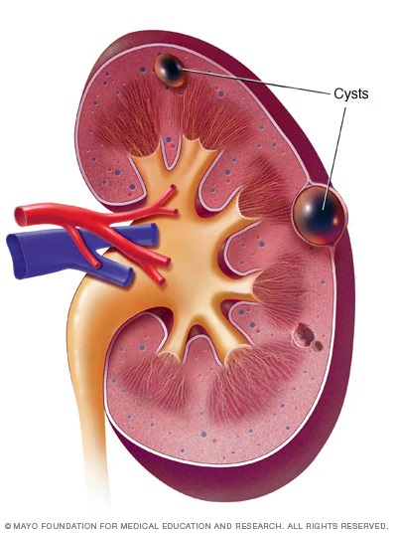
DEFINITION
Kidney cysts are round pouches of fluid that from in the kidney cysts can be associated with serious disorders that may impair kidney function. But more commonly, kidney cysts are a type called simple kidney cysts non-cancerous cysts that rarely cause complications.

Slide 6
ETIOLOGY
It is not clear what causes simple kidney cysts. One theory suggests that kidney cysts develop when the surface layer of the kidney weakens and forms a pouch (diverticulum). The pouch then fills with fluid, detaches and develops into a cyst.

Slide 7
CLINICAL MANIFESTATION
Simple kidney cysts typically don’t cause signs or symptoms. If a simple kidney cyst grows large enough, symptoms may include:
Dull pain in back or side
Fever
Upper abdominal pain

Slide 8
DIAGNOSTIC EVALUATION
Ultrasound
Computerized Tomography
Magnetic resonance imaging

Slide 9
MEDICAL MANAGEMENT
Puncturing and Draining the Cyst, Then Filling it with Alcohol
Rarely, to shrink the cyst, doctor inserts a long, thin needle through skin and through the wall of the kidney cyst. Then the fluid is drained from the cyst. Doctor may fill the cyst with an alcohol solution to prevent it from reforming. The cysts generally return after this type of procedure, so it's reserved for certain situations

Slide 10
Surgery to Remove the Cyst
A large or symptomatic cyst may require surgery to drain and remove it. To assess the cyst, the surgeon makes several small incisions in skin and inserts special tools and a small video camera. While watching a video in the operating room, the surgeon guides the tools to the kidney and uses them to drain the fluid from the cyst. Then, the walls of the cyst are cut or burned away.

Slide 11
COMPLICATIONS
An infected cyst: A kidney cyst may become infected, causing fever and pain.
A burst cyst: A kidney cyst that bursts causes severe pain in your back or side.
Urine obstruction: A kidney cyst that obstructs the normal flow of urine may lead to swelling of the kidney (hydronephrosis).

Slide 12
SUMMARY

Slide 13
REFERENCES

Slide 14


