Slide 1

CUSHING SYNDROME
MR. DINESH SINGH
P.G. NURSING TUTOR
ROHILKHAND COLLEGE OF NURSING

Slide 2
OBJECTIVES
Introduction of the Peritonitis.
Define the Peritonitis.
Explain the causes of Peritonitis.
State the clinical manifestations of Peritonitis.
Elaborate the diagnostic evaluation of Peritonitis.
Discuss the management of Peritonitis.
Describe the prevention of Peritonitis.

Slide 3
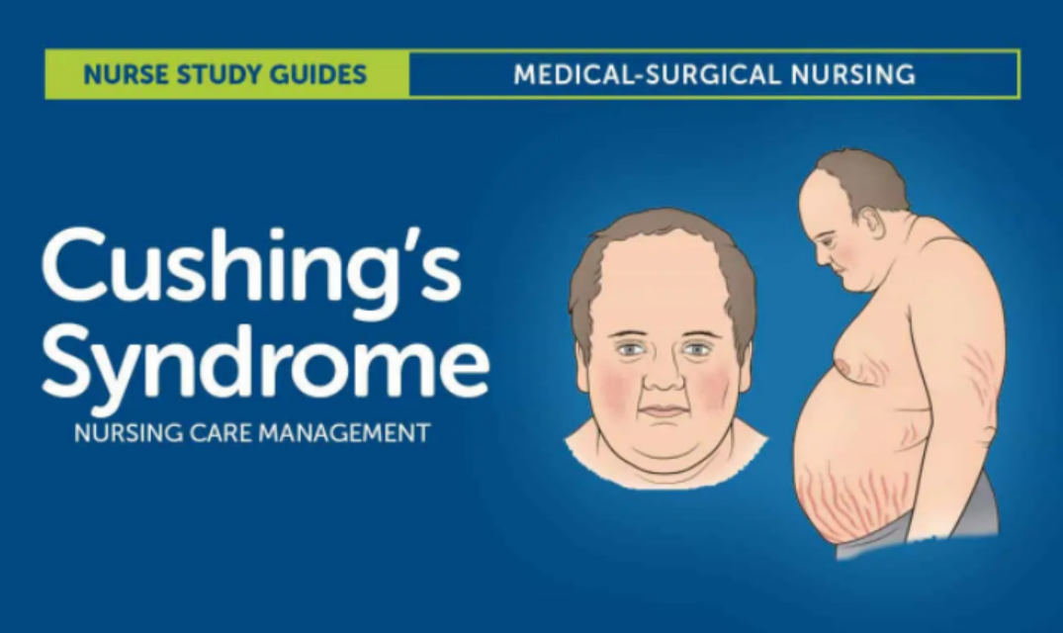
INTRODUCTION

Slide 4
DEFINITION
Cushing’s syndrome is a disorder that occurs when the body makes too much of the hormone cortisol over a long period of time. Cortisol is sometimes called the “stress hormone” because it helps the body respond to stress. Cortisol also helps
Maintain blood pressure
Regulate blood glucose, also called blood sugar
Reduce inflammation
Turn the food you eat into energy

Slide 5
ETIOLOGY
Excessive corticosteroids medications.
Tumor of pituitary gland which results excessive production of ACTH (Adrenocorticotropic hormone)
ACTH stimulated adrenal cortex and produce excessive cortisone.
Tumor in adrenal cortex.

Slide 6
CLINICAL MANIFESTATION
Common signs and symptoms of Cushing syndrome
Weight gain and fatty tissue deposits, particularly around the midsection and upper back, in the face (moon face), and between the shoulders (buffalo hump)
Pink or purple stretch marks (striae) on the skin of the abdomen, thighs, breasts and arms
Thinning, fragile skin that bruises easily
Slow healing of cuts, insect bites and infections
Acne

Slide 7
CONTI…
Signs and symptoms women with Cushing syndrome may experience
Thicker or more visible body and facial hair (hirsutism)
Irregular or absent menstrual periods
Signs and symptoms men with Cushing syndrome may experience
Decreased sex drive
Decreased fertility
Erectile dysfunction

Slide 8
CONT…
Other possible signs and symptoms of Cushing syndrome
Severe fatigue
Muscle weakness
Depression, anxiety and irritability
Loss of emotional control
Cognitive difficulties
Headache
Infections
Skin darkening
Bone loss, leading to fractures over time
In children, impaired growth

Slide 9
DIAGNOSTIC EVALUATION
History collection
Physical examination
Overnight dexamethasone suppression test to measure plasma cortisol level.
Laboratory studies (e.g., Serum sodium, blood glucose, serum potassium, plasma, urinary).
Computerized tomography
Ultrasound
MRI

Slide 10
MANAGEMENT
Surgical removal of tumor by trans-sphenoidal hypophysectomy is the treatment of choice.
Adrenalectomy (surgical removal of adrenal glands)
Postoperatively, temporary replacement therapy with hydrocortisone.
Adrenal enzyme inhibitors: They interferes with the production of hormones (cortisol and aldosterone) e.g., Metyrapone, Mitotane, Ketoconazole

Slide 11
COMPLICATIONS
Possibility of recurrence in patients with adrenal carcinoma.
Fracture
Infections
Gastric ulcer
Pancreatitis

Slide 12
SUMMARY

Slide 13
REFERENCES

Slide 14


