Slide 1

PEPTIC ULCER
MR. DINESH SINGH
P.G. NURSING TUTOR
ROHILKHAND COLLEGE OF NURSING

Slide 2
OBJECTIVES
Introduction of the Peritonitis.
Define the Peritonitis.
Explain the causes of Peritonitis.
State the clinical manifestations of Peritonitis.
Elaborate the diagnostic evaluation of Peritonitis.
Discuss the management of Peritonitis.
Describe the prevention of Peritonitis.

Slide 3
INTRODUCTION
Peptic ulcers are open sores that develop on the inside lining of the stomach and the upper portion of the small intestine. The most common symptom of a peptic ulcer is stomach pain.
Peptic ulcers include:
Gastric ulcers that occur on the inside of the stomach
Duodenal ulcers that occur on the inside of the upper portion of the small intestine (duodenum)

Slide 4
DEFINITION
It is defined as a breakdown in continuity of mucous membrane of duodenum, esophagus, stomach or a breach in lining (mucosa) of digestive tract produced by digestion of mucosa by pepsin and acid are present in abnormally high concentrations.

Slide 5
ETIOLOGY
Genetic
Prolonged excessive stress
Prolonged use of some drugs, NSAID, corticosteroid, antiplatelets.
Excessive intake of caffeine, alcohol
Fasting or resting period
Emotional stress
Infection by bacteria

Slide 6
TYPES
Gastric Ulcer: It is breaking of mucous membrane of stomach due to some injuries like substances, alcohol, caffeine, aspirin, NSAID drugs.
Duodenal Ulcer: They occur in duodenum due to stimulation of vagus nerve during resting period or fasting.
Oesophageal Ulcer: Ulcerations in mucosa of oesophagus. It is due to hydrochloric acid reflux in oesophagus (mostly seen in lower oesophagus).

Slide 7
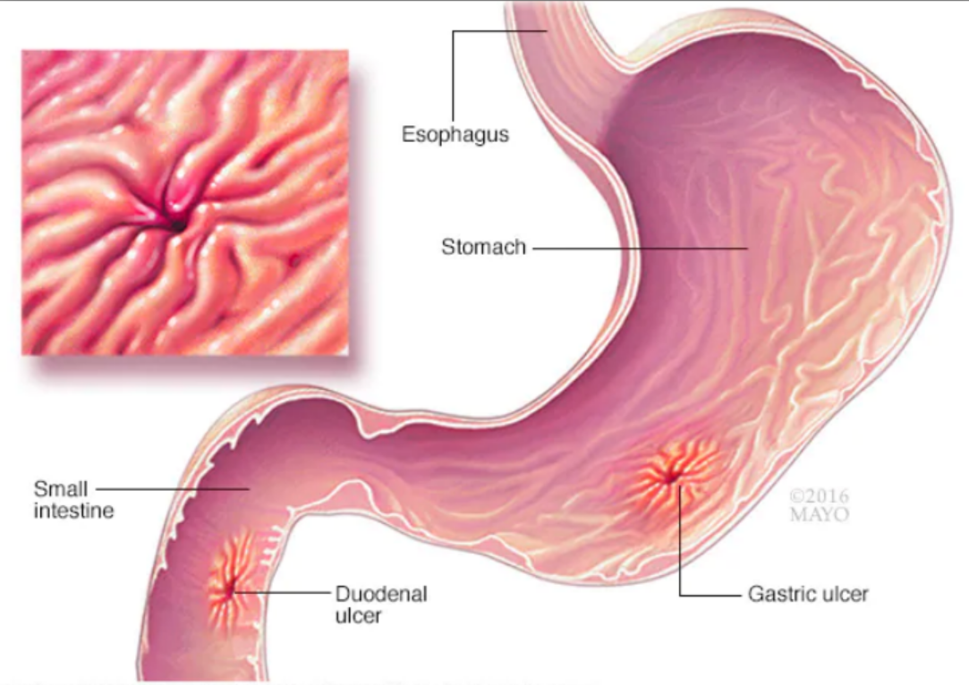

Slide 8
PATHOPHYSIOLOGY
Gastric Ulcer
Due to (NSAIDs), alcohol, coffee or tea
Excessive secretion of HCL and decrease mucous secretion
Breakdown mucus membrane of stomach
Acid enters into gastric mucosa
Gastric ulcers

Slide 9
Duodenal Ulcer
Due to fasting
Stimulation of vagus nerve
Increases gastric secretion
HCl secretion level increase
That lead to duodenal ulcer

Slide 10
CLINICAL MANIFESTATION
Epigastric pain
Nausea
Discomfort
Weight loss
Dyspepsia (indigestion)
Heart burn
Hypochondrium region pain
Vomiting (sometimes with blood)
Anorexia (loss of appetite)
Bloody stool
Hip and knee pain

Slide 11
DIAGNOSTIC EVALUATION
History collection
Physical examination
Endoscopy: Visualization of the stomach ulcers and doctor detects an ulcer, a small tissue sample (biopsy) may be removed for examination in a lab. A biopsy can also identify whether H. pylori is in patient stomach lining.
Ultrasound
Complete blood count

Slide 12
MANAGEMENT
Antimicrobial Drugs: Prevent and treat infections. Eg. Metronidazole
H2- Blocker: Block H2 recepter (that leads to hypersecretion of acid gastric juice). Eg. Ranitidine
Antacids: Nutralizes HCl Secresion,
Eg. Aluminum hydroxide, Calcium Carbonate, Magnesium hydroxide, Sodium bicarbonate
Proton pump inhibitors: Reducing the amount of stomach acid made by glands in the lining of the stomach. Eg. Lansoprazole, Omeprazole.

Slide 13
SURGICAL MANAGEMENT
Vagotomy: Cutting of vagus nerve
Gastro jejunostomy: Remove the antrum part of stomach and join with remaining part of jejunum.
Gastroduodenostomy: Removal of lower portion of stomach and join with remaining part of duodenum.
Subtotal Gastrectomy: Removal that portion which is more effected by ulcer in stomach.
Total gastrectomy: Total removal of stomach.

Slide 14
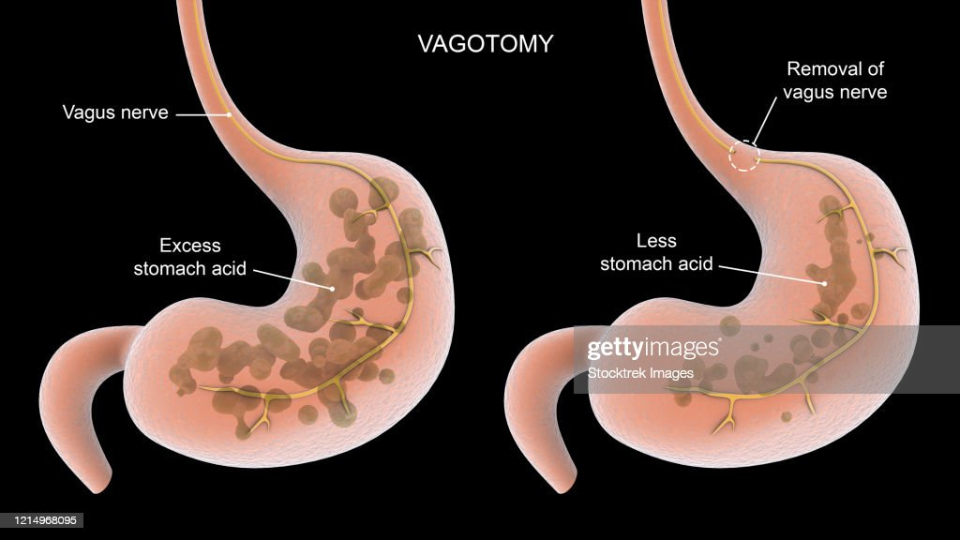

Slide 15
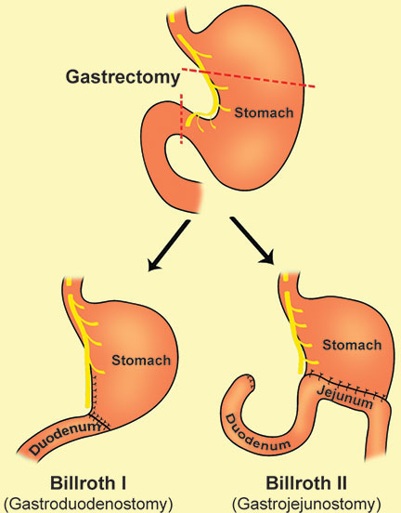

Slide 16
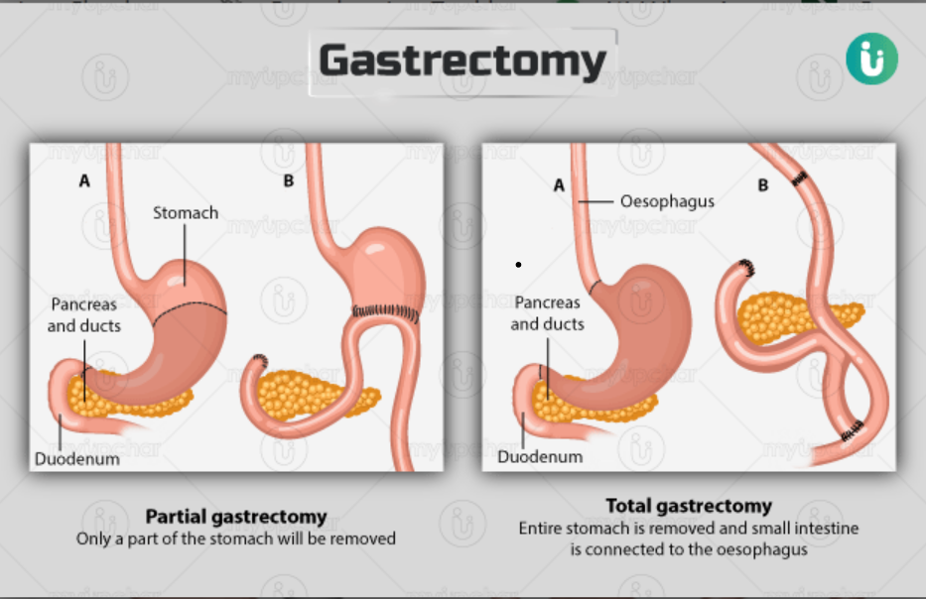

Slide 17
SUMMARY

Slide 18
REFERENCES

Slide 19


