Slide 1
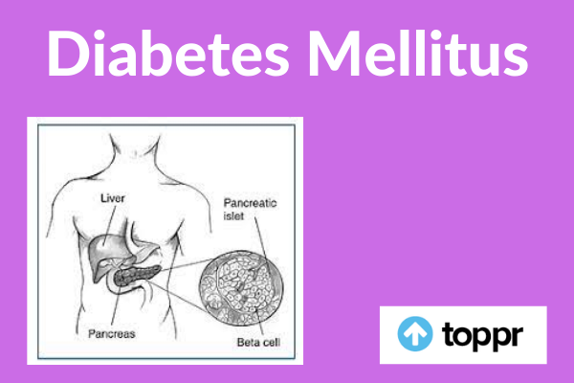

MR. DINESH SINGH
P.G. NURSING TUTOR
ROHILKHAND COLLEGE OF NURSING

Slide 2
OBJECTIVES
Introduction of the Diabetes Mellitus.
Define the Diabetes Mellitus.
Explain the causes of Diabetes Mellitus.
State the clinical manifestations of Diabetes Mellitus.
Elaborate the diagnostic evaluation of Diabetes Mellitus.
Discuss the management of Diabetes Mellitus.
Describe the prevention of Diabetes Mellitus.

Slide 3
DEFINITION
It is the condition in which carbohydrate metabolism disturbed due to insufficient secretion of insulin hormones. It is characterized by tried features, e.g., Polyuria, Polyphagia, Polydypsia
Glucose level in blood increases. This is known as hyperglycemia.
Normal blood sugar level;
Fasting: 70-110 mg/dl
Postprandial (PP): 80-150 mg/dl

Slide 4
CONTI…
Insulin
It as a hormone produced by pancreas. It maintains the level of blood glucose by regulating the production and storage of glucose. As well as carbohydrates, fat and protein metabolism also affected in this case.

Slide 5
TYPES OF DIABETES MELLITUS
IDDM (Insulin Dependent Diabetes Mellitus)
It this condition, patient is unable to produce endogenous insulin due to destruction of pancreatic beta cells by genetic immunologic and environmental factors.
About 5-10% cases have diabetes type I of Total DM
It has sudden onset, usually before the age of 30 years (Mostly in young age)
Insulin therapy is necessary.

Slide 6
CONTI…
NIDDM (Non-insulin Dependent Diabetes Mellitus)
It results from a decreased sensitivity to insulin (insulin resistance) or from a decreased amount of insulin production.
About 90-95% of patient have type-2 DM.
Type-2 diabetes is first treated with diet and exercise and then with oral hypoglycaemic agents as needed.
It occurs mostly after 40 years of age.
About 80% cases due to obesity
There is no need of exogenous insulin

Slide 7
CONTI…
Gestational DM
Gestational diabetes is characterized by any degree of glucose intolerances with onset during pregnancy (Second or Third trimester).

Slide 8
ETIOLOGY
Heredity
Obesity, mostly due to imbalance insulin level because supply of insulin is less and requirement is more in obesity.
Old age (pancreatic functions become slow)
Other systemic disease. Like Heart disease, MI stroke.
Renal disease
Virus (Coxsackie B, Strepto)
Africans and Asians are more susceptible.

Slide 9
PATHOPHYSIOLOGY
Destruction or inflammation of beta cells of Langerhans of pancreas
Decrease secretion of insulin
Insulin requirement is not sufficient for total body
Obstruction or disturbances in carbohydrates metabolism
Increase blood sugar level
Decreases Glycogen level and decreases energy, patient feels fatigue
Weight loss due to improper carbohydrates metabolism and also increases appetite.

Slide 10
CLINICAL MANIFESTATION
In early stage (No symptoms)
3P’s Symptoms
Polyuria
Polydypsia
Polyphagia

Slide 11
CONTI…
Later Symptoms are:
Slow healing of cuts
Blurred vision
Itching (Pruritis)
Weight loss
Skin becomes dry
Fatigue
Cramps in legs, feet and fingers
Drowsiness
Skin infections
Tingling and numbness in hands or feet
Vaginal infection
Hypotension

Slide 12
DIAGNOSTIC EVALUATION
History collection
Physical examination
Blood glucose level test:
Fasting plasma glucose level- 126 mg/dl or more
Random or PP- 180 mg/dl or more
Detection of complication

Slide 13
MANAGEMENT
Pharmacological Management
Insulin injection should be given according to blood sugar level. It should given before meal (half an hours) in three times in a day.
Hypoglycaemic drugs, e.g., Pioglitazone Hydrochloride, Metformin (Biguanides), Glipizide (second generation sulfonylureas).

Slide 14
NURSING MANAGEMENT
Assessment
Get base-line information, e.g. Polyurea, polydipsia, polyphagia
Take family history of DM
Assess knowledge level of patient’s and family
Perform physical assessment
Assess anxiety level of patient

Slide 15
DIETARY MANAGEMENT
Sufficient quantity of diet is very necessary which satisfy to appetite.
About 1/2 energy should be get from carbohydrates, and 1/3 energy get from fat and 15-20% from protein.
Meal should be taken at regular time. If meal will be late, it may cause hypoglycemic attack.
Total calories- 2200/8800 KJ should be taken.

Slide 16
COMPLICATIONS
Kidney Disease: Albuminuria, Oedema in legs, High Blood pressure, Uremia
Neuropathy: Pain in legs, Sexual impotency, Retrograde ejaculation, Sweating, Muscles damage
Infection: Tonsillitis, Pneumonia, Appendicitis, Pyelitis (inflammation of pelvis of the kidney).

Slide 17
SUMMARY

Slide 18
REFERENCES

Slide 19


