Slide 1

CHOLELITHIASIS
MR. DINESH SINGH
P.G. NURSING TUTOR
ROHILKHAND COLLEGE OF NURSING

Slide 2
OBJECTIVES
Introduction of the Cholelithiasis.
Define the Cholelithiasis
Explain the causes of Cholelithiasis.
State the clinical manifestations of Cholelithiasis.
Elaborate the diagnostic evaluation of Cholelithiasis.
Discuss the management of Cholelithiasis.
Describe the prevention of Cholelithiasis.

Slide 3
INTRODUCTION
Gallstones are hardened deposits of digestive fluid that can form in the gallbladder. The gallbladder is a small, pear-shaped organ on the right side of the abdomen, just beneath the liver. The gallbladder holds a digestive fluid called bile that's released into the small intestine.

Slide 4
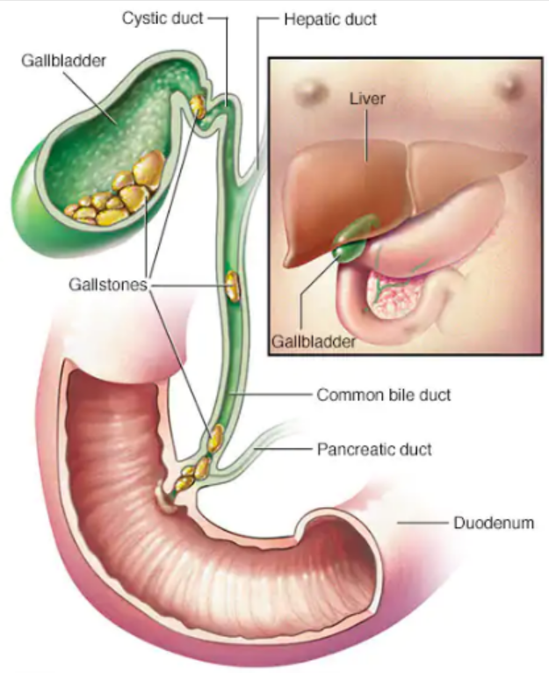
DEFINITION
Cholelithiasis is a formation of calculi or gall stones in the gallbladder from the solid composition is known as cholelithiasis.
There are two types of gall stones:
Those composed of pigment
Those composed of cholesterol

Slide 5
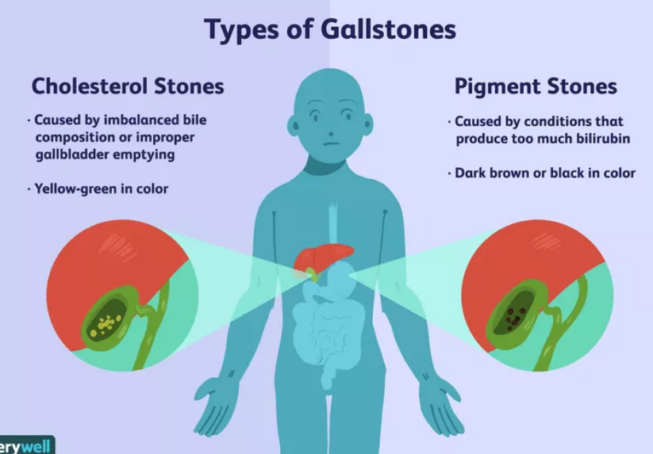

Slide 6
ETIOLOGY
Bile contains too much cholesterol: Normally, bile contains enough chemicals to dissolve the cholesterol excreted by the liver. But if liver excretes more cholesterol than bile can dissolve, the excess cholesterol may form into crystals and eventually into stones.
Bile contains too much bilirubin: Bilirubin is a chemical that's produced when body breaks down red blood cells. Certain conditions cause liver to make too much bilirubin, including liver cirrhosis, biliary tract infections and certain blood disorders. The excess bilirubin contributes to gallstone formation.

Slide 7
PATHOPHYSIOLOGY
Decreased bile acid synthesis
Increased cholesterol synthesis in the liver
Super saturation of bile with cholesterol
Formation of precipitates
Gall stones (cholelithiasis)
Inflammatory changes (cholecystitis)

Slide 8
CLINICAL MANIFESTATION
Feeling of fullness
Abdominal distention
Pain in the right upper quadrant of abdomen
Indigestion
Changes in urine and stool color
Fever
Nausea, vomiting
Vitamin K deficiency

Slide 9
DIAGNOSTIC EVALUATION
History Collection
Physical Examination
Abdominal X-ray
Ultra sonography
Cholecystography
Percutaneous Transhepatic Cholangiography (PTCA)

Slide 10
MANAGEMENT
Analgesics (For reducing pain) Eg. Acetaminophen, Aspirin
Antacids: (To reduce the amount of acid in stomach) Eg. Calcium carbonate, magnesium carbonate.
Antiemetics: (to reduce the vomiting) Eg. Emset

Slide 11
SURGICAL MANAGEMENT
Cholecystectomy (surgical removal of gallbladder)
Cholelithotomy (Removal of gall stones)

Slide 12
NURSING MANAGEMENT
Assess the level of pain, consciousness level, activity level.
Enquire about the anxiety/stress, perception about disease.
Assess about respiratory status, nutritional status.
Monitor vital sign

Slide 13
HEALTH EDUCATION
Give bed rest to the patient.
Analgesics and Antibiotics are given to the patient
The diet is restricted to low fat, liquids, high protein and carbohydrates.
Avoid eggs, cream, fried food, cheese and gas forming vegetables and alcohol.

Slide 14
REFERENCES
Brunner and Suddarth’s “textbook of medical-surgical nursing” “10th edition, published by “Suzanne C. Smeltzer Brenda Bare”.
PR Ashalatha, G. Deepa “textbook of Anatomy and physiology” Fourth edition” published by “Jaypee Brothers.
Linda S. Williams, Paula D. Hopper “textbook of Medical Surgical Nursing” “Third edition” Published by F.A. Davis 2007.
Priscilla LeMone, Karen Burke, Gerene Bauldoff “textbook of Medical Surgical Nursing” “Fifth edition” “published by Julie Levin Alexander”.
Lewis Dirksen Heitkemper Bucher, textbook of medical surgical nursing second south Asia edition, volume 1.

Slide 15


