Slide 1



Slide 2
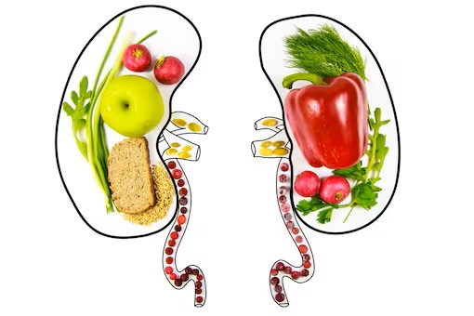
CHRONIC RENAL FAILURE
MR. DINESH SINGH
P.G. NURSING TUTOR
ROHILKHAND COLLEGE OF NURSING

Slide 3
OBJECTIVES
Introduction of the Chronic renal failure.
Define the Chronic renal failure.
Explain the causes of Chronic renal failure.
State the clinical manifestations of Chronic renal failure.
Elaborate the diagnostic evaluation of Chronic renal failure.
Discuss the management of Chronic renal failure.
Describe the nursing management of Chronic renal failure.

Slide 4

INTRODUCTION
Chronic kidney disease is a long-term condition where the kidneys do not work as well as normal CKD is very common and is mainly associated with ageing. It is estimated that about one in five men and one in four women between the ages of 65 and 74 has some degree of CKD. The most common cause of CKD is damage caused by other chronic conditions such as hypertension and diabetes.

Slide 5
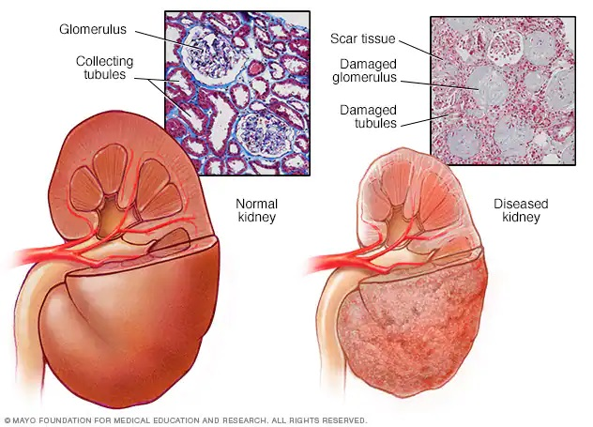
DEFINITION
Chronic renal failure or irreversible failure is a progressive reduction of renal functions that leads to uremia (increases urea and nitrogenous wastes in blood).

Slide 6

CAUSES
Glomerular dysfunction
Diabetes mellitus
Acute renal failure
Hereditary renal disease (polycystic kidney disease)
Hypertension (prolonged and severe)
Obstruction uropathy
Pyelonephritis

Slide 7

STAGE OF CHRONIC RENAL FAILURE
Normal kidney
Renal disease
Reduce renal function
Renal insufficiency
Renal failure
Uremia

Slide 8

CLINICAL MANIFESTATION
Cardiovascular System
Arrhythmia due to hyperkalemia
Hypertension (due to decreased GFR)
Hypervolemia
Tachycardia

Slide 9
CONTI….
Respiratory System
Tachypnoea
Kussmaul respiration (a slow deep respiration)
Pain with cough
Pulmonary oedema.

Slide 10
CONTI….
Gastrointestinal System
Anorexia
Nausea
Vomiting
Salty metallic taste
Peritonitis
Stomatitis
Gingivitis

Slide 11
CONTI….
Neurologic System
Lethargy
Coma
Unusual behaviour
Confusion
Sleep disturbances

Slide 12
CONTI….
Skeletal System
Joint Pain
Renal rickets
Increase chance of fracture

Slide 13
CONTI….
Dermatological
Dry skin
Uremic frost
Pallor skin
Pruritis
Itching

Slide 14
CONTI….
Metabolic
Protein urea
Acidosis
Increase triglyceride
Genitourinary
Decrease specific gravity of urine
Proteinuria

Slide 15
CONTI….
Psychological changes
Personality Changes
Behavioral changes
Change in mood

Slide 16
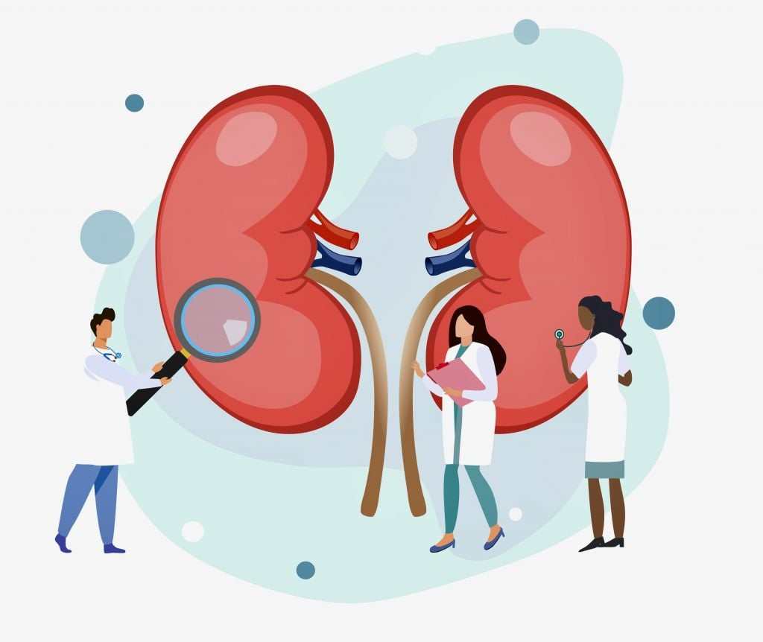
DIAGNOSTIC EVALUATION
Blood investigation for anemia
Elevated serum phosphate
Low serum proteins
KUB (Kidney urinary bladder)
CT scan
Elevated S. creatinine and BUN

Slide 17
CONTI…
Decreased serum calcium
Low blood pH (acidosis)
Renal angiography

Slide 18

MEDICAL MANAGEMENT
To Control diabetes by insulin therapy.
To treat hypertension by providing anti-hypertensive drugs.
To treat anemia
To treat acidosis by infusion and oral administration of sodium bicarbonate.
To treat hyperkalemia
To treat hyperphosphatemia by providing aluminum and calcium antacid.
Provide vitamin and minerals to patient.
Provide diuretics in condition of hypervolemia and oedema.

Slide 19

DIETARY MANAGEMENT
Provide low protein diet
Provide increase carbohydrates diet to patient
Restricted potassium diet to patient. e.g. Banana, Citrus fruit, etc.
Restricted phosphate diet to patient, e.g. Beverages, meat, chocolates.

Slide 20

DIALYSIS
It is a diffusion process by which solutes pass from high concentration to low concentration through semipermeable membrane.
Purpose: To save life.
TYPES OF DIALYSIS
Peritoneal Dialysis: in this type of dialysis, peritoneum works like as semipermeable membrane. It is used in cases of chronic renal failure.

Slide 21
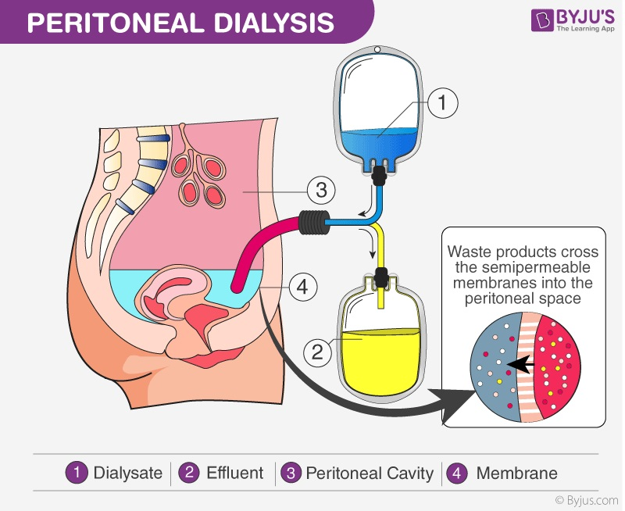
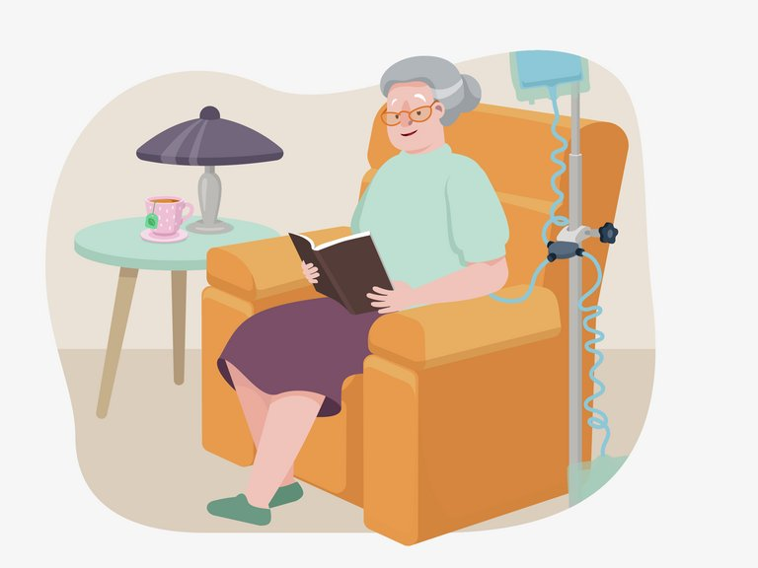
Peritoneal Dialysis

Slide 22
Haemodialysis: A technique of removing waste materials or poisons from the blood using the principle of dialysis.
Haemodialysis is performed on patient’s whose kidneys have ceased to function, the process takes places in an artificial kidney or dialyser.
Duration: 4Hrs/day- 3 times in a week.

Slide 23
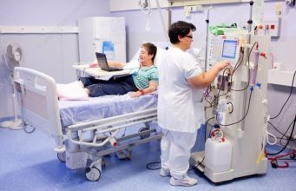
Haemodialysis

Slide 24

SURGICAL MANAGEMENT
KIDNEY TRANSPLANTATION:
The kidney transplant is placed in the front (anterior) part of the lower abdomen, in the pelvis.
The original kidneys are not usually removed unless they are causing severe problems such as uncontrollable high blood pressure, frequent kidney infections, or are greatly enlarged.

Slide 25
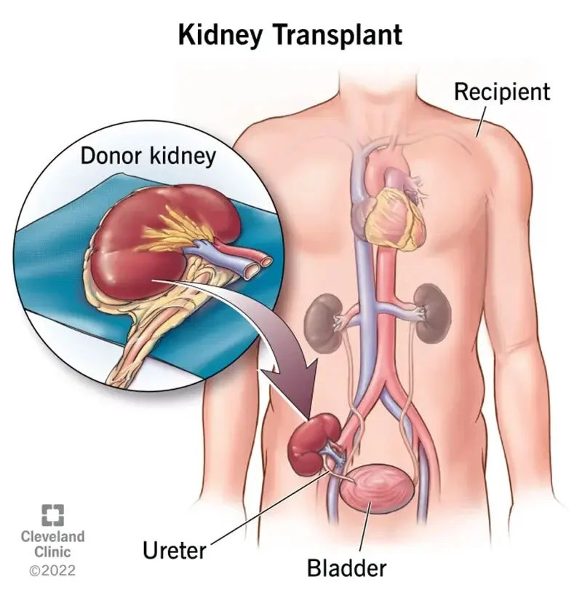

Slide 26
SUMMARY

Slide 27
REFERENCES

Slide 28


