Slide 1

CHOLEDOCHOLILITHIASIS
MR. DINESH SINGH
P.G. NURSING TUTOR
ROHILKHAND COLLEGE OF NURSING

Slide 2
OBJECTIVES
Introduction of the Peritonitis.
Define the Peritonitis.
Explain the causes of Peritonitis.
State the clinical manifestations of Peritonitis.
Elaborate the diagnostic evaluation of Peritonitis.
Discuss the management of Peritonitis.
Describe the prevention of Peritonitis.

Slide 3
INTRODUCTION
Choledocholithiasis is when you have a gallstone in your common bile duct. That’s the duct that carries bile from your gallbladder. Gallstones in this narrow passageway pose a risk of obstructing the flow of bile. An obstruction can cause pain, inflammation and serious complications.

Slide 4
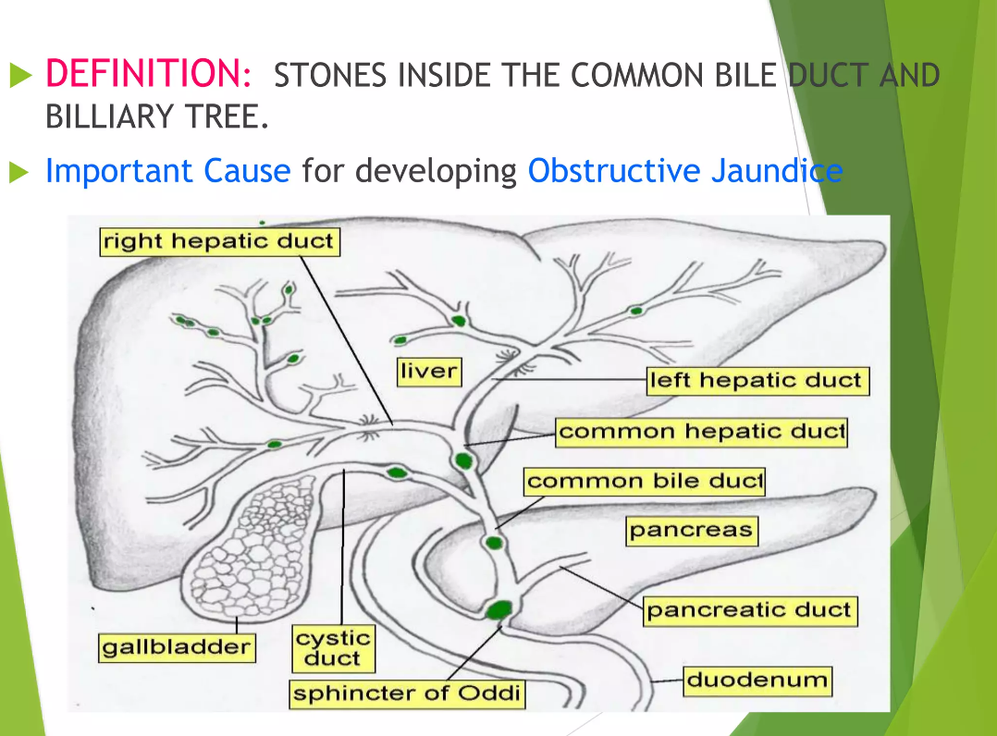
DEFINITION

Slide 5
ETIOLOGY
Liver to make too much cholesterol
Liver to make too much bilirubin
Gallbladder does not empty correctly
Cirrhosis of liver
Biliary tract infections

Slide 6
RISK FACTORS
Obesity
Low-fiber, high-calorie, high-fat diet
Pregnancy
Prolonged fasting
Rapid weight loss
Lack of Physical activity

Slide 7
CLINICAL MANIFESTATION
Abdominal pain
Fever
Jaundice
Loss of appetite
Nausea and vomiting
Clay-colored stools

Slide 8
DIAGNOSTIC EVALUATION
History collection
Physical examination
Trans-abdominal ultrasound: an imaging procedure that uses high-frequency sound waves to examine the liver, gallbladder, spleen, kidneys, and pancreas.
Endoscopic retrograde cholangiography: A procedure used to identify stones, tumors, and narrowing in the bile ducts
Percutaneous transhepatic cholangiogram (PTCA): An X-ray of the bile ducts

Slide 9
CONTI…
Complete blood count
Bilirubin
Pancreatic enzymes
Liver function tests

Slide 10
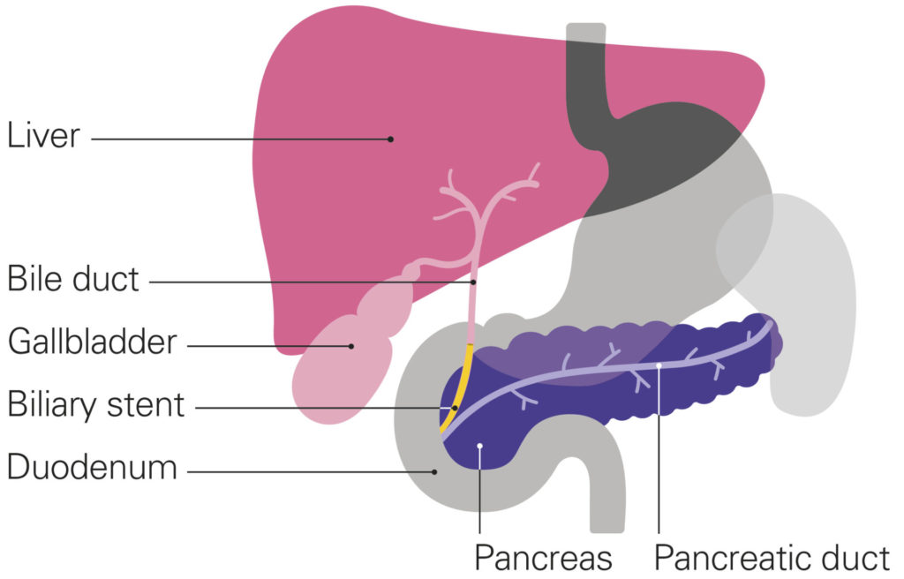
MANAGEMENT
SURGICAL MANAGEMENT
Stone extraction
Cholecystectomy: Surgery to remove the gallbladder and stones.
Sphincterotomy: Surgery that makes a cut into the common bile duct to remove stones or help them pass.
Biliary stenting

Slide 11
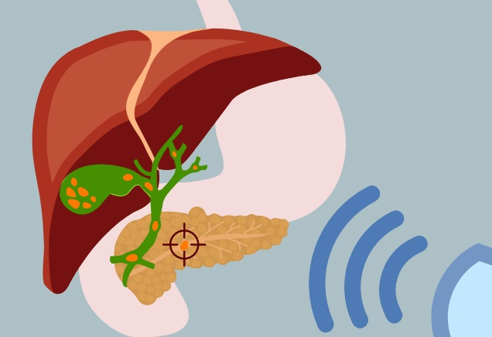
Fragmenting stones (lithotripsy)
Extracorporeal shock wave lithotripsy is a procedure to break up stones inside the urinary tract, bile ducts or pancreatic duct with a series of shock waves generated by a machine called a lithotripter.

Slide 13
SUMMARY

Slide 14
REFERENCES

Slide 15


