Slide 1

HIATUS HERNIA
MR. DINESH SINGH
P.G. NURSING TUTOR
ROHILKHAND COLLEGE OF NURSING

Slide 2
OBJECTIVES
Introduction of the.
Define the .
Explain the causes of .
State the clinical manifestations of .
Elaborate the diagnostic evaluation of.
Discuss the management of.
Describe the prevention of.

Slide 3
INTRODUCTION
A hiatal hernia occurs when the upper part of the stomach bulges through the large muscle separating the abdomen and chest (diaphragm). And diaphragm has a small opening (hiatus) through which food tube (esophagus) passes before connecting to the stomach. In a hiatal hernia, the stomach pushes up through that opening and into the chest.

Slide 4
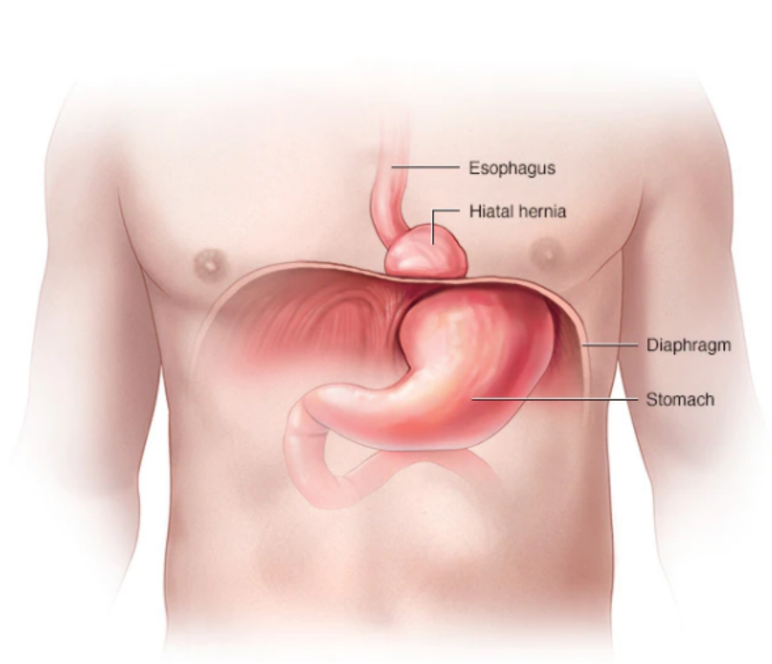
DEFINITION
A protrusion (Abnormal growth) from cavity wall of any organ, tissue or structure is called hernia.
Hiatal hernia/ Diaphragmatic Hernia: A protrusion (Abnormal growth) of a part of stomach into esophagus through diaphragm.

Slide 5
ETIOLOGY
Weakness of muscles
Increases intra abdominal pressure
Chronic constipation
Surgery
Poor nutrition
Trauma
Old age
Excessive physical work or exercise
Obesity
Heavy weight lift
Pregnancy
Ascites

Slide 6
CLINICAL MANIFESTATION
Indigestion
Retrosternal pain
Nausea
Vomiting
Hurt burn up to 60 min after meal
Swelling in hernial sac
Fever
Dyspnea

Slide 7
DIAGNOSTIC EVALUATION
History collection
Physical examination
Ultrasound
Chest X-ray
Barium meal test

Slide 8
MANAGEMENT
Antacid for heart burn, e.g., Magnesium hydroxide.
Antiemetic for vomiting
Antihistamine for allergic reaction (Levocetirizine)

Slide 9
SURGICAL MANAGEMENT
Nissen fundoplication: In this procedure, the surgeon wraps the top of the stomach around the lower esophagus. This reinforces the lower esophageal sphincter, making it less likely that acid will back up in the esophagus.

Slide 10
SUMMARY

Slide 11
REFERENCES

Slide 12


