Slide 1

CHOLECYSTITIS
MR. DINESH SINGH
P.G. NURSING TUTOR
ROHILKHAND COLLEGE OF NURSING

Slide 2
OBJECTIVES
Introduction of the Cholecystitis.
Define the Cholecystitis.
Explain the causes of Cholecystitis.
State the clinical manifestations of Cholecystitis.
Elaborate the diagnostic evaluation of Cholecystitis.
Discuss the management of Cholecystitis.
Describe the nursing management of Cholecystitis.

Slide 3
INTRODUCTION
Cholecystitis is inflammation of the gallbladder. The gallbladder is a small, pear-shaped organ on the right side of the abdomen, beneath the liver. The gallbladder holds a digestive fluid (bile) that's released into the small intestine.

Slide 4
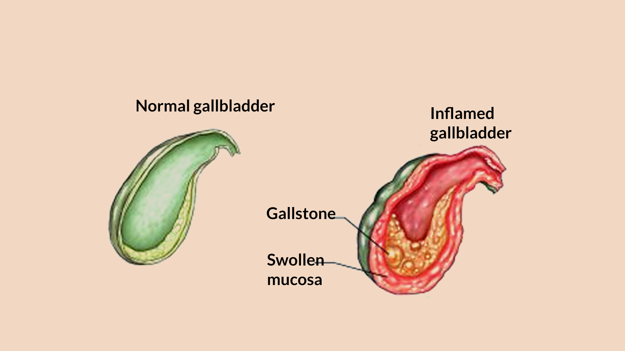
DEFINITION
Cholecystitis is an inflammation of gallbladder causing severe abdominal pain.
Types:
Acute cholecystitis: It is mostly caused by gallstones.
Chronic cholecystitis: Repeated acute attack of acute cholecystitis will lead to chronic cholecystitis.

Slide 5
ETIOLOGY
Gallstones: Cholecystitis is the result of hard particles that develop in gallbladder (gallstones). Gallstones can block the tube (cystic duct) through which bile flows when it leaves the gallbladder. Bile builds up in the gallbladder, causing inflammation.
Bile duct blockage: Stones or thickened bile and tiny particles can block the bile duct and lead to cholecystitis. Scarring of the bile ducts can also cause blockage.

Slide 6
CONTI…
Tumor: A tumor may prevent bile from draining out of gallbladder properly. This causes bile buildup that can lead to cholecystitis.
Infection: AIDS and certain viral infections can trigger gallbladder inflammation.
Severe illness: Very severe illness can damage blood vessels and decrease blood flow to the gallbladder, leading to cholecystitis.

Slide 7
PATHOPHYSIOLOGY
Due to etiological factors
Venous and lymphatic drainage impaired
Proliferation of bacteria takes place
Cellular irritation and inflammation
Acute cholecystitis

Slide 8
CLINICAL MANIFESTATION
Fever
Pain (right upper quadrant region)
Nausea/vomiting, Indigestion
Heart Burn
Feeling of pressure in right upper quadrant region
Murphy's sign- Patient is unable to take deep inspiration when hepatic region press by fingers
Jaundice (if obstruction)

Slide 9
DIAGNOSTIC EVALUATION
History Collection
Physical examination
Blood test- Increase WBC
Ultrasound
Conjugated bilirubin level
Cholangiography: Cholangiography means looking at the structure of the bile ducts and gallbladder. It can help to find the size of a cancer and whether it has spread.

Slide 10
MANAGEMENT
Analgesics (For reducing pain) Eg. Acetaminophen, Aspirin
Antacids: (To reduce the amount of acid in stomach) Eg. Calcium carbonate, magnesium carbonate.
Antiemetics: (to reduce the vomiting) Eg. Emset
H2 blockers: Block H2 recepter (that leads to hypersecretion of acid gastric juice). Eg. Ranitidine

Slide 11
SURGICAL MANAGEMENT
Cholecystectomy (surgical removal of gallbladder)
Cholelithotomy (Removal of gall stones)

Slide 12
NURSING MANAGEMENT
Provide complete bed rest to patient
Administer prescribed analgesics to patient
Provide comfortable position to patient
Administer antiemetics as prescribed
Provide psychological support to patient.

Slide 13
SUMMARY

Slide 14
REFERENCES
Brunner and Suddarth’s “textbook of medical-surgical nursing” “10th edition, published by “Suzanne C. Smeltzer Brenda Bare”.
PR Ashalatha, G. Deepa “textbook of Anatomy and physiology” Fourth edition” published by “Jaypee Brothers”.
Linda S. Williams, Paula D. Hopper “textbook of Medical Surgical Nursing” “Third edition” Published by F.A. Davis 2007.
Priscilla LeMone, Karen Burke, Gerene Bauldoff “textbook of Medical Surgical Nursing” “Fifth edition” “published by Julie Levin Alexander”.
Lewis Dirksen Heitkemper Bucher, textbook of medical surgical nursing second south Asia edition, volume 1.

Slide 15


