Slide 1



Slide 2

ACUTE RENAL FAILURE
MR. DINESH SINGH
P.G. NURSING TUTOR
ROHILKHAND COLLEGE OF NURSING

Slide 3

OBJECTIVES
Introduction of the Acute renal failure.
Define the Acute renal failure.
Explain the causes of Acute renal failure.
State the clinical manifestations of Acute renal failure.
Elaborate the diagnostic evaluation of Acute renal failure.
Discuss the management of Acute renal failure.
Describe the nursing management of Acute renal failure.

Slide 4

INTRODUCTION
Acute kidney failure occurs when kidneys suddenly become unable to filter waste products from blood. When kidneys lose their filtering ability, dangerous levels of wastes may accumulate, and Your blood's chemical makeup may get out of balance.

Slide 5

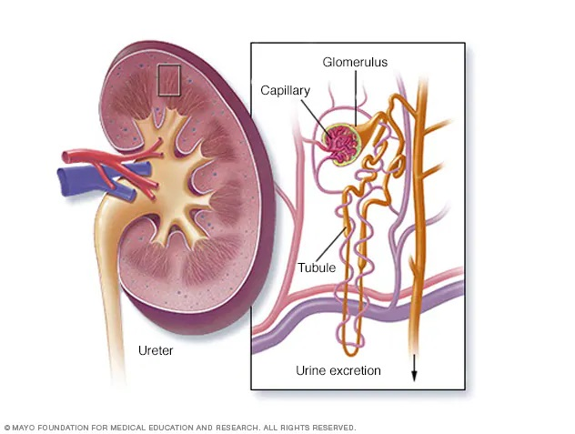
DEFINITION
Acute renal failure refers to the abrupt loss of kidney function. It is frequently associated with an increase in BUN and creatinine.

Slide 6

CAUSES
Prerenal Causes: Sudden and severe drop in blood pressure (shock) or interruption of blood flow to the kidneys from severe injury or illness.
Dehydration
Shock
Heart failure
Burns
Sepsis (pus formation)

Slide 7
CONTI…
Intrarenal Causes: Direct damage to the kidneys by inflammation, toxins, drugs, infection or reduced blood supply.
Acute tubular necrosis
Acute glomerulonephritis
Diabetic nephropathy
Intestinal nephritis

Slide 8
CONTI…
Postrenal Causes: Sudden obstruction of urine flow due to enlarged prostate, kidney stones, bladder tumor or injury.
Urolithiasis
Tumor
Benign prostatic hyperplasia
Urethral stricture
Neurogenic bladder
Bladder outlet obstruction

Slide 9

CLINICAL MANIFESTATION
PRE-RENAL
Decrease tissue turgor
Dryness of mucous membrane
Weight loss
Hypotension
Oliguria and anuria
Tachycardia

Slide 10
CONTI…
POST-RENAL
Obstruction to urine flow
Obstructive symptoms of BPH (benign prostate hyperplasia)
INTRARENAL
Oedema

Slide 11

DIAGNOSTIC EVALUATION
History collection
Physical examination
Urinalysis
Blood test
  Serum creatinine
  Azotemia (increase Uric acid level)
  Increase serum creatinine and BUN Level
  Renal ultrasonography

Slide 12

MEDICAL MANAGEMENT
Diuretics therapy may be used, eg., furosemide and mannitol.
Electrolyte replacement should be maintained.
Fluid replacement also maintained.
If metabolic acidosis is there, then sodium bicarbonate, lactate may be used.
Sodium bicarbonate for acidosis / Aluminium hydroxide for decrease level of S.phosphate.

Slide 13

DIETARY MANAGEMENT
A high calorie, low protein, low sodium and potassium diet is usually prescribed.

Slide 14
SUMMARY

Slide 15
REFERENCES

Slide 16


