Slide 1

CANCER OF ESOPHAGUS
MR. DINESH SINGH
P.G. NURSING TUTOR
ROHILKHAND COLLEGE OF NURSING

Slide 2
OBJECTIVES
Introduction of the.
Define the .
Explain the causes of .
State the clinical manifestations of .
Elaborate the diagnostic evaluation of.
Discuss the management of.
Describe the prevention of.

Slide 3
INTRODUCTION
Esophageal cancer is a disease in which malignant (cancer) cells form in the tissues of the esophagus. Smoking, heavy alcohol use, and Barrett esophagus can increase the risk of esophageal cancer. Signs and symptoms of esophageal cancer are weight loss and painful or difficult swallowing.

Slide 4
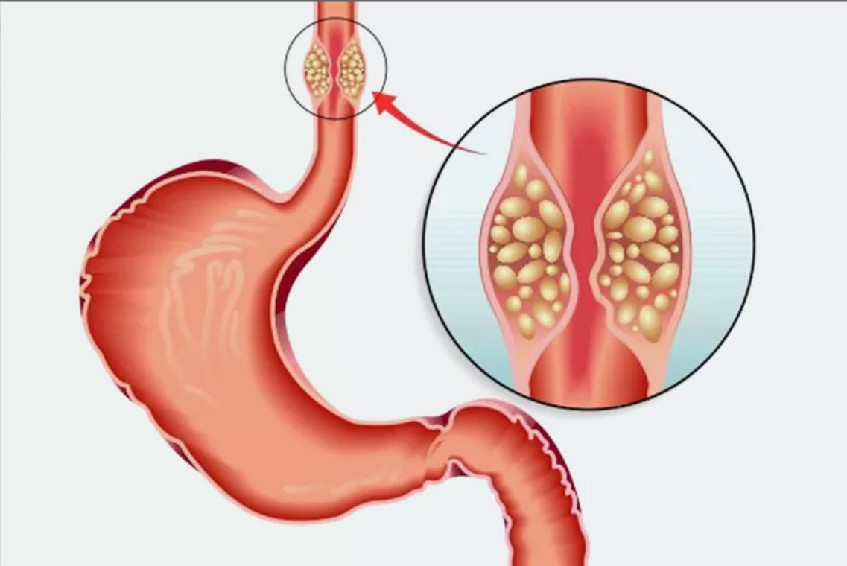
DEFINITION
It is a malignancy that develops in the tissues of esophagus involving muscles, can spread to lymphatic system.

Slide 5
ETIOLOGY
Gender: More in men.
Race: African American race is more prone.
Age: Fifth decade of life is at great risk.
Use of alcohol and tobacco.
Chronic initiation of esophagus.
GERD.
Hot, spicy dietary intake.
Exposure to nitrosomine in food/environment.

Slide 6
CLINICAL MANIFESTATION
Dysphasia, earlier with solid foods than to liquids
Feeling of lump in throat.
Painful and difficult swallowing.
Substernal pain.
Regurgitation of undigested food.
Loss of appetite.
Loss of weight.

Slide 7
DIAGNOSTIC EVALUATION
History collection
Physical examination
Esophagogastroscopy with biopsy
CT Scan
A positron emission tomography (PET): is an imaging test that can help reveal the metabolic or biochemical function of the tissues and organs.

Slide 8
MANAGEMENT
Combination of chemotherapy
Four common combinations of chemotherapy drugs for include:
Cisplatin and etoposide
Carboplatin (Paraplatin) and etoposide
Cisplatin and irinotecan (Camptosar)
Carboplatin and irinotecan
Radiotherapy: is a cancer treatment that uses high doses of radiation to kill cancer cells and shrink tumors.

Slide 9
SURGICAL MANAGEMENT
Esophagectomy: During esophagectomy, your surgeon removes the portion of your esophagus that contains the tumor, along with a portion of the upper part of your stomach, and nearby lymph nodes. The remaining esophagus is reconnected to your stomach.

Slide 10
NURSING MANAGEMENT
Check the vital signs
Assess emotional status, provide psychological support.
Meet the hygiene needs of the client.
Maintain or promote the body weight by providing high calorie and high protein diet.
Sometime gastrostomy feed is also given.
Meet the perioperative nursing care needs.
Do care for chemotherapy, radiotherapy.
Monitor client for complication and effects of chemotherapy, radiotherapy etc.

Slide 11
SUMMARY

Slide 12
REFERENCES

Slide 13


