Slide 1
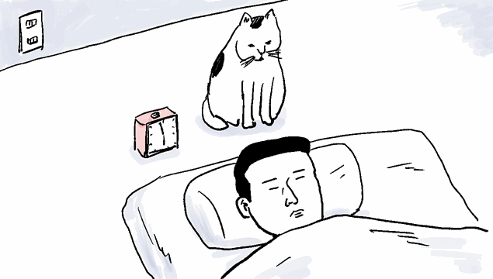


Slide 2
TUBERCULOSIS OF
URINARY TRACT
MR. DINESH SINGH
P.G. NURSING TUTOR
ROHILKHAND COLLEGE OF NURSING

Slide 3
OBJECTIVES
Introduction of the Tuberculosis of urinary tract.
Define the Tuberculosis of urinary tract.
Explain the causes of Tuberculosis of urinary tract.
State the clinical manifestations of Tuberculosis of urinary tract.
Elaborate the diagnostic evaluation of Tuberculosis of urinary tract.
Discuss the management of Tuberculosis of urinary tract.
Describe the nursing management of Tuberculosis of urinary tract.

Slide 4
INTRODUCTION
The bacillus causing tuberculosis, Mycobacterium tuberculosis, was identified and described on 24 March 1882 by Robert Koch.

Slide 5
PULMONARY TUBERCULOSIS
It is a chronic infectious disease caused by mycobacterium tuberculosis and characterized by the formation of tubercles (round nodules, warty outgrowth) or granulomas in lungs.
Granulomas means localized collection of cells usually produced in response to an infectious process.
It may be transmitted to other body parts such as meninges, bones, kidneys, lymph nodes.

Slide 6
DEFINITION
Renal tuberculosis (renal TB) or tuberculosis of the kidney is a type of extra-pulmonary tuberculosis that affects the kidney. Extra-pulmonary tuberculosis refers to tuberculosis that affects an organ outside the lungs.

Slide 7
ETIOLOGY
Mycobacterium tuberculosis
By air droplets
By exposure with person who is infected to prolonged and close frequent.

Slide 8
RISK FACTORS
Malnutrition
Excessive alcohol addiction
Infant and children under 5 year of age
Immuno-suppressive clients
HIV infection
Poor health
Smoking

Slide 9
CLINICAL MANIFESTATION
Heamaturia, pyuria, dysuria
Anorexia
Unexplained weight loss
Intermittent fever

Slide 10
DIAGNOSTIC EVALUATION
Screening for pulmonary tuberculosis
Urine samples
CBC
Mantoux skin test

Slide 11
MEDICAL MANAGEMENT
Broad spectrum antibiotics and antimicrobial are used.
These drugs are divided into two categories
Primary Agents
Secondary Agents

Slide 12
Primary Agents
These agents start till report of culture and sensitivity reaction of patient.
S.NO | MEDICINES | DOSE | ROUTE
1. | Isoniazid | 5 mg/kg/day | Oral/IM
2. | Rifampicin | 10 mg/kg/day | P.O.
3. | Ethambutol | 25 mg/kg/day | P.O.
4. | Streptomycin | 15 mg/kg/day | I.M.
5. | Pyrazinamide | 20 mg/kg/day | P.O.

Slide 13
Secondary Agents
Capromycin
Kanamycin
PASA (Para amino salicylic acid)
Cycloserine

Slide 14
NURSING MANAGEMENT
Instruct the patient regarding pain, discomfort and medication ragimen.
Patient must be instructed to continue entire course of medication even after symptoms subsides.
Instructed the patient regarding bed rest and well balance diet, e.g. High protein diet, green leafy vegetable, milk products, etc.
General measures such as avoidance of over crowded places and unsanitary conditions are also necessary aspects of prevention.

Slide 15
SUMMARY

Slide 16
REFERENCES

Slide 17


