Slide 1

HYPOTHYROIDISM
MR. DINESH SINGH
P.G. NURSING TUTOR
ROHILKHAND COLLEGE OF NURSING

Slide 2
OBJECTIVES
Introduction of the Peritonitis.
Define the Peritonitis.
Explain the causes of Peritonitis.
State the clinical manifestations of Peritonitis.
Elaborate the diagnostic evaluation of Peritonitis.
Discuss the management of Peritonitis.
Describe the prevention of Peritonitis.

Slide 3
INTRODUCTION
Hypothyroidism, also called underactive thyroid, is when the thyroid gland doesn’t make enough thyroid hormones to meet your body’s needs. The thyroid is a small, butterfly-shaped gland in the front of your neck.

Slide 4
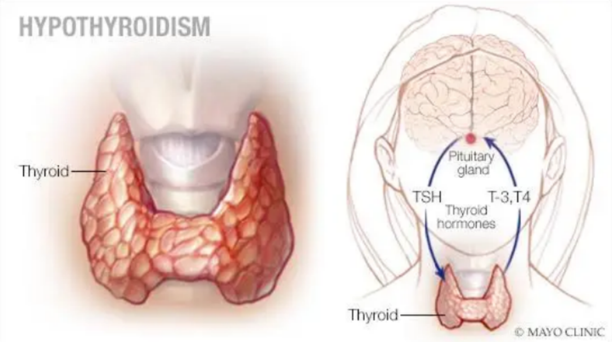
DEFINITION
Subnormal secretion of thyroid hormone by thyroid glands is known as Hypothyroidism.

Slide 5
TYPES
Primary: Insufficient amount of thyroid hormone secreted by thyroid gland.
Secondary: it is due to pituitary gland failure ( Inadequate amount secretion of TSH).
Tertiary: it is due to hypothalamus failure (subnormal thyrotropin releasing hormone secretion).

Slide 6
ETIOLOGY
Use of radioactive iodine
Over treated with antithyroid drugs.
Removing of thyroid tissue in thyroidectomy.
Malignancy of neck or forehead.
Pituitary dysfunction
Goitrogenic food, e.g. Turnip, cauliflower

Slide 7
CLINICAL MANIFESTATION
CVS
Decrease heart rate
Hypercholesterolemia
Weak contractility
Hyperlipidemia
Bradycardia
Anemia
GIT
Loss of appetite
Constipation
Distension in abdomen
Increase weight
Nausea/vomiting
Enlargement of tongue.

Slide 8
CLINICAL MANIFESTATION
Skin
Dry skin, thick and elasticity increase
Brittle nails
Puffy face
Dry hair
Excessive sweating
Respiratory
Dyspnea
Musculoskeletal
Fatigue
Weakness
Slow movement
Muscular pain

Slide 9
DIAGNOSTIC EVALUATION
History collection
Physical examination
Serum TSH, T3 and T4 level
ECG
Elevate serum cholesterol level

Slide 10
MANAGEMENT
To restore normal metabolic activity, the missing hormone is replaced. Preparations of synthyroid or levothyroid is given to the patient.
In severe hypothyroidism, coma management includes maintaining vital functions, Arterial Blood Gases is done, pulse oximetry is done to monitor O2 saturation levels.
Fluids are administered as per doctor order.
Application of external heat is avoided because it increases O2 requirement.
Patient is given hormonal therapy.

Slide 11
DIETARY MANAGEMENT
If patient having hypothyroidism due to iodine deficiency then provide high iodine diet.
Avoid soyabean
Avoid green leafy vegetables.

Slide 12
COMPLICATIONS
Hypoventilation
Convulsion
Cerebral hypoxia

Slide 13
SUMMARY

Slide 14
REFERENCES

Slide 15


