Slide 1

GASTRO ESOPHAGEAL REFLUX DISEASE
MR. DINESH SINGH
P.G. NURSING TUTOR
ROHILKHAND COLLEGE OF NURSING

Slide 2
OBJECTIVES
Introduction of the.
Define the .
Explain the causes of .
State the clinical manifestations of .
Elaborate the diagnostic evaluation of.
Discuss the management of.
Describe the prevention of.

Slide 3
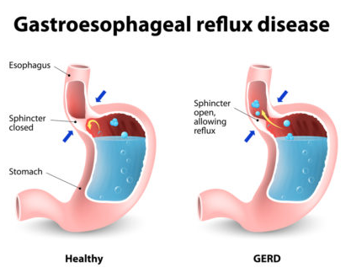
INTRODUCTION

Slide 4
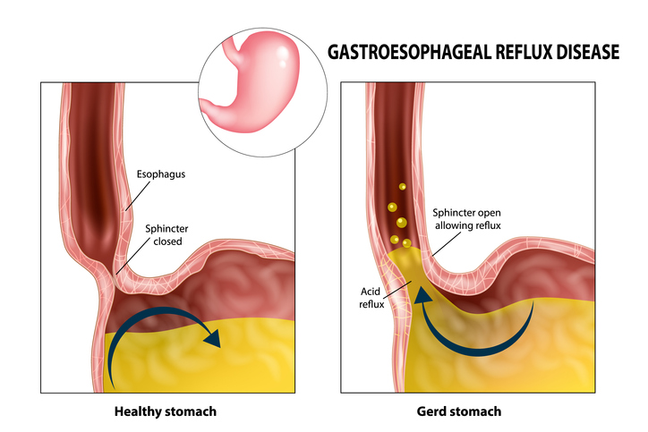
DEFINITION
Excessive back flow of gastric or duodenal contents into esophagus because of incompetent gastro-esophageal sphincter/pyloric stenosis/motor disorder of the esophagus is known as gastro-esophageal reflux.

Slide 5
ETIOLOGY
Delayed neuromuscular development
Cerebral defect
Increased abdominal pressure, e.g. obesity, constipation, etc
Bronchopulmonary dysplasia
Certain medicines such as theophylline.

Slide 6
CLINICAL MANIFESTATION
Burning sensation (pyrosis) in esophagus
Indigestion (Dyspepsia)
Dysphagia (difficulty in swallowing)
Odynophagia (pain on swallowing)
Upper abdominal discomfort
Anorexia
Refusal to eat
Loss of weigh
Esophagitis
Hyper salivation

Slide 7
DIAGNOSTIC EVALUATION
History collection
Physical examination
Endoscopy
Bilirubin monitoring
Esophageal histology findings
Esophagogastro duodenoscopy

Slide 8
MANAGEMENT
Antacids H2-receptor antagonists (Cemitidine)
Prokinetic drugs (metaclopromide)
Proton pump inhibitors (Omeprazole)

Slide 9
SURGICAL MANAGEMENT
Fundoplication (Nissen's operation): It is the most commonly used surgery. It involves wrapping of gastric fundus around the lower esophageal sphincter.
Antroplasty/pyloroplasty
Gastrotomy may be done for feeding purpose or temporarily to decompress the stomach.

Slide 10
NURSING MANAGEMENT
Avoid cigarettes, fatty food, milk products, spicy food, onion, garlic to prevent acid reflux.
Don't immediately lying down after eating meal.
Minimize the soft drinks, beverages such as coffee, tea, alcohol etc.
Recommend for low fat, high protein diet, fibrous foods and green leafy vegetables etc.
Encourage for lifestyle medication e.g. weight loss, cessation of smoking and tobacco.
Advise to take dinner before 3 hours going to bed, it help to prevent acid reflux.
Teach to raise the head-end side during sleep to enhance the nocturnal acid clearance.
Encourage to take high intake of fluids at least 2 litre per day.
Teach to take small, frequent diet than large 3 meals.

Slide 11
SUMMARY

Slide 12
REFERENCES

Slide 13


