Slide 1

HYPERTHYROIDISM
MR. DINESH SINGH
P.G. NURSING TUTOR
ROHILKHAND COLLEGE OF NURSING

Slide 2
OBJECTIVES
Introduction of the Hyperthyroidism.
Define the Hyperthyroidism.
Explain the causes of Hyperthyroidism.
State the clinical manifestations of Hyperthyroidism.
Elaborate the diagnostic evaluation of Hyperthyroidism.
Discuss the management of Hyperthyroidism.
Describe the prevention of Hyperthyroidism.

Slide 3
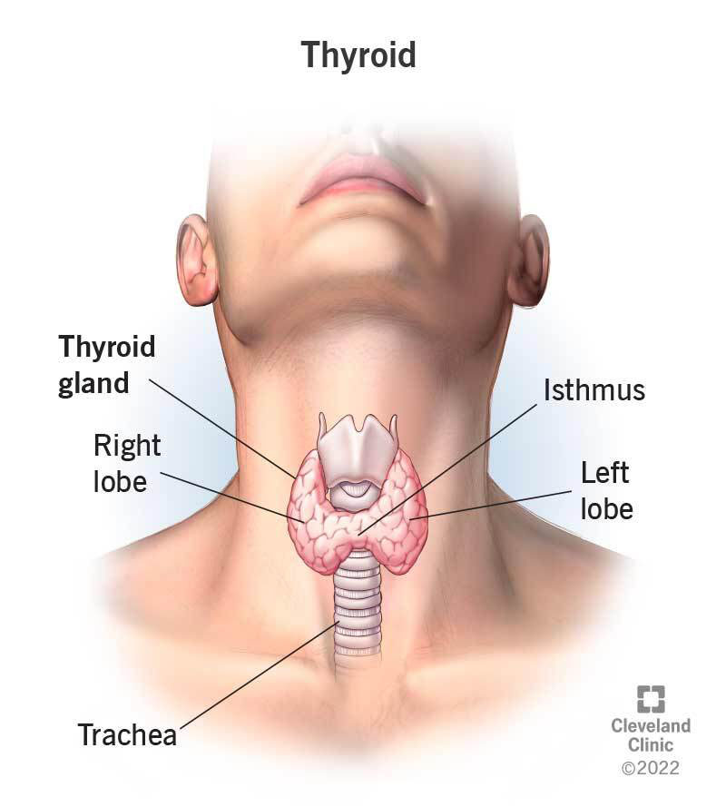
Overview of Thyroid gland
The thyroid gland produces hormones that regulate the body's metabolic rate, growth and development. It plays a role in controlling heart, muscle and digestive function, brain development and bone maintenance. Its correct functioning depends on a good supply of iodine from the diet.

Slide 4
INTRODUCTION
Hyperthyroidism happens when the thyroid gland makes too much thyroid hormone. This condition also is called overactive thyroid. Hyperthyroidism speeds up the body's metabolism. That can cause many symptoms, such as weight loss, hand tremors, and rapid or irregular heartbeat.

Slide 5
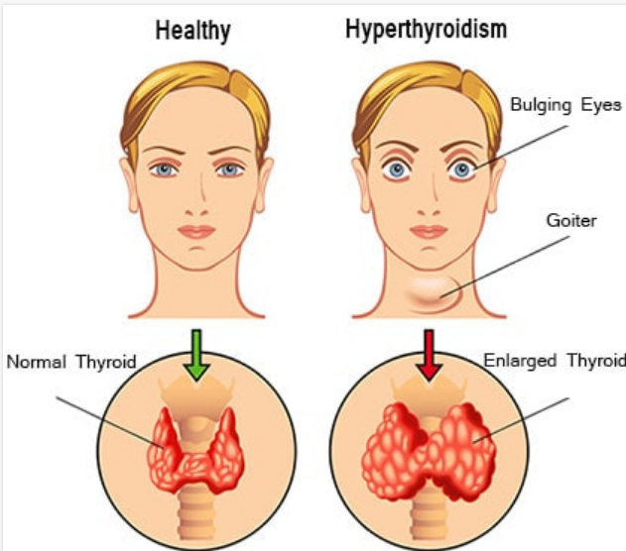
DEFINITION
Excessive secretion or synthesis of thyroid hormone by thyroid gland is known as hyperthyroidism, grave disease and thyrotoxicosis.
Also temperature, pulse, respiration are increases in this case.

Slide 6
ETIOLOGY
Over function of entire thyroid gland
Over treatment of myxedema (Severe advanced hypothyroidism)
Plummer’s disease (multinodular Goiter)
Emotional upset
Over work
Worry
Anxiety
Acute infection
Stimulation of sympathetic system

Slide 7
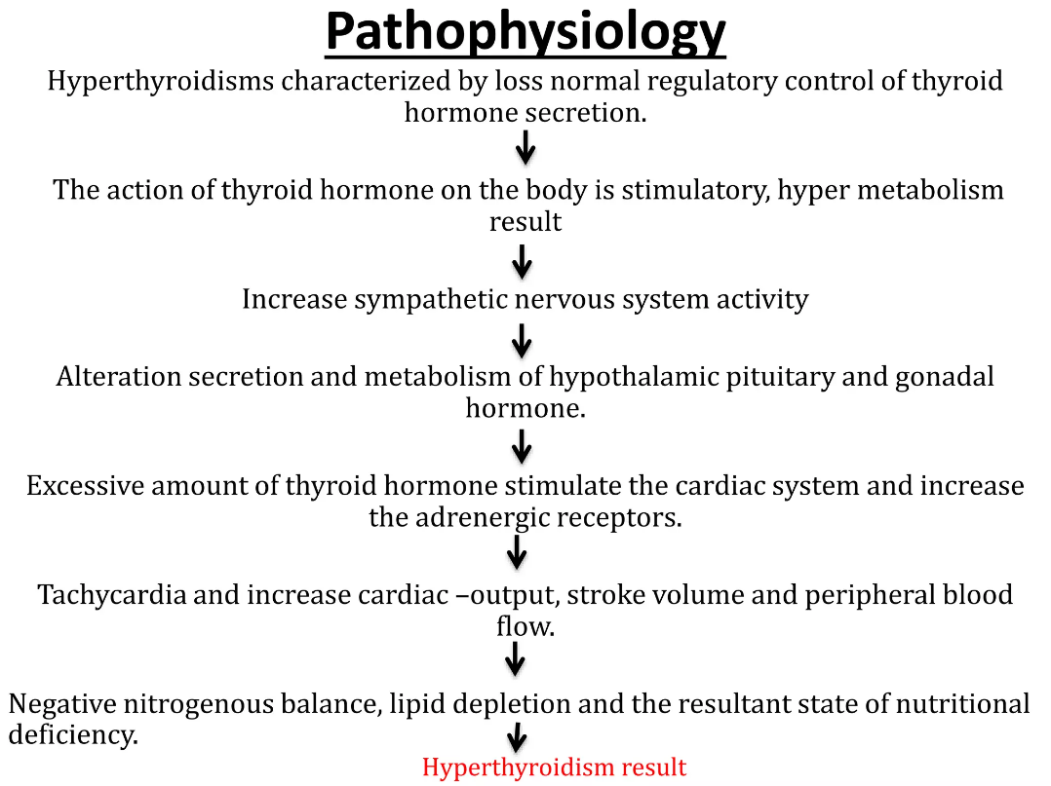

Slide 8
CLINICAL MANIFESTATION
Cardiovascular System
Hypertension
Tachycardia
Bound and rapid pulse
Palpitation
Respiratory System
Dyspnea
Increase respiratory rate
G.I.T
Appetite increase but weight loss due to improper metabolism.
Diarrhea
Splenomegaly
Hepatomegaly
Musculo-Skeletal System
Fatigue
Muscle weakness

Slide 9
CONT…
Nervous System
Difficulty in focusing of eye
Nervousness
Insomnia
Restlessness
Fatigue
Lack of concentration
Reproductive
Amenorrhea (absence of menstruation)
Menstrual irregularities

Slide 10
DIAGNOSTIC EVALUATION
Physical appearance
Enlarge neck
Protruding eyes
Agitating expression due to basal metabolic rate (BMR)

Slide 11
MANAGEMENT
Antithyroid drugs: Most often used to treat an overactive thyroid (hyperthyroidism)
Methimazole
Potassium iodine therapy
B-adrenergic blockers, e.g. Atenolol (to reduce Blood Pressure)

Slide 12
SURGICAL MANAGEMENT
Subtotal thyroidectomy (removal of one lobe)
Total thyroidectomy (Removal of gland)

Slide 13
COMPLICATIONS
Hypertension
Heart failure

Slide 14
REFERENCES

Slide 15


