Slide 1



Slide 2

GENITOURINARY
TRAUMA
MR. DINESH SINGH
P.G. NURSING TUTOR
ROHILKHAND COLLEGE OF NURSING

Slide 3
OBJECTIVES
Introduction of the Genitourinary trauma.
Define the Genitourinary trauma.
Explain the causes of Genitourinary trauma.
State the clinical manifestations of Genitourinary trauma.
Elaborate the diagnostic evaluation of Genitourinary trauma.
Discuss the management of Genitourinary trauma.
Describe the prevention of Genitourinary trauma.

Slide 4
INTRODUCTION
Uro-trauma is a word used for an injury to the urinary tract or reproductive organs. It could be from any traumatic event or impact. It could be from a fall, car or bicycle accident, chemical or weapon. Organs that may be affected by uro-trauma include: the kidneys, ureters, bladder, urethra, and genitals.

Slide 5
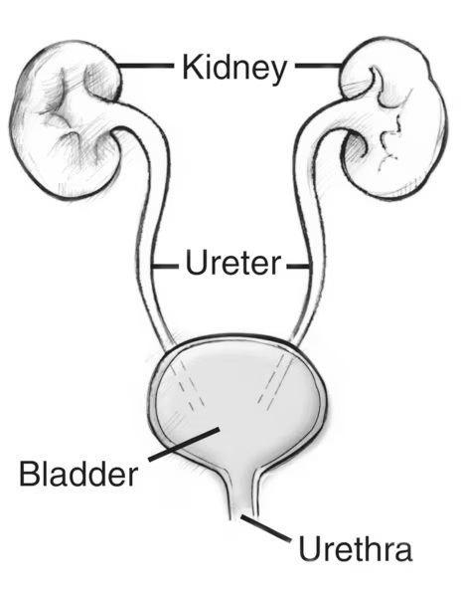

Slide 6

DEFINITION
Injuries particularly related to the urinary tract damage include fractures of the pelvis, penetrating blows to the body and blunt trauma.

Slide 7
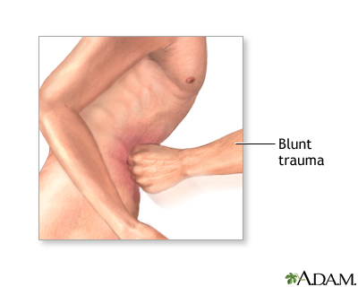
ETIOLOGY
Blunt trauma: Blunt trauma is the most frequent cause of kidney trauma.
Blunt trauma to the abdomen is a major component of traumatic injury and can be deadly. Blunt trauma can occur during falls, motor vehicle accidents, or severe blows to the abdomen.

Slide 8


CONTI…
Penetrating Trauma: Penetrating trauma occurs when a foreign object pierces the skin and enters the body creating a wound.
It may result from violent encounters, e.g. Knife wound, gun shots or from surgical procedure error.

Slide 9
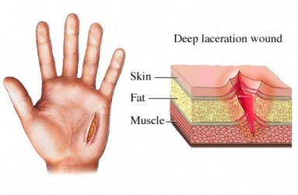
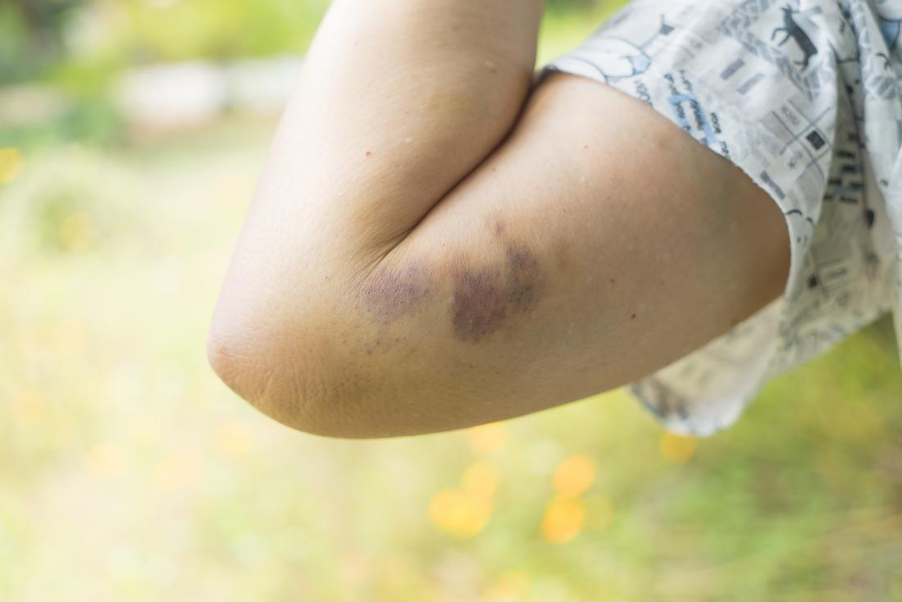
CONTI…
Renal Trauma is classified to severity
Minor injuries: Contusion, minor lacerations.
Major injuries: Major lacerations, rupture of kidney capsule.
Critical injuries: Multiple and severe lacerations.

Slide 10

CLINICAL MANIFESTATION
Hematuria
Nausea/ Vomiting
Abdominal pain
Flank pain
Perirenal hematoma
Shock

Slide 11
DIAGNOSTIC EVALUATION
Kidney, Ureter, Bladder Ultrasound and Pyelography
CT scan
Laboratory test
Cystogram
Haemoglobin level
Renal angiography
BUN and creatinine
Urinalysis

Slide 12
MANAGEMENT
Contusion and minor lacerations are managed conservatively with bed rest, I/V fluid, urine analysis.
Major lacerations are surgically repaired.
If the patient is having consistent renal injury and the patient presents in shock, suspect a renal pedicle injury. It is a haemorrhagic emergency requiring immediate treatment of shock and preparation for surgery.

Slide 13

COMPLICATIONS
Shock
Hematoma
Hypertension
Pyelonephritis
Nephrolithiasis

Slide 14
NURSING MANAGEMENT
Assess the vital signs frequently, including BP, heart rate and CVP to monitor for haemorrhage and impending shock.
Assess abdomen and back for local tenderness and palpable mass, swelling.
Maintain IV line, support for blood pressure with fluids, replacement of blood and perfusion of kidneys.

Slide 15
SUMMARY

Slide 16
REFERENCES

Slide 17


