Slide 1
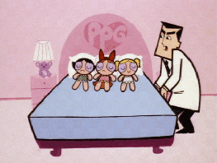

GOOD MORNING DEAR

Slide 2
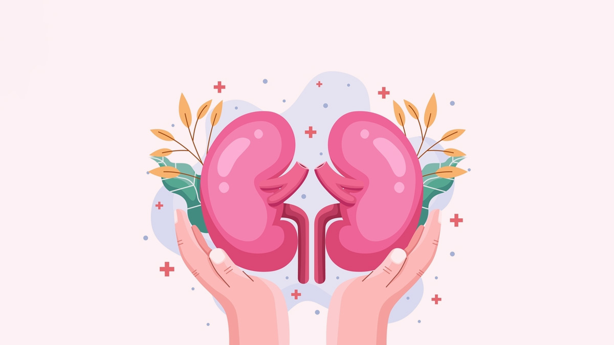
RENAL CALCULI
“Nephrolithiasis”
MR. DINESH SINGH
NURSING TUTOR
ROHILKHAND COLLEGE OF NURSING

Slide 3
OBJECTIVES
Introduction of the Renal calculi.
Define the Renal calculi.
Explain the causes of Renal calculi.
State the clinical manifestations of Renal calculi.
Elaborate the diagnostic evaluation of Renal calculi.
Discuss the management of Renal calculi.
Describe the prevention of Renal calculi.

Slide 4
INTRODUCTION
Kidney stones (also called renal calculi, nephrolithiasis or urolithiasis) are hard deposits made of minerals and salts that form inside the kidneys.
Kidney stone disease also known as urolithiasis. It means a solid piece of material occurs in the urinary tract. The majority of renal calculi contain calcium. The pain generated by renal colic is primarily caused by dilation, stretching, and spasm because of the acute uretheral obstruction

Slide 5

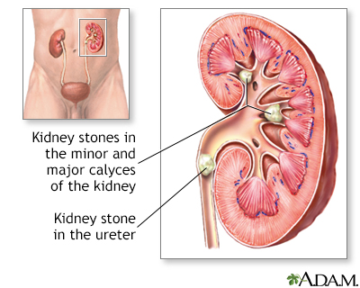
DEFINITION
The calculus (stone) formation in kidney is called Nephrolithiasis.

Slide 6
ETIOLOGY
Preceptors increases in urine, e.g.,Bacterial infection and other inflammation
Increases soluble concentration of calcium, oxalate, cystine, phosphate, xanthin, etc.
Reduced amount of inhibitors, e.g., citrate and pyrophosphate.
Urine pH
Increase pH-Possibility of phosphate stone
Decrease pH- Uric acid stone

Slide 7
ETIOLOGY
Dehydration, excessive oedema
Increase intake of vitamin C which increases absorption of oxalate
Medication: e.g. Iron or folic acid, Calcium gluconate, Calcium carbonate, Sodium bicarbonate.
More intake of Brinjal, Tomato in diet
Inflammatory bowel disease
Immobilization (prolonged sitting or standing in same position).

Slide 8
TYPES
Calcium stone (80%cases) cause of Ca+ stone: Hypercalcemia
Oxalate stone: Mostly cause of oxalate stone are rich sources tomato, brinjal.
Increase Vit. C diet, they increase absorption of oxalate.
Uric acid stone: Due to decrease pH
Xanthin stone: Hereditary
Cysteine stone: Due to inborn metabolic error.

Slide 9
CLINICAL MANIFESTATION
Pain
In flank region
If stone is in ureter- pain in lower flank region.
Obstruction of urine
Decrease frequency of urine
Dysuria (painful micturition)
Hematuria (Blood in urine)

Slide 10
CONTI…
Inflammatory symptoms
Fever
Nausea
Vomiting
Chills
Abdominal Discomfort
Diaphoresis (excessive sweating)

Slide 11
DIAGNOSTIC EVALUATION
History Collection
Physical Examination
I.V.P. (Intravenous Pyelography)
Retrograde (pyelography)
K.U.B. X-ray
Urine analysis for haematuria.

Slide 12
MEDICAL MANAGEMENT
Analgesic
Spasmodic e.g. Buscopan
NSAID e.g. Steroid
Maintain I/O charting
Provide rest

Slide 13
SURGICAL MANAGEMENT
CLOSE PROCEDURE:
Lithotripsy (Extracorporeal Shockwave lithotripsy)
Non-invasive
Percutaneous Nephrolithotomy

Slide 14
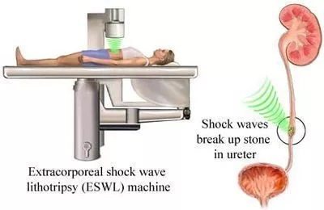
Lithotripsy

Slide 15
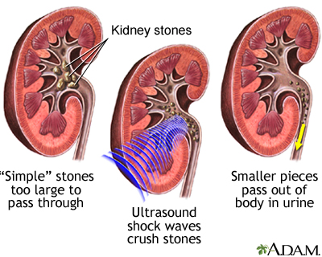
USG Shock Waves Crush Stones

Slide 16
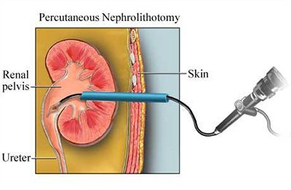
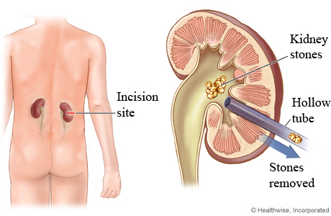
Percutaneous Nephrolithotomy

Slide 17
CONTI…
OPEN PROCEDURE
Ureter lithotomy
Pyelolithotomy
Nephrolithotomy
Partial or total nephrectomy

Slide 18
COMPLICATIONS
Infection
Hydro-ureter
Hydro-nephrosis
Renal failure

Slide 19
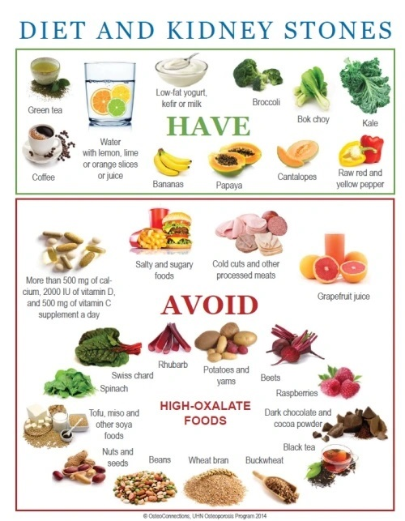

Slide 20
SUMMARY

Slide 21
REFERENCES
Lewis Dirksen Heitkemper Bucher, textbook of medical surgical nursing second south Asia edition, volume 1 page no.
Brunner and Suddarth’s textbook of medical surgical nursing 13th south Asia edition, volume-2 page no 1532
P.K. Panwar, textbook of medical surgical nursing 4th edition page no.182, 183, 184.

Slide 22


