Slide 1

LIVER ABSCESS
MR. DINESH SINGH
P.G. TUTOR
ROHILKHAND COLLEGE OF NURSING

Slide 2
OBJECTIVES
Introduction of the Liver Abscess.
Define the Liver Abscess.
Explain the causes of Liver Abscess.
State the clinical manifestations of Liver Abscess.
Elaborate the diagnostic evaluation of Liver Abscess.
Discuss the management of Liver Abscess.
Describe the prevention of Liver Abscess

Slide 3
INTRODUCTION
It is an abscess formation in liver. Whenever an infection develops anywhere along the billiary or GI tract infection, organism may reach the liver through the billiary system, portal system, lymphatic system etc. which destroys the liver cells resulting in necrotic tissue of liver abscess.

Slide 4
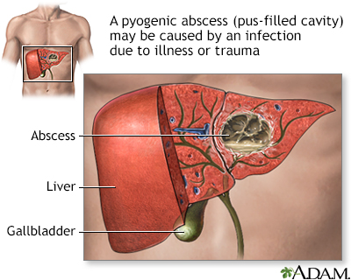
DEFINITION
Liver abscess is a localized collection of pus and organism within the parenchyma of the liver.

Slide 5
ETIOLOGY
Immune deficiency
Diabetes mellitus
Infected hepatic cysts
Metastatic liver/ cancer
Cholangitis (inflammation of the bile duct)
Infection in blood (septicemia)
Abdominal infection such as appendicitis
Trauma that injuries the liver

Slide 6
PATHOPHYSIOLOGY
Due to etiological factors
Infection of GI tract
Organism enters Biliary system
Formation of abscess cavity
Portal venous system
Bacterial toxins cause destruction of neighboring liver cells
Hepatic arteries
Necrotic tissue (serve as protective wall for infective organism) As body’s immune response, leukocyte reaches the infected area

Slide 7
CLINICAL MANIFESTATION
Fever with chills
Diaphoresis (excessive sweating)
Anorexia
Weight loss
Nausea and vomiting
Dull abdominal pain and tenderness in right upper quadrant of the abdomen
Jaundice
Anemia
Hepatomegaly
Sepsis and shock
Malaise
Pruritis (itchy skin)

Slide 8
DIAGNOSTIC EVALUATION
Aspiration of liver abscess
Blood culture for bacteria
Ultrasound and CT scan
Liver biopsy
Liver function test
Bilirubin blood test
Complete blood count

Slide 9
MANAGEMENT
Intra venous antibiotics therapy
Surgical drainage, if antibiotic therapy and percutaneous drainage fail.
Antimicrobial therapy taken 3 times a day for 10 days.

Slide 10
NURSING MANAGEMENT
Monitor vital signs
Do thorough inspection, palpation of abdomen
Ask about sign and symptoms of liver abscess
Enquire about eating habits.
Observe skin for jaundice.

Slide 11
SUMMARY

Slide 12
REFERENCES

Slide 13


