Slide 1

HALITOSIS
MR. DINESH SINGH
P.G. NURSING TUTOR
ROHILKHAND COLLEGE OF NURSING

Slide 2
OBJECTIVES
Introduction of the.
Define the .
Explain the causes of .
State the clinical manifestations of .
Elaborate the diagnostic evaluation of.
Discuss the management of.
Describe the prevention of.

Slide 3
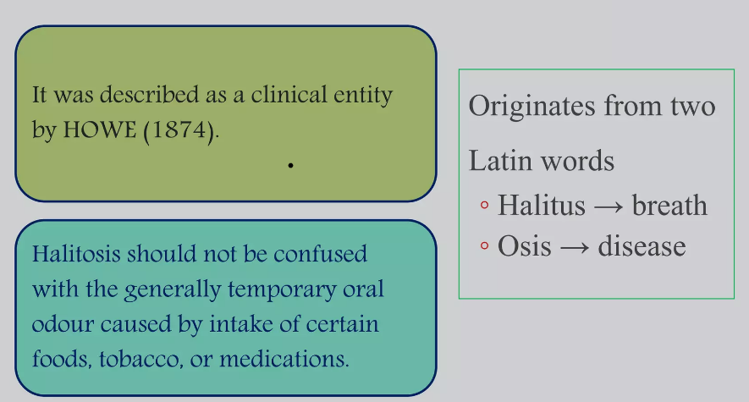
INTRODUCTION

Slide 4
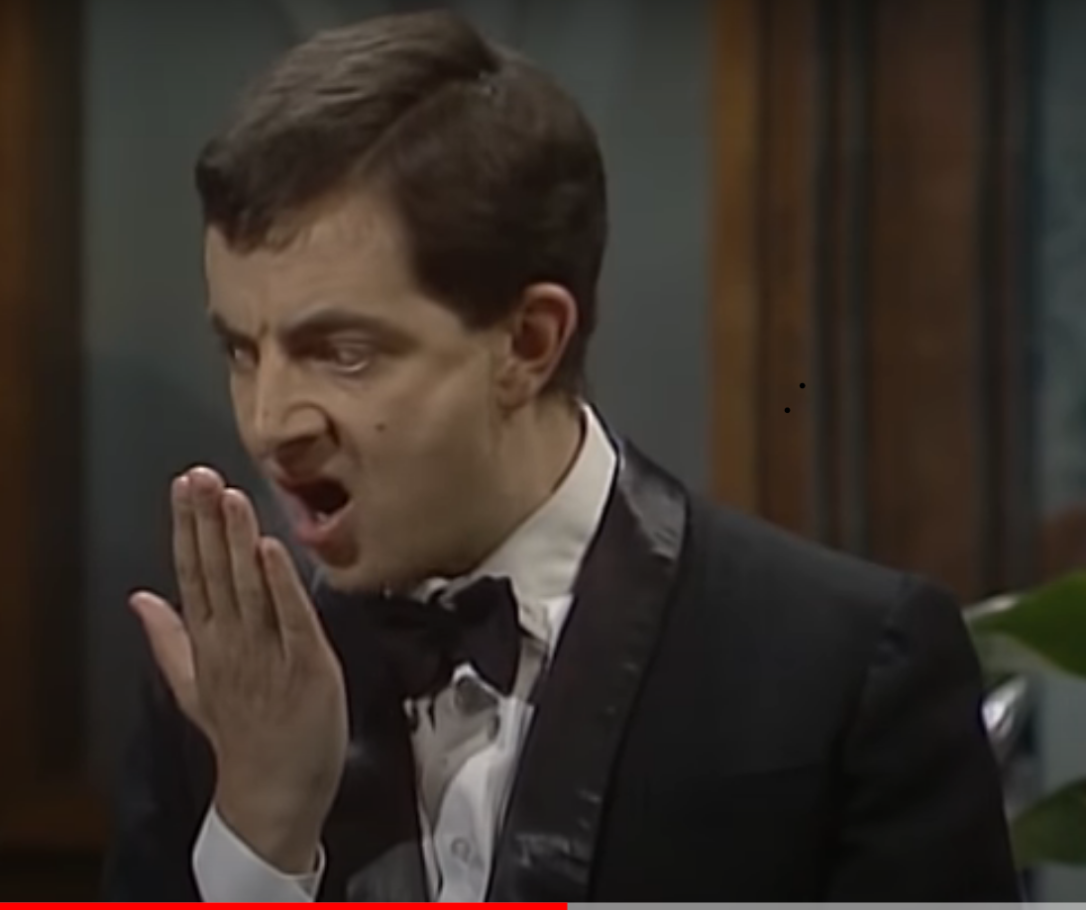
SYNONYMS
Bad or foul breath
Breath malodour
Oral malodour
Foetor-oris

Slide 5
DEFINITION
Breath malodor, defined as foul or offensive odor of expired air, may be caused by a number of factors, both intra-oral & extra-oral (gingivitis/ periodontitis, nasal inflammation, chronic sinusitis, diabetes mellitus, liver insufficiency etc..) & can be linked to more serious underlying medical problems including primary biliary cirrhosis, uremia, lung carcinoma, decompensated liver cirrhosis.

Slide 6
CAUSES
LOCAL FACTOR
Oral disease: Acute gingivitis, Oral ulceration, Periodontitis,
Respiratory disease: Sinusitis, Tonsilitis, Bronchiectasis
Voliate foodstuff: Garlic, Onions, Spiced foods
SYSTEMIC FACTORS
Respiratory tract infection
Renal failure
Diabetic
Hepatic failure

Slide 7
CLASSIFICATION
GENUINE HALITOSIS
Physiologic halitosis: Morning breath odour, tobacco smoking and certain food, starvation, Medication (Disulfaram, Antihistamine)
Pathologic halitosis:
Intra oral OR extra oral origin
90% of patient- oral cavity
Bacteria, volatile sulphus compound

Slide 8
Conti…
Intra oral origin: Poor oral hygiene, dental caries, periodontal disease, tongue coating
Extra oral origin: Respiratory tract infection
Chronic sinusitis and tonsillitis, kidney, liver, stomach affected by systemic disease.

Slide 9
DIAGNOSTIC EVALUATION
HISTORY COLLECTION
Onset/ Duration
Constant/intermittent
Self reported or reported by other
Systemic disease or medication

Slide 10
Conti…..
PHYSICAL EXAMINATION
Tongue coating
Periodontal disease
DETECTION
Self assessment test
Wrist lick test
Spoon test
Saliva odour test

Slide 11
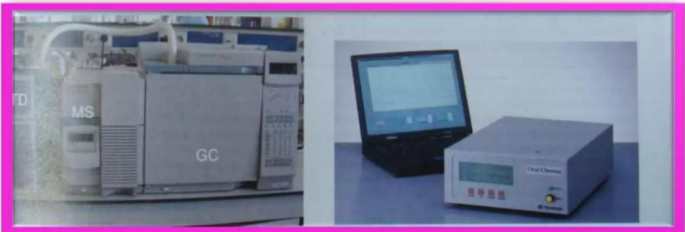
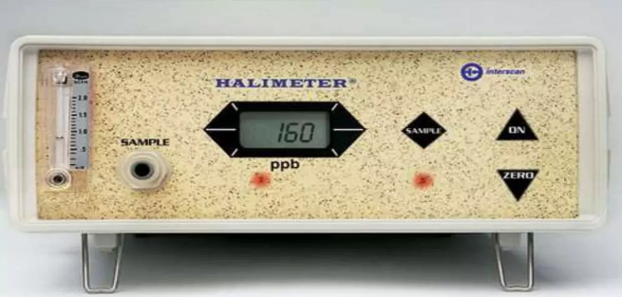
Conti…
Some device used to detect halitosis
Gas chromatography Halimeter

Slide 12
MANAGEMENT
Mechanical reduction of intraoral nutrient and micro organism:
Tongue cleaning
Tooth brush
Inter dental cleaning
Chewing gum
Professional periodontal therapy

Slide 13
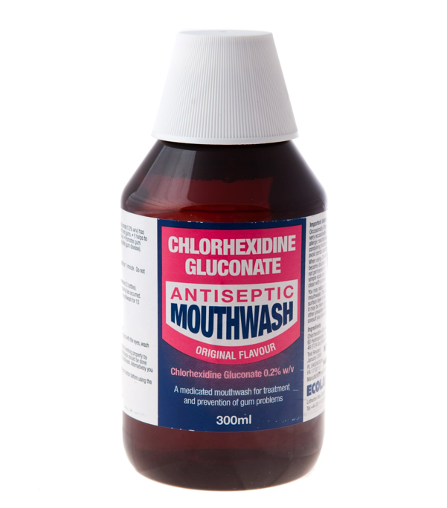
Conti….
Chemical reduction of oral microbial load
Chlorhexidine
Essential oils
Triclosan
Hydrogen peroxide
Satannous fluoride

Slide 14
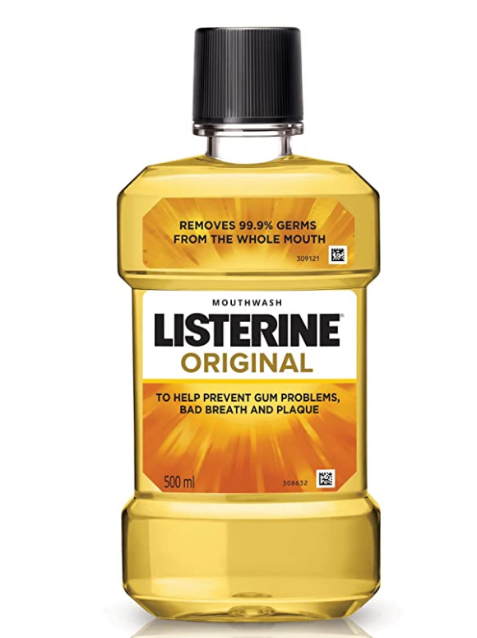
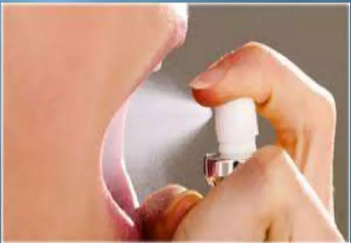
Conti….
Masking the malodor
Rinses
Mouth sprays
Chewing gum

Slide 15
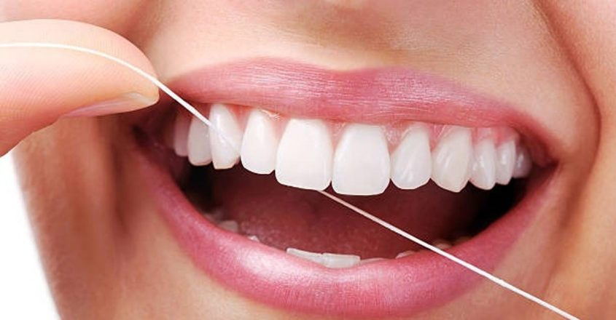
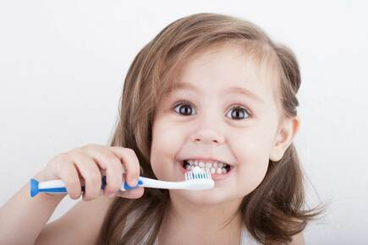
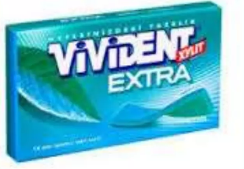
PREVENTIVE MEASURES
Visit dentist regularly
Brushing of teeth twice daily
Periodical tooth cleaning
Use of tongue scraper
Flossing after brushing to remove food particles
Chew gum free-sugar

Slide 16
SUMMARY

Slide 17
REFERENCES

Slide 18


