Slide 1

VIRAL HEPATITIS
MR. DINESH SINGH
P.G. NURSING TUTOR
ROHILKHAND COLLEGE OF NURSING

Slide 2
OBJECTIVES
Introduction of the Viral Hepatitis.
Define the Viral Hepatitis
Explain the causes of Viral Hepatitis.
State the clinical manifestations of Viral Hepatitis
Elaborate the diagnostic evaluation of Viral Hepatitis
Discuss the management of Viral Hepatitis.
Describe the prevention of Viral Hepatitis

Slide 3
INTRODUCTION
Hepatitis means inflammation of the liver. The liver is a vital organ that processes nutrients, filters the blood, and fights infections. When the liver is inflamed or damaged, its function can be affected. Heavy alcohol use, toxins, some medications, and certain medical conditions can cause hepatitis. However, hepatitis is often caused by a virus. In the United States, the most common types of viral hepatitis are hepatitis A, hepatitis B, and hepatitis C.

Slide 4
DEFINITION
Hepatitis is the inflammation of liver. Viral hepatitis is a systemic viral infection in which necrosis and inflammation of liver cells, Five different types of viral hepatitis have been identified namely:
Hepatitis A
Hepatitis B
Hepatitis C
Hepatitis D
Hepatitis E

Slide 5
CAUSES
S. NO. | TYPES | CAUSES
1 | Hepatitis-A | RNA virus (entero virus)
2 | Hepatitis-B | Blood, Saliva, Semen, Vaginal secretions, can transmitted through mucus membrane and breakage in skin
3 | Hepatitis-C | Blood transfusion, sexual contacts, sharing contaminated needles, accidental needle pricks
4 | Hepatitis-D | Delta hepatitis
5 | Hepatitis-E | Genotype-1 (contaminated drinking water)

Slide 6
CAUSES
Immune cells in the body attacking the liver and causing autoimmune hepatitis.
Infections due to viruses ( such as hepatitis A, B, or C), bacteria, or parasites.
Liver damage due to alcohol, poisonous mushrooms, or other poisons.
Medication, such as an overdose of acetaminophen, which can be deadly.

Slide 7
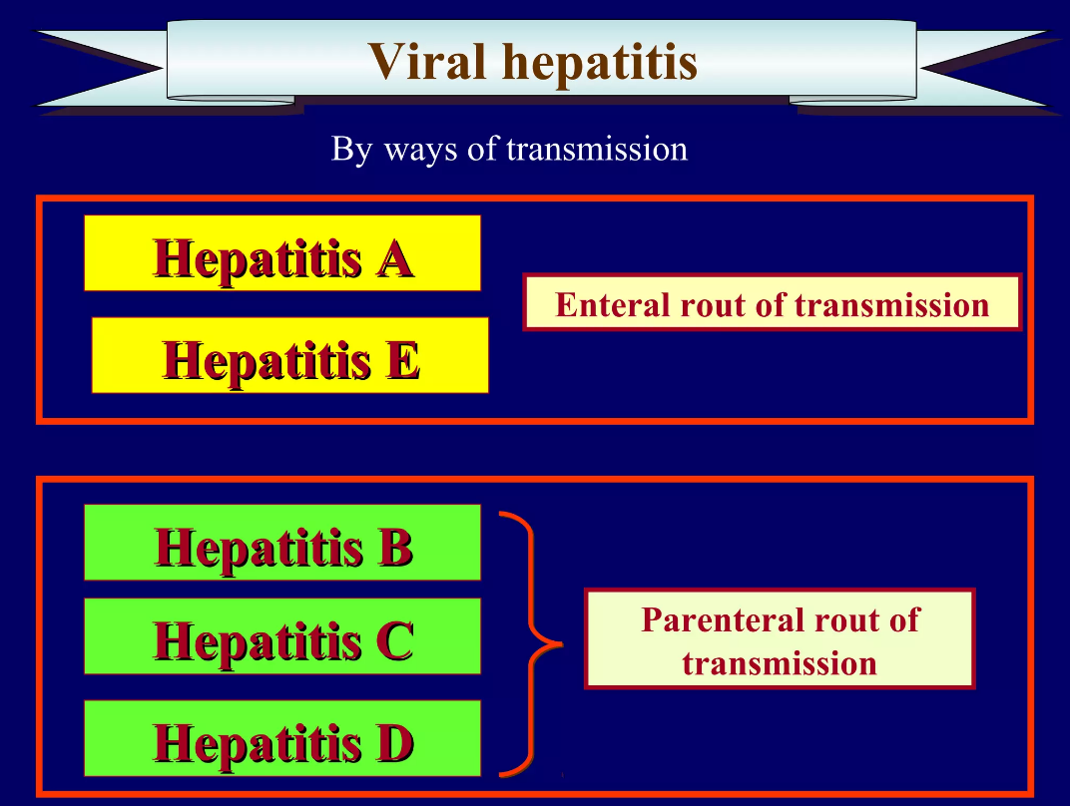
MODE OF TRANSMISSION

Slide 8
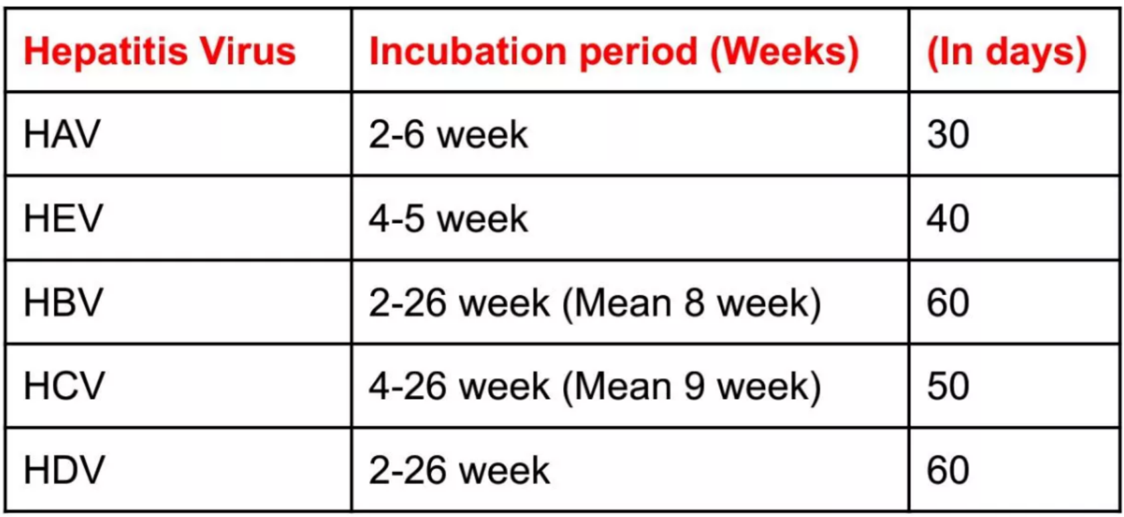
INCUBATION PERIODS

Slide 9
CLINICAL MANIFESTATION
Abdominal pain or distention
Breast development in males
Dark urine and pale or clay-colored stools
Fatigue
Fever, usually low grade
General itching
Jaundice (yellowing of the skin or eyes)
Loss of appetite, weight loss

Slide 10
DIAGNOSTIC EVALUATION
History collection
Physical examination
Abdominal ultrasound
Liver function test
Liver biopsy to check for liver damage
Paracentesis if fluid is in abdomen

Slide 11
MANAGEMENT
Small, frequent feedings of a high-calorie, low-fat diet; proteins are restricted
Vitamin K injected subcutaneously if PT is prolonged.
I.V. fluid and electrolyte replacement as indicated.
Administration of antiemetic for nausea.
Vaccines (Hepatitis A, B).
Strict isolation of the patient.

Slide 12
SUMMARY

Slide 13
REFERENCES

Slide 14


