Slide 1



Slide 2
GLOMERULONEPHRITIS
MR. DINESH SINGH
P.G. NURSING TUTOR
ROHILKHAND COLLEGE OF NURSING

Slide 3
OBJECTIVES
Introduction of the Glomerulonephritis.
Define the Glomerulonephritis.
Explain the causes of Glomerulonephritis.
Enlist the types of Glomerulonephritis.
Enumerate the pathophysiology of Glomerulonephritis.
State the clinical manifestations of Glomerulonephritis.
Elaborate the diagnostic evaluation of Glomerulonephritis.
Discuss the management of Glomerulonephritis.
Describe the nursing diagnosis of Glomerulonephritis.

Slide 4
INTRODUCTION
Glomerulonephritis is a group of diseases that injure the part of kidney that filters blood (called glomeruli). When kidney is injured, it can not get rid of wastes and extra fluid in the body if it is continue, then kidneys may stop working completely, resulting in kidney failure.

Slide 5
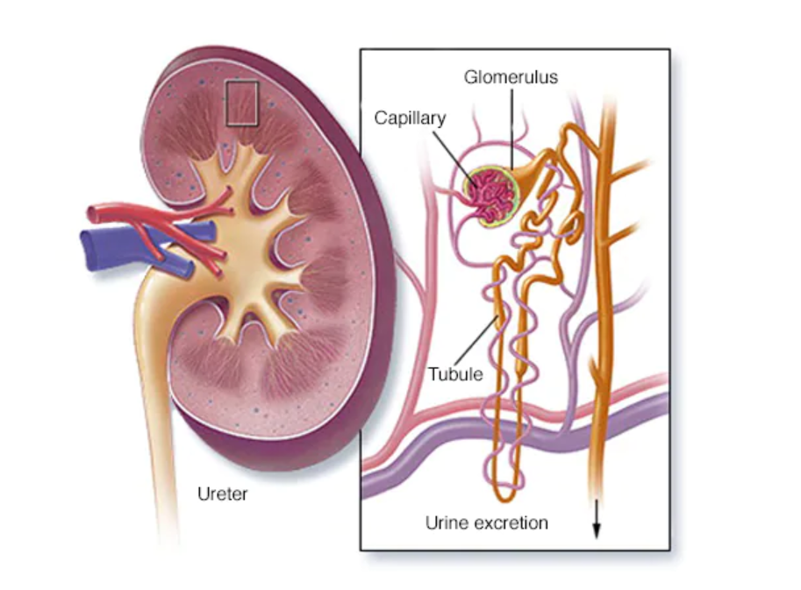
DEFINITION
It is an inflammatory process of glomerular portion of kidney due to changes in immune system.

Slide 6
ETIOLOGY
It is an immunologic disorder that occur in response to either endogenous antigen or exogenous antigen.
Endogenous: IgG, Nuclear antigen, Carcinogens
Exogenous: Staphylococcus infection, Streptococcus infection, Mycobacterium infection, Pneumococci infection, Measles virus.

Slide 7
TYPES
It is of two types
Acute: (After 2-3 weeks of infection)
Chronic: ( After so many months of infection)

Slide 8
PATHOPHYSIOLOGY
Due to causes
Antigen + Antibody reaction within glomerulus
Inflammatory damage and delay or obstruct glomerular function
Reduce glomerular membranes capacity for selective permeability

Slide 9
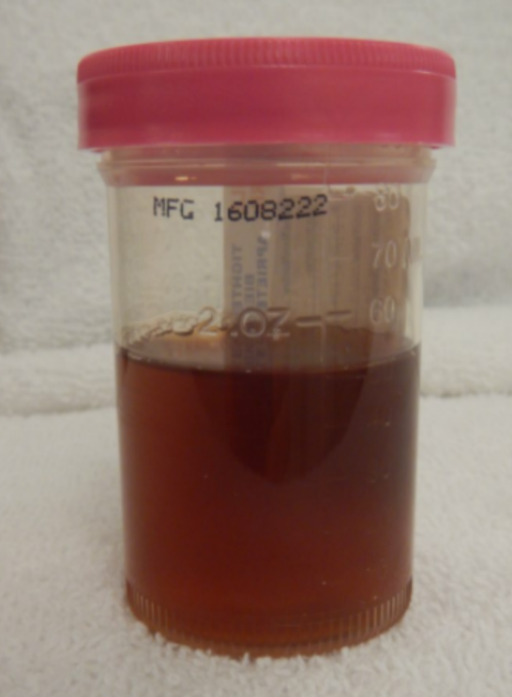
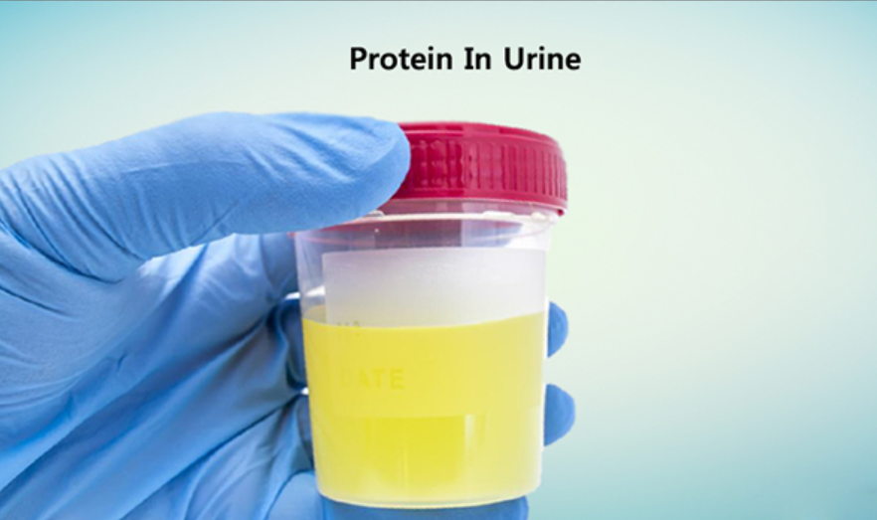
CLINICAL MANIFESTATION
Dark cola Colour urine
Proteinuria

Slide 10
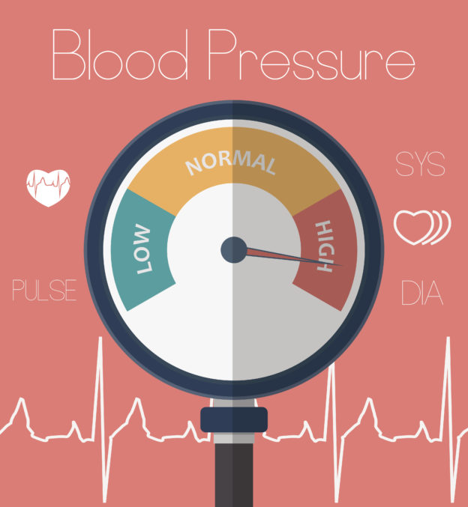
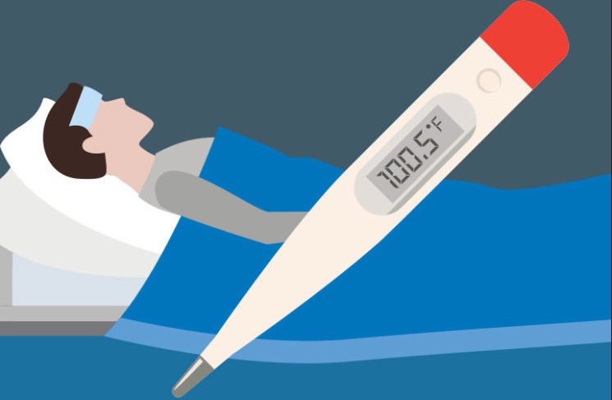
CONTI…
Hypertension
Fever

Slide 11

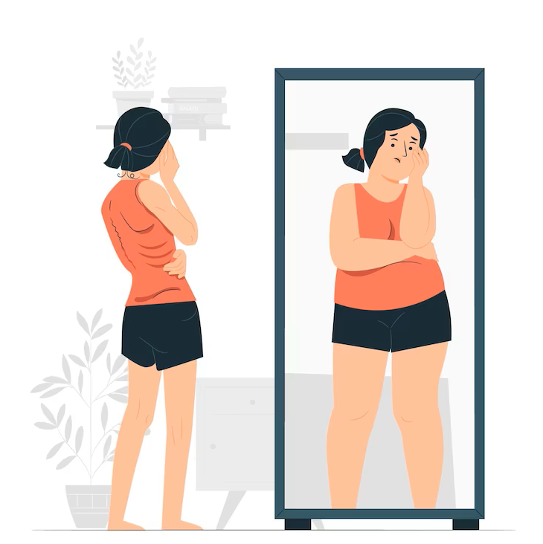
CONTI…
Fatigue
Anorexia

Slide 12
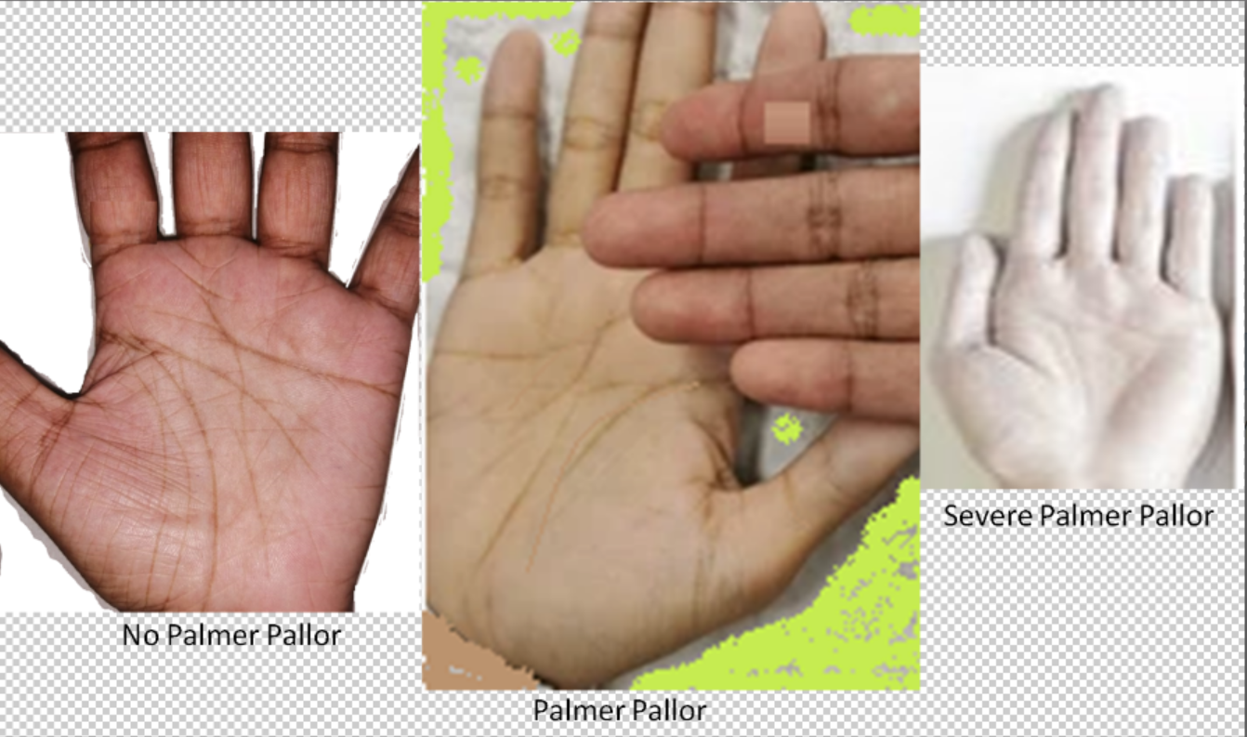
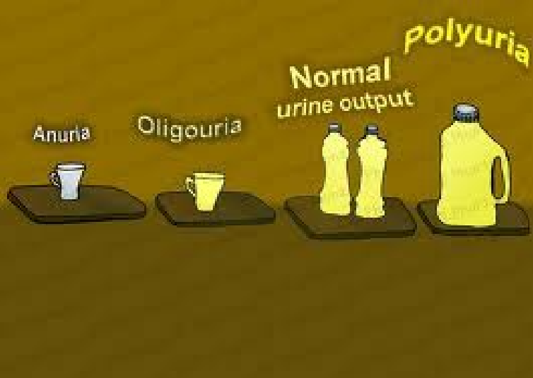
CONTI…
Pallor
Oliguria
Urinary output less than 400 ml per day or less than 20 ml per hour

Slide 13
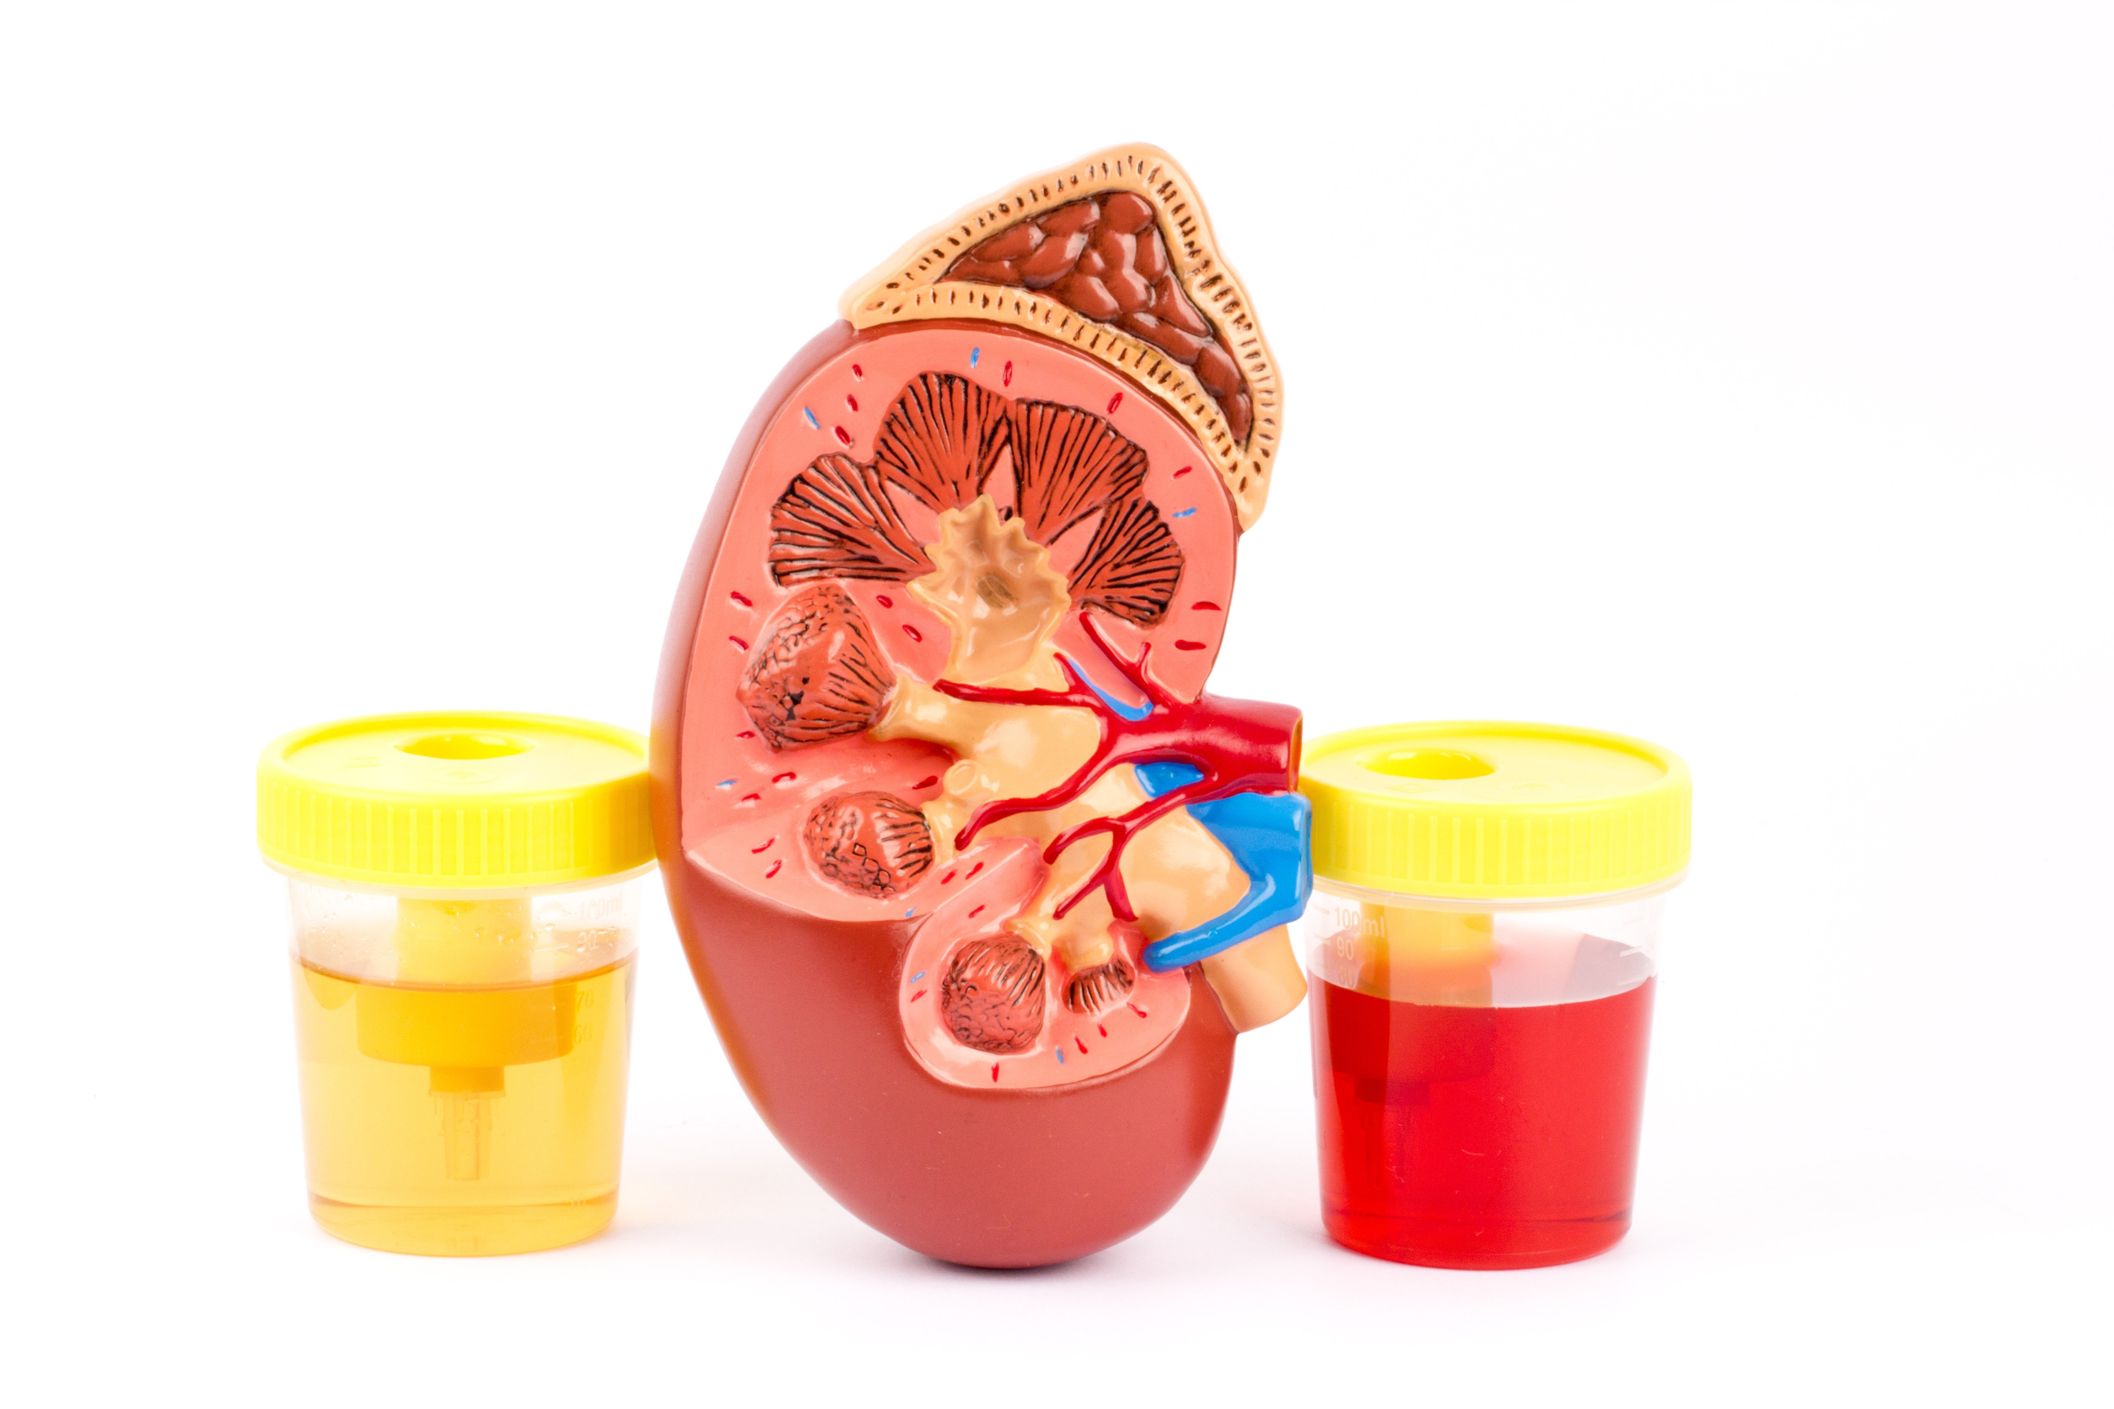
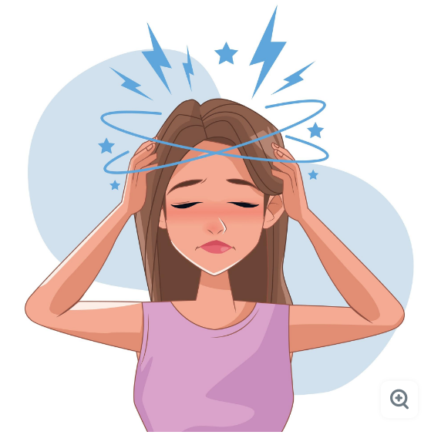
CONTI…
Haematuria
Headache

Slide 14
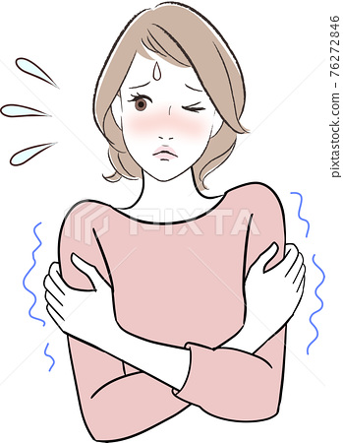
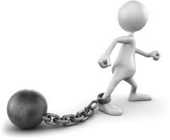
CONTI…
Chills
Weakness

Slide 15

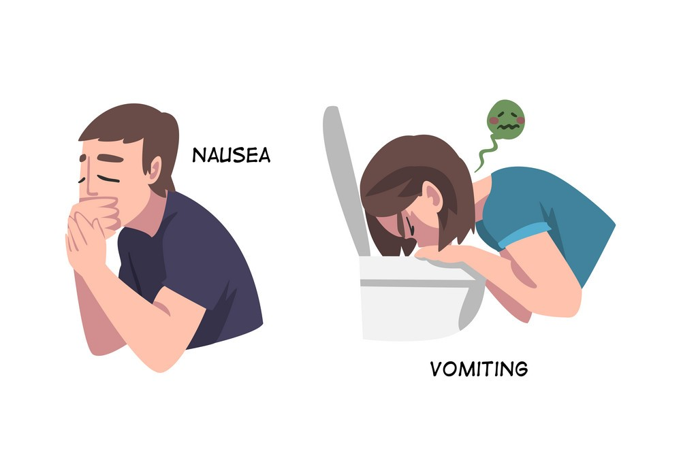
CONTI…
Facial Edema
Nausea/Vomiting

Slide 16
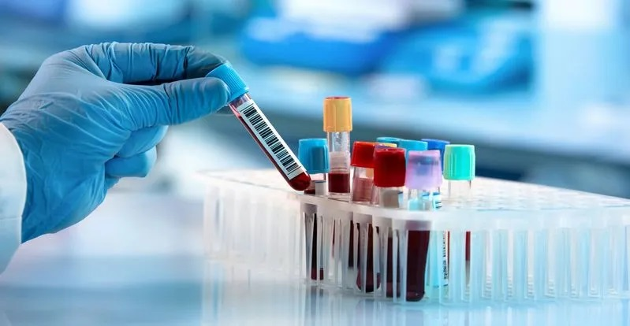
DIAGNOSTIC EVALUATION
HISTORY COLLECTION
PHYSICAL EXAMINATION
BUN (Blood Uria Nitrogen)
Urinalysis
ASO (Anti-streptolysin titter):- To detect streptococcus infection.
Needle Biopsy

Slide 17
MANAGEMENT
Antibiotic therapy for streptococcal infection, e.g.,
Ciprofloxacin
Ofloxacin
Levofloxacin
Antihypertensive therapy, e.g.,
Propranolol
Atenolol

Slide 18
CONTI…
Corticosteroid and immune suppressant agent, e.g., cyclophosphamide, prednisolone
Diuretics (to relive edema), e.g.,
Furosemide
Spironolactone

Slide 19
DIETARY MANAGEMENT
Low sodium diet should be given
Provide balanced nutritional diet
High calories and rich protein diet.

Slide 20
NURSING DIAGNOSIS
Excess fluid volume related to decrease fluid excretion by kidney as evidenced by Dependent oedema.
Activity Intolerance related to Bed rest as evidenced by expressed weakness and fatigue.
Imbalanced nutrition less than body requirement related to anorexia and altered renal function
Risk for impaired skin integrity related to edema and decrease activity.

Slide 21
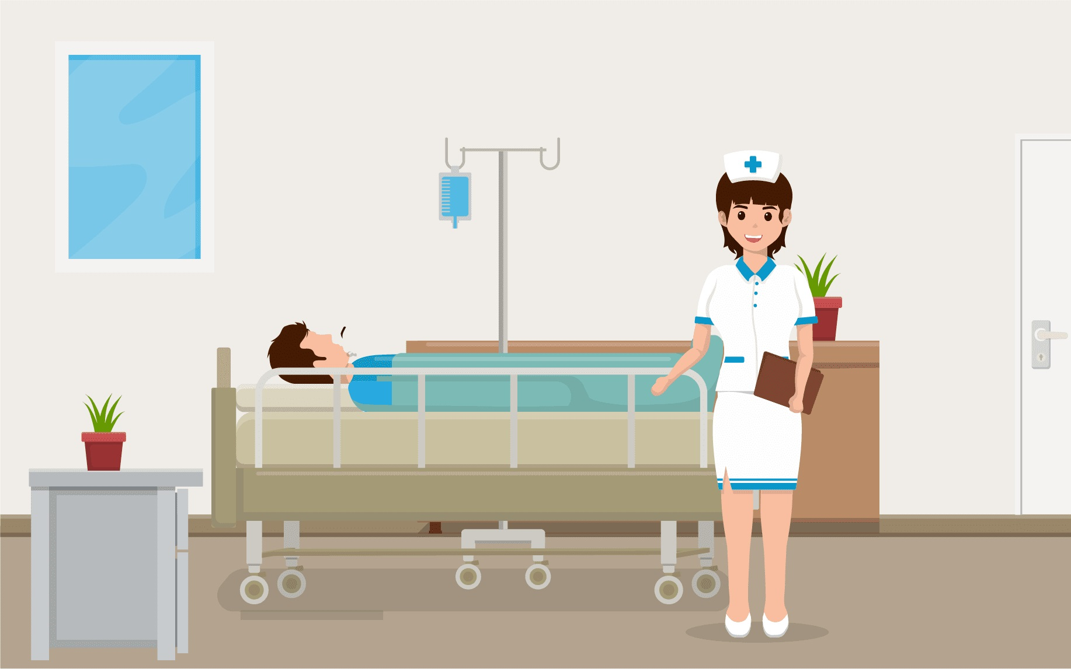
NURSING MANAGEMENT
Maintain fluid intake
Monitor daily intake and output chart
Check weight daily.
Provide sodium restricted diet
Provide high calories in diet and controlled protein diet.
Provide good hygiene, massage and change position regularly.

Slide 22
SUMMARY

Slide 23
REFERENCES
Lwis. Dirksen. Heitkemper. Textbook of medical surgical nursing, second south asia edition, volume1. page no.
Brunner and suddarth’s textbook of medical surgical nursing 13th south Asian edition, volume 2 page no. 1532 to 1533.
Panwar K.P. medical surgical nursing, 4th edition, AITBS publishers, India, page no.133-134

Slide 24


