Slide 1

DENTAL CARIES
MR. DINESH SINGH
P.G. NURSING TUTOR
ROHILKHAND COLLEGE OF NURSING

Slide 2
OBJECTIVES
Introduction of the.
Define the .
Explain the causes of .
State the clinical manifestations of .
Elaborate the diagnostic evaluation of.
Discuss the management of.
Describe the prevention of.

Slide 3
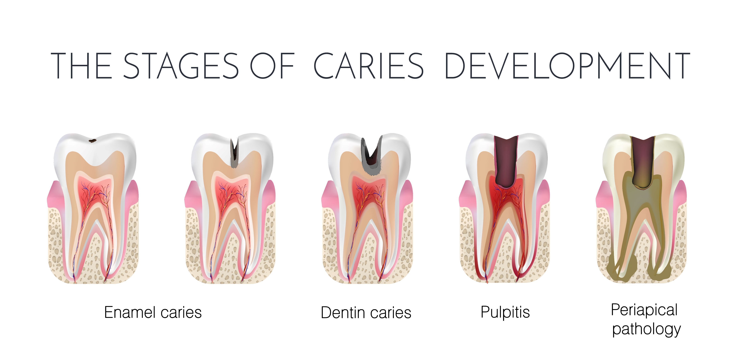
INTRODUCTION

Slide 4
DEFINITION
Cavities are permanently damaged areas in the hard surface of the teeth that develop into tiny openings or holes. Cavities, also called tooth decay or caries, are caused by, including bacteria into the mouth, frequent snacking, sipping sugary drinks and not cleaning your teeth well.

Slide 5
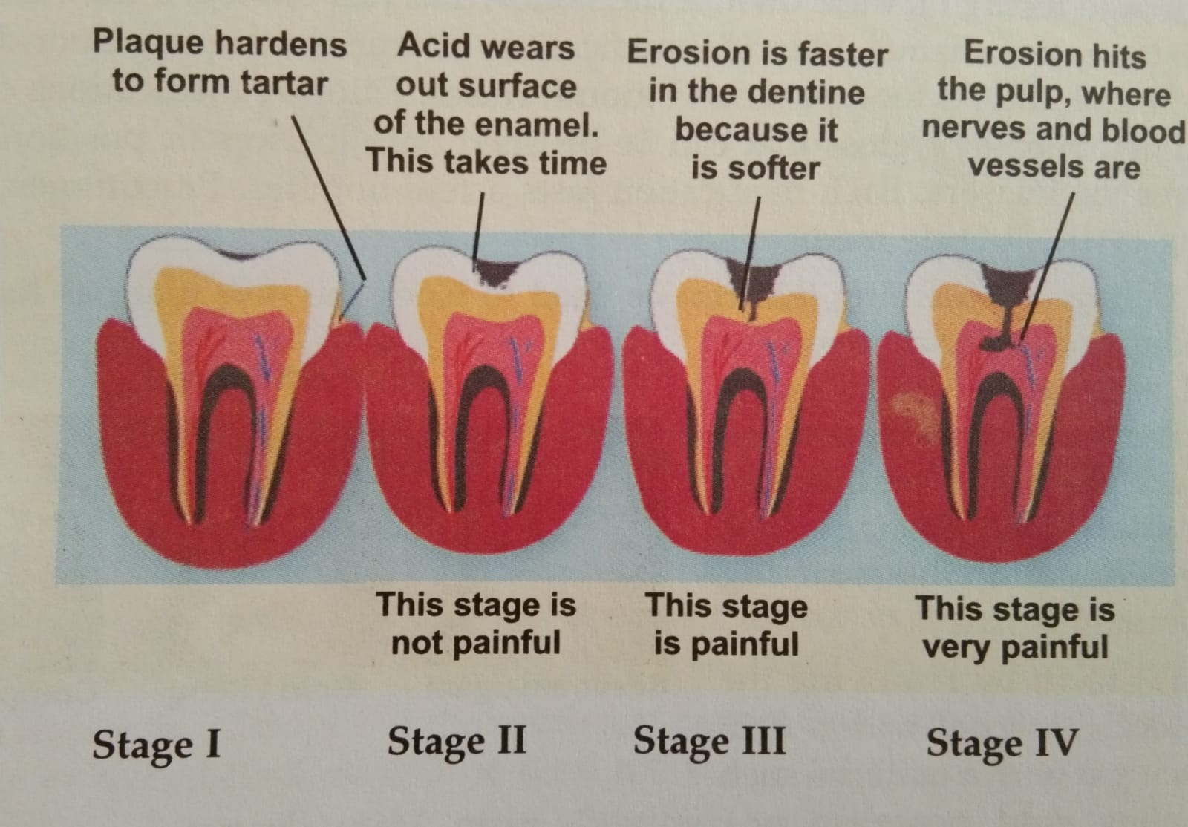
ETIOLOGY
Bacteria
Frequent snacking
Sipping sugary drinks
Not cleaning your teeth well

Slide 6
RISK FACTORS
Poor Oral Hygiene
Unregulated diet of sweet food and drinks
Autoimmune disease: connective tissue disorder, dry mouth
Dehydrated mouth
Some cancer medications

Slide 7
CLINICAL MANIFESTATION
Dull continuous severe pain
Edema of facial structures
Mobility of involved tooth
Swelling of gum and fever
Hot and cold sensation

Slide 8
DIAGNOSTIC EVALUATION
History collection
Physical examination: All sign and symptoms
X-ray’s

Slide 9
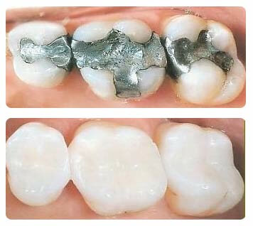
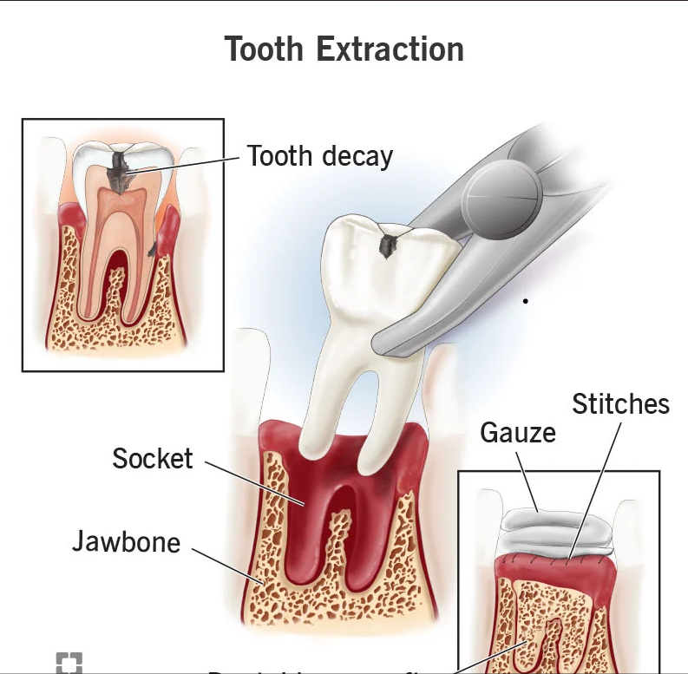
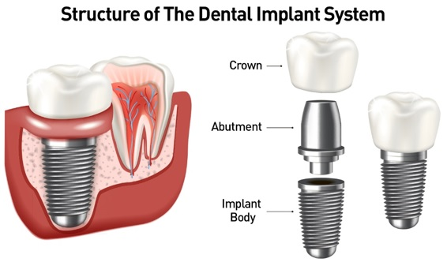
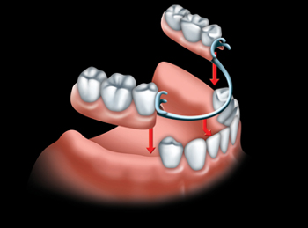
MANAGEMENT
It includes:
Filling tooth
Tooth extraction
Dental implants
Dentures

Slide 10
PREVENTION
Brushing- teeth must be brushed twice in a day to prevent plaque formation.
Flossing- this will help in removing plaque from between teeth.
Rinsing- mouth should be rinsed with water thoroughly after each meal.
Regular dental exams at the dentist to verify the brushing method
Nutritious and balanced diet should be taken.
Topical fluoride is also recommended to protect the surface of the teeth. This may include a fluoride toothpaste or mouthwash.

Slide 11
SUMMARY

Slide 12
REFERENCES

Slide 13


