Slide 1



Slide 2
U
R
O
L
I
T
H
I
A
S
I
S
MR. DINESH SINGH
P.G. NURSING TUTOR
ROHILKHAND COLLEGE OF NURSING

Slide 3
OBJECTIVES
Introduction of the Peritonitis.
Define the Peritonitis.
Explain the causes of Peritonitis.
State the clinical manifestations of Peritonitis.
Elaborate the diagnostic evaluation of Peritonitis.
Discuss the management of Peritonitis.
Describe the prevention of Peritonitis.

Slide 4

INTRODUCTION
Urolithiasis (from Greek ouron-urine and lithos-stone) is the condition where urinary stones are formed or located anywhere in the urinary system.

Slide 5
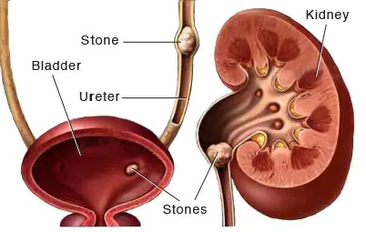

Slide 6

DEFINITION
It refers to stones in urinary tract. These stones are formed when concentration of substances such as calcium and uric acid increases in the urine.
Stones are formed in urinary tract when urinary concentration of calcium oxalate, calcium phosphate and uric acid increases

Slide 7
ETIOLOGY
Hyperparathyroidism: Hyperparathyroidism is a condition in which one or more of your parathyroid glands become overactive and release (secrete) too much parathyroid hormone (PTH). This causes the levels of calcium in your blood to rise, a condition known as hypercalcemia
Renal tubular acidosis: Hyperparathyroidism happens when the parathyroid glands make too much parathyroid hormone. This can affect your calcium levels

Slide 8
CONTI…
Granulomatous disease: is an inherited disorder that occurs when a type of white blood cell, called a phagocyte, doesn't work properly. Phagocytes usually help your body fight infections. When they don't work as they should, phagocytes can't protect body from bacterial and fungal infections.
Excessive vitamin D intake
Excessive milk intake
Cancer

Slide 9
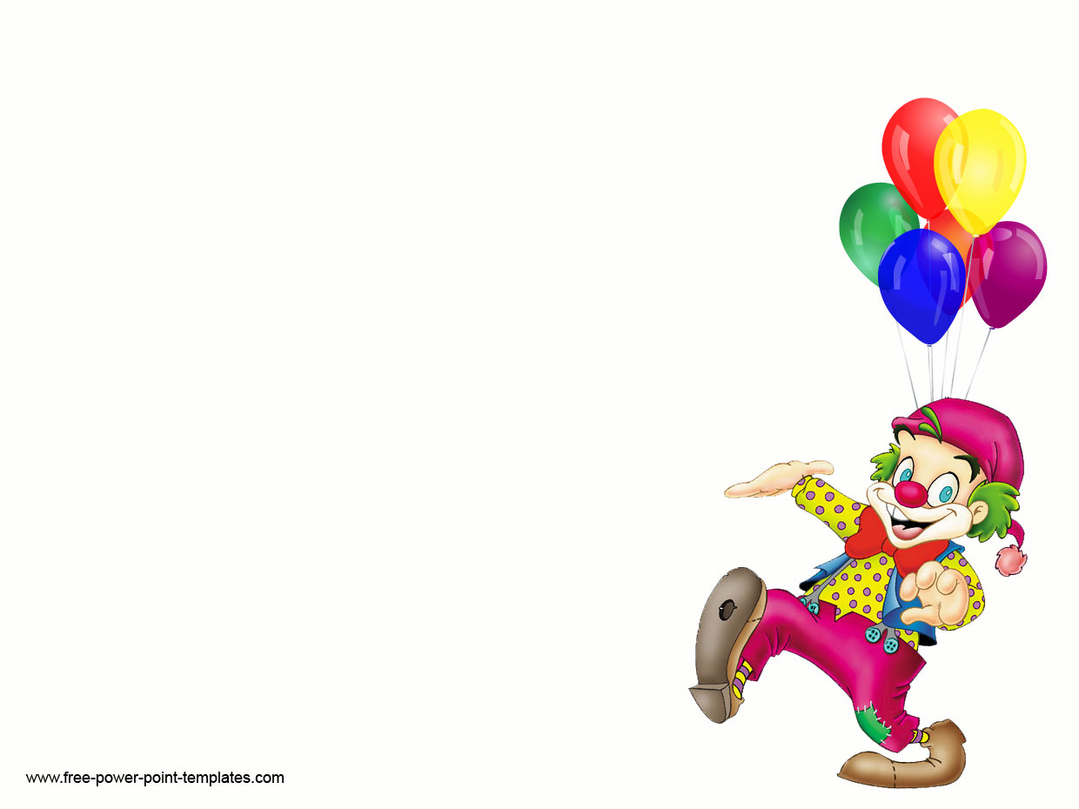
PATHOPHYSIOLOGY
Supersaturation of crystals due to excess calcium oxalate, calcium phosphate and uric acid
Stone formation
May pass through the urinary tract
Obstruction, infection and hydronephrosis occurs

Slide 10
CLINICAL MANIFESTATION
Infection can occur from irritation by stone.
Some stones cause pain and discomfort.
Hematuria is common and Pyuria is also present.
Pain originating in the renal area radiate towards the bladder in the female and towards testes in male.
Nausea and vomiting is also present along renal colic pain. Diarrhea and abdominal discomfort may occur.

Slide 11
CLINICAL MANIFESTATION
When stones move to the ureter it causes acute colicky wave like pain radiating down to the thigh and genital organs.
Usually patient feels urge to void but little urine is passed and it contains blood.

Slide 12
DIAGNOSTIC EVALUATION
History collection
Physical examination
X-rays
Ultrasound
24 hrs. urine test
Blood chemistry study.

Slide 13
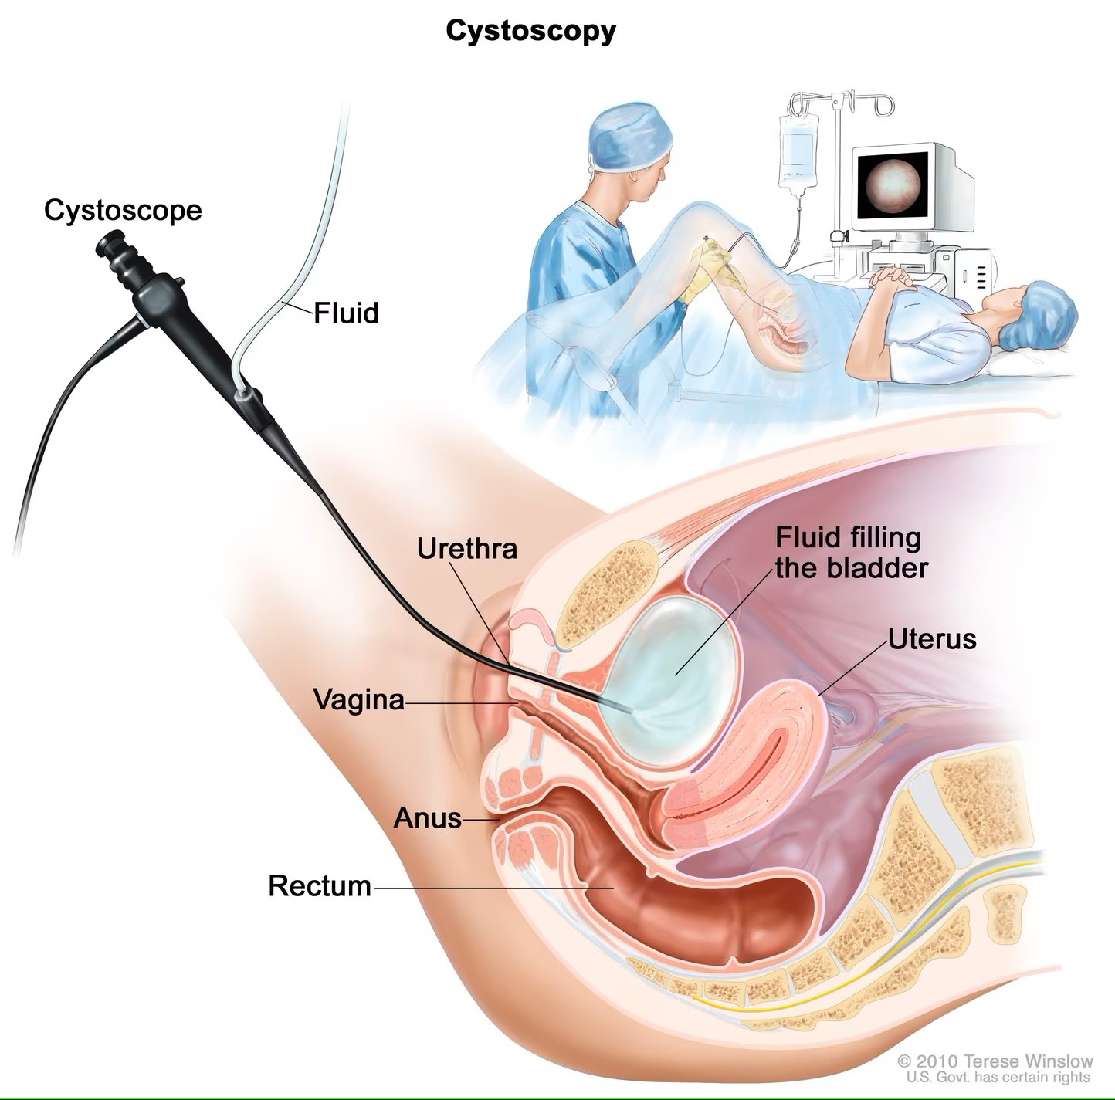
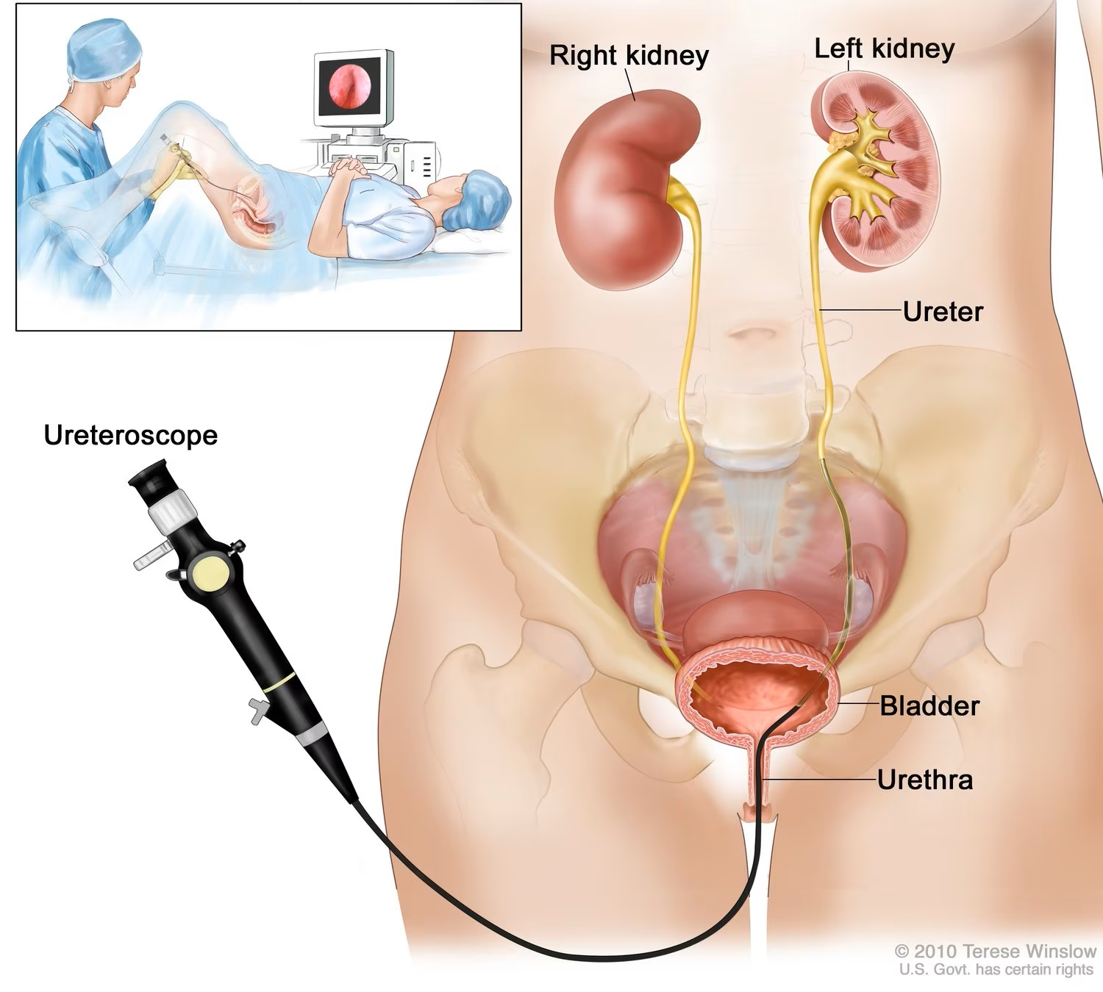
CONTI…
Retro-grade pyelography: Retrograde pyelography uses a special dye ("contrast agent") injected into the ureters. The dye makes the ureters and kidneys more easily seen on the x-ray.

Slide 14
MANAGEMENT
Management is according to stone type and its location. Immediate objective is to relive colicky pain. Opioids analgesics are given.
Hot bath or moist heat is used.
Fluids are encouraged. It helps in downward passage of the stone.
Nutritional therapy is also important. At least 2liter/day water is encouraged. Food containing calcium is to be avoided (rice, milk).
For calcium stones, calcibine is given that absorbs the calcium into the circulation.

Slide 15
CONTI…
For Oxalates stones food items like Chocolate, tea, palak are avoided.
Protein is also restricted.

Slide 16
SURGICAL MANAGEMENT
Electro hydraulic lithotripsy hemolysis: is a medical procedure which uses targeted shockwaves to break up kidney stones and gallstones.
Surgical removal: including nephrolithotomy, nephrectomy, uretrolithotomy.

Slide 17
SUMMARY

Slide 18
REFERENCES

Slide 19
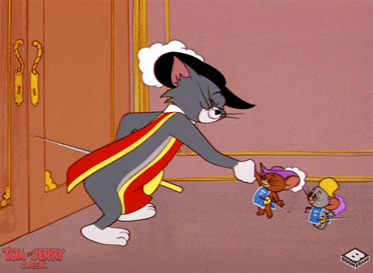
Thank You

