Slide 1

PYORRHEA PERIODONTITIS
MR. DINESH SINGH
P.G. NURSING TUTOR
ROHILKHAND COLLEGE OF NURSING

Slide 2
OBJECTIVES
Introduction of the Peritonitis.
Define the Peritonitis.
Explain the causes of Peritonitis.
State the clinical manifestations of Peritonitis.
Elaborate the diagnostic evaluation of Peritonitis.
Discuss the management of Peritonitis.
Describe the prevention of Peritonitis.

Slide 3
INTRODUCTION
Periodontitis (per-e-o-don-TIE-tis), also called gum disease, is a serious gum infection that damages the soft tissue and, without treatment, can destroy the bone that supports your teeth. Periodontitis can cause teeth to loosen or lead to tooth loss.

Slide 4
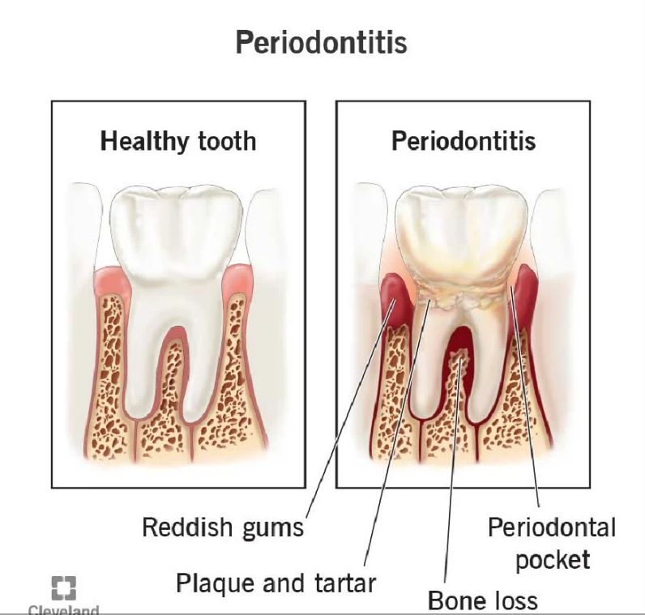
DEFINITION
Periodontitis or pyorrhea is a set of inflammatory disease affecting the periodontium.

Slide 5
ETIOLOGY
Dental plaque forms on teeth: This is a pale-yellow biofilm that develops naturally on teeth. It is formed by bacteria that try to attach themselves to the tooth's smooth surface.
Brushing teeth gets rid of plaque, but it soon builds-up; within a day or so. If it is not removed, within two or three days it hardens into tartar. Tartar is much harder to remove than plaque. Another name for tartar is calculus.
Plaque can gradually and progressively damage teeth and surrounding tissue. At first, the patient may develop gingivitis - inflammation of the around the base of the teeth, gum

Slide 6
ETIOLOGY
Persistent gingivitis can result in pockets developing between the teeth and gums. These pockets fill up with bacteria.
Bacterial toxins and immune system's response to infection start destroying the bone and connective tissue that hold teeth in place. Eventually the teeth start becoming loose, and can even fall out.

Slide 7
CAUSES AND RISK FACTORS
Gingivitis
Heredity
Poor oral health habits
Tobacco use
Diabetes
Decreased immunity, such as that occurring with leukemia or HIV/AIDS or chemotherapy
Poor nutrition
Hormonal changes, such as those related to pregnancy or menopause
Substance abuse
Older age
Certain medications: cold remedies, antihistamines, calcium channel blockers and drugs that suppress immune system.

Slide 8
CLINICAL MANIFESTATION
Swollen, bright red or purple gums
Gums that feel tender when touched
Gums that pull away from teeth, making teeth look longer than normal
New spaces developing between teeth
Pus between teeth and gums
Persistent breath odor or a bad taste in mouth
Loose teeth or a change in the way teeth fit together when bite

Slide 9
DIAGNOSTIC EVALUATION
History collection: The dentist will ask the patient regarding symptoms and carry out an examination of his/her mouth.
Physical examination: Dentist will look for plaque and tarter buildup and check for easy bleeding. Examination of the mouth and teeth by the dentist shows soft, swollen, red-purple gums.
The dentist may order an X-ray to see what condition the jaw bone and teeth are in.

Slide 10
MANAGEMENT
Non surgical treatments
Scaling: Scaling removes tartar and bacteria from tooth surfaces and beneath gums. It may be performed using instruments or an ultrasonic device.
Root Planning: Root planning smoothes the root surfaces, discouraging further buildup of tartar.
Antibiotics: Periodontist or dentist may be recommend using topical or oral antibiotics to help control bacterial infection.

Slide 11
Conti…
Surgical Treatment
Flap Surgery (pocket reduction surgery):
Soft tissue grafts
Bone grafting

Slide 12
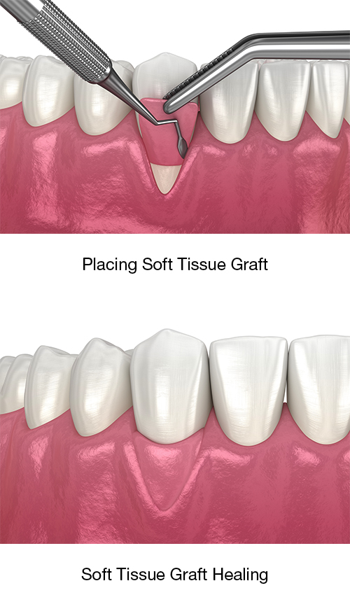
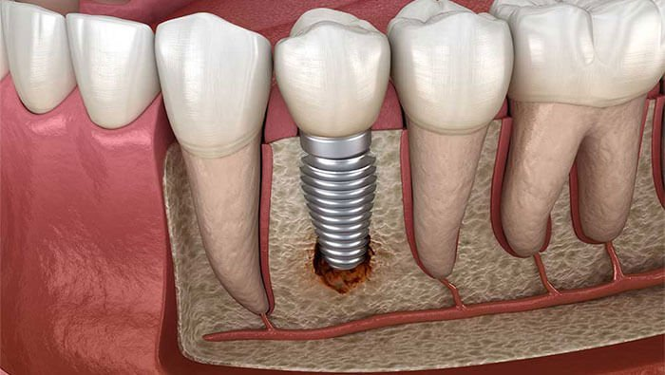

Slide 13
PREVENTION
Choose the right toothbrush
Brush as if teeth depended on it
Pay attention to the brushing action, not the type of toothpaste
Eat a healthy diet

Slide 14
SUMMARY

Slide 15
REFERENCES

Slide 16


