Slide 1

HEPATIC ENCEPHALOATHY
MR. DINESH SINGH
P.G. NURSING TUTOR
ROHILKHAND COLLEGE OF NURSING

Slide 2
OBJECTIVES
Introduction of the Hepatic Encephalopathy.
Define the Hepatic Encephalopathy.
Explain the causes of Hepatic Encephalopathy.
State the clinical manifestations of Hepatic Encephalopathy.
Elaborate the diagnostic evaluation of Hepatic Encephalopathy.
Discuss the management of Hepatic Encephalopathy
Describe the prevention of Hepatic Encephalopathy.

Slide 3

INTRODUCTION

Slide 4
DEFINITION
  Hepatic encephalopathy is a nervous system disorder brought on by severe liver disease. When the liver doesn’t work properly, toxins build up in the blood. These toxins can travel to the brain and affect brain function.

Slide 5
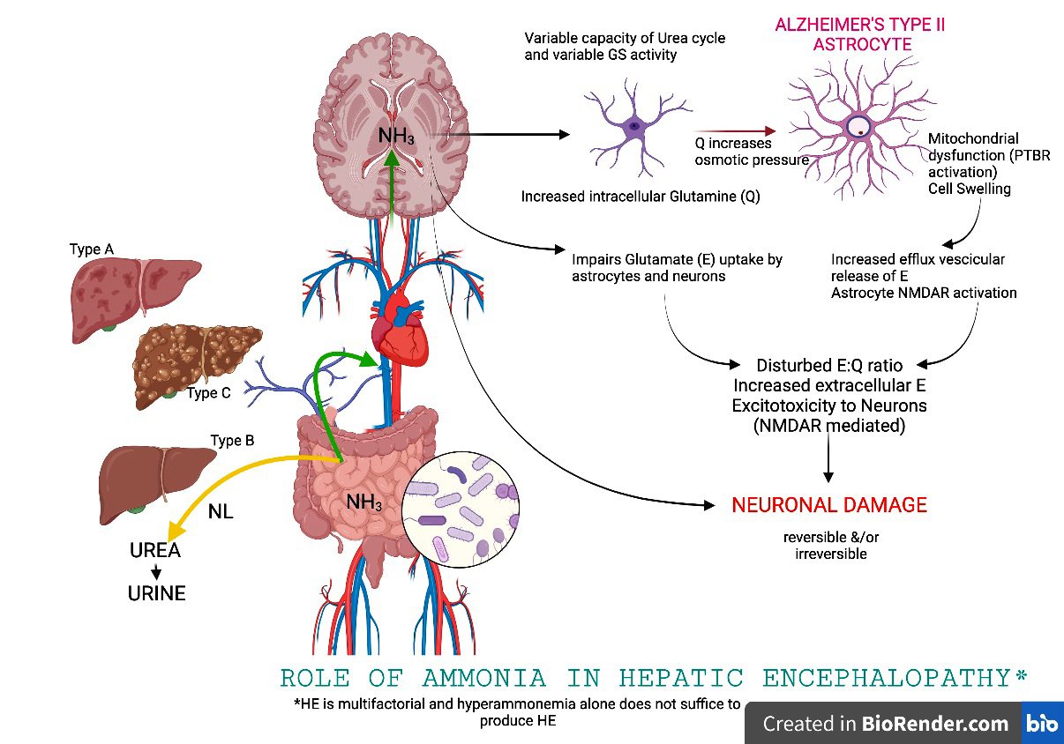

Slide 6
Grading
Grade 1: Poor concentration, slurred speech, disordered sleep rhythm.
Grade 2: Occasional aggressive behaviour, lethargic.
Grade 3: Marked confusion, lethargic, sleepy but responds to pain and voice, gross disorientation.
Grade 4: unresponsive to voice, may or may not respond to painful stimuli, unconscious.

Slide 7
ETIOLOGY
Advanced liver diseases
Acute or chronic hepatic failure

Slide 8
Pathophysiology
Due to etiological factors
Liver cells are unable to detoxify ammonia into glutamine and then into urea
Accumulation of ammonia in the body
Ammonia concentration also arises in blood stream
Due to increased permeability of blood brain barrier for ammonia
Cause central nervous system dysfunction
Hepatic encephalopathy

Slide 9
CLINICAL MANIFESTATION
Disturbance in Consciousness
Disturbance in sleep rhythm
Impaired memory
Mental confusion
Apathy
Drowsiness
Coma
Changes in Personality
Childish behavior
May be aggressive outburst
Euphoric
Fetor hepaticus: Foul-smelling breath associated with liver disease due to mercaptans.

Slide 10
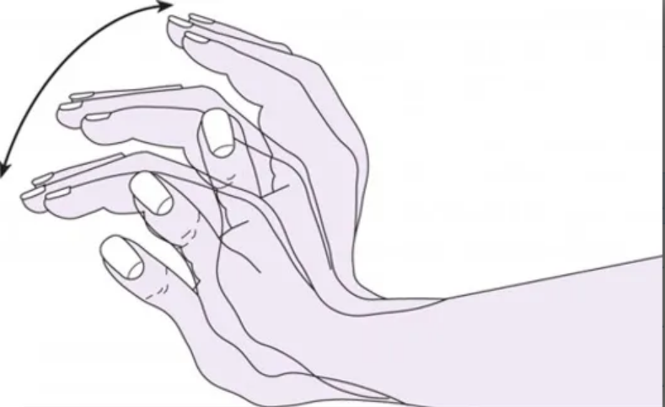
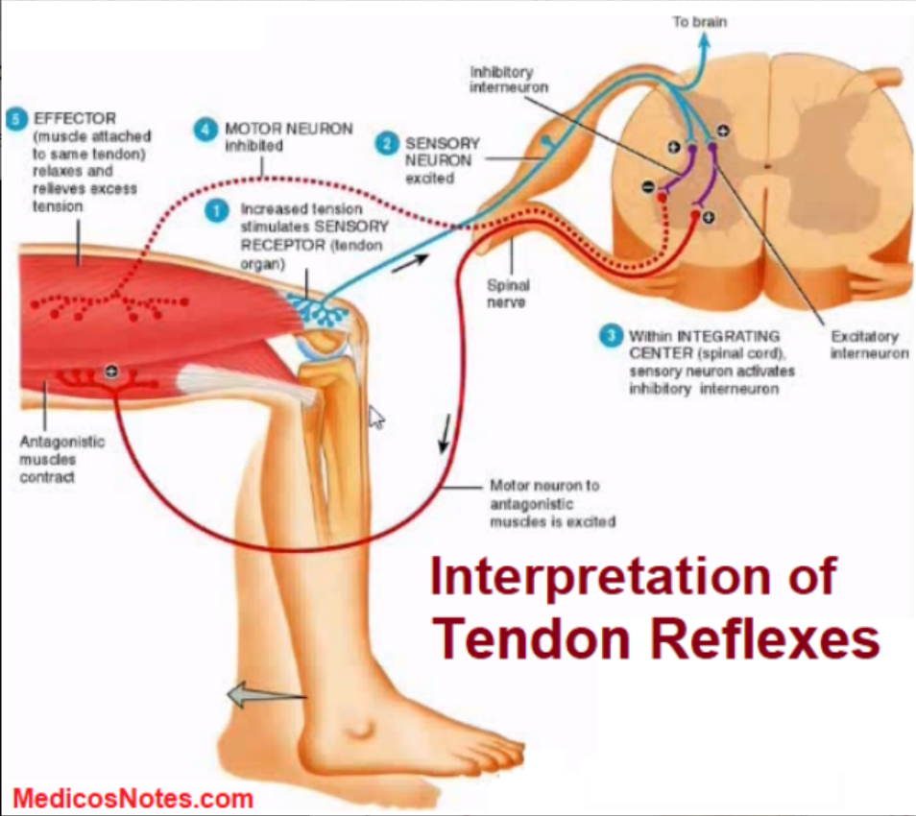
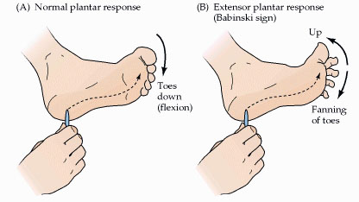
CONTI…
Neurological signs
Flapping tremor/Asterixis (in pre coma)
Exaggerated tendon reflex
Extensor plantar reflex.

Slide 11
DIAGNOSTIC EVALUATION
Diagnosis is usually made clinically:
Elevation of blood ammonia
Hypokalemia
EEG (Electroencephalogram)
Cerebrospinal fluid Examination and CT Scan
Other routine investigations: CBC, ESR, electrolytes LFT or RFT, Coagulation profile.

Slide 12
MANAGEMENT
MEDICAL MANAGEMENT
Hospitalization is mandatory.
ABC maintenance.
Remove the cause and precipitating factors.
IV fluid dextrose saline and inj. Thiamine.
Maintenance of fluid, electrolytes and calorie
Diet – restriction of protein diet.
High glucose diet.

Slide 13
Conti…
Avoid Constipation: Lactulose 15-20 ml / TDS
Antibiotics: Neomycin, Ampicillin, Metronidazole
Inj. Vitamin K

Slide 14
CONTI…
NURSING MANAGEMENT
1.5 gm of protein per kilograms of body weight may be ordered to maintain plasma osmotic balance and promote liver cell regeneration.
Vitamins supplements are usually given. Protein rich food is includes:
Fish
Meat
Eggs
Dairy products

Slide 15
SUMMARY

Slide 16
REFERENCES

Slide 17


