Slide 1



Slide 2
PYLONEPHRITIS
MR. DINESH SINGH
P.G. NURSING TUTOR
ROHILKHAND COLLEGE OF NURSING

Slide 3
OBJECTIVES
Introduction of the Pyelonephritis.
Define the Pyelonephritis.
Explain the causes of Pyelonephritis.
State the clinical manifestations of Pyelonephritis.
Elaborate the diagnostic evaluation of Pyelonephritis.
Discuss the management of Pyelonephritis.
Describe the prevention of Pyelonephritis.

Slide 4
INTRODUCTION
PYELONEPHRITIS (Greek means “pyelum”-renal-pelvis,”nephros”- kidney &” itis”-inflammation) is an ascending urinary tract infection that has reached the pelvis of the kidney.

Slide 5
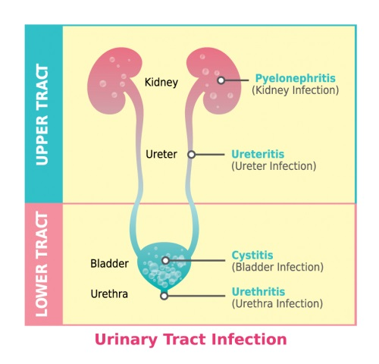

Slide 6
DEFINITION
Pyelonephritis is a bacterial infection of renal pelvis tubules and interstitial tissue of one or both kidneys. Bacteria reach the bladder through urethra and reach the kidney. Urinary tract obstructions, tumors, urinary stones also causes acute pyelonephritis.

Slide 7
ETIOLOGY
Bacterial infections
E. Coli
Klebsiella
Enterobacter
It is most frequently associated with cystitis, obstruction, trauma of the urinary tract.
Other risk factors include septicemia, chronic health problem including diabetes, analgesic abuse

Slide 8
CLINICAL MANIFESTATION
Sudden onset of chills, fever
Vomiting, malaise, flank pain
Dysuria and frequent urination
Bacteriuria and pyuria is common.

Slide 9


CONTI…
Sudden onset of chills
Fever

Slide 10


CONTI…
Vomiting
Malaise
General Discomfort

Slide 11
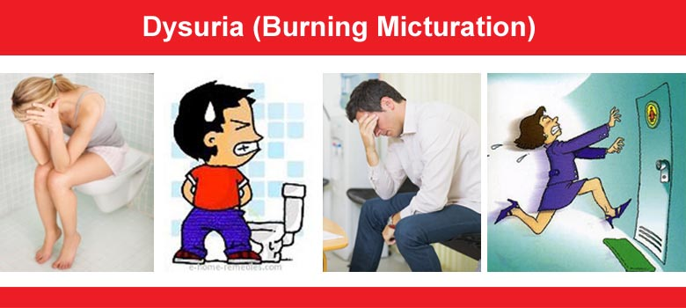

CONTI…
Dysuria
Frequent urination

Slide 12
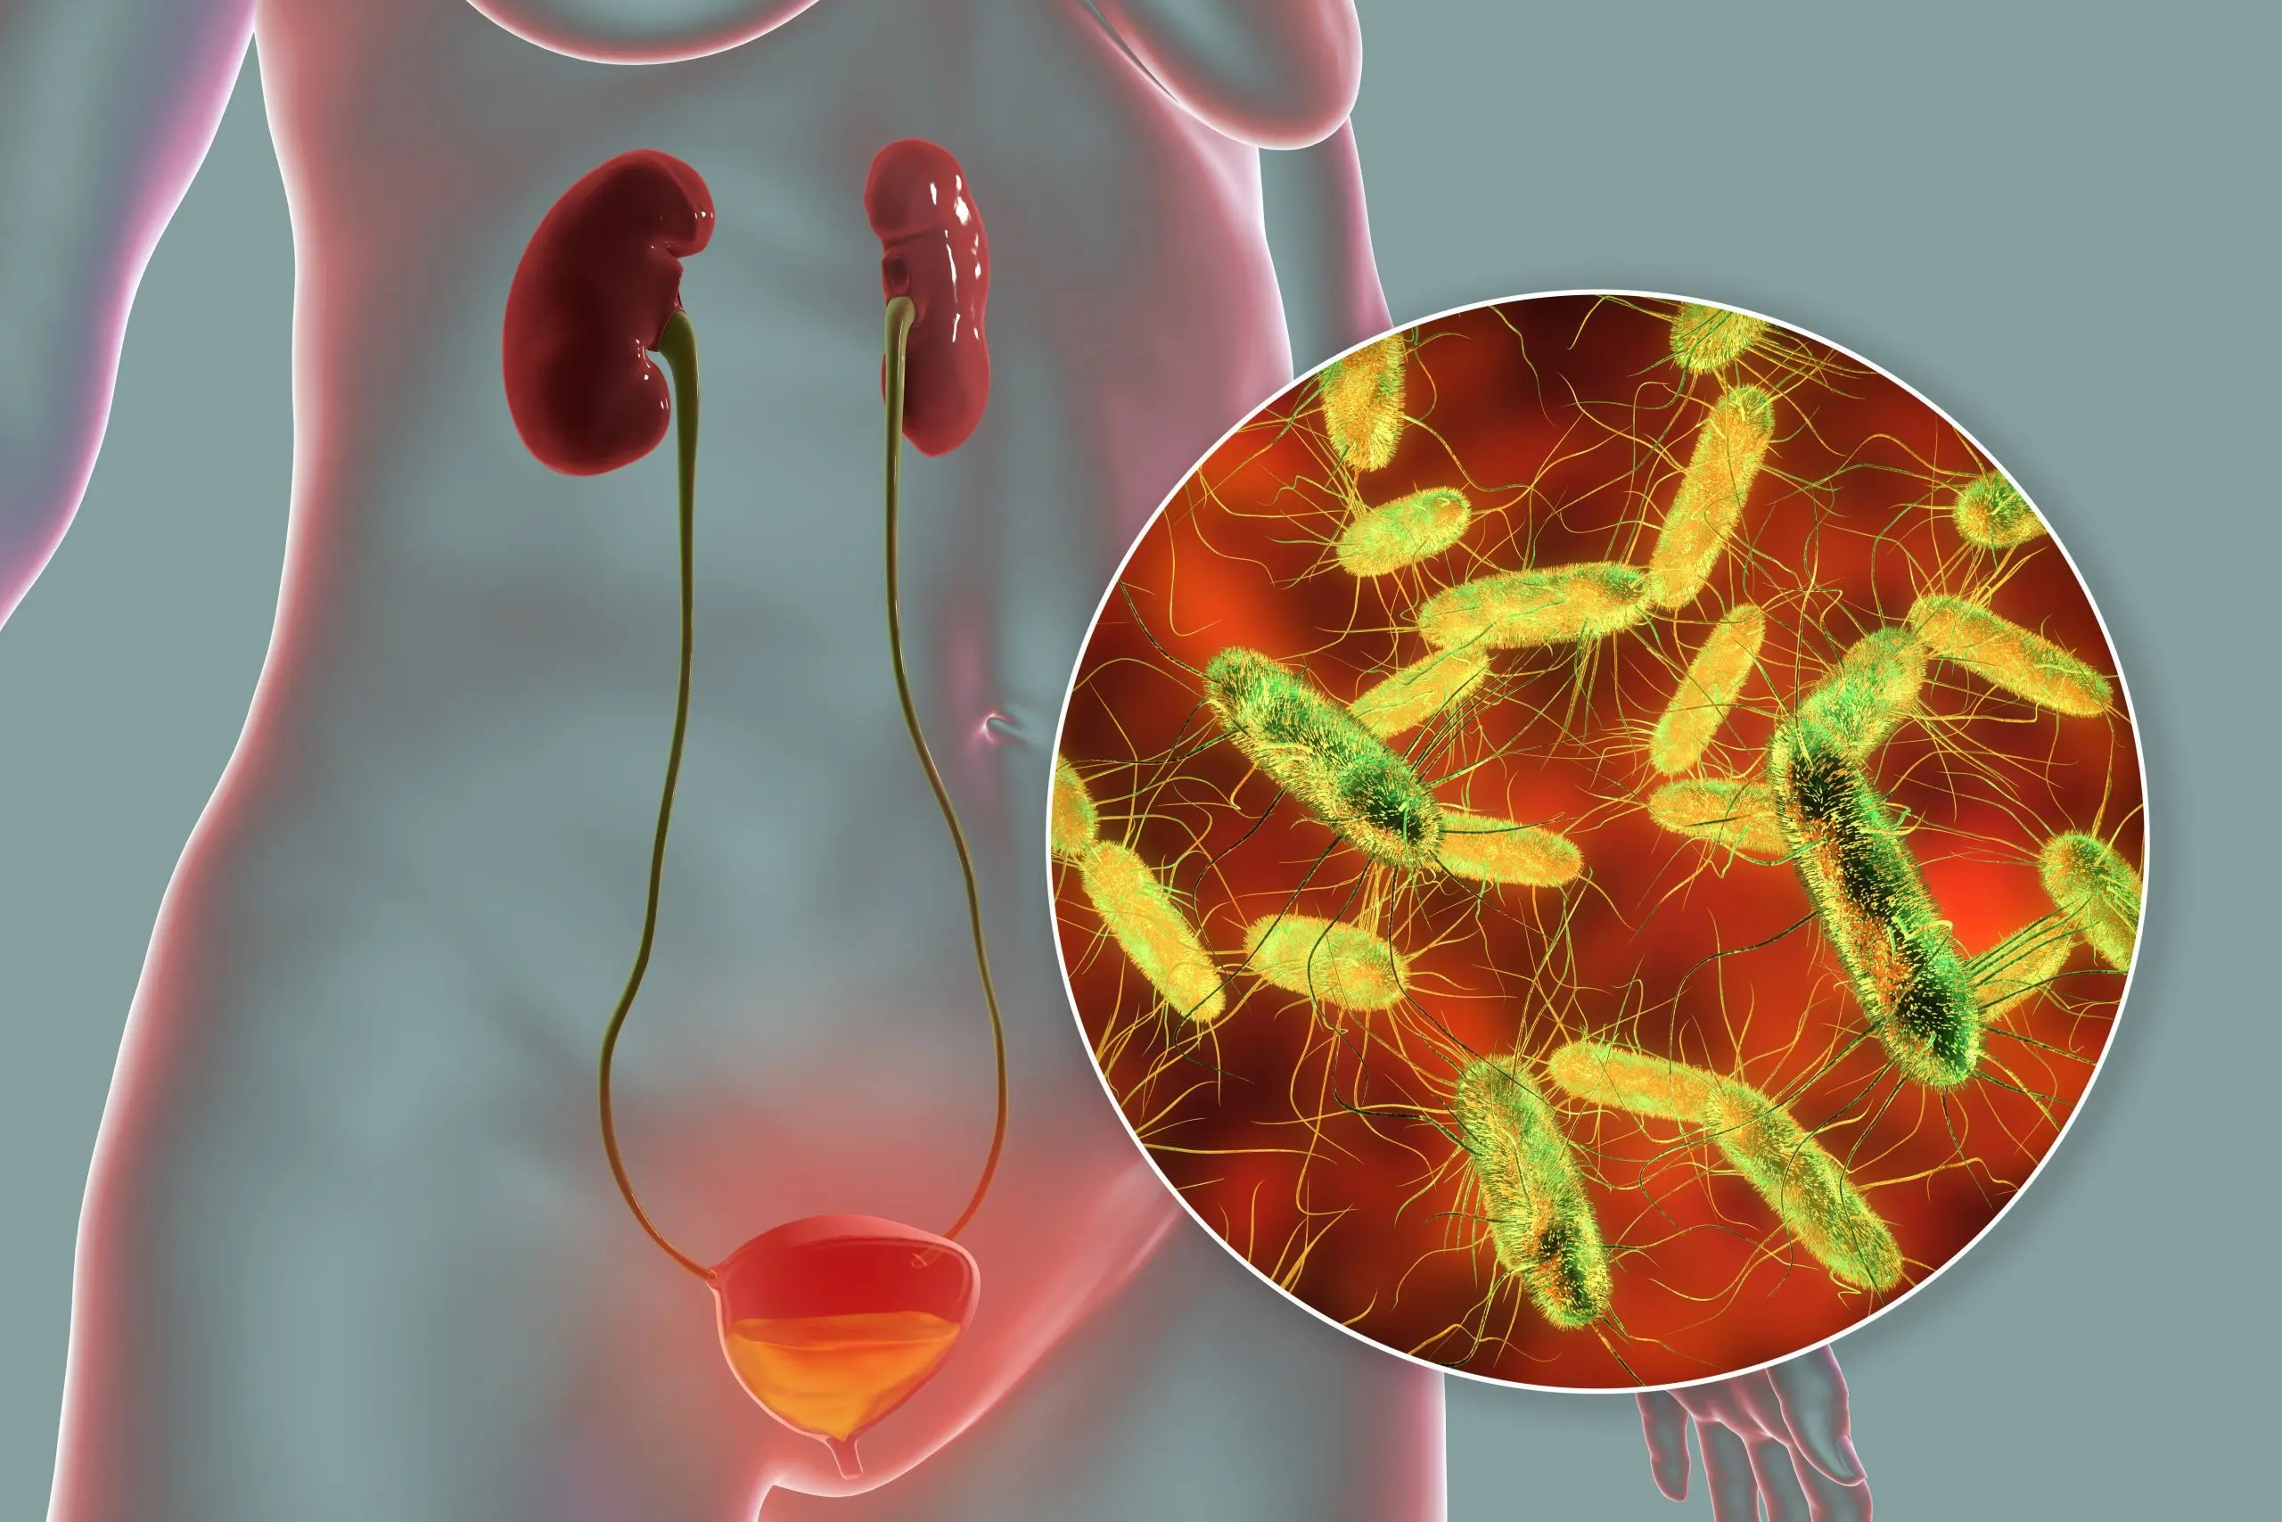
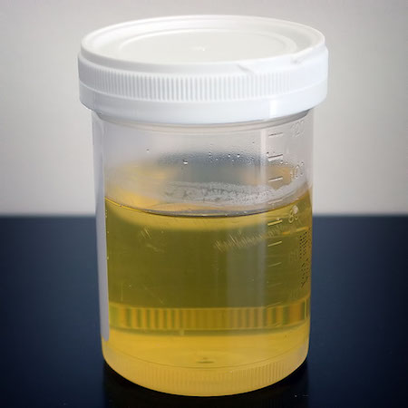
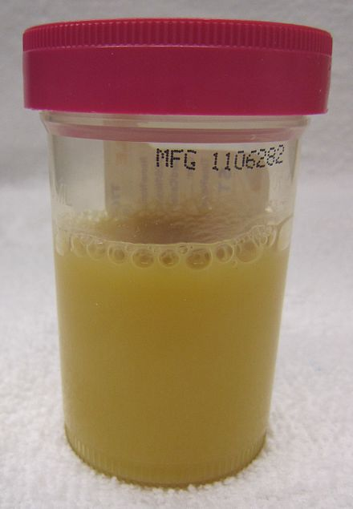
CONTI…
Bacteriuria
Pyuria
Presence of pus in urine
Normal Pyuria

Slide 13
DIAGNOSTIC EVALUATION
History Collection: You will be asked questions about your symptoms, when they began, and about your general health history.
Physical exam: You will receive a general medical exam to collect blood and urine samples. The doctor will likely press your abdomen to check for pain or tenderness.
Urinalysis: A sample of your urine will be tested to look for signs of infection. High counts of white blood cells and bacteria mean that there is an infection.

Slide 14
CONTI…
Urine culture: In a urine culture, bacteria in urine may grow on a culture dish within a few days. This information will help the doctor determine the best antibiotic to use.
Kidney ultrasound: Ultrasound can create images of the kidneys and ureters to show if there are wounds, stones, or other things that block the urinary tract. This information can help guide treatment decisions.
CT Scan

Slide 15
MANAGEMENT
Best treatment of pyelonephritis includes early detection of the bacterial infection through urine culture and antibacterial therapy.
Administer oral antibiotics for 14-21 days, e.g. Norfloxacin, Ofloxacin, ciprofloxacin.
Urine is re-cultured 2 weeks after drug therapy.
Patient is encouraged to take 3-4 litres of fluid per day.
During the acute phase, patient is encouraged to do rest.
Back massage gives short term relief.

Slide 16

NURSING MANAGEMENT
The need for follow-up culture to ensure proper management and identification of recurrence of infection.
Continuous antibiotic therapy
Weight self daily.
Monitor urinary output: report to the doctor if output is considerable less than fluid intake.
Take measures to prevent infection, report sign of urinary infection, e.g. pain, fever, chills, frequency, urgency to doctor.

Slide 17
SUMMARY

Slide 18
REFERENCES

Slide 19


