Slide 1

PORTAL HYPERTESION
MR. DINESH SINGH
P.G. NURSING TUTOR
ROHILKHAND COLLEGE OF NURSING

Slide 2
OBJECTIVES
Introduction of the Peritonitis.
Define the Peritonitis.
Explain the causes of Peritonitis.
State the clinical manifestations of Peritonitis.
Elaborate the diagnostic evaluation of Peritonitis.
Discuss the management of Peritonitis.
Describe the prevention of Peritonitis.

Slide 3
INTRODUCTION
It is increased blood pressure with in portal venous system. Obstructed blood flow through the damaged liver results in increased blood pressure (portal hyper-tension) throughout the portal venous system. Although, portal hypertension is commonly associated with hepatic cirrhosis, it can also occur with non-cirrhotic liver disease. The major consequences of portal hypertension are ascites and varices. In ascites, fluid accumulates in the abdominal cavity. Varices are varicosities that develop from elevated pressures transmitted to all veins that drain into the portal system.

Slide 4
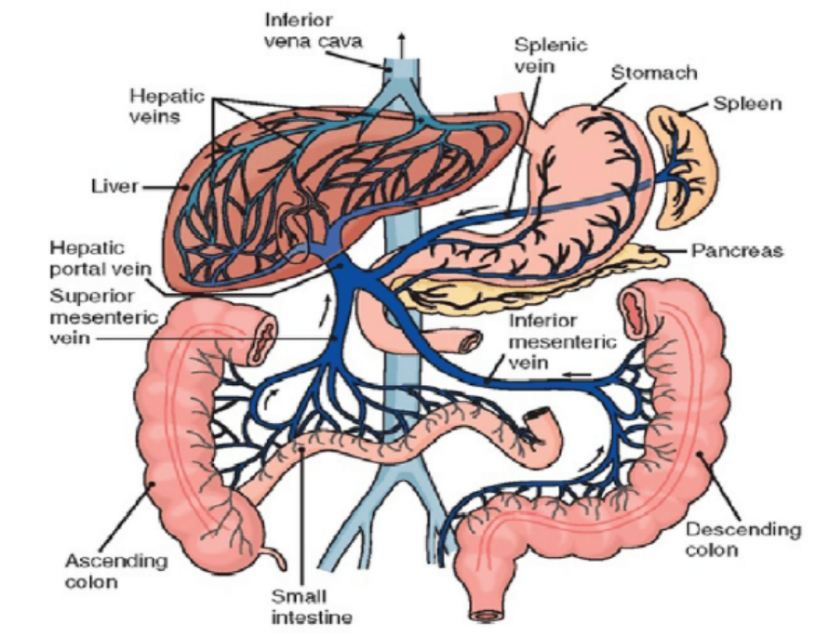
DEFINITION
It is defined as the elevation of the hepatic venous pressure gradient to >10mm/Hg.
Portal venous pressure is the blood pressure in the hepatic portal vein, and is normally between 5-10 mmHg.

Slide 5
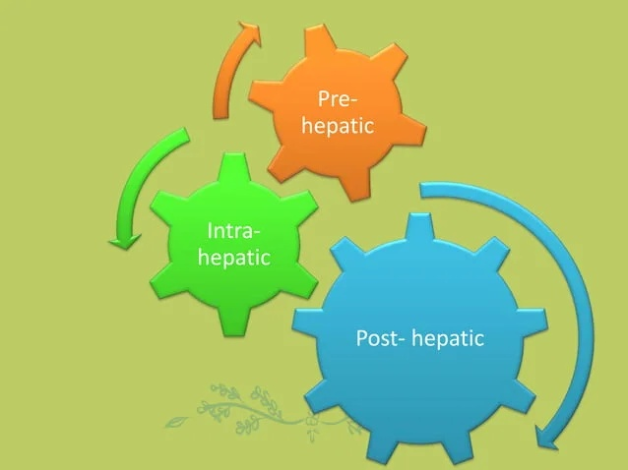
CAUSES
Depending on the site of vascular obstruction:

Slide 6
Pre hepatic
Portal vein Thrombosis
Pancreatitis
Trauma
Hypercoagulable states

Slide 7
Intra- hepatic
Cirrhosis
Fatty liver
Metastatic malignant disease

Slide 8
Post-hepatic
Hepatic vein thrombosis (Budd-chiarisyndrome)
Constrictive pericarditis
Right sided heart failure

Slide 9
CLINICAL MANIFESTATION
Increase abdominal girth and abdominal pain.
Rapid weight gain are common presenting symptoms of ascites
Shortness of breath
Discomfort from the enlargement abdomen
Distended veins may be visible over the abdominal wall
Fluid and electrolyte imbalances are common
Hepatic encephalopathy
Umbilical hernia

Slide 10
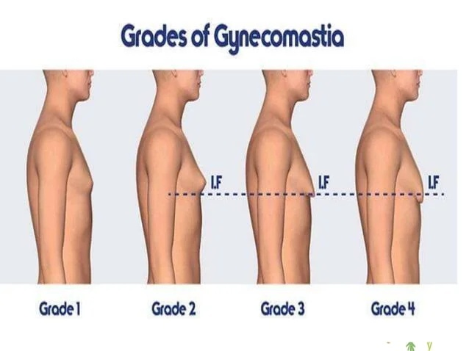
Cont…
Fatigue and weakness
Hematemesis
Gastrointestinal bleeding
Black, tarry stool (melena)
Ascites
Jaundice
Weight loss
Gynecomastia

Slide 11
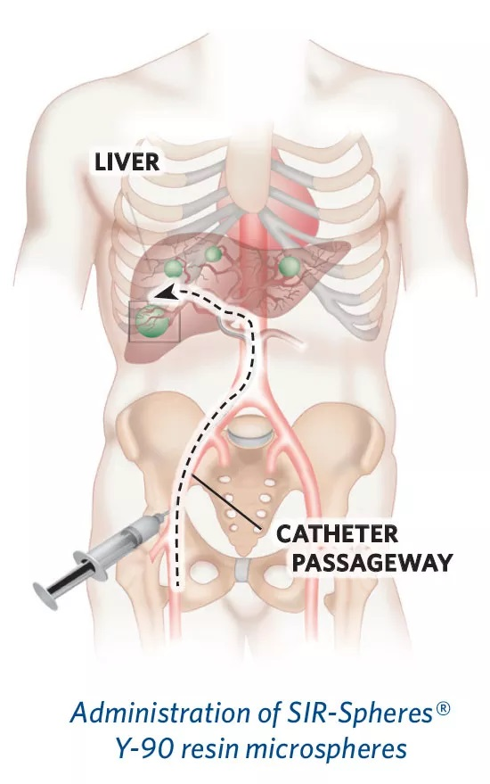
DIAGNOSTIC EVALUATION
Blood count
Liver Function Tests
Oesophago-gastro-duodnoscopy
Ultrasound
MRI
Liver Angiography
Splenic Portogram

Slide 12
MANAGEMENT
Medical management
Beta blockers
Anti-emetics
Vitamin K also given for GI bleeding
Lactulose: to treat mental confusion.
Diuretics

Slide 13
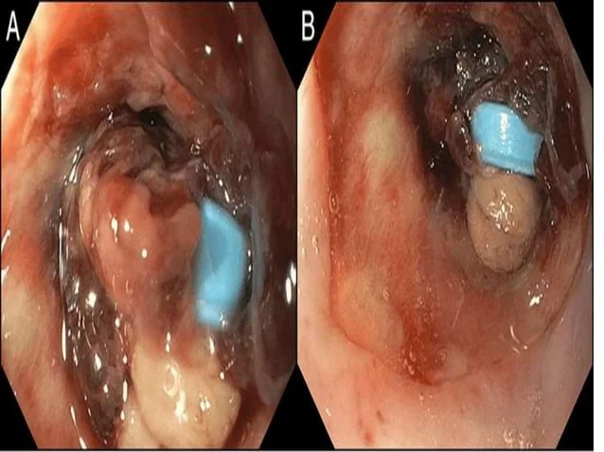
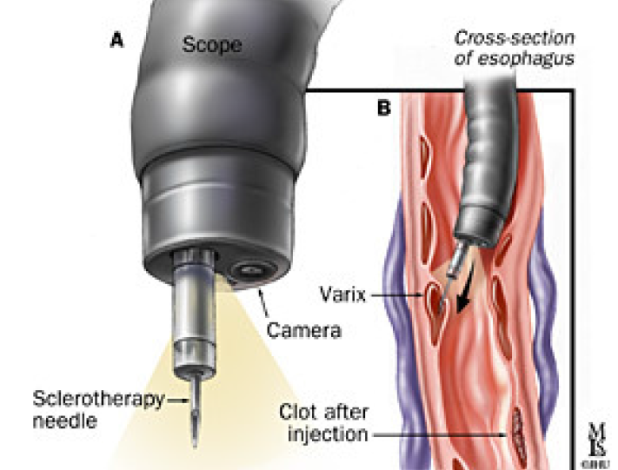
Conti…
Endoscopic therapy
Banding
Sclerotherapy: Involves injecting a chemical solution directly into the varicose or spider vein.

Slide 14
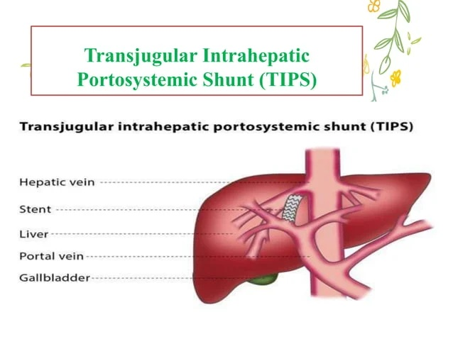

Slide 15
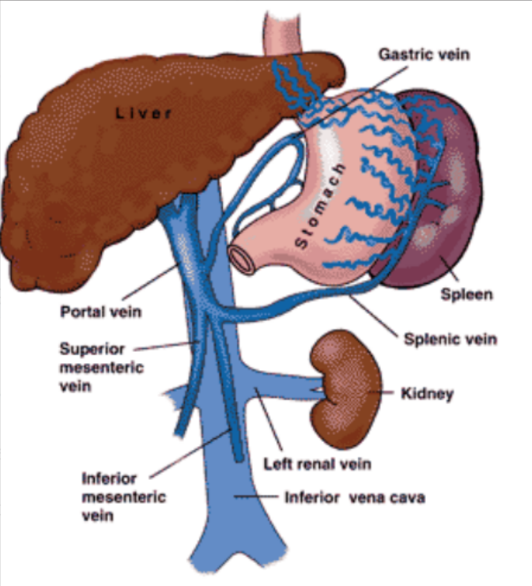
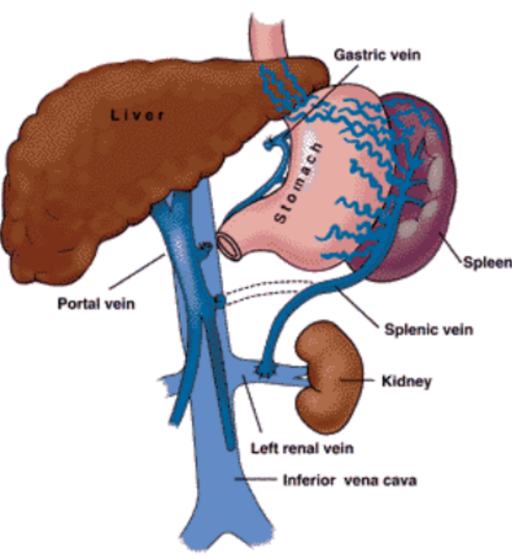
Distal Splenorenal Shunt

Slide 16
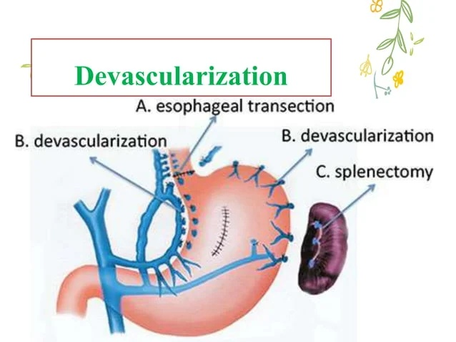

Slide 17
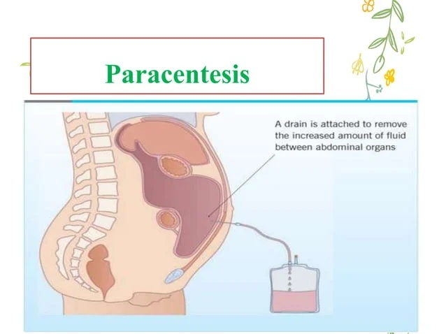

Slide 18
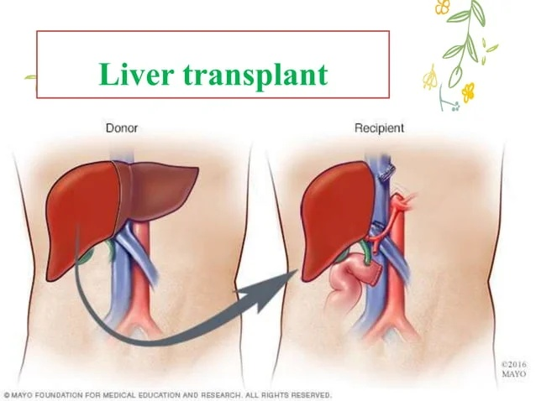

Slide 19
SUMMARY

Slide 20
REFERENCES

Slide 21


