Slide 1

GINGIVITIS
MR. DINESH SINGH
P.G. NURSING TUTOR
ROHILKHAND COLLEGE OF NURSING

Slide 2
OBJECTIVES
Introduction of the
Define the
Explain the causes of
State the clinical manifestations of
Elaborate the diagnostic evaluation of
Discuss the management of
Describe the prevention of

Slide 3
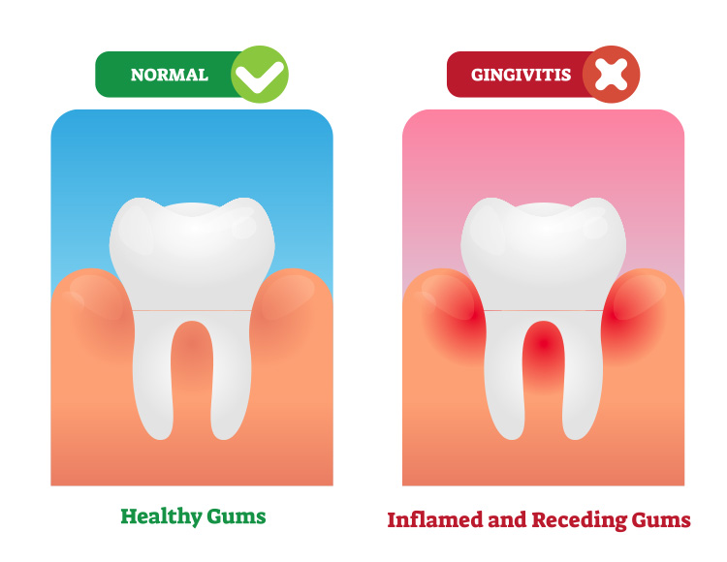
INTRODUCTION

Slide 4
DEFINITION
Gingivitis is an inflammation of the gums (gingiva). Gingivitis is a non-destructive periodontal disease and bacterial biofilms (also called plaque) adherent to tooth surfaces termed as plaque-induced gingivitis.

Slide 5
ETIOLOGY
Bacterial: formation of oral biofilm
Genetic: family history
Breathing through the mouth
Local trauma
Dry mouth because of loss of protective effect of saliva
Vitamin deficiency, especially of vitamin C.

Slide 6
RISK FACTORS
Low dental care
Poor oral hygiene
Smoking
Psychosocial stress and genetic factors

Slide 7
CLASSIFICATION
Dental Plague-induced gingival disease
Gingivitis associated with plaque only.
Gingivitis diseases modified by systemic factors.
Gingivitis diseases modified by medications.
Gingivitis diseases modified by malnutrition.

Slide 8
Conti….
Non –Plague induced gingival lesions
Gingival disease of viral origin
Gingival disease of fungal origin
Gingival disease of genetic origin
Traumatic lesions
Foreign body reactions

Slide 9
CLINICAL MANIFESTATION
Bright red or purple gums
Shiny gums
Gums that are painless, except when pressure is applied
Gums that easily bleed, even with gentle brushing
Receding gum line
Bed breath (halitosis)
Inflammation (swollen gums)

Slide 10
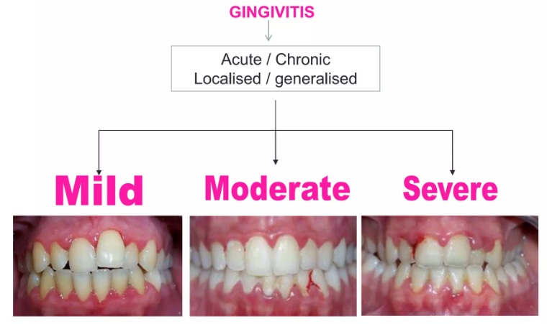
DIAGNOSTIC EVALUATION
History collection
Physical examination: bleeding gum, look for red, swollen sensitive around the gum line may indicate areas of receding gums.
X-ray

Slide 11
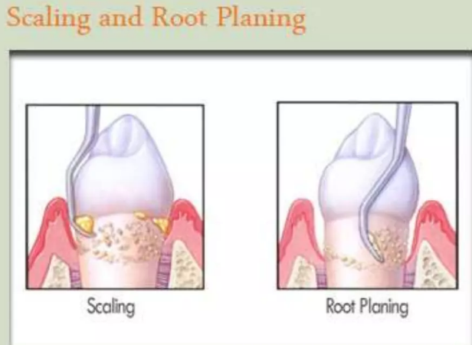
MANAGEMENT
More frequent cleanings.
Scaling, root planning and curettage of the periodontal pocket (Basic Periodontal Treatment)
Scaling is removing the calculus deposit from the teeth.
Root planning is the smoothing of the root surfaces so that the gum tissue can reattach to the tooth.
Curettage is the removal of the soft tissue lining the periodontal pocket this helps the gum tissue to heal.

Slide 12
Conti….
Flap surgery (Advanced Periodontal Treatment) allows us to gain access to the root of the tooth for removal of calculus, plaque and diseased tissue.
Antibacterial mouth rinses or other aids may be also be recommended.

Slide 13
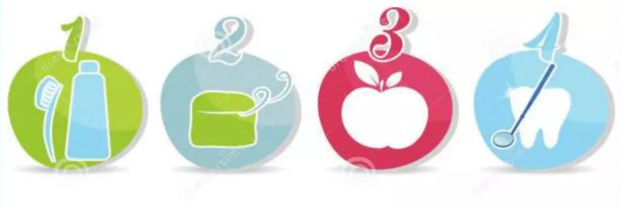
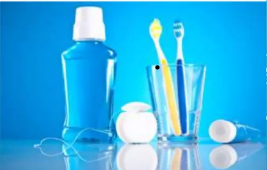
PREVENTION
Brush your teeth at least twice a day
Floss your teeth at least once a day
Regularly rinse your mouth with an antiseptic mouthwash.
Avoid smoking.
Avoid refined sugars between meals
Drink plenty of water: water increases production of saliva, which has a protective effect on teeth and gums.

Slide 14
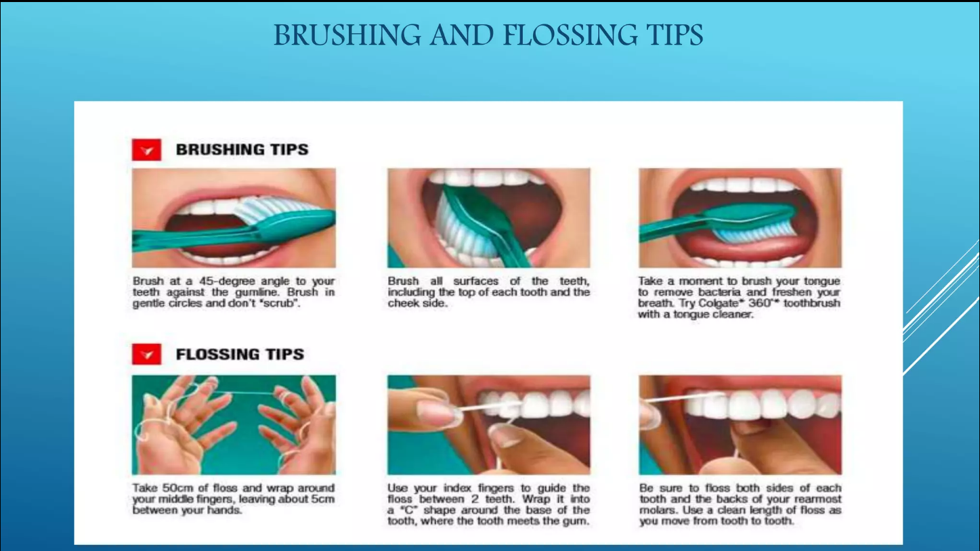

Slide 15
REFERENCES

Slide 16
