Slide 1


Slide 2

URINARY RETENTION
MR. DINESH SINGH
P.G. NURSING TUTOR
ROHILKHAND COLLEGE OF NURSING

Slide 3
OBJECTIVES
Introduction of the urinary retention.
Define the urinary retention.
Explain the causes of urinary retention.
State the clinical manifestations of urinary retention.
Elaborate the diagnostic evaluation of urinary retention.
Discuss the management of urinary retention.
Describe the prevention of urinary retention.

Slide 4
INTRODUCTION
Urinary retention is a condition in which patient cannot empty all the urine from the bladder. Urinary retention can be acute a sudden inability to urinate, or chronic a gradual inability to completely empty the bladder of urine.

Slide 5
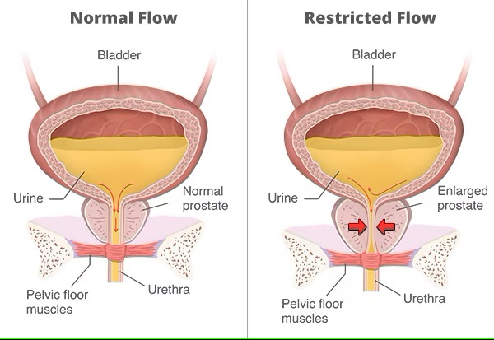

Slide 6
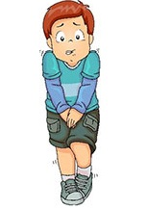
DEFINITION
Urinary retention is a sudden and painful inability to void the bladder.
It’s urological emergency.
Commonly affected man.
Men : Female ratio – 13:1

Slide 7
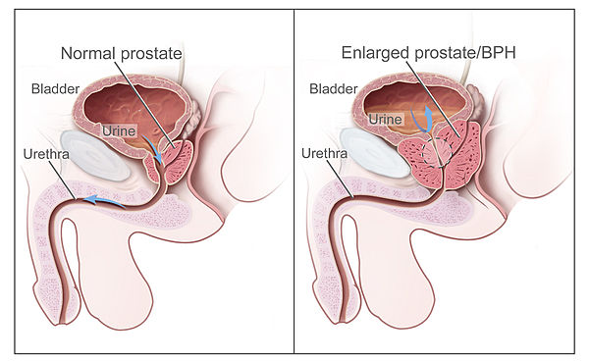
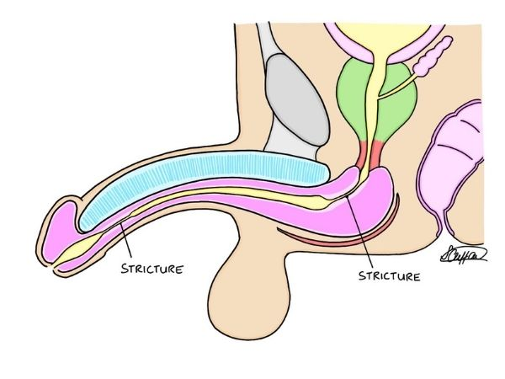
ETIOLOGY/CAUSES
Benign prostatic hyperplasia
Urethral strictures

Slide 8
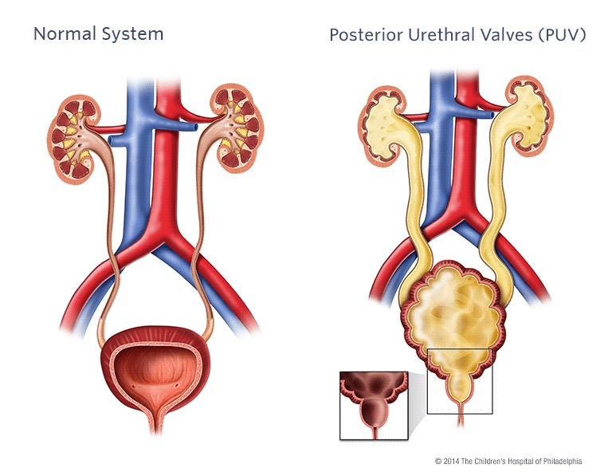
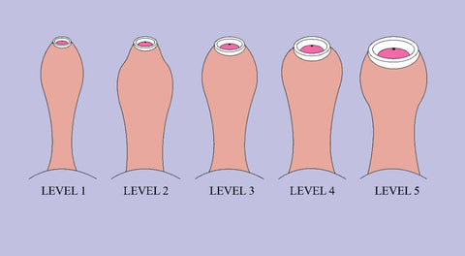
CONTI…
Urethral valves disease
Phimosis
Narrowing of opening of the foreskin of glans penis

Slide 9
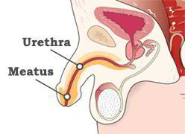
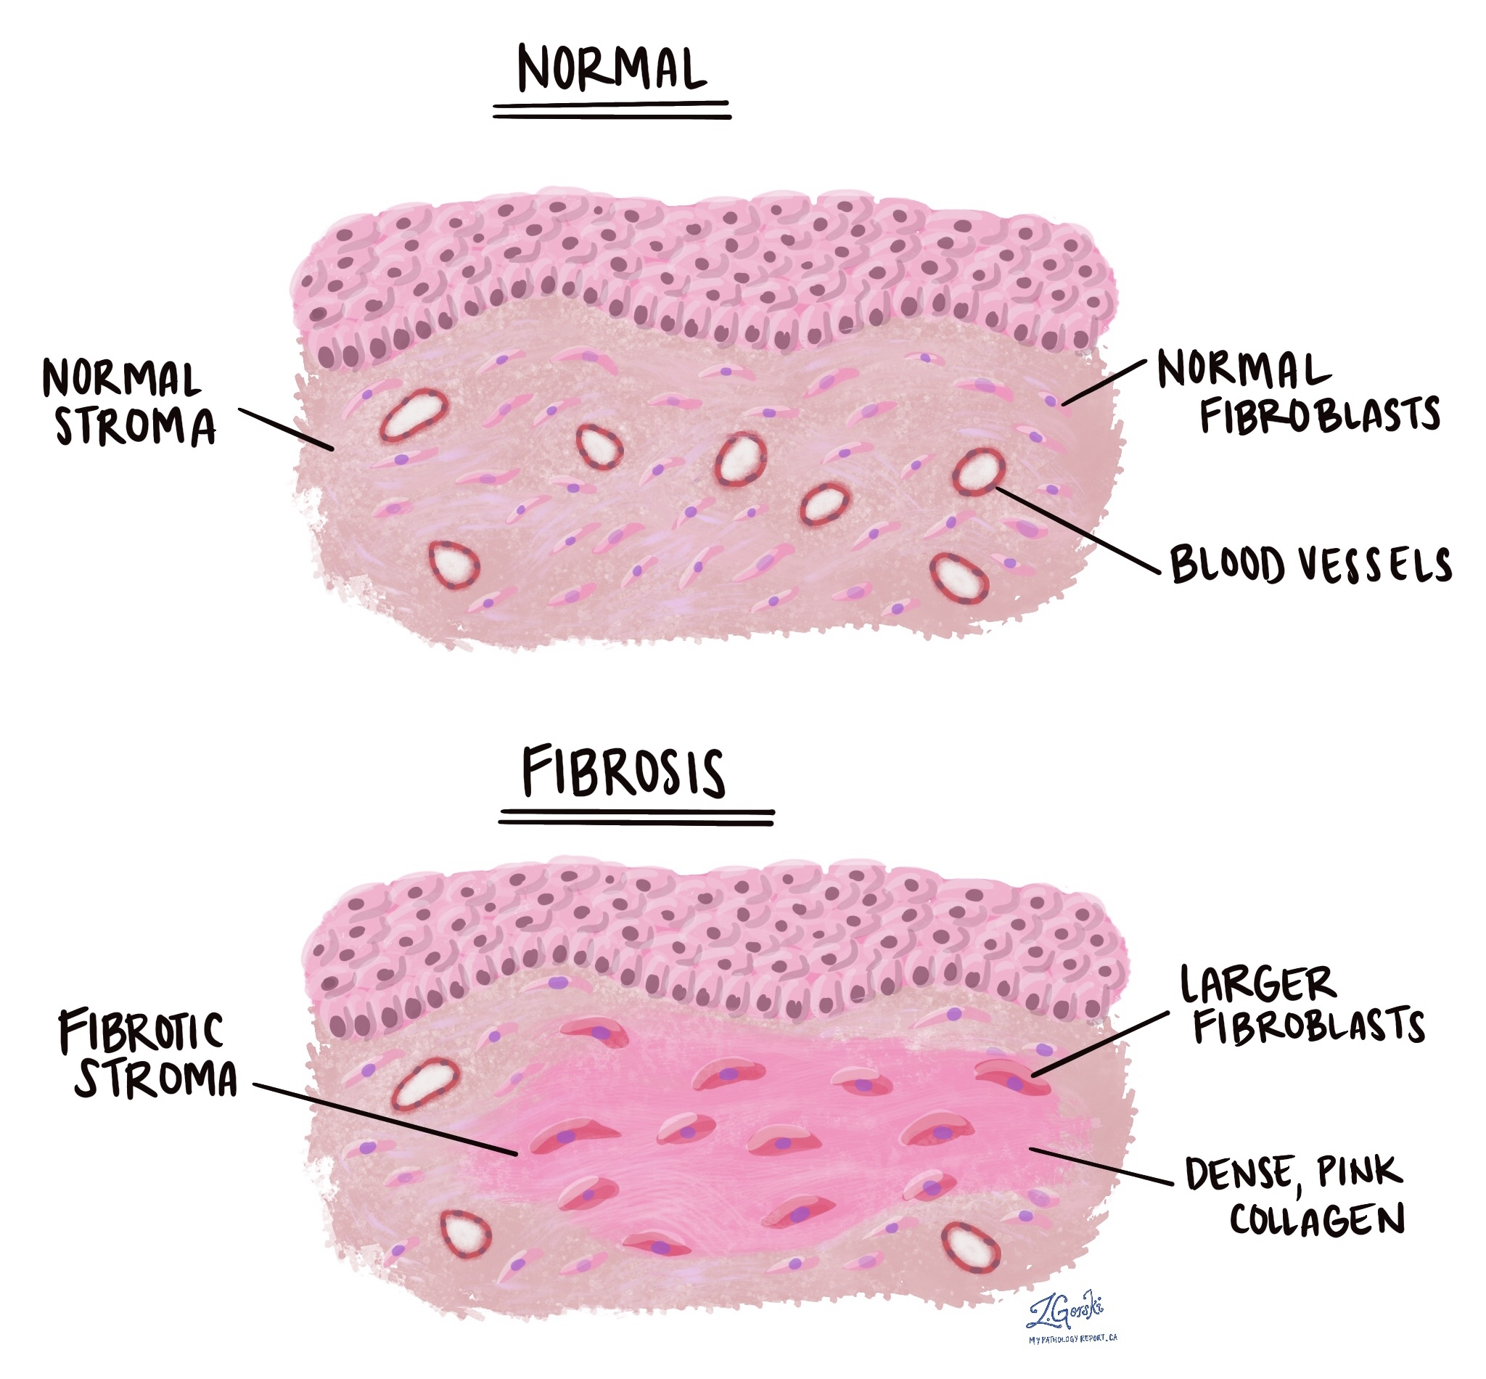
CONTI…
Meatal Stenosis
Fibrosis
Abnormal narrowing of the urethral opening (meatus)
Thickening or scarring of the tissue

Slide 10
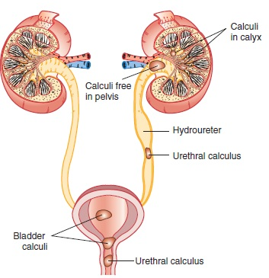
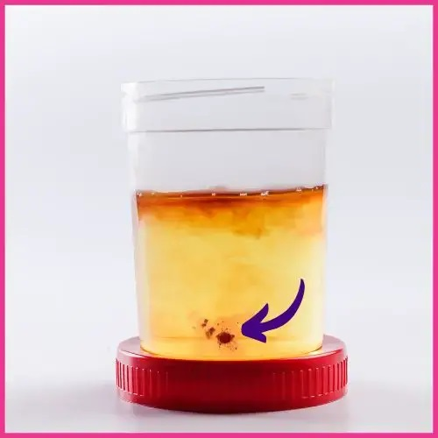
CONTI…
Calculi
Blood Clots

Slide 11
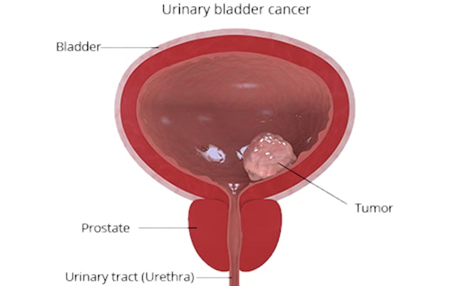
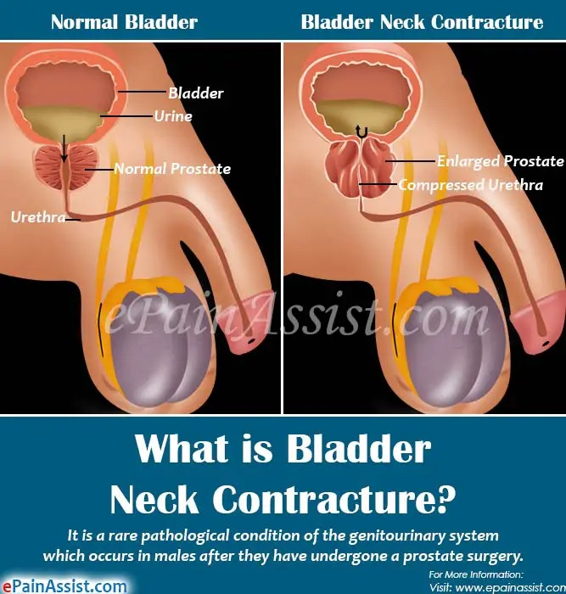
CONTI…
Tumors
Bladder neck contractures

Slide 12
CLINICAL MANIFESTATION
Distended bladder
Inability to void
Oliguria
Anuria (absence of urine)

Slide 13
DIAGNOSTIC EVALUATION
History Collection
Course of development including onset and progression
Have you any fever?
Any previous episodes? Any history of BPH?
Past medical history, neurological disease, other medical conditions.
Take the drug history.
Ask about alcohol, constipation, long travel, low fluid intake, high fluid intakes.

Slide 14
CONTI….
Physical Examination
Abdominal- A tender enlarged bladder with dullness to percussion well above the symphysis pubis, often almost to level of the umbilicus.
Look for phimosis, meatal stenosis and look for signs of infections in genitalia.
In females- look for cystoceles, rectoceles, Uterovaginal prolapse, do a Vaginal examination and look for pelvic mases. Look for vaginal infections and inflammations.
In Males- Do a Digital Rectal Examination/Per Rectum examination in males. Looks for enlarged prostate.

Slide 15
CONTI….
Blood Tests
Complete blood count
Creatinine, estimated glomerular filtration rate
Blood glucose
Prostate- specific antigen

Slide 16
CONTI….
Imaging studies
Ultrasound: commonly used, as it can provide a measure of post-void residual urine as well as looking for hydronephrosis and other structural abnormalities of the renal system.
CT Scan- exclude intra abdominal masses.
MRI Scan of the spine:- used to look for disc prolapse, spinal tumors, spinal cord.
Cystoscopy: is a procedure that uses a cystoscope to look inside the urethra and bladder.

Slide 17
CONTI…
Retrograde Cystourethrography: Retrograde cystourethrography is an imaging test that uses X-rays to see the urethra. X-rays are made of the urethra after it has been filled with a contrast dye. The dye lets the radiologist see patient urethra and nearby tissues more clearly.

Slide 18
MANAGEMENT
Cholinergic drugs (carbachol, bethanechol) helps stimulate bladder contraction, but these drugs must never be used if a mechanical obstruction is present.
Alpha adrenergic blockers, e.g., Phenoxy benzamines (which dilate the blood vessel and increases blood pressure).

Slide 19
SURGICAL MANAGEMENT
Transurethral incision of bladder
Meatotomy:- (The meatus is the opening that allows urine to leave the penis. If this opening is not big enough, the child will have difficulty urinating or it may cause him pain.)
Suprapubic catheterization.

Slide 20
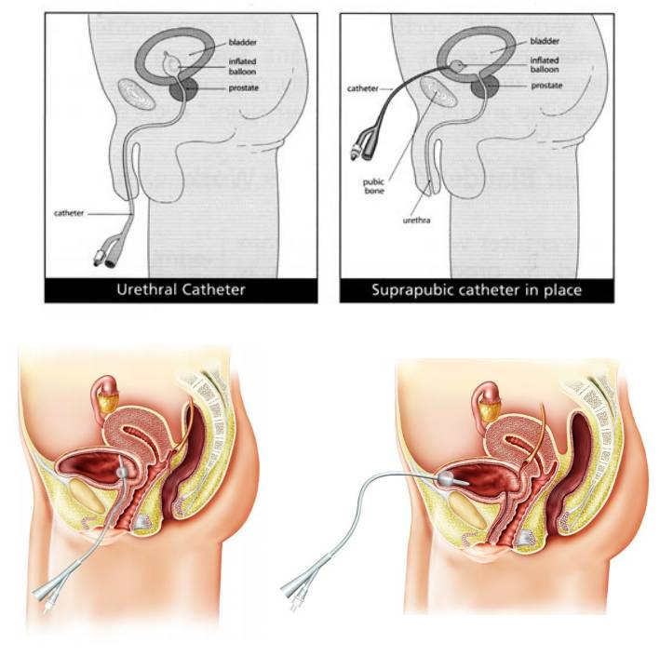
SUPRAPUBIC CATHETERIZATION

Slide 21
SUMMARY

Slide 22
REFERENCES

Slide 23


