Slide 1
Physiology of lactation and its management
Mrs. Preeti Bahuguna
Assistant Professor
Rohilkhand college of nursing

Slide 2
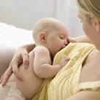
INTRODUCTION
Breastfeeding depends on the interplay of hormones, reflexes and learned behavior of the mother and newborn. Successful lactation is the end result of numerous interacting factors including the maturity and anatomy of the newborn , the health and nutrition of the mother, and the development of the mammary glands.

Slide 3
COLOSTRUM
It is deep yellow serous fluid , alkaline in reaction. It has got a higher specific gravity; a high protein , vitamin A sodium and chloride content but has got lower carbohydrate fat and potassium than breast milk. It contain antibody (IgA) produced locally.

Slide 4
COMPOSITION
 | Protein | Fat | CHO | Water
Colostrum | 8.6 | 2.3 | 3.2 | 86
Breast milk | 1.2 | 3.2 | 7.5 | 87

Slide 5
PHYSIOLOGY OF LACTATION
Lactation starts following delivery under the control of numerous endocrine glands particularly the pituitary hormones prolactin and oxytocin. It is influenced by the suckling process and by maternal emotion.

Slide 6
STAGES OF LACTATION
Mammogenesis
Lactogenesis
Galactokinesis
Galactopoiesis

Slide 7
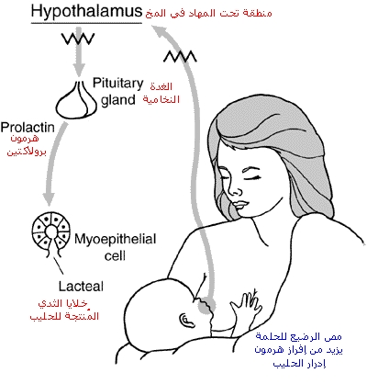
MATERNAL BREAST FEEDING REFLEXES
PROLACTIN REFLEX:

Slide 8
NIPPLE ERECTION REFLEX
Stimulation of the breast nipple by the infant’s mouth leads to nipple erection. The stimulation makes the nipples more prominent . This assists in the propulsion of milk through the lactiferous sinuses to the nipple pores.

Slide 9
MILK PRODUCTION
In the first postpartum week, the total amount of milk yield in 24 hours is calculated to be 60 multiplied by the number of postpartum days and is expressed in terms of milliliters.
Thus the milk yield on the 4th day is about 60*4=240ml . A milk yield of 120-180 ml per feeding is usual by the end of second week.

Slide 10

STIMULATION OF LACTATION

Slide 11
DURING DELIVERY
To improve the maternal instinct to nurse the baby mentioning the advantages of breastfeeding.
Care and preparation of the nipples including teaching the patient as to how to express out the colostrums and to take care of the crust formed on the nipples.

Slide 12
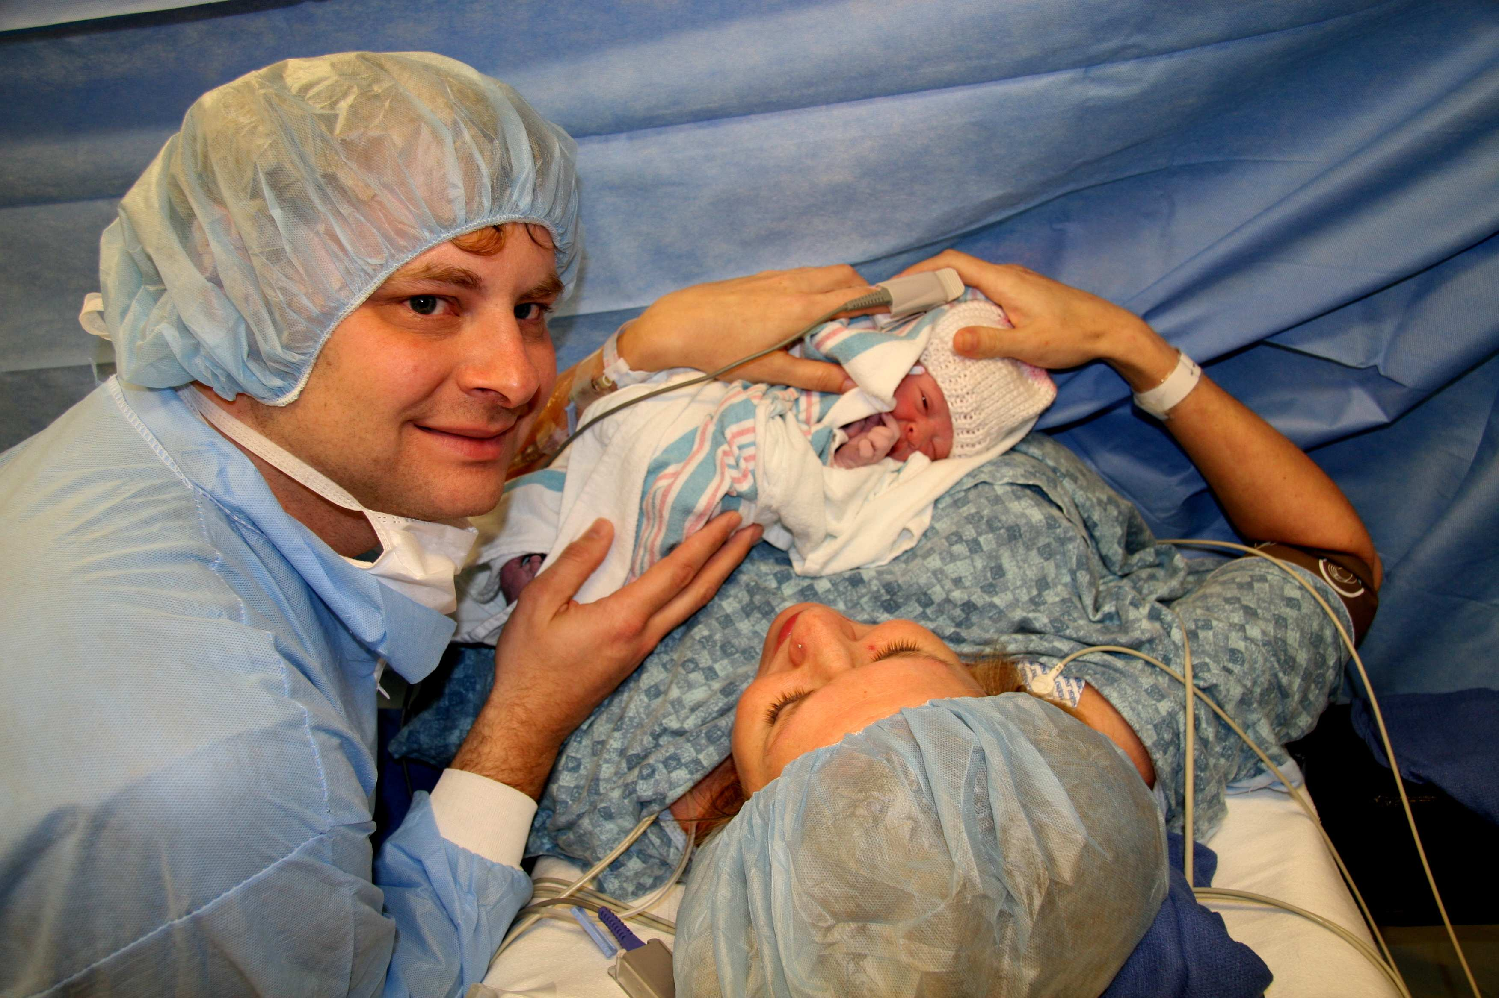
FOLLOWING DELIVERY

Slide 13
Cont……
To put the baby to the breast immediately intervals for 3 minutes from the first day, If the condition permits /demand feeding.
Plenty of fluids to drink.
To avoid engorgement and trapping of milk, manual expression prior to the nursing is done.

Slide 14

LACTATION FAILURE
It may be due to infrequent suckling or due to the endogeneous suppression of prolactin .
Pain anxiety and insecurity May be the hidden reasons. Unrestricted feeding at short intervals (2-3 hours ) is helpful.

Slide 15

DRUGS TO IMPROVE MILK PRODUCTION
Metaclopramide (10mg thrice daily ) increases milk volume by increasing prolactin levels.
Sulpuride has also been found effective .
Intranasal oxytocin contracts myoepithelial cells and causes milk let down.

Slide 16

LACTATION SUPRESSION
This becomes necessary if the baby is born dead or dies in the neonatal period or when patient does not like to breastfeed her baby or if breastfeeding is contraindicated. This can be effective , either by using hormones or by mechanical means.

Slide 17
COMMON USED METHOD
To stop breastfeeding
To avoid pumping or milk expression
To wear breast support
Ice packs to prevent engorgement
Analgesics to relieve pain
A tight compression bandage is applied for 2-3 days.

Slide 18
DRUGS USED IN LACTATION SUPPRESSION
Combination of testosterone and oestrogen preparation(mixogen)-2 ampoules intramuscularly .
The risk of using oestrogenic preparation in puerperium includes thromboembolic manifestation or late postpartum blood loss.

Slide 19
CULTURE ASPECT OF LACTATION
To promote lactation and provide proper assistance to a new mother , nurses should consider cultural beliefs :
In the Philippines if the mother’s milk does not flow regularly , a meal of chicken and green papaya boiled in coconut milk is suggested.
A phillippines mother may be adviced to eat a soup of boiled clams and ginger. Some phillippines mother use hot application of special medicinal preparartion to stimulate lactation.

Slide 20
CONT……
Korean mothers eat sea weeds soup with rice to increase milk production.
Curner 1978 reported that Hispanic Americans believe that exposing mothers to cold diminishes the flow of milk.
Filipinas ,Mexicans Americans and some Nigerians typically don’t give colostrums to their infants . These mothers begin breastfeeding after their milk has come in.
Some Korean women don’t begin breastfeeding until 3 days after the birth , whereas others begins breast feeding immediately and offer the breast every time the infant cries.

Slide 21
MINOR DISCOMFORTS OF PUERPERIUM
There are certain ailments which occurs during the puerperium:-
After pains
Pains in the perineum
Constipation
Fatigue
Post partum diuresis
Disturbed daily living activity

Slide 22
AFTER PAINS
It is a spasmodic, colicky pain in the lower abdomen during the early postpartum days due to vigorous contraction of the uterus . It is more common & more severe in multiparous due to weak muscle tone.

Slide 23
CHARACTERISTICS
After pain occurs during the first 2-3 days of Puerperium
Abdominal pains (like cramps ) and back pain.
Strong regular & Co-ordinate.
The intensity frequency and regularity of contraction decrease after the 1st postpartum day.
More severe when breast-feeding in both primipara & multipara.

Slide 24
Predisposing Factors
Presence of blood clot , piece of membranes or placental tissue.
Breast-Feeding increases after pains.

Slide 25
CAUSES
Uterine contraction
Lactation
Lochia discharge
infection

Slide 26
MANAGEMENT
Use relaxation & breathing technique used during labour.
Start walking after soon after delivery.
Keep your bladder empty.
Frequent breastfeeding ,starting immediately after birth,can also alleviate after pains.

Slide 27
Massage the uterus & with expulsion of clot administer analgesic (ibuprofen) And antispasmodic.
Encourage mother for warm and liquid diet.
Encourage mother for vulval hygiene.

Slide 28
PAIN IN PERINEUM
It is normal in the area between the vagina and anus (perineum) to feel sore and uncomfortable for a while after the birth.
This area will have stretched a lot as baby’s head entered.
Some degree of pain is felt in the stitches ,abnormal pain should be investigated to diagnose vulvus –vaginal hematoma or infection is developing.

Slide 29
MANAGEMENT
Lie down ,so that pressure is taken off to the bottom.
Put a cold gel pad or frozen pack of peas ,wrapped in a clean flannel on your perineum.
Have a warm bath.
Keep doing the pelvic floor exercise.
Keep the wound clean and have a shower or bath daily.

Slide 30
Cont….
Contact to the doctor if fever is there.
Take analgesics prescribed by the doctor.

Slide 31
Care of perineal stitches
Clean & dress the perineal area daily & cover with sterile pad.
Advice the mother to use topical anesthetic spray or ointment .

Slide 32
CONSTIPATION
The problem is much less because of early ambulation and liberalization of diary intake .
At least 20% of the mothers constipated after giving birth, intake of prenatal medication may change bowel movement.

Slide 33
CAUSES
Internal causes:-
Numbness of area around the anus vagina and nerve inside .
Intake of prenatal Vitamin.
Anxiety
High level of progesterone.

Slide 34
External causes:-
The stitches and bruising of skin during delivery.
Painkillers like pethidine or diamorphine.

Slide 35
MANAGEMENT
Treatment through diet:-
Drink plenty of water.
Drink copious quantity of fruit juice.
Drink a cup of warm water after waking up.
High fibre diet.
Avoid refined food.

Slide 36
Treatment through life style changes:-
Don’t ignore any bowel movement for the fear of pain.
Increasing your activity by moving around a bit.
Instead of sitting down straight after a meal , walk around a bit.
Consult with your doctor.

Slide 37
Postpartum fatigue
It is the physical and emotional exhaustion expect in the weeks following delivery. Every women experience postpartum fatigue.

Slide 38
CAUSES
Rigors of labour and delivery.
Too little sleep.
Stress of caring newborn.
Excessive blood loss.

Slide 39
MANAGEMENT
Take rest, sleep when the baby sleeps.
Ask your partner to help in daily living activities as well as in care of baby.
If fatigue seems excessive check with your practitioner to make sure it does not have a hidden physiological cause.
Advice mother to eat healthy diet, drink plenty of water because dehydration leads to more fatigue , take naps.

Slide 40
POST-PARTUM DIURESIS
With in 12 hours of birth the women begins to loose excess fluid accumulated during pregnancy.
The profuse diaphoresis occurs especially at night for the first 2-3 days after child birth.

Slide 41
Causes
Decreased estrogen level
Removal of increased venous pressure in the lower extremities.
Loss of remaining pregnancy induced increase in blood volume.

Slide 42
MANAGEMENT
Keep the mother clean and dry.
Change the dress frequently.
Changes the bed sheet frequently.
Care must be taken to ensure that the mother is well hydrated.

Slide 43
Thank u

