Slide 1

GLOSSITIS
MR. DINESH SINGH
P.G. NURSING TUTOR
ROHILKHAND COLLEGE OF NURSING

Slide 2
OBJECTIVES
Introduction of the Glossitis.
Define the Glossitis.
Explain the causes of Glossitis s.
State the clinical manifestations of Glossitis.
Elaborate the diagnostic evaluation of Glossitis.
Discuss the management of Glossitis.
Describe the prevention of Glossitis.

Slide 3
INTRODUCTION
Glossitis is a condition that causes your tongue to become swollen and inflamed. People with glossitis often have tongues that look smooth or glossy.
Glossitis may appear suddenly (acute glossitis) or it may recur over time (chronic glossitis).

Slide 4
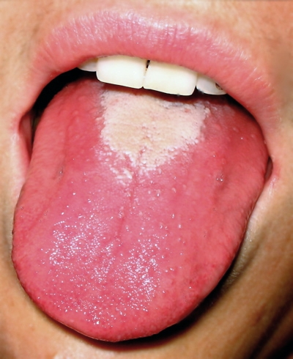
DEFINITION
Glossitis is an inflammation of the tongue. It causes the tongue to swell and change color. Finger-like projections on the surface of the tongue (papillae) may be lost, causing the tongue to appear smooth.

Slide 5
ETIOLOGY
Bacterial or viral infections (including oral herpes simplex).
Poor hydration and low saliva in the mouth may allow bacteria to grow more rapidly.
Mechanical irritation or injury from burns, rough edges of teeth or dental appliances or other trauma.
Exposure to irritants such as tobacco, alcohol, hot foods, or spices.
Allergic reaction to toothpaste, mouthwash, breath fresheners, plastic in dentures or certain blood-pressure medications (ACE inhibitors).

Slide 6
CLINICAL MANIFESTATION
Tongue swelling
Smooth appearance to the tongue due to pernicious anemia (vitamin B12 deficiency)
Tongue color changes (usually dark “beefy” red)
Sore and tender tongue
Difficulty with chewing, swallowing or speaking.

Slide 7
DIAGNOSTIC EVALUATION
History collection
Physical examination: find the significant signs and symptoms related to Glossitis.
Blood test: Complete blood count

Slide 8
MANAGEMENT
The goal of treatment is to reduce inflammation. Treatment usually does not require hospitalization unless tongue swelling is severe. Good oral hygiene is necessary, including thorough tooth brushing at least twice a day and flossing at least daily.
Corticosteroids such as Prednisone may be given to reduce the inflammation of glossitis. For mild cases, topical applications (such as a prednisone mouth rinse that is not swallowed) may be recommended to avoid the side effects of swallowed or injected Corticosteroids.

Slide 9
Conti…..
Antibiotics, antifungal medications or other anti-microbials may be prescribed if the cause of glossitis is an infection.

Slide 10
NURSING MANAGEMENT
Take balanced diet to prevent nutritional deficiencies.
Avoid to eat too hot and too cold food items.
Minimize irritant food like hot coffee, tea, spicy and salty food to prevent tongue discomfort.
Avoid cigarettes smoking and liquors consumption.
Avoid mouth allergens such as mouth wash, breath fresheners, certain antihypertensive drugs, e.g. ACE Inhibitors.

Slide 11
SUMMARY

Slide 12
REFERENCES

Slide 13


