Slide 1

ASCITES
MR. DINESH SINGH
P.G. NURSING TUTOR
ROHILKHAND COLLEGE OF NURSING

Slide 2
OBJECTIVES
Introduction of the Peritonitis.
Define the Peritonitis.
Explain the causes of Peritonitis.
State the clinical manifestations of Peritonitis.
Elaborate the diagnostic evaluation of Peritonitis.
Discuss the management of Peritonitis.
Describe the prevention of Peritonitis.

Slide 3
INTRODUCTION
Ascites is a condition in which fluid collects in spaces within patient abdomen. If severe, ascites may be painful. Fluid may also move into patient chest and surround the lungs. This makes it hard to breathe.

Slide 4
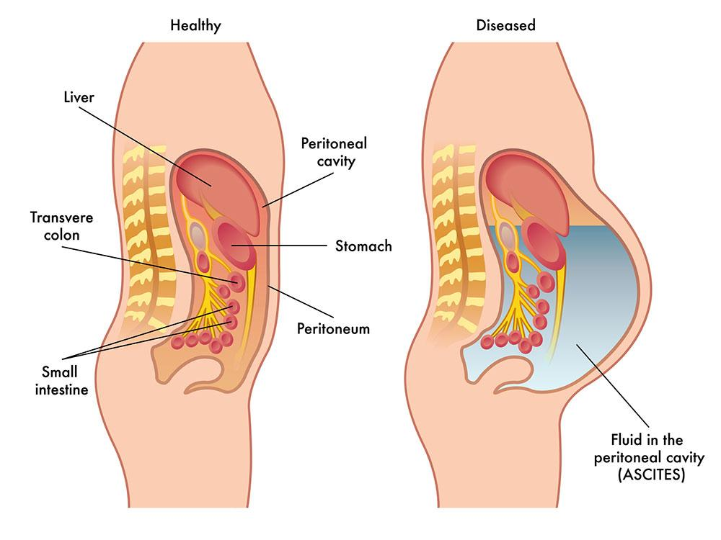
DEFINITION
An accumulation of fluid in peritoneum cavity is called ascites.

Slide 5
CAUSES
Liver cirrhosis
Liver carcinoma
Due to CHF (Congestive Heart Disease)
Due to infection in peritoneum
Peritonitis
Cancer of peritoneum.

Slide 6
PATHOPHYSIOLOGY
Portal Hypertension
Liver Cirrhosis
Right sided Heart Failure
↑ Plasma and lymphatic hydrostatic pressure
Disturbances in blood flow through hepatic veins and vena-cava
Congestion in portal venous system
↑se hydrostatic pressure in portal venous system
Accumulation of fluid in peritoneal cavity (Ascites)

Slide 7
CLINICAL MANIFESTATION
Abdominal distension
Shortness of breath
Abdominal pain
Bloating (a buildup of gas in the stomach and intestines)
Nausea or Vomiting
Indigestion
Sense of heaviness

Slide 8
DIAGNOSTIC EVALUATION
History collection
Physical Examination
X-ray Abdominal
USG (Ultrasonography)
Abdominal Paracentesis: A needle or catheter is inserted into the peritoneal cavity and ascitic fluid is removed for diagnostic or therapeutic purposes. The fluid may be used to determine the etiology of ascites and evaluate for cancer or infection.

Slide 9
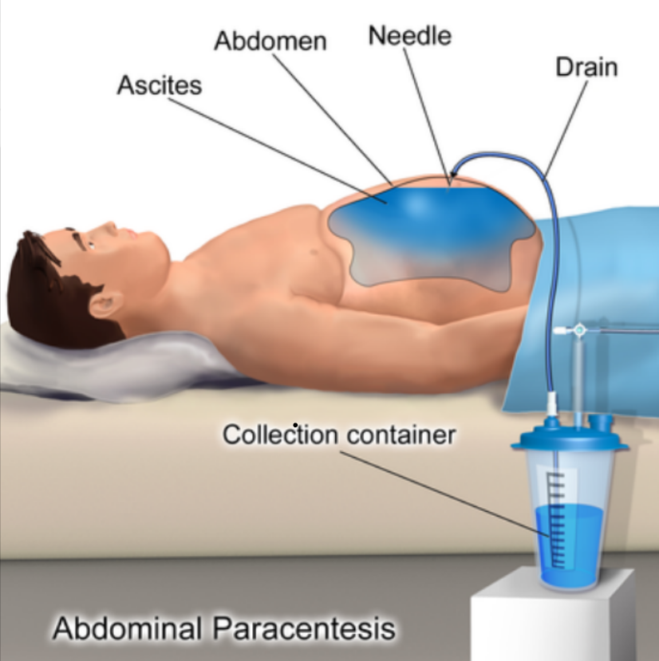
MANAGEMENT
Abdominal paracentesis (aspiration of accumulated fluid from peritoneal cavity).
Diuretics
Antibiotics for infections

Slide 10
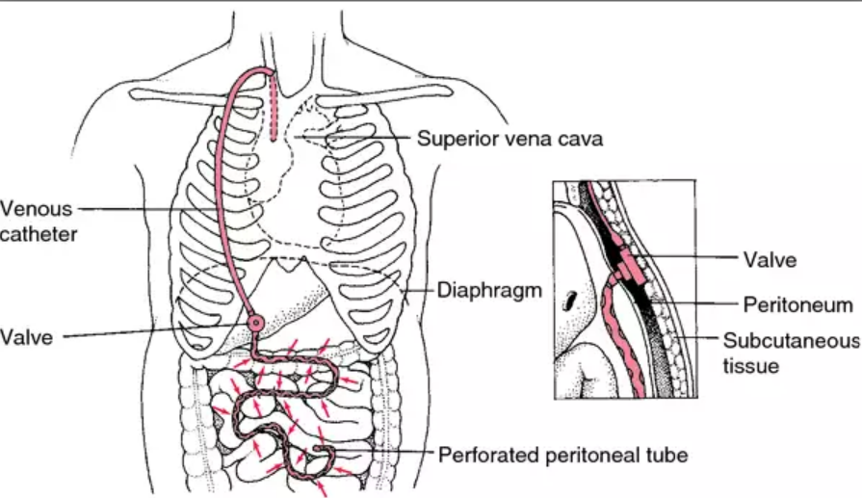
SURGICAL MANAGEMENT
Peritoneal Venous Shunt: Continuous Shunting of ascites fluid from the peritoneal cavity to the jugular vein by means of a surgically implanted subcutaneous plastic tube.

Slide 11
COMPLICATIONS
Spontaneous bacterial peritonitis
Hepatorenal syndrome (kidney failure)
Weight loss and protein malnutrition
Mental confusion, change in the level of alertness, or coma (hepatic encephalopathy
Bleeding from the upper or lower gastrointestinal tract
Build-up of fluid in the space between the lungs and chest cavity (pleural effusion)

Slide 12
PREVENTION
Stop drinking alcohol
Maintain a healthy weight
Exercise regularly
Stop smoking
Limit salt in your diet

Slide 13
SUMMARY

Slide 14
REFERENCES

Slide 15


