Slide 1
NURSING RESEARCH AND STATISTICS
UNIT VI
ANALYSIS OF DATA-
DATA PRESENTATION,
SUMMARIZATION
AND INTERPRETATION

Slide 2
LEARNING OBJECTIVES
The students will be able to
Describe various methods of presenting data
Identify the suitable method of data presentation based on the objective and the levels of measurement
Understand the methods of data summarization
Comprehend the data interpretation process

Slide 3
CONTENT OVERVIEW
Introduction
Data Presentation
  Tables
  Diagrams
  Graphs
Summarization of data
Interpretation of data

Slide 4
INTRODUCTION
The collection of numerical information often leads to large masses of data which, if they are to be understood, or presented effectively, must be summarized and analysed in some way.
The presentation of data in the form of tables, graphs and charts is an important part of the process of data analysis and report writing.

Slide 5
DATA PRESENTATION
Tables and graphs share some common features, but for any specific situation, one is likely to be more suitable than the other.
• Purpose: To display data so that they can be readily understood
• Principle: Tables and graphs should contain
enough information to be self-sufficient

Slide 6
TABULATION OF DATA
The process of placing classified data into tabular form is known as tabulation. A table is a symmetric arrangement of statistical data in rows and columns.

Slide 7
OBJECTIVES
To simplify the complex data in a systematic and concise form.
To facilitate easy comparison.
To facilitate analysis of data through central tendency and measures of dispersion.
To defect errors if any in the data.

Slide 8
PRINCIPLES
Precise, comprehensive and self explanatory.
A title must be on the top explaining the content clearly.
Follow a sequence in arranging the items.
Rows and columns must have similar content.
State the unit clearly. Unit must be either in the caption/stubs.
Write the foot notes at the bottom of the table.

Slide 9
RULES AND GUIDELINES
Table should stand alone
Clear title
Minimal statistical abbreviations
Continuous data: Mean +/- SD or SEM
Categorical: proportions – N [%]
Provide sample size
Present main results
Spell out abbreviations in the tables in foot note
Do not repeat the table word by word in text
Obtain copyright – if the tables are reprinted in another article

Slide 10
PARTS OF THE TABLE
Table number
Title of the table
Subheads if any
Head note – it is placed below the title of the table
Captions (Column heading) and stubs (row designations)
Body of the table
Units of measurements
Dividers
Foot notes if needed
Source notes.

Slide 11
TYPES OF TABLES
1. Frequency distribution tables
2. Contingency tables
3. Multiple response tables
4. Miscellaneous tables

Slide 12
FORMAT OF THE TABLE
Stub (heading) | Caption(heading) |  |  | Total
 |  | Caption (sub-heading)
 |  | Body
Total

Slide 13
1.FREQUENCY DISTRIBUTION TABLES
To distribute frequency and percentage of information
Keep the class interval constant. (10 – 20, 21 – 30)
Ex. Demographic data of the participants

Slide 14
1.a.One Way Frequency Table
Show the frequency of one variable at different levels.
Table:1. Frequency and Percentage of Flower Color
Sl.no | Flower colour | No of plants
01 | Red | 13
02 | white | 7

Slide 15
1.b.Two –Way Frequency Tables
In these tables two or more than two variables are represented simultaneously. It is also called as complex tables. Eg.
Day of the week | Caloric intake by a child |  | Total
 | Less than 2500 | More than 2500
Sunday | 4 | 1 | 5
Monday | 3 | 2 | 5
Tueday | 6 | 3 | 9
Wednesday | 2 | 2 | 3
Thursday | 1 | 2 | 3
Friday | 3 | 1 | 4
Saturday | 3 | 1 | 4

Slide 16
2.Contingency Tables
Tables report the frequency distribution of two nominal variables simultaneously and include the totals
Known as cross tabs that present two or more variables.
Shows the relationship or association between variables.
Can be prsent as 2x2,2x3,3x3 base the number of variables and used in chi square test.

Slide 17
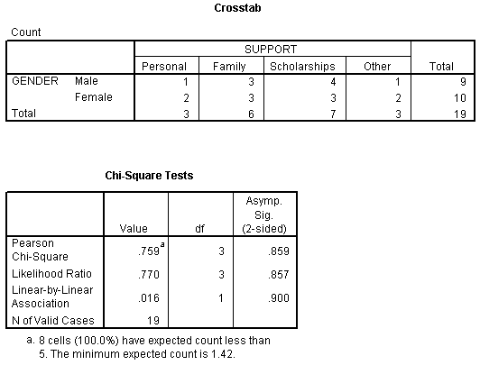
CONTD…
Contingency tables - Example

Slide 18
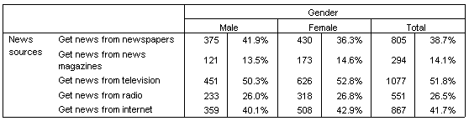
3. Multiple Response Tables
The various responses of the participants can be depicted in the form of table

Slide 19
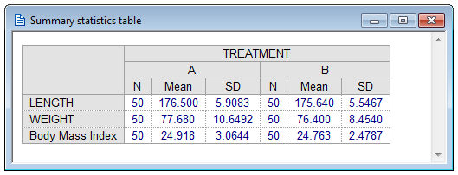
4. Miscellaneous Tables
These tables are used to present data other than frequency or percentage such as mean, median, mode, range, SD etc.

Slide 20
GRAPHICAL PRESENTATION OF DATA
Diagramatic Representation
Graphic Representation
Plot Representation
Histogram
Frequency polygon
Frequency curve
Scatter plot
Stem and leaf plot
Box plot
Kaplan Meier plot
ROC
Bar diagram
Pie diagram
Pictogram
Cartogram

Slide 21
ADVANTAGES OF DIAGRAMS AND CHARTS
It gives Bird’s Eye view
Easy to understand
Easy for comparison
Easy to memorize
Common man can also understand
No need of Mathematical knowledge
Attractable & Reachable to audience
Save time and labor
Comparing to textual & tables, charts and graphs are better

Slide 22
GRAPHS VERSUS TABLES
Advantages
Simplicity, clarity
Disadvantages
Lack of precision
Picture of complex relationships
Emphasis
Popular
Lack of flexibility
Easily remembered visual image

Slide 23
RULES TO FOLLOW THE CONSTRUCTION
Title and index.
Proportion between width and height must be balanced.
Select appropriate scale.
Include foot notes.
It must be simple.
Must be neat and comprehensive.

Slide 24
TYPES OF DIAGRAM
Bar Diagram
  Simple, Multiple, Proportional, Inverted and Percentage
Pie chart
Histogram
Scatter diagram
Line graph
Pictogram & Cartogram
Others

Slide 25
1. Bar Diagram
To represent nominal and ordinal data.
It’s the easy method to compare the magnitude of different frequencies.
It can be vertical or horizontal bars
Type of bar: simple, multiple and proportional.
Width and gap between the bar should be uniform

Slide 26
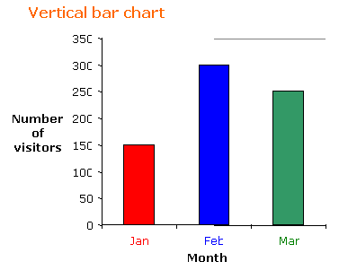
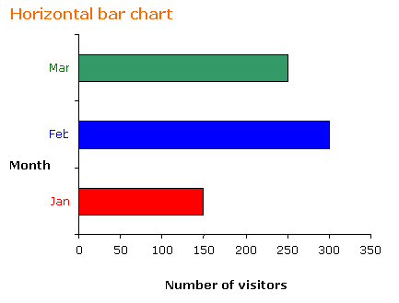
1.a. Simple Bar

Slide 27
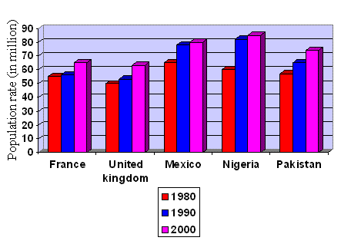
1.b. Multiple Bar

Slide 28
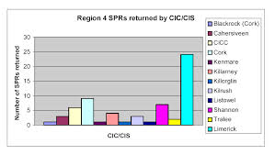
1.c. Proportional Bar Chart

Slide 29
1.d. Inverted Bar Diagram

Slide 30
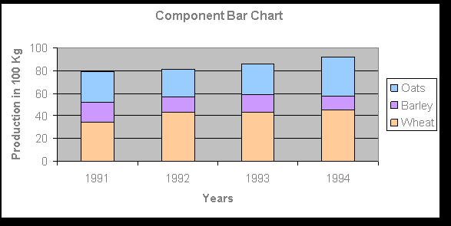
1.e. Percentage or Component Bar Diagram

Slide 31
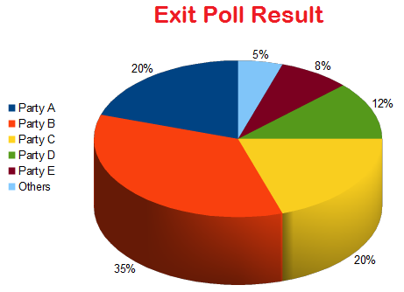
2. Pie Diagram
To present discrete data of qualitative characteristics
Complete circle is the entire data - 100%
Only percentage of data must be used to prepare pie diagram.

Slide 32
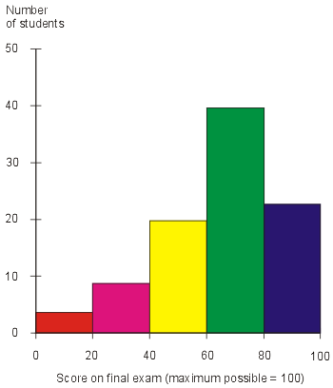
3. Histogram
It represent grouped frequency distribution.
Variable are indicated on a horizontal line and frequencies in vertical line.
Frequency of each group forms a column or rectangle.

Slide 33
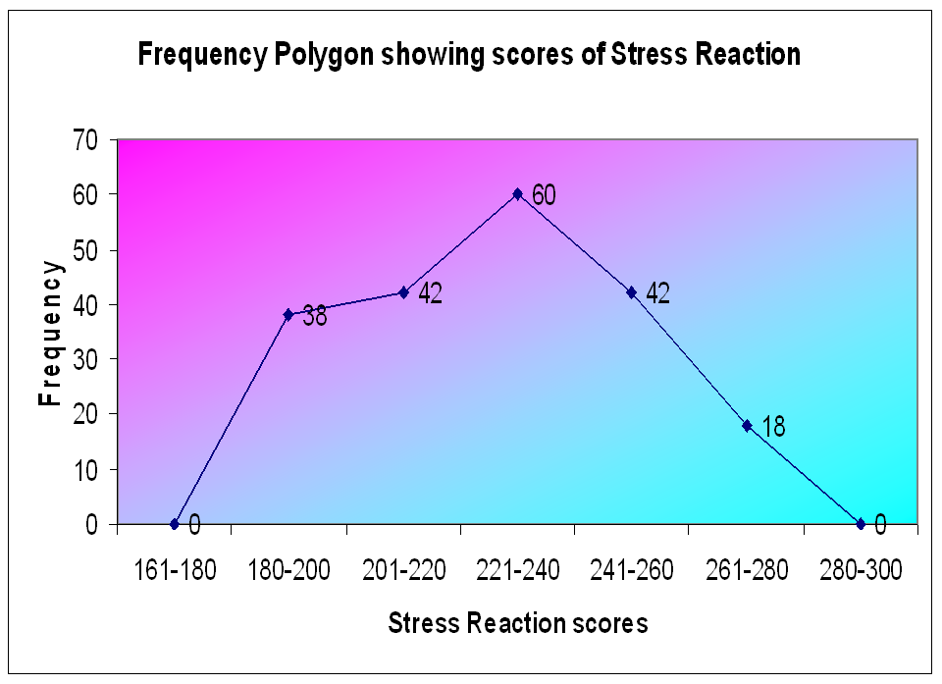
3.a. Frequency polygon
It’s a curve obtained by joining the midpoints of the top of rectangle in a histogram by straight line.
.

Slide 34
3.b. Frequency Curves
When number of observations is very large and the class intervals are of small widths, It then produces smooth curve, called as frequency curve.

Slide 35
3.c. Symmetrical and Skewed Curves
Symmetrical curves:
These curves are usually bell- shaped curves. In these distributions the frequency increases up to the middle item and then decreases in the same ratio. These curves are known as “normal curves”.
Asymmetrical or Skewed curves:
These curves shows skewness which means they are asymmetrical. These curves have more frequencies on one side than on the other. In these curves one tail is always longer than the other. These curves may be of two types:

Slide 36
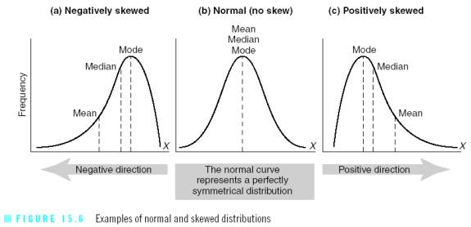
CONTD..

Slide 37
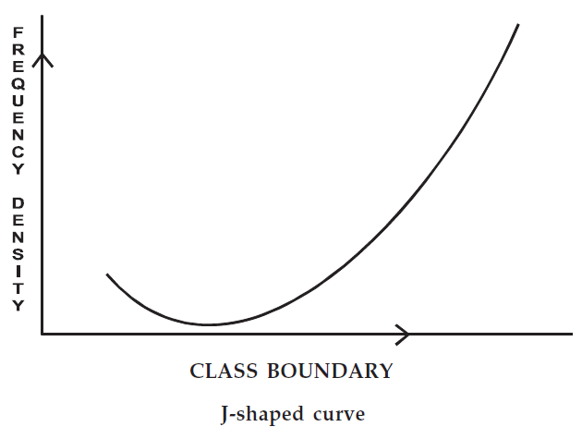
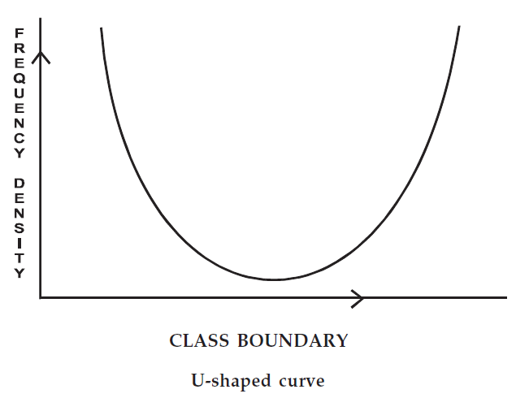
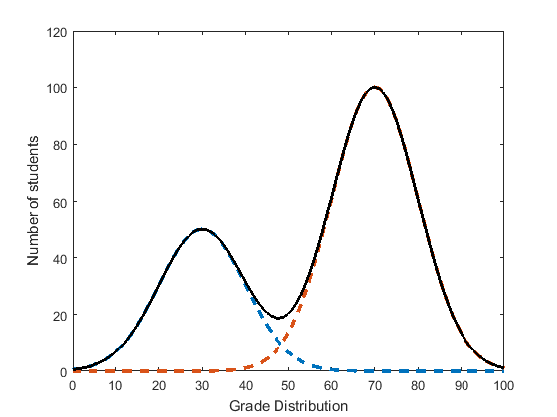
CONTD..
Bimodal Curve

Slide 38
3.d. Kurtosis
The relative flatness or peakedness of the frequency curve is termed as kurtosis. It can be;
Playkurtic curve: when the frequency distribution curve is flatter than the normal bell shaped curve,it is termed as playkurtic curve.
Leptokurtic curve: when the frequency distribution curve is more peaked the normal bell shaped curve,it is termed as leptokurtic curve.
Mesokurtic curve: The normal bell shaped curve, is termed as mesokurtic curve.

Slide 39
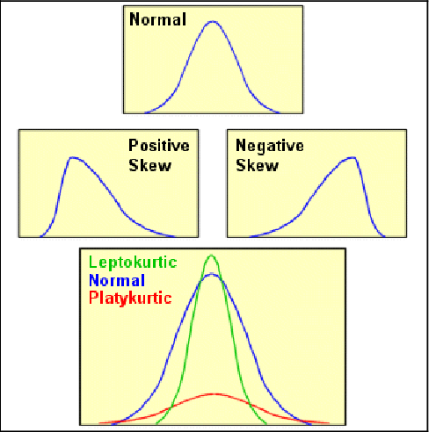
CONTD..

Slide 40
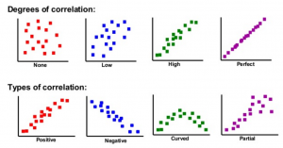
4. Scattered or Dotted Diagrams
It is a graphic presentation to show correlation between two variables. Ex: height and weight in men aged 20yrs.
It is also called correlation diagram.

Slide 41
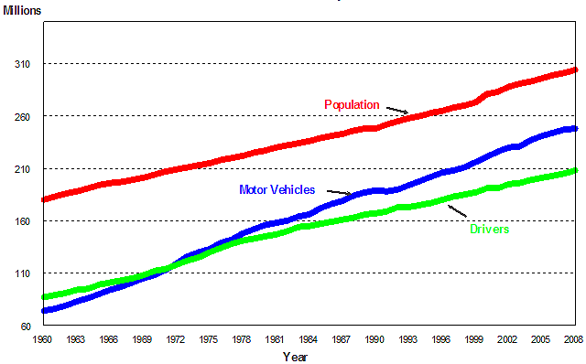
5. Line graph
It is presented in lines.
Its used when data are collected over a long period.
On x axis values of independent variable and in y axis values of dependent variables.

Slide 42
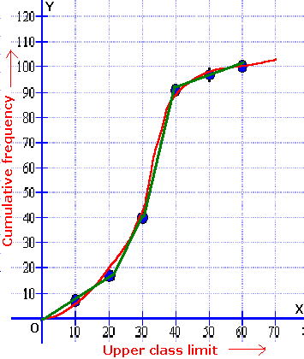
5. Cumulative Frequency Curve Or Ogive
Represents cumulative frequency.
The cumulative frequency are plotted corresponding to upper limits of the classes.
The points corresponding to cumulative frequency at each upper limit of classes are joined by free hand curve.

Slide 43
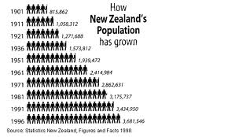
6. Pictogram
A method to impress the frequency of occurrence of event to a common people such as attacks, death, accidents, admissions etc.

Slide 44
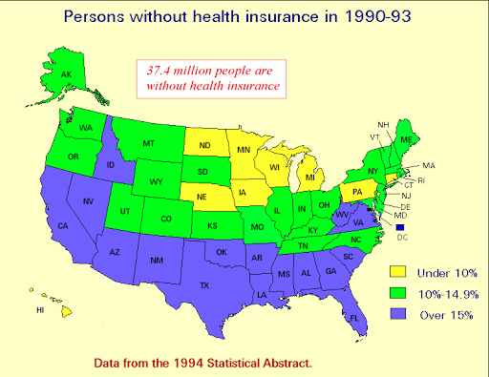
6. Cartogram or Map Diagram
to show geographical distribution of frequency of characteristics.

Slide 45
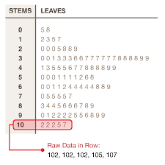
7.a. Stem and Leaf Displays
Visual presentation of numbers. The numbers are organized by lines. Each line of the display is a stem; each piece of information on the stem is a leaf.

Slide 46
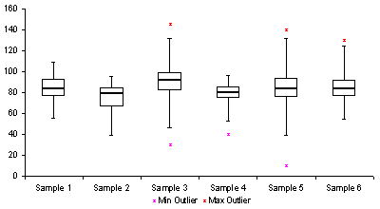
7.b. Box Whisker Plot
A box and whisker graph is used to display a set of data so that you can easily see where most of the numbers are.

Slide 47
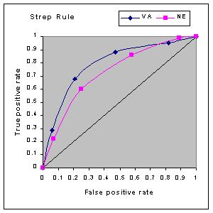
7.c. ROC Curve
ROC means Receiver operator characteristic curve
Used to compare two diagonostic tests.
It is useful to show graphically the relationship between sensitivity and specificity for a diagonostic test

Slide 48
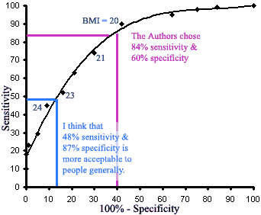
Contd….
The area under the curve represents the overall accuracy of a test.
The larger the area, the better the test.

Slide 49
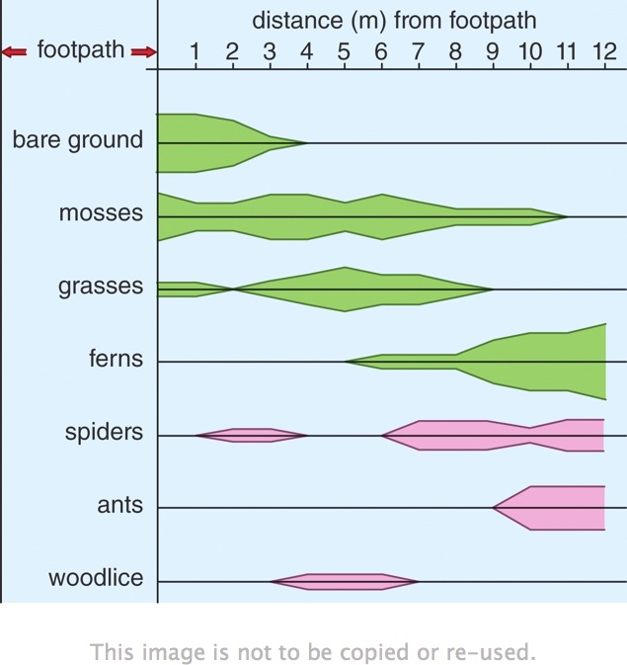
7.d. Kite Diagram:
This is a special type of bar graph which provides an extremely clear visual display of change in frequency of non –numerical variables that are continuously distributed within a given year.

Slide 50
LIMITATIONS OF GRAPHS
Limited Application: Graphic representation is useful for a common man but for an expert, its utility is limited.
Lack of Accuracy: Graphs do not measure the magnitude of the data. They only depict the fluctuations in them.
Subjective: Graphs are subjective in character. Their interpretation varies from person to person.
Misleading Conclusions: The person who has no knowledge can draw misleading conclusions from graphs.

Slide 51
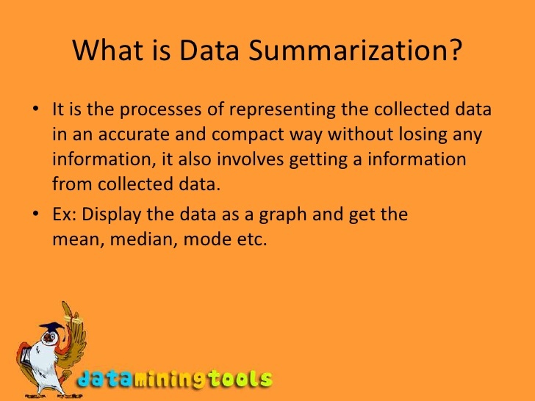
SUMMARIZATION OF DATA
It is the process of

Slide 52
PURPOSE
Data summarization helps to understand large scale data in few lines or pages instead of reading thousands or millions of pages
This helps to speed up decisions on time without losing any oppurtunitu
What
Why
Who
Where
How

Slide 53
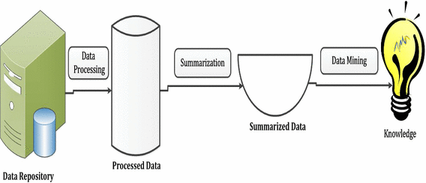
STEPS
It includes
Data charecterisation – present in various forms such as pie charts bar charts
Data discrimination – comparision of general features of target class of data objects from one or a set of contrasting class.

Slide 54
METHODS
  Descriptive statistics refers to methods for summarizing and organizing the information in a data set
  1. Frequency and Percent Distributions
  First strategy used to organize data for examination. Also used to check for errors in coding and computer programming.

Slide 55
Contd..
Table. 1 Frequency and Percentage distribution of demographic variables of Control and experimental group of infertile women.
Variables | Control Group (n=60) N % |  | Experimental Group (n=60) N %
Age in years
21 – 25 | 6 | 10.0 | 5 | 9.8
26 – 30 | 22 | 36.7 | 21 | 35.3
31 – 35 | 23 | 38.3 | 24 | 40.0
36 – 40 | 9 | 15.0 | 10 | 16.7

Slide 56
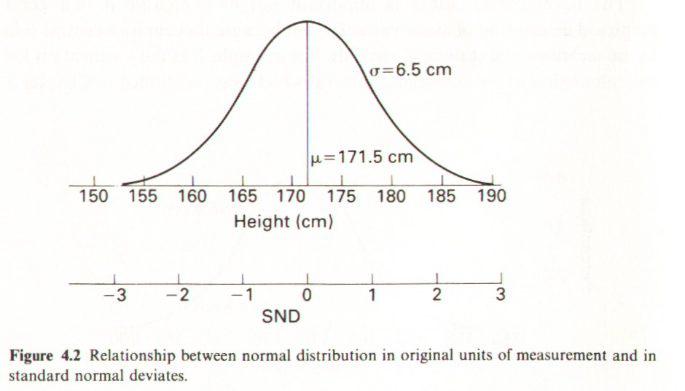
CONTD…
2. The Standard Normal distribution

Slide 57
CONTD….
3. Measures of central tendency
Table. Mean, median, mode and standard deviation of pre and post test Stress reactions in control group of infertile women. (N = 60)
Stress | Min. | Max. | Mean | Mode | Median | SD.
Pre test | 194 | 290 | 246.13 | 244.5 | 242 | 21.82
Post test | 194 | 292 | 247.06 | 245.0 | 248 | 21.89

Slide 58
CONTD….
3. Frequency Polygon

Slide 59
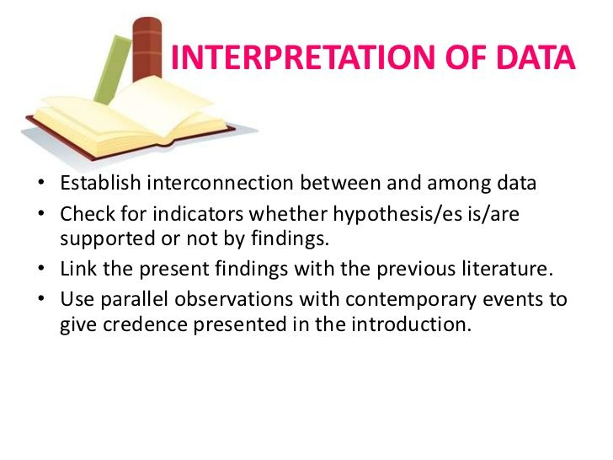

Slide 60
CONTD…
Interpretation is the process of making sense of numerical data that has been collected, analyzed, and presented
The activity of analyzing and interpreting data in order to make predictions is known as inferential statistics
It is important to select appropriate statistical tool to make useful interpretation of the data

Slide 61
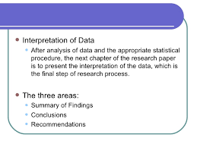
CONTD…

Slide 62
Interpretation - Example.
Table.10: Comparison of Clinical Pulmonary Infection Score (CPIS) between control and Experimental Group of Patients on Mechanical Ventilator
Variable | Before intervention (n= 382) |  | After intervention (n= 514) |  | Mean Difference | “t” | Sig
 | Mean | SD | Mean | SD
CPIS | 3.1 | 2.2 | 2.0 | 1.3 | 1.1 | 9.584 | P<0.001

Slide 63
CONTD…
It is inferred from the table .10 that the mean score of the CPIS was 3.1±2.2 in pre-intervention group and 1.3 ± 1.1 in post-intervention group. This significance difference at P<0.001 with t value 9.584 demonstrated the effectiveness of real time compliance to certain interventional methods including VAP bundle in reducing the incidence of VAP rate. Hence the hypothesis No1 “there will be no significant difference in the incidence rate of Ventilator Associated Pneumonia between the control and experimental group of patients on mechanical ventilator at p<0.05 level of significance” was rejected. The results were corroborative with the study conducted by Dorothy to assess the impact of adherence to a ventilator-associated pneumonia (VAP) bundle on the incidence of VAP

Slide 64
SUMMARY
Be very clear about the analysis objectives
Be very familiar with all aspects of what defines your data
Develop and stay true to your data analysis plans and research questions
Be cognizant of which statistical software programs can best answer your research questions and present your results.
Be thorough in your analyses, express openness to additional investigations, yet be mindful of limitations given the data and the programs you are using

Slide 65
BIBLIOGRAPHY
Burns, N. and Grove, S K. (2007). Under standing the theoretical frameworks ed.4. Philadelphia : Saunders
Polit, DF Beck, CT. (2004). Developing a conceptual context ed.7. Philadelphia: Mosby.
Wood GL, Haber, J., (2002) Nursing research – methods, critical appraisal and utilization. Philadelphia: Mosby

