Slide 1

TEERTHANKER MAHAVEER COLLEGE OF NURSING
TEACHING PRACTICE
ON
“URINARY TRACT INFECTION”
PRESENTED BY
MR. DINESH SINGH
M.SC. NURSING 1st YEAR
TMCON

Slide 2


Slide 3
INTRODUCTION
Urinary tract infection can be divided into upper urinary tract infections, which involves the kidneys (pyelonephritis) and lower urinary tract infections, which involve the bladder (cystitis), urethra (urethritis) and prostate (prostatic).

Slide 4
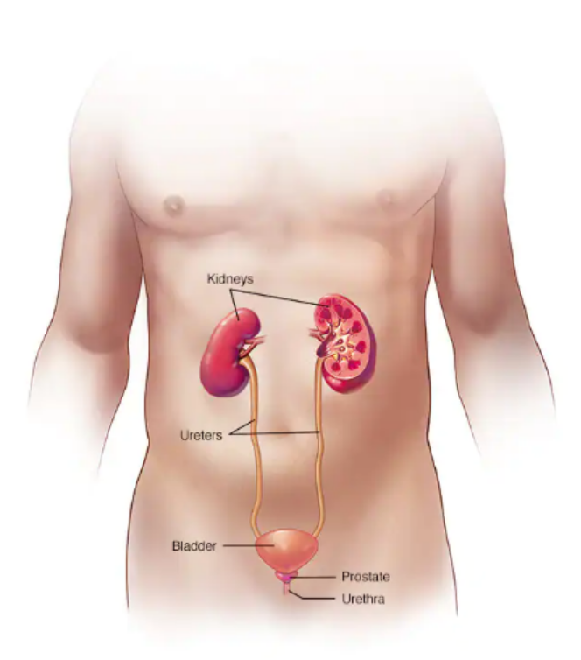
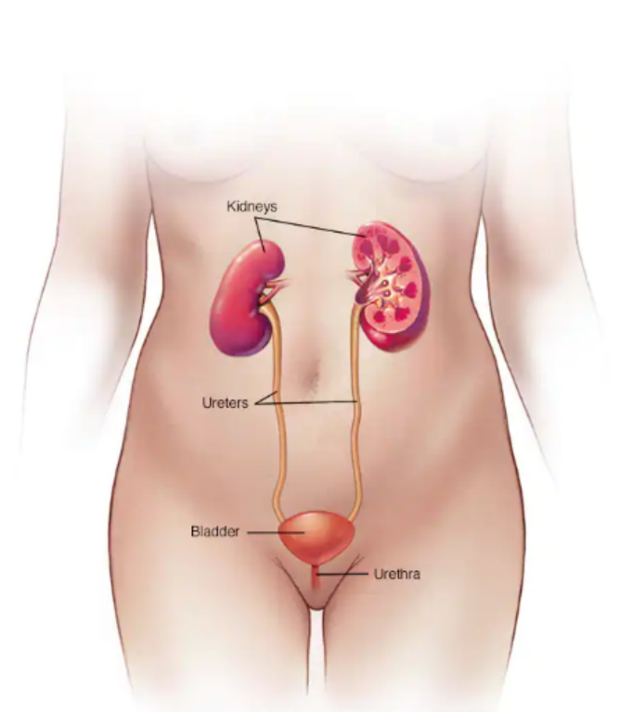
Male Female

Slide 5
DEFINITION
A urinary tract infection, or UTI is an infection in any part of the urinary system, which includes the kidneys, bladder, ureters and urethra.

Slide 6
INCIDENCE
More common in women than man.

Slide 7
ETOLOGY
Bacterial infection (mostly E.coli) 80%
Candida infection
Sexual intercourse
Tight and synthetic clothing
Indwelling catheters
Upper urinary tract disease
Obstructive abnormalities (strictures, prostatic hyperplasia)
Calculus
Under-treated cystitis

Slide 8

PATHOPHYSIOLOGY
Bacteria or fecal organisms enters to urethra and bladder from perineum
Attach and colonize the epithelium of urinary tract
Avoid host defense mechanisms
Initiate inflammation

Slide 9
CLINICAL MANIFESTATION
Pain in the side (flank), abdomen and pelvic area
Pressure in the lower pelvis
Frequent need to urinate (urgency)
Urgent need to urinate (urgency)
Incontinence (urine leakage)
Painful urination (dysuria)
Blood in urine (hematuria)
Abnormal urine colour (cloudy urine) and strong or foul-smelling urine.

Slide 10
OTHER SYMPTOMS
Pain during sex
Penis pain
Fatigue
Fever
Vomiting

Slide 11
MEDICAL MANAGEMENT
Antibiotics:- are medicines that kill bacteria and fight an infection. Antibiotics are typically used to treat urinary tract infections.
Example:- Bactrim, cotrimazine (trimethoprim/sulfadiazine)
Other are
Ampicillin/Amoxicillin
Doxycycline
Ciprofloxacin
Norfloxacin

Slide 12
SURGICAL MANAGEMENT
Surgical management is necessary than any congenital anomalies or BPH (benign prostatic hyperplasia) is there.

Slide 13
NURSING MANAGEMENT
Assessment
Assess risk factors for development of cystitis.
Take a detailed history.
Collect urine culture and sensitivity specimen.

Slide 14
NURSING DIAGNOSIS
Acute pain related to irritation of bladder and urethral mucosa.
Altered urinary pattern related to irritation of bladder mucosa.
Risk of infection related to urinary stasis, pregnancy and risk factors.
Knowledge deficit related to prevention, medications, hygiene and fluid intake.

Slide 15
REFERENCE
Lewis Dirksen Heitkemper Bucher, textbook of medical surgical nursing second south Asia edition, volume 1 page no.
Brunner and Suddarth’s textbook of medical surgical nursing 13th south Asia edition, volume-2 page no 1532
P.K. Panwar, textbook of medical surgical nursing 4th edition page no.

