Slide 1


STOMATITIS
MR. DINESH SINGH
P.G. NURSING TUTOR
ROHILKHAND COLLEGE OF NURSING

Slide 2
OBJECTIVES
Introduction of the.
Define the.
Explain the causes of.
State the clinical manifestations of.
Elaborate the diagnostic evaluation of.
Discuss the management of.
Describe the prevention of.

Slide 3
INTRODUCTION
Stomatitis, a non-specific term for an inflamed and sore mouth, can disrupt a person’s ability to eat, talk, and sleep. Stomatitis can occur any where within the mouth, including inside of the cheeks, gums, tongue, lips and palate.

Slide 4
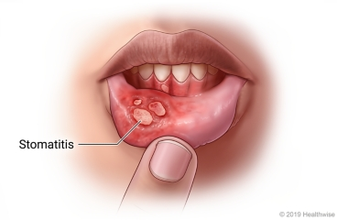
DEFINITION
Stomatitis is an inflammation of the mucous lining of the mouth, which may involve the cheeks, gums, tongue, lips, and roof or floor of the mouth. The word “stomatitis” literally means inflammation of the mouth.

Slide 5
CAUSES
Chemotherapy
Radiotherapy
Loose-fitting dental prosthetics
Trauma
Poor dental hygiene
Smoking
Infection (viral, Fungal, and Bacterial)

Slide 6
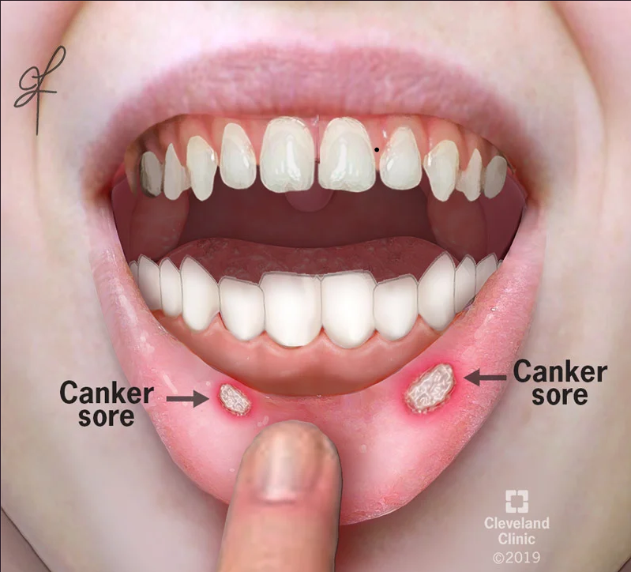
TYPES
Types of stomatitis include:
Cancer sore: A cancer sore, also known as an aphthous ulcer, is a single pale or yellow ulcer with a red outer ring or a cluster of such ulcers in the mouth, usually on the cheeks, tongue, or inside the lip.

Slide 7
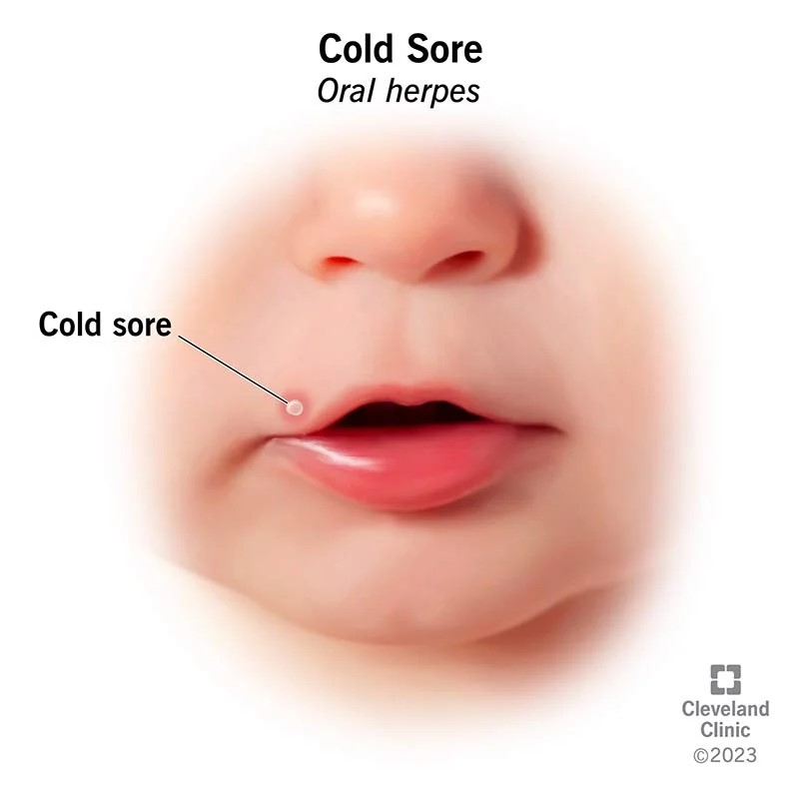
Cold sores: Also called fever blisters, cold sores are fluid-filled sores that occur on or around the lips. They rarely form on the gums or the roof of the mouth. Cold sores later crust over with a scab and are usually associated with tingling, tender- ness, or burning before the actual sores appear.

Slide 8
CLINICAL MANIFESTATION
Cancer Sore Symptoms
Sores that can be painful
Sores usually last 5 to 10 days
Sores tend to re-occur
Sores are generally not associated with fever.
Cold Sore Symptoms
Sores are usually painful
Sores are usually gone in 7 to 10 days
Sores are sometimes associated with cold or flu like symptoms.

Slide 9
OTHER SIGN
Burning and tingling sensation.
Gums are swollen and bleed.
Tenderness in mucous membrane.
Redness.

Slide 10
DIAGNOSTIC EVALUATION
History collection
Physical examination
Complete blood count

Slide 11
MANAGEMENT
Coating agents such as bismuth salicylate or other antacids
Water- soluble lubricants for mouth and lips
Topical analgesics, such as benzamine hydrochloride
Topical anaesthetics, such as lidocaine viscous (might impair gag reflex for a short period)
Oral or parenteral analgesics, including opioids if needed, for pain not controlled with above.

Slide 12
Conti….
Antiseptic mouthwash
Protective pastes
Local aesthetic mouthwash or spray
Oral analgesics (pain killers)
Topical corticosteroids.

Slide 13
SUMMARY

Slide 14
REFERENCES

Slide 15


