Slide 1

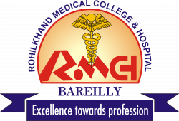
CIRRHOSIS OF LIVER
MR. DINESH SINGH
P.G. NURSING TUTOR
ROHILKHAND COLLEGE OF NURSING

Slide 2
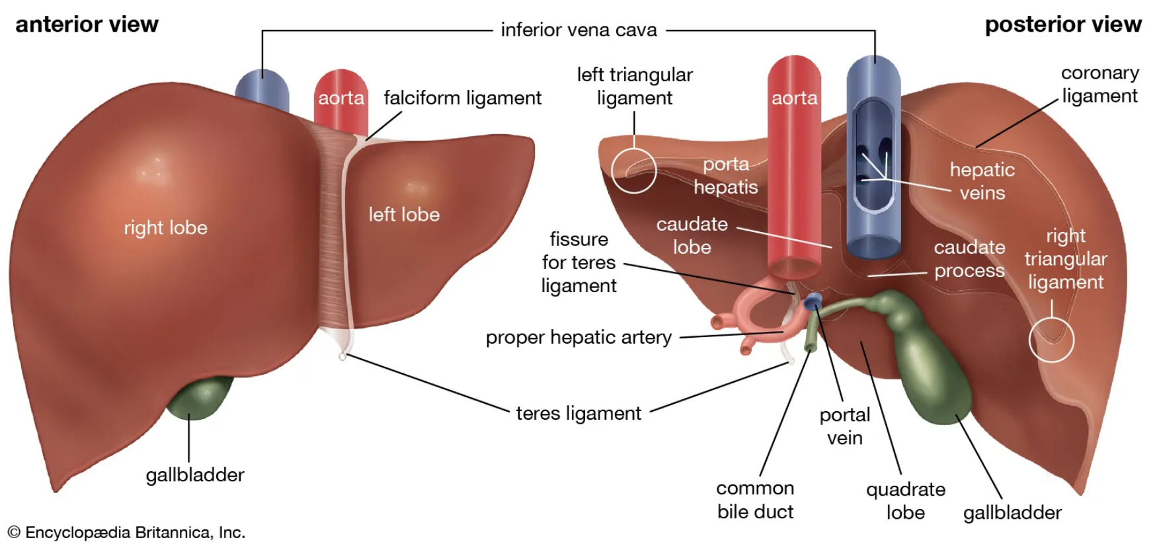
LOBES OF THE LIVER

Slide 3
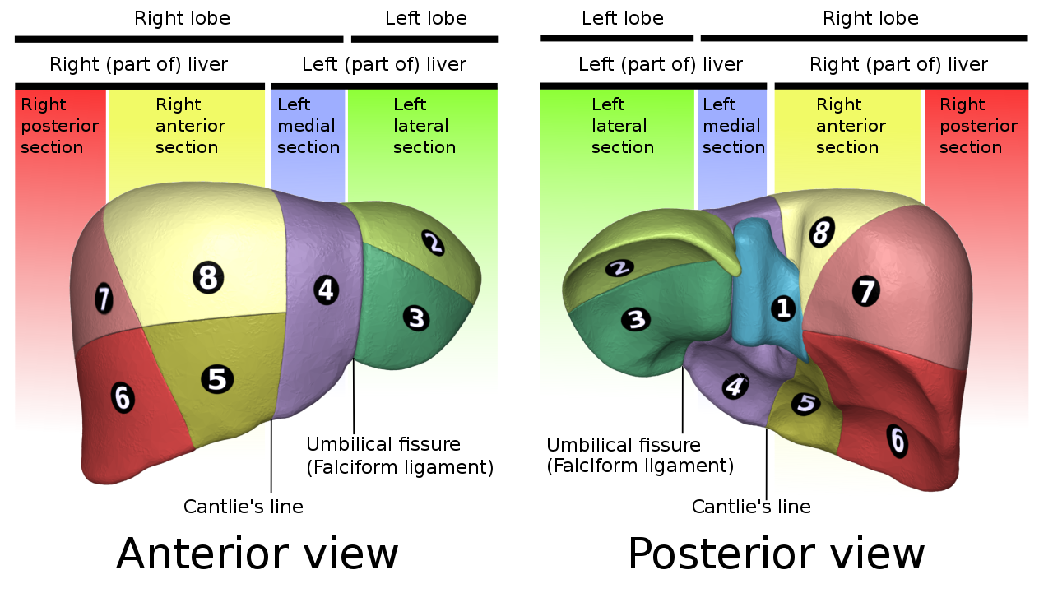
SEGMENT OF THE LIVER

Slide 4
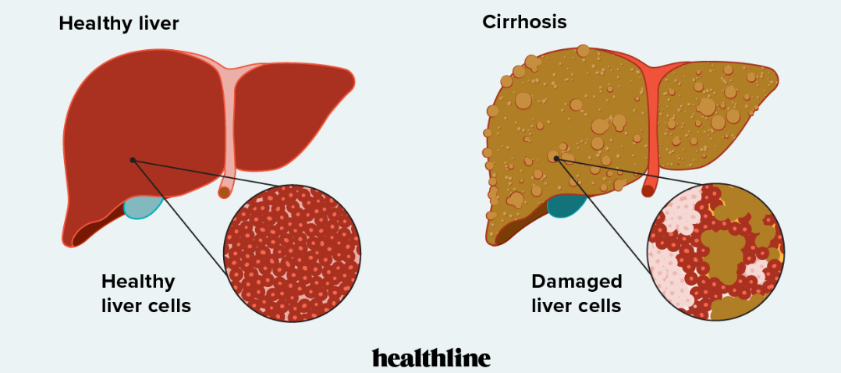
INTRODUCTION
Cirrhosis is a late-stage liver disease in which healthy liver tissue is replaced with scar tissue and the liver is permanently damaged.

Slide 5
DEFINITION
Cirrhosis complication of liver disease which involve loss of liver cells and irreversible scaring of liver cells. It is a chronic disease characterized by replacement or degenerative changes in normal liver cells. Tissue with diffuse fibrosis and nodules that disturbs the structure and function of liver. Also scar formation occurs due to destroyed hepatocytes.

Slide 6
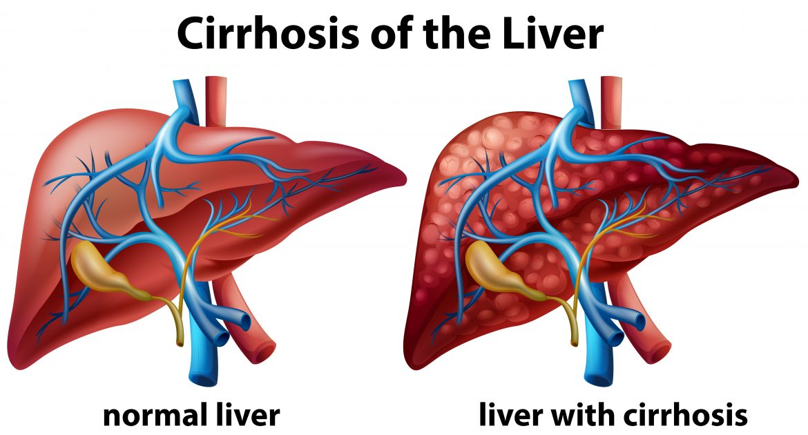

Slide 7
ETIOLOGY
Alcoholism
Hepatitis A,B,C,D
Hepatotoxic drugs
CHF (Congestive heart failure)
Biliary obstruction
Diabetes
Glycogen storage disease
Immunological causes

Slide 8
TYPES
Post Necrotic Cirrhosis: Due to severe inflammation and massive necrosis of hepatocytes cells.
Alcoholic Cirrhosis: It occurs due to excessive intake of alcohol that leads to accumulation of fat in liver.
Biliary Cirrhosis: Due to biliary obstruction for long time and cholestasis (stoppage of growth)
Cardiac Cirrhosis: Main cause of this type of cirrhosis is right side congestive heart failure.

Slide 9
PATHOPHYSIOLOGY
Due to Alcohol abuse, Malnutrition, Infection, Drugs or Biliary obstruction
Destruction of hepatocytes
Fibrosis/scar formation
Obstruction of blood flow
Increase pressure in venous and sinusoidal channels
Fatty infiltration fibrosis/scaring
Portal hypertension

Slide 10
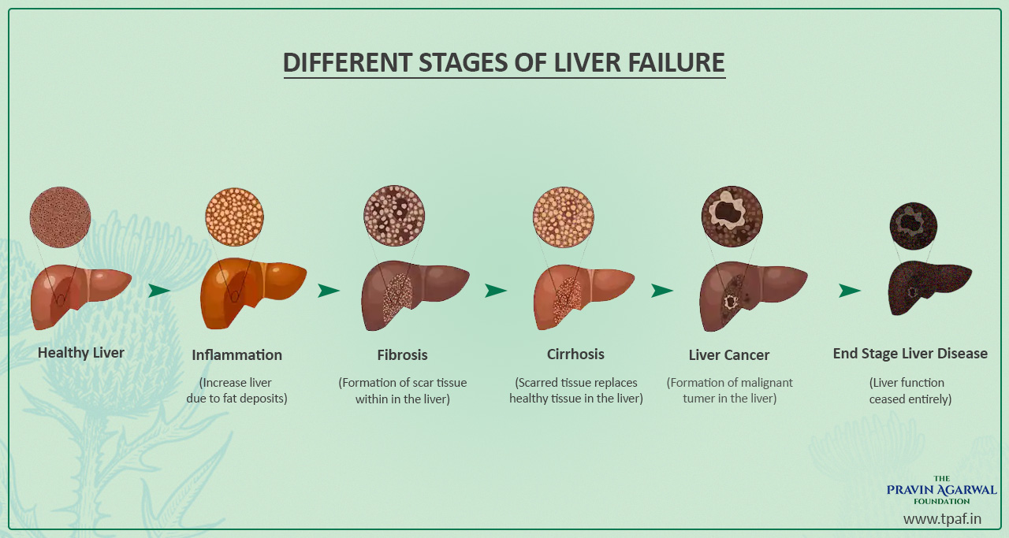

Slide 11
CLINICAL MANIFESTATION
Early symptoms due to inflammation
Fever
Pain
Anorexia
Fatigue
nausea
If biliary obstruction
Increase serum bilirubin level so appear dark color of urine.
Jaundice due to accumulation of bilirubin under skin.

Slide 12
Conti…
Hormonal disturbances
Reduce androgen and estrogen which produce abnormal menses
Amenorrhea
Loss of body hair
Gynecomastia (upper swelling on breast in men)
Other Symptoms are
Oedema
Ascites (excess abdominal fluid)
Abdominal distension
Increased abdominal girth
Yellowish skin
Difficulty in breathing

Slide 13
DIAGNOSTIC EVALUATION
Serum examination
Increased SGOT/SGPT level: high level SGOT/SGPT released into the blood may be a sign of liver or heart damage.
Low protein level
Increase bilirubin level raised
Liver Function Test
AST-Aspirate Aminotransferase (Test is a blood test that checks for liver damage)
ALT- Alanine Transferase

Slide 14
Conti…
LDH- Lactate dehydrogenase
Ultrasound ( for Hepatomegaly)
WBC (for determination of infection)
RBC (in Anaemia)
Liver biopsy- FNAC (Fine Needle Aspiration Cytology)
Abdominal paracentesis (for determine pus cells bacterial infection or protein component in accumulated fluid).

Slide 15
MANAGEMENT
Antacids
Antiemetics
Vitamins and nutritional supplement
Balanced diet
Potassium sparing diuretics (for ascites), e.g. Spironolactone.
Avoidance of alcohol.

Slide 16
SURGICAL MANAGEMENT
Porta-Caval Shunt (porta caval anastomosis)
A Surgical technique in which hepatic portal vein is joined to inferior vena cava.
Splenorenal Shunt (splenorenal anastomosis)
A surgical technique in which spleen vein is joined to the left renal vein. (mostly for treating portal hypertension).
Liver Transplant: Right lobe 60-70% of whole liver. Left lobe 30-40%.

Slide 17
DIETARY MANAGEMENT
Provide high caloric diet and low liquid dirt (800-1000 ml/day)
In Hepatic coma, give low protein and low sodium diet.
Provide Albumin containing food.
Vitamin A, D, E, K include with diet to patient.

Slide 18
REFERENCES

Slide 19


