Slide 1
III YR B.Sc NURSING
Nursing research and statistics
Unit VII / Introduction to Statistics
P. Shanthi

Slide 2
Definition
Statistics
Statistics is defined as collection, presentation, analysis and interpretation of numerical data.
Statistics is the body of techniques used to facilitate the collection, organization, presentation, analysis, and interpretation of data for the purpose of making better decisions

Slide 3
Definition
Statistics is the science and art of dealing with figure and facts.
Biostatistics
Biostatistics is simply statistics as applied to the biological sciences, health, and medicine.

Slide 4
What is data ?..
Definition : A collection of items or information
Types of data: Quantitative & Quantitative
            Data
Qualitative
Quantitative
It was great fun
Discrete-5…..
Continuous
3.345

Slide 5
Statistical Methods
Statistical Methods
Descriptive Statistics
Inferential statistics

Slide 6
TWO APPROCHES TO THE STATISTICAL ANALYSIS OF DATA- Descriptive Statistics
Descriptive Statistics: Descriptive statistics are techniques which help the investigator to describe, organize, and summarize the measures of data.
EXAMPLE: According to Consumer Reports, Whirlpool washing machine owners reported 9 problems per 100 machines during a year. The statistic9 describes the number of problems out of every 100 machines

Slide 7
Inferential Statistics
Webster’s New Collegiate Dictionary
Infer –to derive as a conclusion from facts of premises.
Inference –the act of passing from statistical sample data to generalizations.
Statistics –a branch of mathematics dealing with the collection, analysis, interpretation, presentation of masses of numerical data.

Slide 8
Inferential Statistics
Statistical inference is the process of using data obtained from a small group of elements (the sample) to make estimates and test hypotheses about the characteristics of a larger group of elements (the population).EX
Strength of steel must is determined by a laboratory experiment.

Slide 9


Inferential statistics
. Involves
- Estimation
-Hypothesis testing
Purpose
-draw conclusion
Or inferences about
population characteristics
Population ????

Slide 10
Uses and application of statistics
It facilitates comparisons
It simplifies the message of figure
It helps in formulating and testing hypothesis
It plays a vitally important role in research.
It help to answer important research questions and field in study
Helps in to understand how to apply statistical method.
It is important to understand what tools are suitable for a particular research study.
It enables to understand specified statistical concepts and procedure.

Slide 11
Scales of Measurements
In statistics and Quantitative research Methodology,Levels of Measurements are developed by the psychologist”Stanley Smith Stevens “

Slide 12
What are measurements and Variables
1.
Variables: Characteristics that can take on different values for different members of a group.For example :Height
2.
Measurement: “Assignment of numbers to characteristics ( Variables) of objects ,person or events”

Slide 13
IMPORTANCE OF MEASUREMENTS
Research conclusion are accurate on which they are based .
The more precise, sensitive the method of measurement, the better are the result.

Slide 14
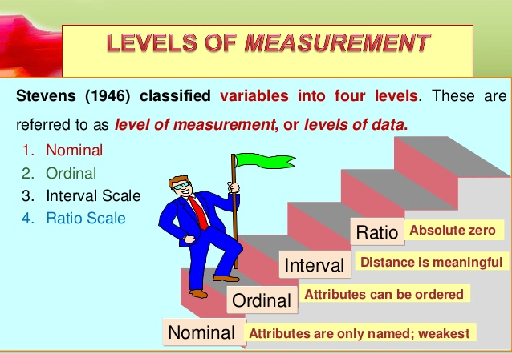

Slide 15
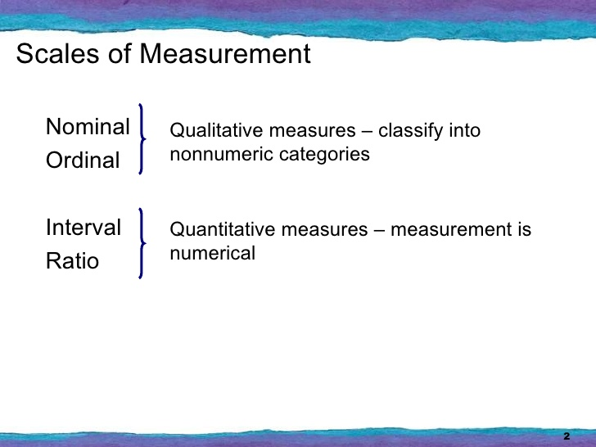

Slide 16
THE NOMINAL SCALE
The Nominal scale, sometimes called qualitative type That differentiate between Items or subjects only on the
basis of their names or categories or qualities
Examples
Include Gender,
nationality, language,
style,
Marital status,
student ID,
state of residence

Slide 17
THE NOMINAL SCALE
A nominal scale represents lower level of measurements
Such scales classifies persons or objects into two or more categories

Slide 18
ORDINAL SCALE
An ordinal scale not only classifies subject but also ranks them in terms of the degree to which they possess a characteristics of interest . An ordinal scale indicates relative position
Ordinal scale can determine whether an object has more or less of a characteristic than some other object. The exact measurement is not available like student A is taller than student B but their actual heights are not available
It permits the researcher to rank or order the respondents or their responses

Slide 19
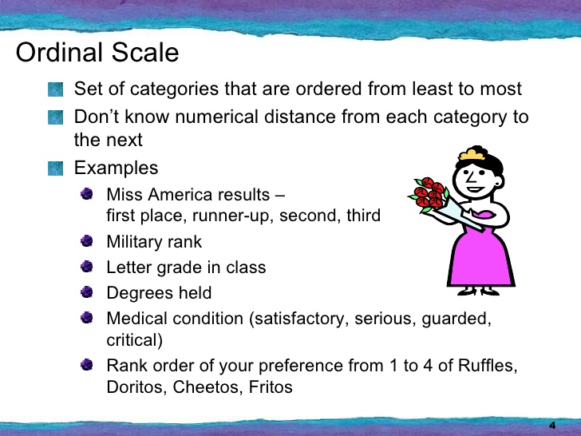

Slide 20
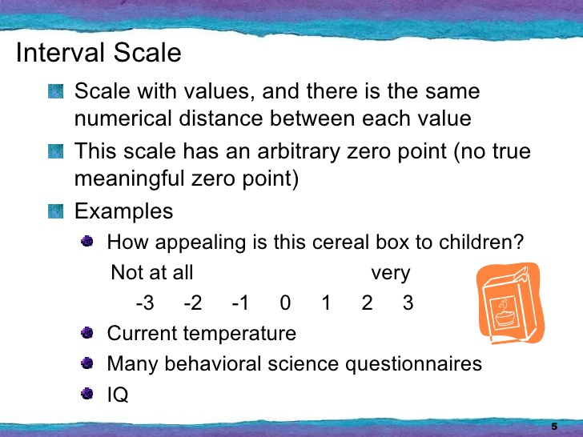

Slide 21
INTERVAL SCALE
Interval scales indicate order and distance in the order
Zero point on the interval scale is arbitary zero, it does not means the complete absence of anything

Slide 22
RATIO SCALE
Ratio scale allow comparison of the difference of magnitude (e.g of attitudes) as well as determinations of the actual strength of the magnitude.

Slide 23
RATIO SCALE
This is the highest level of measurement and has the properties of other three levels.
This scale has a unique or fixed beginning or true zero point.(complete absence of the phenomenon being measured)

Slide 24
RATIO SCALE
For Example
1. Heart beat per minute has a very natural zero point. Zero means no heart beats.
2. Weight (in grams) is also a ratio variable. Again the zero value is meaningful, zero grams means the absence of weight.

Slide 25
INTRODUCTION
In statistics, a central tendency is a central value or a typical value for a probability distribution.
It is occasionally called an average or just the center of the distribution.
The most common measures of central tendency are the arithmetic mean, median and mode.

Slide 26
Definitions
“A measure of central tendency is a typical value around which other figures gather” - Simpson and Kafka
“A measure of central tendency is a single number of value which can be considered typical in a set of data as a whole” - Waugh

Slide 27
Importance of Central Tendency
To find representative value
To make more concise data
To make comparisons
Helpful in further statistical analysis

Slide 28
Three common measures of central tendency
Arithmetic mean
Median
Mode

Slide 29
Characteristics for a good or an ideal average
The following properties should possess for an ideal average.
It should be rigidly defined.
It should be easy to understand and compute.
It should be based on all items in the data.
Its definition shall be in the form of a mathematical formula.

Slide 30
Characteristics for a good or an ideal average
It should be capable of further algebraic treatment.
It should have sampling stability.
It should be capable of being used in further statistical computations or processing.

Slide 31
Arithmetic mean or mean
Arithmetic mean or simply the mean of a variable is defined as the sum of the observations divided by the number of observations.

Slide 32
Formula for the ungrouped or raw data
If the variable x assumes n values x₁, x₂ …x_{n} then the mean,
x = x1 + x2 + x3 +….. + xn
n

Slide 33
Example 1
Calculate the mean for 2, 4, 6, 8, 10
Solution:
x = 2 + 4 + 6 + 8 +10
5
= 30 = 6
5

Slide 34
Merits of Arithmetic mean
Merits
It is rigidly defined.
It is easy to understand and easy to calculate.
If the number of items is sufficiently large, it is more accurate and more reliable.
It is a calculated value and is not based on its position in the series.

Slide 35
Merits of Arithmetic mean
It is possible to calculate even if some of the details of the data are lacking.
Of all averages, it is affected least by fluctuations of sampling.
It provides a good basis for comparison.

Slide 36
Demerits of Arithmetic mean
It cannot be obtained by inspection nor located through a frequency graph.
It cannot be in the study of qualitative phenomena not capable of numerical measurement i.e. Intelligence, beauty, honesty etc.,
It can ignore any single item only at the risk of losing its accuracy.

Slide 37
Demerits of Arithmetic mean
It is affected very much by extreme values.
It cannot be calculated for open-end classes.
It may lead to fallacious conclusions, if the details of the data from which it is computed are not given.

Slide 38
Median
Median
It is a Measure of Central Tendency.
Denoted Md, is the middle value of the sample when the data are ranked in order according to size.
The median is determined by sorting the data set from lowest to highest values and taking the data point in the middle of the sequence.
Middle Value In Ordered Sequence

Slide 39
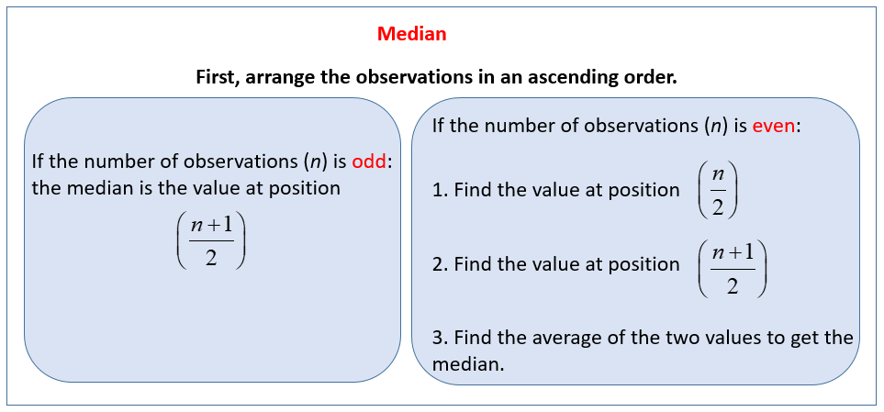

Slide 40
Example
Q: When odd number of values are given. Find median for the following data
25, 18, 27, 10, 8, 30, 42, 20, 53
Solution:
Arranging the data in the increasing order 8, 10, 18, 20, 25, 27, 30, 42, 53
The middle value is the 5th item i.e., 25 is the median

Slide 41
Example
Q: When even number of values are given. Find median for the following data 5, 8, 12, 30, 18, 10, 2, 22
Solution:
Arranging the data in the increasing order
2, 5, 8, 10, 12,18, 22, 30
Here median is the mean of the middle two items (ie) mean of (10,12) ie
= 10 + 12 = 2
2

Slide 42
Merits of Median
Merits
Median is not influenced by extreme values because it is a positional average.
Median can be calculated in case of distribution with open- end intervals.
Median can be located even if the data are incomplete.
Median can be located even for qualitative factors such as ability, honesty etc.

Slide 43
Demerits of Median
A slight change in the series may bring drastic change in median value.
In case of even number of items or continuous series, median is an estimated value other than any value in the series.
It is not suitable for further mathematical treatment except its use in mean deviation.
It is not taken into account all the observations.

Slide 44
Mode
According to Croxton and Cowden “The mode of a distribution is the value at the point around which the items tend to be most heavily concentrated. It may be regarded at the most typical of a series of values”.

Slide 45
Example
For ungrouped data or a series of individual observations, mode is often found by mere inspection.
Example 25:
2 , 7, 10, 15, 10, 17, 8, 10, 2
Mode = M₀ =10

Slide 46
Merits of Mode
Mode
It is easy to calculate and in some cases it can be located mere inspection
Mode is not at all affected by extreme values.
It can be calculated for open-end classes.
It is usually an actual value of an important part of the series.
In some circumstances it is the best representative of data.

Slide 47
Demerits of mode
It is not based on all observations.
It is not capable of further mathematical treatment.
Mode is ill-defined generally, it is not possible to find mode in some cases.
As compared with mean, mode is affected to a great extent, by sampling fluctuations.
It is unsuitable in cases where relative importance of items has to be considered.

Slide 48
FREQUENCY DISTRIBUTION
Frequency means the number of times a particular value occurs. It is the repetition of values.
In Frequency distribution, the data are arranged in an order in a table.
Frequency distribution is the organisation of raw data in table from using classes and frequency.
In a frequency table the data are grouped in to classes.The number of values in each class is called frequency

Slide 49
The reasons for constructing a frequency distribution
To organize the data in a meaningful, intelligible way.
To enable the reader to determine the nature or shape of the distribution.
To facilitate computational procedures for measures of average and spread
To enable the researcher to draw charts and graphs for the presentation of data.
To enable the reader to make comparisons among different data sets.
​

Slide 50
TYPES
1.Frequency Distribution without class intervals
2.Frequency Distribution with class intervals
3. Cumulative Frequency Table

Slide 51
1.Frequency Distribution without class intervals

Slide 52
Raw Data
Example: Number of children in 30 families
1, 4, 7, 9, 10, 3
5, 0, 5, 0, 2, 4
0, 3, 2, 6, 3, 8
6, 2, 1, 4, 2 ,3
9, 1, 8, 0, 1, 1

Slide 53
Step :No 1.Data are arranged in the ascending order
0, 0, 0, 0, 1, 1
1, 1, 1, 2, 2, 2
2, 3, 3, 3 , 3, 4
4, 4, 5, 5, 6, 6
7, 8, 8, 9, 9, 10

Slide 54
Step No2:A table is formed with three vertical columns
Number of children | Tallies | Frequency
0 1 2 3 4 5 6 7 8 9 10 | IIII / IIII IIII III II II I II II I | 4 5 4 4 3 2 2 1 2 2 1
 | Total
IIII

Slide 55
Step No: 3
In the second column repetition of items are given in the form of tally marks (bars). For each variable one tally mark is given. They are written in groups of five tally each. The first four tally marks are written as straight lines and the fifth tally marks are written as crossed.This is Four and cross method

Slide 56
Step No :4
The tally marks for each item is counted and is given in the third column.It is the frequency. The frequency for each item is equal to the number of tally marks against each items.
At the bottom of the third column, the frequency is given by adding all the frequencies.

Slide 57
2.Frequency Distribution with class intervals
Frequency distribution with class interval is a table of values with classes. It is constructed with class intervals. It Is a frequency distribution of continuous series. example, let’s say you have a list of IQ scores for a gifted classroom in a particular elementary school.
The IQ scores are: 118, 123, 124, 125, 127, 128, 129, 130, 130, 133, 136, 138, 141, 142, 149, 150, 154.

Slide 58
How to Draw a Frequency Distribution Table
Part 1: Choosing Classes
Step 1: Figure out how many classes (categories) you need. There are no hard rules about how many classes to pick, but there are a couple of general guidelines:
1. Pick between 5 and 20 classes. For the list of IQs above, we picked 5 classes.
2.Make sure you have a few items in each category. For example, if you have 20 items, choose 5 classes (4 items per category), not 20 classes (which would give you only 1 item per category).

Slide 59
Part 2: Sorting the Data
Step 2: Subtract the minimum data value from the maximum data value. For example, our IQ list above had a minimum value of 118 and a maximum value of 154, so:
154 – 118 = 36

Slide 60
condt
Step 3: Divide your answer in Step 2 by the number of classes you chose in Step 1.
36 / 5 = 7.2
Step 4: Round the number from Step 3 up to a whole number to get the class width. Rounded up, 7.2 becomes 8.
Step 5: Write down your lowest value for your first minimum data value: The lowest value is 118

Slide 61
condt
Step 6: Add the class width from Step 4 to Step 5 to get the next lower class limit:
118 + 8 = 126
Step 7: Repeat Step 6 for the other minimum data values (in other words, keep on adding your class width to your minimum data values) until you have created the number of classes you chose in Step 1. We chose 5 classes, so our 5 minimum data values are:
118
126 (118 + 8)
134 (126 + 8)
142 (134 + 8)
150 (142 + 8)

Slide 62
Step 8:
Write down the upper class limits. These are the highest values that can be in the category, so in most cases you can subtract 1 from the class width and add that to the minimum data value.
For example:
118 + (8 – 1) = 125
118 – 125
126 – 133
134 – 141
142 – 149
150 – 157

Slide 63
Condt ….
Step 10: Count the number of items in each class, and put the total in the second column. The list of IQ scores are:
118, 123, 124, 125, 127, 128, 129, 130, 130, 133, 136, 138, 141, 142, 149, 150, 154.

Slide 64
Step No10:A table is formed with three vertical columns
I.Q | Frequency
118-125 126-133 134-141 142-149 150-157 | 4 6 3 2 2
Total | 17

Slide 65
3.Cumulative Frequency Table
The cumulative frequency of a set of data or class intervals of a frequency table is the sum of the frequencies of the data up to a required level. It can be used to determine the number of items that have values below a particular level.

Slide 66
3.Cumulative Frequency Table (Ungrouped data)
The following table gives the frequency distribution of marks obtained by 28 students in a Statistics test.
Construct a cumulative frequency table for the given data.
Marks | 30 | 31 | 32 | 33
Frequency | 5 | 7 | 10 | 6

Slide 67
Construct a cumulative frequency table for the given data.
Marks | Frequency | Marks less than | Cumulative Frequency
30 | 5 | 30 | 5
31 | 7 | 31 | 5+7=12
33 | 10 | 32 | 12+10=22
34 | 6 | 33 | 22+6=28

Slide 68
Cumulative Frequency Table (Grouped data)
The following table gives the frequency distribution of mass of 40 objects.
Mass(g) | 10-14 | 15-19 | 20-24 | 25-29 | 30-34 | 35-39 | 40-44
Frequency | 3 | 4 | 10 | 12 | 6 | 3 | 2

Slide 69
Construct a cumulative frequency table
Solution:
Mass | Upper class boundaries | Frequency | Mass less than | Cumulative frequency
10-14 | 14.5 | 3 | 14.5 | 3
15-19 | 19.5 | 4 | 19.5 | 3+4=7
20-24 | 24.5 | 10 | 24.5 | 7+10=17
25-29 | 29.5 | 12 | 29.5 | 17+12=29
30-34 | 34.5 | 6 | 34.5 | 29+6=35
35-39 | 39.5 | 3 | 39.5 | 35+3=38
40-44 | 44.5 | 2 | 44.5 | 38+2=40

Slide 70
Probability Distribution
We study probability to get an idea of how well sample statistics match up to their population parameters.
Probability: The proportion of times that a particular outcome would occur in a long run of repeated observations
Example : When you toss a coin ,what is the probability of Head in a Toss.
Probability Distribution : a listing of possible outcomes for a variable, together with thrie probabilities

Slide 71
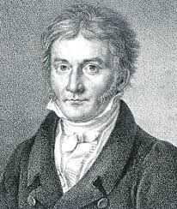
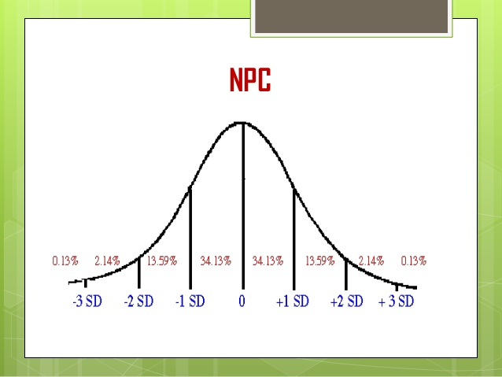
Carl Gauss
The Normal Probability distribution or the , “ NORMAL CURVE” is often called the Gaussian distribution

Slide 72
Definition
It is defined as a continuous frequency distribution of infinite variable.
The probability distribution is a descriptive model that describes real world situations.
Many dependent variables are commonly assumed to be normally distributed in the population. So that we can make inferences about values of that variable.

Slide 73
Normal probability curve
J.P. Guilford has defined normal probability curve comprehensively.
“ Normal probability curve is well defined well structure, mathematical curve, having a distribution of the scores with mean,median, and modes are equal.

Slide 74
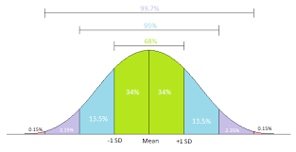
Characteristics – 1.Bell shaped

Slide 75
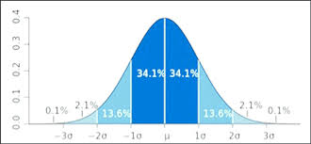

Slide 76
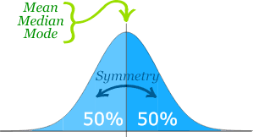
Characteristics 2. Mean=Median=Mode

Slide 77
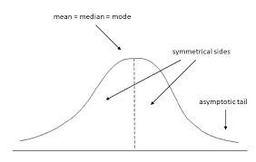
Characteristics 3.Asymptotic
Total area under the curve above the x-axis is = 1 or 100 %,Tail are on both sides not touching x – axis. It extends infinitely in both directions i.e. from minus infinity (-∞) to plus infinity (+∞) as shown in Figure below. As the distance from the mean increases the curve approaches to the base line more and more closely.

Slide 78
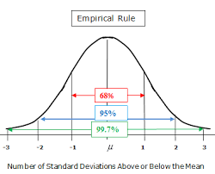

Slide 79
4.Emprical Rule
Greater percentage of cases at the middle of the distribution:
There is a greater percentage of cases at the middle of the distribution.
1.In between -1σ and + 1σ, 68.26% (34.13 + 34.13), nearly 2/3 of eases lie.
2.To the right side of +1σ, 15.87% (13.59 + 2.14 + .14), and to the left of-1σ, 15.87% (13.59 + 2.14 + .14) of cases lie.
3.Beyond +2σ. 2.28% of eases lie and beyond -2σ also 2.28% of cases lie.

Slide 80
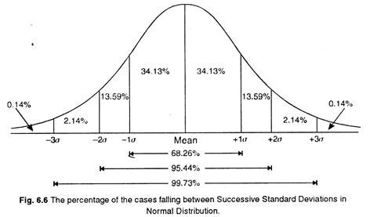
Percentage of cases between Mean and different a distances can be read from the figure below:

Slide 81
Graphical Representation
Graphical Representation is a way of analyzing numerical data. It exhibits the relation between data, ideas, information and concepts in a diagram. It is easy to understand and it is one of the most important learning strategies.
A graph is a sort of chart through which statistical data are represented in the form of lines or curves drawn across the coordinated points plotted on its surface

Slide 82
General Principles of Graphic Representation
Algebraic principles which apply to all types of graphic representation of data.
In a graph there are two lines called coordinate axes.
One is vertical known as Y axis and the other is horizontal called X axis.
These two lines are perpendicular to each other.
Where these two lines intersect each other is called ‘0’ or the Origin.
On the X axis the distances right to the origin have positive value and distances left to the origin have negative value.
On the Y axis distances above the origin have a positive value and below the origin have a negative value.

Slide 83
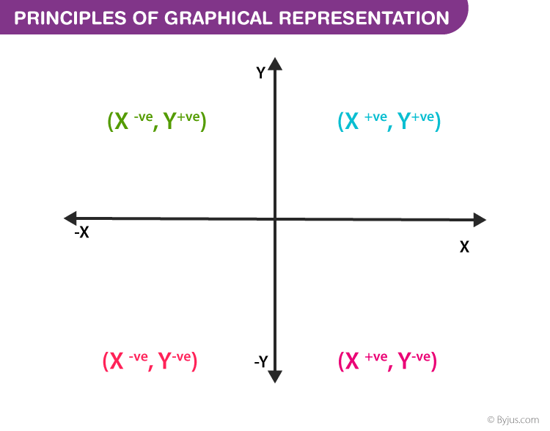

Slide 84
Two types of data
1. Ungrouped data
2. Grouped data
Ungrouped data is in the form of raw scores
When it is organized into frequency distribution, then it is referred to as Grouped data.

Slide 85
Graphical Representation of Ungrouped data
Bar graph or bar diagram
Circle diagram or pie diagram
Pictogram
Line graph
Frequency curve & Frequency polygon
Cumulative or ogive frequency graph

Slide 86
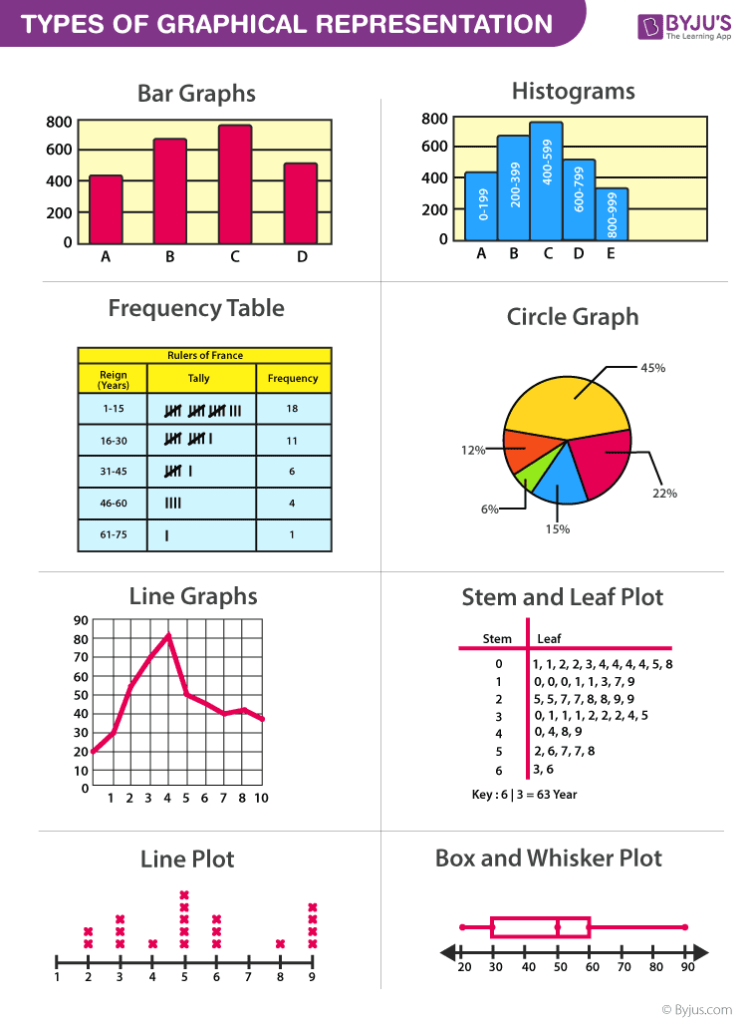

Slide 87
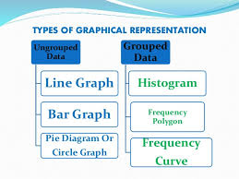

Slide 88
1.Line Graph
Most common graphical representation By plotting X axis on horizontally while Y axis vertically. Find out the intersecting point or origin and join all intersections. A line graph is formed by joining the points given by the data with straight lines.
A line graph is usually used to show the change of information over a period of time. This means that the horizontal axis is usually a time scale, for example minutes, days, months or years.

Slide 89
1.Draw Line graph
This table shows daily earning of a store for five days
Days | Mon | Tues | Wed | Thurs | Fri
Earnings | 100 | 450 | 200 | 400 | 650

Slide 90
1.Line graph

Slide 91
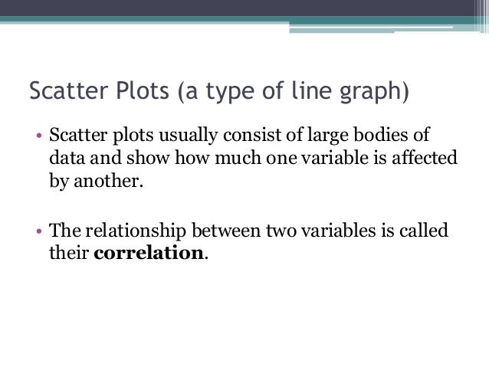

Slide 92
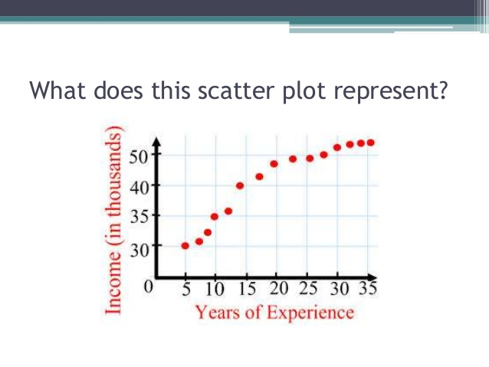
Notes:
As year of experience increase ,income also increase

Slide 93
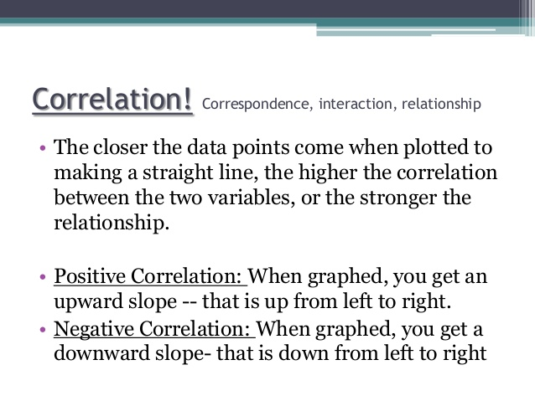

Slide 94
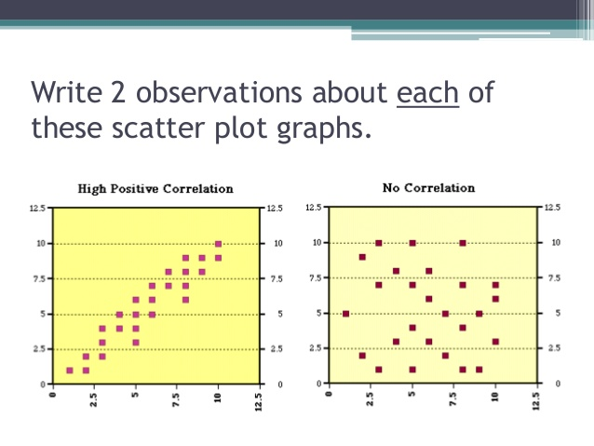

Slide 95
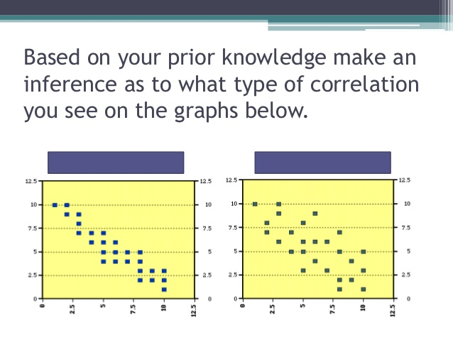
Notes:
1.Negative correlation 2.No correlation

Slide 96
2. Bar Graph
The bars drawn are of uniform width and the variable quantity is represented on one of the axes. Also, the measure of the variable is depicted on the other axes.
The heights or the lengths of the bars denote the value of the variable and these graphs are also used to compare certain quantities.
The frequency distribution tables can be easily represented using bar charts which simplify the calculations and understanding of data.

Slide 97
2. Bar Graph
The bar graphs can be vertical or horizontal. The primary feature of any bar graph is its length or height. If the length of the bar graph is more, then the values are greater of any given data.

Slide 98
2. Bar Graph Types
The types of bar charts are as follows:
Vertical bar chart
Horizontal bar chart
Multiple Bar Diagram

Slide 99
2.(a)Vertical Bar Graphs
When the grouped data are represented vertically in a graph or chart with the help of bars, where the bars denote the measure of data, such graphs are called vertical bar graphs. The data is represented along the y-axis of the graph and the height of the bars shows the values.

Slide 100
2.(b) Horizontal Bar Graphs
When the grouped data are represented horizontally in a chart with the help of bars, then such graphs are called horizontal bar graphs, where the bars shows the measure of data. The data is depicted here along the x-axis of the graph and the length of the bars denote the values.

Slide 101
Example 1:
In a firm of 400 employees, the percentage of monthly salary saved by each employee is given in the following table. Represent it through a bar graph.
Savings (in percentage) | Number of Employees (Frequency)
20 | 105
30 | 199
40 | 29
50 | 73
Total | 400

Slide 102
2.(a)Vertical Bar Graphs

Slide 103
2.(b)Horizontal Bar Graphs

Slide 104
Example 2:
A cosmetic company manufactures 4 different shades of lipstick. The sale for 6 months is shown in the table. Represent it using bar charts.
Month | Shade 1 | Shade 2 | Shade3 | Shade 4
Jan | 4500 | 1600 | 4400 | 3245
Feb | 2870 | 5645 | 5675 | 6754
Mar | 3985 | 8900 | 9768 | 7786
Apr | 6855 | 8976 | 9008 | 8965
May | 3200 | 5678 | 5643 | 7865
Jun | 3456 | 4555 | 2233 | 6547

Slide 105
2.(c).Multiple Bar Diagram

Slide 106
3.Histogram
A Histogram is a graphic representation of a continuous frequency distribution through special kind of vertical bar charts.

Slide 107
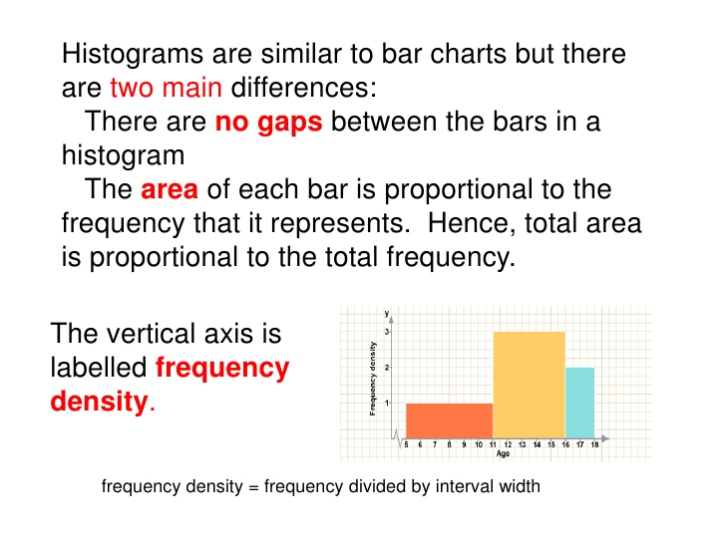

Slide 108
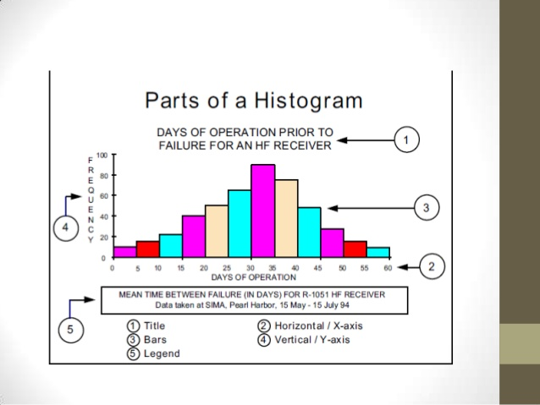

Slide 109
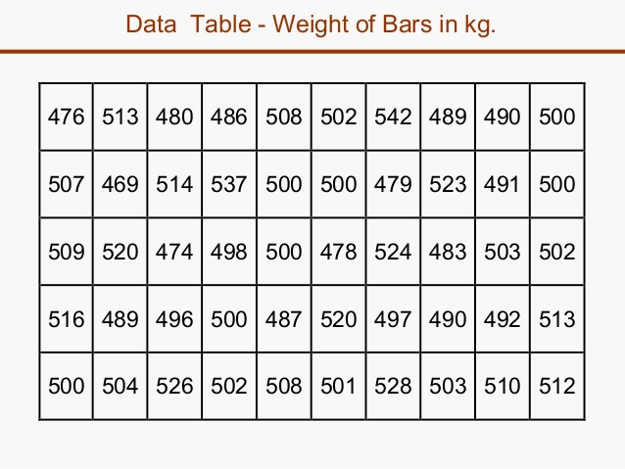
Construct Histogram

Slide 110
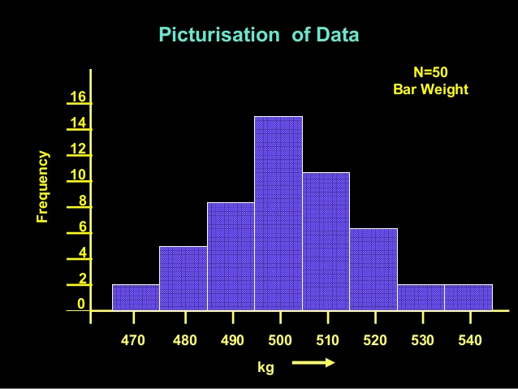

Slide 111
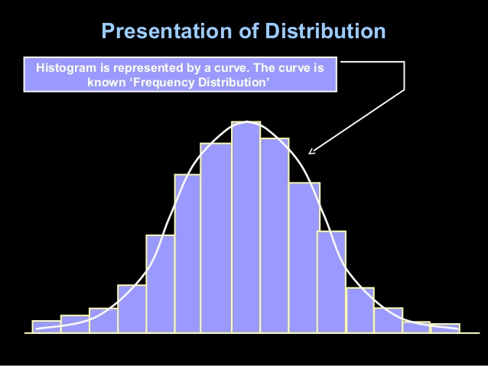

Slide 112
4.Frequency Polygon
Frequency Polygon is a histogram with straight lines joining the midpoint of the rectangles.
Polygon means a figure with many angles.
X- axis is marked with class intervals.
Y- axis is marked with frequencies.
Vertical rectangles are drawn as per height og the frequency of the class. The rectangles are drawn without any gap in between.
Width is equal to the range of the class. Height is equal to the frequency of each class.

Slide 113
Example 1: In a batch of 400 students, the height of students is given in the following table. Represent it through a frequency polygon.
Height (in C.M) | No. Of students
140-150 | 74
150-160 | 163
160-170 | 135
170-180 | 28
total | 400

Slide 114
Steps to draw Frequency Polygon
Steps to Draw Frequency Polygon
To draw frequency polygons, first we need to draw histogram and then follow the below steps:
Step 1- Choose the class interval and mark the values on the horizontal axes
Step 2- Mark the mid value of each interval on the horizontal axes.
Step 3- Mark the frequency of the class on the vertical axes.
Step 4- Corresponding to the frequency of each class interval, mark a point at the height in the middle of the class interval
Step 5- Connect these points using the line segment.
Step 6- The obtained representation is a frequency polygon.

Slide 115
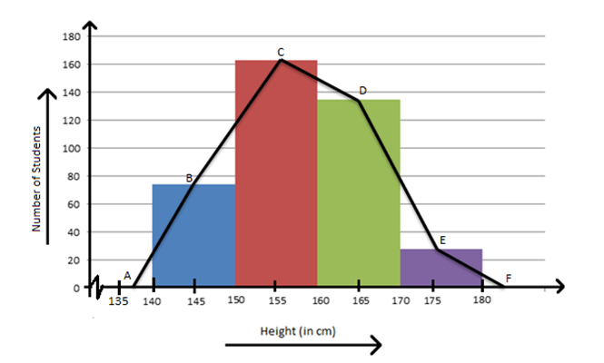
Frequency polygons can also be drawn independently without drawing histograms. For this, the midpoints of the class intervals known as class marks are used to plot the points.

Slide 116
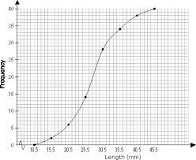
The procedure for drawing a frequency curve is same as for frequency polygon. But the points are joined by smooth or free hand curve

Slide 117
5.Ogives
Ogives are known also as cumulative frequency curves and there are two kinds of ogives.
1.Less than ogive
2.Greater than ogive.
Less than ogive: Here the cumulative frequencies are plotted against the upper boundary of respective class interval.
Greater than ogive:
Here the cumulative frequencies are plotted against the lower boundaries of respective class intervals.

Slide 118
6.Circle Graph or Pie Diagram
Also known as pie chart that shows the relationships of the parts of the whole. The circle is considered with 100% and the categories occupied is represented with that specific percentage like 15%, 56% , etc.

Slide 119
Other graphs
Stem and Leaf Plot – In stem and leaf plot , the data are organised from least value to the greatest value. The digits of the least place values from the leaves and the next place value digit forms the stems.
Box and Whisker Plot – The plot diagram summarises the data by dividing into four parts. Box and whisker shows the range (spread) and the middle ( median) of the data.

Slide 120
Merits of Using Graphs
Some of the merits of using graphs are as follows:
The graph is easily understood by everyone without any prior knowledge.
It saves time
It allows to relate and compare the data for different time periods
It is used in statistics to determine the mean, median and mode for different data, as well as in interpolation and extrapolation of data.

Slide 121
Bar graphs are used to match things between different groups or to trace changes over time. Yet, when trying to estimate change over time, bar graphs are most suitable when the changes are bigger.
Bar charts possess a discrete domain of divisions and are normally scaled so that all the data can fit on the graph. When there is no regular order of the divisions being matched, bars on the chart may be organised in any order. Bar charts organised from the highest to the lowest number are called Pareto charts.

Slide 122
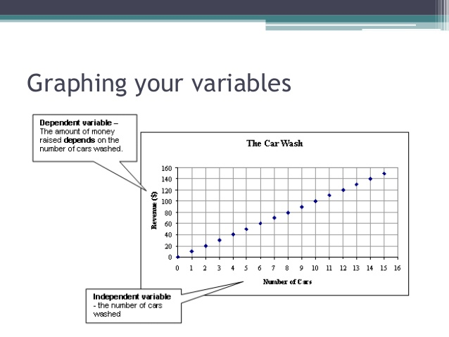

Slide 123
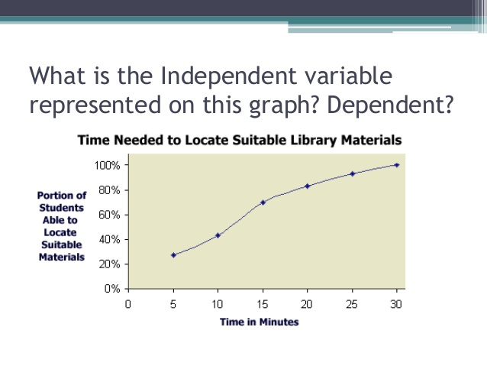
Notes:
Independent variable- time in minutes

Slide 124
Standard Deviation
Karl Pearson introduced the concept of standard deviation in 1893.
It is the most important measure of dispersion and is widely used in many statistical formulae.
Standard deviation is also called Root-Mean Square Deviation.
The reason is that it is the square–root of the mean of the squared deviation from the arithmetic mean.
It provides accurate result. Square of standard deviation is called Variance.

Slide 125
Definition
It is defined as the positive square-root of the arithmetic mean of the Square of the deviations of the given observation from their arithmetic mean.

Slide 126
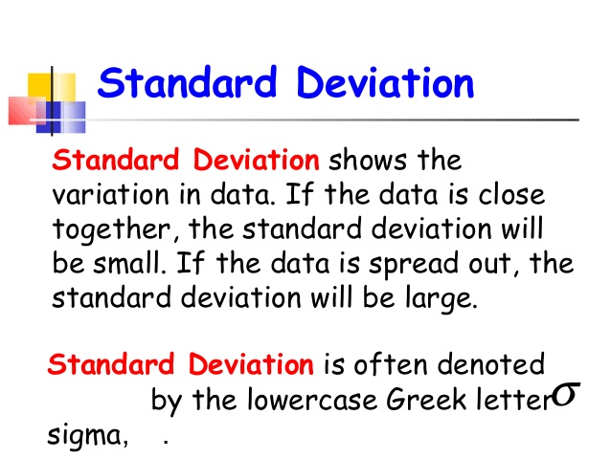

Slide 127
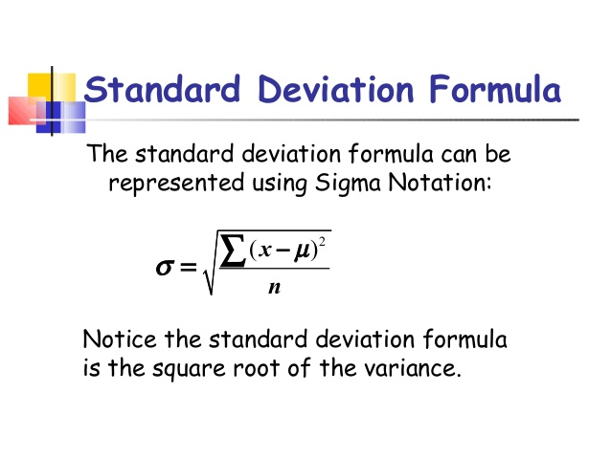
For Ungrouped data

Slide 128
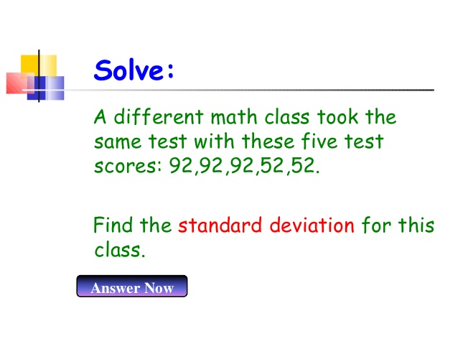

Slide 129
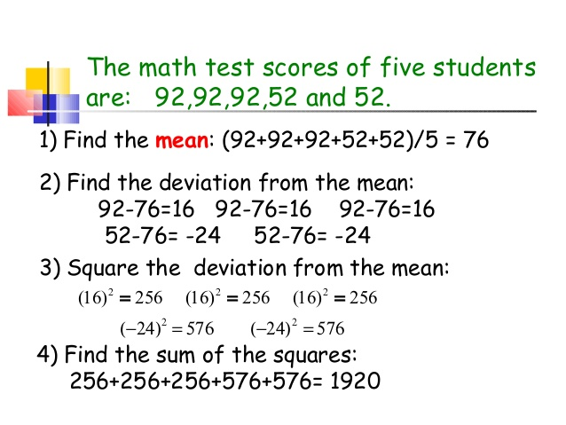

Slide 130
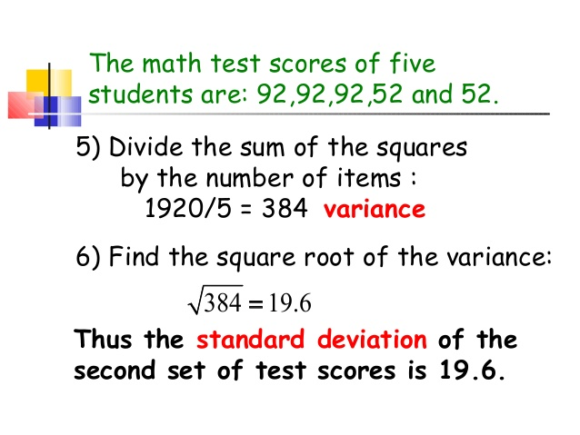

Slide 131
Merits of SD
It is rigidly defined and its value is always definite and based on all the observations and the actual signs of deviations are used.
As it is based on arithmetic mean, it has all the merits of arithmetic mean.
It is the most important and widely used measure of dispersion.
It is possible for further algebraic treatment.
It is less affected by the fluctuations of sampling and hence stable.
It is the basis for measuring the coefficient of correlation and sampling.

Slide 132
Demerits of SD
  It is not easy to understand and it is difficult to calculate.
  It gives more weight to extreme values because the values are squared up.
  As it is an absolute measure of variability, it cannot be used for the purpose of comparison.

Slide 133
INTRODUCTION
It is a measure of the strength of the straight-line or linear relationship between two variables.
The correlation coefficient takes on values ranging between +1 and -1.
The correlation coefficient, denoted by r
It measures the strength and the direction of a linear relationship between two variables

Slide 134

Definitions
Correlation is usually defined as a measure of the linear relationship between two quantitative variables (e.g., height and weight).
The correlation coefficient is a statistical measure of the strength of the relationship between the relative movements of two variables.

Slide 135
Common Methods of computing the correlation
3 commonly used methods
Scatter diagram method
Karl Pearson’s Correlation Coefficient
Spearman’s Rank Correlation Coefficient

Slide 136
Scatter diagram

Slide 137
Type of correlation coefficient
Perfect Positive correlation
Perfect negative correlation
Low Positive correlation
Low negative correlation
No correlation

Slide 138
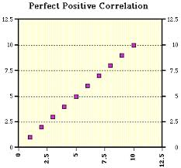
Perfect Positive correlation
An r value of exactly +1 indicates a perfect positive fit.
Positive values indicate a relationship between x and y variables such that as values for x increases, values for y also increase.

Slide 139
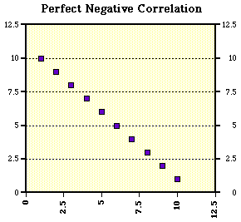
Perfect negative correlation
An r value of exactly -1 indicates a perfect negative fit.
Negative values indicate a relationship between x and y such that as values for x increase, values for y decrease.

Slide 140
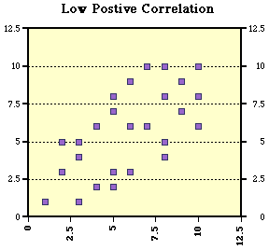
Low positive correlation
Low positive correlation is something that seems to kind of correlate in a positive direction might have a value 0 < r < 1, example 0.4

Slide 141
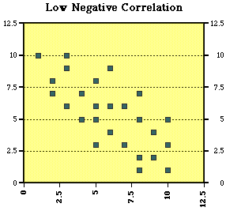
Low negative correlation
Low negative correlation is something that seems to kind of correlate in a negative direction might have a value -1 < r < 1 example - 0.4

Slide 142
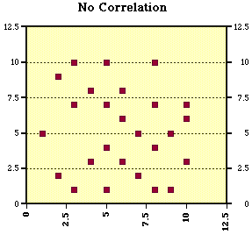
No correlation
If there is no linear correlation or a weak linear correlation, r is close to 0.
A value near zero means that there is a no relationship between the two variables

Slide 143
KARL PEARSON’s Correlation
Coefficient

Slide 144
Karl Pearson’s Correlation Coefficient
Karl Pearson’s method, popularly known as a Pearsonian Coefficient of Correlation, is the most extensively used quantitative methods in practice. The coefficient of correlation is denoted by “r”.

Slide 145
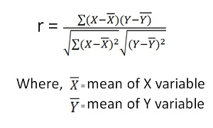
Formula
If the relationship between two variables X and Y is to be ascertained, then the following formula is used:

Slide 146
Assumptions of Karl Pearson’s Coefficient of Correlation
The relationship between the variables is “Linear”
The variables under study so as to form a Normal Distribution.
The variables are independent of each other.

Slide 147
Spearman’s Rank
Correlation Coefficient

Slide 148
Definition:
The Spearman’s Rank Correlation Coefficient is the non-parametric statistical measure used to study the strength of association between the two ranked variables. This method is applied to the ordinal set of numbers.

Slide 149

Formula
R = Rank coefficient of correlation
D = Difference of ranks
N = Number of Observations

Slide 150
Steps
Where actual ranks are given: the steps are
The difference between the ranks (R1-R2) must be calculated, denoted by D
Square these differences to remove the negative sign and obtain its sum ∑D²
Apply the formula

Slide 151
Definition
Statistical software are specialized computer programmes for analysis in statistics. There are number of software available to manage statistical data. Nurse researchers almost invariably use computer to calculate statistics.

Slide 152
There are many statistical software packages available for nursing research, many proprietary and many free. Some have been around for many years and some are new on the scene.

Slide 153
Statistical software package for analyzing Quantitative data
There are some software packages that are readily available and often used at UniSA, including Microsoft Excel, SPSS, SAS, Stata and R, which will briefly overviewed here.

Slide 154
Microsoft Excel
Pros and Cons
Extremely easy to use and interchanges nicely with other Microsoft products
Excel spreadsheets can be read by many other statistical packages
Add on module which is part of Excel for undertaking basic statistical analyses
Can produce very nice graphs

Slide 155
Excel is designed for financial calculations, although it is possible to use it for many other things
Cannot undertake more sophisticated statistical analyses without purchase of expensive commercial add ons.

Slide 156
SPSS
Statistical Package for Social Sciences
Pros and Cons
Very easy to learn and use
Can use either with menus or syntax files
Quite good graphics
Excels at descriptive statistics, basic regression analysis, analysis of variance and some newer techniques such as Classification and Regression Trees (CART)

Slide 157
Focus is on statistical methods mainly used in the social sciences, market research and psychology
Has advanced regression modelling procedures such as LMM and GEE, but they are awful to use with very obscure syntax
Has few of the more powerful techniques required in epidemiological analysis, such as competing risk analysis or standardized rates

Slide 158
SAS (Statistical Analysis System)
A researcher often gets a large data set in the field of medicine and nursing, so in those fields, the researcher generally uses SAS (Statistical Analysis System) instead of SPSS (Statistical Package for Social Sciences) to analyze the clinical data.

Slide 159
SAS provides a graphical point-and-click user interface for non-technical users and more through the SAS language.
SAS programs have DATA steps, which retrieve and manipulate data, and PROC steps, which analyze the data. Each step consists of a series of statements.

Slide 160
SAS data can be published in HTML, PDF, Excel, RTF and other formats using the Output Delivery System. The SAS software suite has more than 200 components.

Slide 161
Pros and Cons
Can use either with menus or syntax files
Much more powerful than SPSS
Commonly used for data management in clinical trials
Harder to learn and use than SPSS

Slide 162
Stata
Pros and Cons
Can use either with menus or syntax files
Much more powerful than SPSS – probably equivalent to SAS
Excels at advanced regression modelling
Has its own in-built structural equation modelling

Slide 163
Has a good suite of epidemiological procedures
Researchers around the world write their own procedures in Stata, which are then available to all users
Harder to learn and use than SPSS
Does not yet have some specialised techniques such as CART or Partial Least squares regression

Slide 164
R
S-plus is a statistical programming language developed in Seattle in 1988. R is a free version of S-plus developed in 1996.
Pros and Cons
Very powerful – easily matches or even surpasses many of the models found in SAS or Statas

Slide 165
Researchers around the world write their own
procedures in R, which are then available to all users
Free
Much harder to learn and use than SAS or Stata

Slide 166
Statistical software package for analyzing Qualitative data
Computer-assisted qualitative data analysis software (CAQDAS)offers tools that assist with qualitative research such as transcription analysis, coding and text interpretation, recursive abstraction, content analysis, discourse analysis, grounded theory methodology, etc.

Slide 167
CAQDAS is used in psychology, marketing research, ethnography, public health and other social sciences.
The CAQDAS networking project lists the following tools a CAQDAS program should have:
Content searching tools
Coding tools

Slide 168
Linking tools
Mapping or networking tools
Query tools
Writing and annotation tools

Slide 169
Pros and Cons
Such software helps to organize, manage and analyze information
The advantages of using this software include saving time, managing huge amounts of qualitative data, having increased flexibility, having improved validity and auditability of qualitative research, and being freed from manual and clerical tasks

Slide 170
Concerns include increasingly deterministic and rigid processes, privileging of coding and retrieval methods; reification of data, increased pressure on researchers to focus on volume and breadth rather than on depth and meaning.

Slide 171
Time and energy spent learning to use computer packages, increased commercialism and distraction from the real work of analysis

Slide 172
Definition
Parametric tests assume underlying statistical distributions in the data. Therefore, several conditions of validity must be met so that the result of a parametric test is reliable.

Slide 173
Definition
A parametric test is a hypothesis testing procedure based on the assumption that observed data are distributed according to some distributions of well-known form.

Slide 174
For example, Student’s t-test for two independent samples is reliable only if each sample follows a normal distribution and if sample variances are homogeneous.

Slide 175
Test of significance
A test of significance is a formal procedure for comparing observed data with a claim (also called a hypothesis), the truth of which is being assessed.

Slide 176
7 Steps In Test of significance
Step 1: State the Null Hypothesis
Step 2: State the Alternative Hypothesis
Step 3: Set α
Step 4: Collect Data
Step 5: Calculate a test statistic
Step 6: Construct Acceptance / Rejection regions
Step 7: Based on steps 5 and 6, draw a conclusion about H0

Slide 177
Step 1: State the Null Hypothesis
The null hypothesis can be thought of as the opposite of the "guess" the research made. So we set up a Null hypothesis which is effectively the opposite of the working hypothesis.

Slide 178
The hope is that based on the strength of the data we will be able to negate or Reject the Null hypothesis and accept an alternative hypothesis. We state the Null hypothesis as: H0

Slide 179
Step 2: State the Alternative Hypothesis
To cover all alternative outcomes, we resort to a verbal statement of ‘not all equal’ and then follow up with mean comparisons to find out where differences among means exist. We state the alternative hypothesis as: Ha

Slide 180
Step 3: Set α
Researcher should be familiar with type I and type II errors. It is important to note that we want to set α before the experiment (a-priori) because the Type I error is the more ‘grevious’ error to make. The typical value of α is 0.05, establishing a 95% confidence level. For this course we will assume α =0.05.

Slide 181
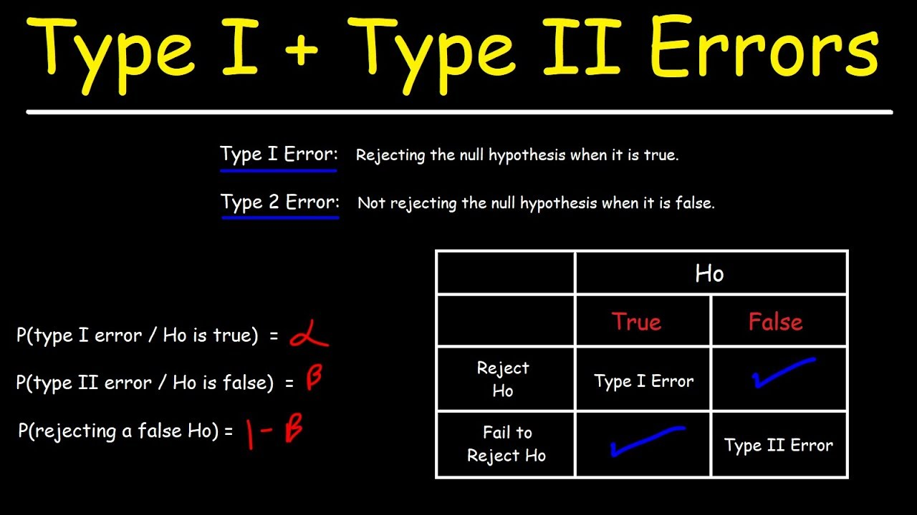

Slide 182
Step 4: Collect Data
Data is collected through experimental design or observation.
Step 5: Calculate a test statistic
Hypothesis testing generally uses a test statistic that compares groups or examines associations between variables. When describing a single sample without establishing relationships between variables, a confidence interval is commonly used.

Slide 183
The p-value describes the probability of obtaining a sample statistic as or more extreme by chance alone if your null hypothesis is true. This p-value is determined based on the result of your test statistic.

Slide 184
Step 6: Construct Acceptance / Rejection regions
Well, there is a cut-off line. Since we are conducting a two-sided or a two-tailed test, there are two cut-off lines, one on each side.
The area that is cut-off actually depends on the significance level. Say the level of significance, α, is 0.05.

Slide 185
Then we have α divided by 2, or 0.025 on the left
side and 0.025 on the right side.
The acceptance region with p value < 0.05
The rejection region with p value > 0.05

Slide 186
Step 7: Based on steps 5 and 6, draw a conclusion about H0
P-value <= significance level (a) => Reject your null hypothesis in favor of your alternative hypothesis. Your result is statistically significant.
P-value > significance level (a) => Fail to reject your null hypothesis. Your result is not statistically significant.

Slide 187
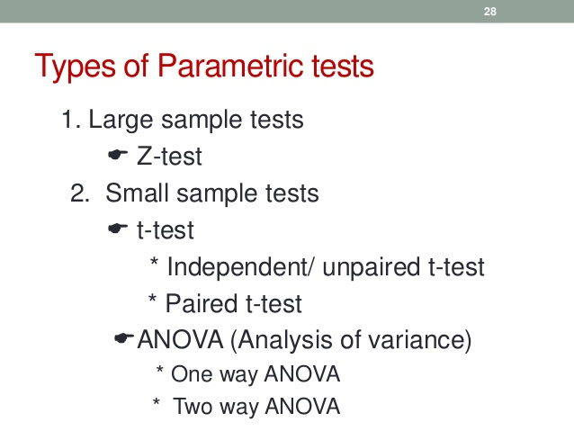
Table 1: Types of Parametric test

Slide 188
Parametric tests are used only where a normal distribution is assumed. The most widely used tests are the t-test (paired or unpaired). Here we shall discuss about it.

Slide 189
Paired and Un paired t-test
Paired t-test
A paired t-test (also known as a dependent or correlated t-test) is a statistical test that compares the averages/means and standard deviations of two related groups to determine if there is a significant difference between the two groups.

Slide 190
Paired t-tests are considered more powerful than unpaired t-tests because using the same participants or item eliminates variation between the samples that could be caused by anything other than what’s being tested. The variables must consist of two related groups or matched pairs.

Slide 191
When to use a paired t-test?
Paired t-tests are used when the same item or group is tested twice, which is known as a repeated measures t-test. Some examples of instances for which a paired t-test is appropriate include:
The before and after effect of a pharmaceutical treatment on the same group of people.

Slide 192
Body temperature using two different thermometers on the same group of participants.
Standardized test results of a group of students before and after a study prep course.

Slide 193
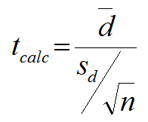
Formula for Paired t- test

Slide 194
Advantage and disadvantage of paired t-test
The value of test statistic and other numerical value can easily be calculated under the paired t-test.
The hypothesis process is easy to understand and save time.

Slide 195
Multiple comparisons are not possible under the paired data t-test.
The sample size is small, the result may not be reliable and accurate.

Slide 196
Un paired t-test
An unpaired t-test (also known as an independent t-test) is a statistical procedure that compares the averages/means of two independent or unrelated groups to determine if there is a significant difference between the two. The variables must consist of two independent groups.

Slide 197
When to use an unpaired t-test?
An unpaired t-test is used to compare the mean between two independent groups. You use an unpaired t-test when you are comparing two separate groups with equal variance.

Slide 198
Example of appropriate instances during which to use an unpaired t-test:
Research during which there are two independent groups, such as women and men, that examines whether the average bone density is significantly different between the two groups.

Slide 199
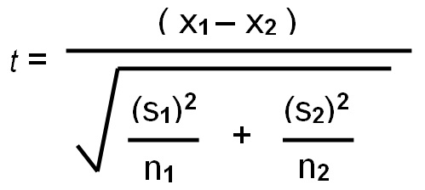
Formula for Unpaired t- test

Slide 200
Advantage and disadvantage of unpaired t-test
The claim of non paired data and conclusion is easy to interpret and understandable.
The unpaired sample provide necessary data for two different population.

Slide 201
Hypothesis process contains a lot of calculation and takes time to reach the conclusion.
Analysis of two different population is expensive and complex for research work.

Slide 202
Type I and II error
In statistical hypothesis testing, a type I error is the rejection of a true null hypothesis (also known as a "false positive" finding or conclusion),
while a type II error is the non-rejection of a false null hypothesis (also known as a "false negative" finding or conclusion).

Slide 203
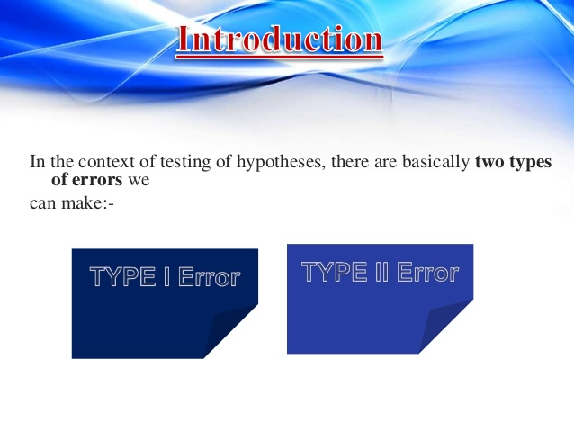

Slide 204
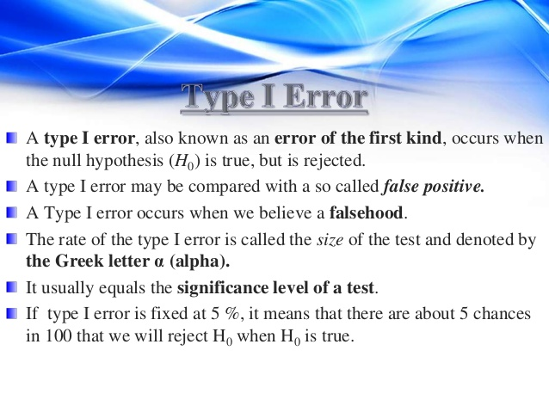

Slide 205
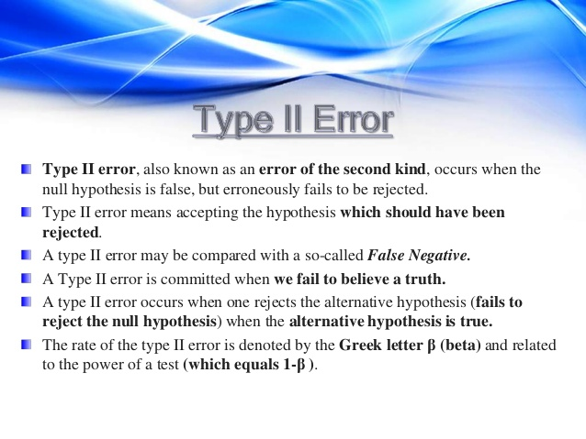

Slide 206
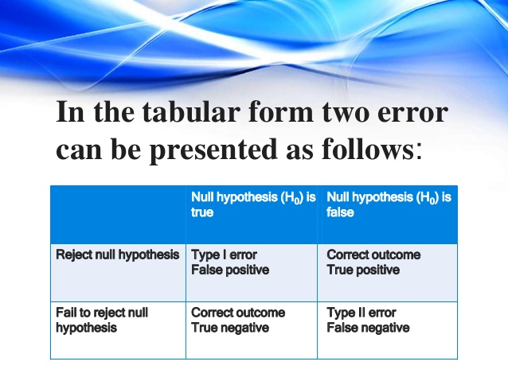

Slide 207
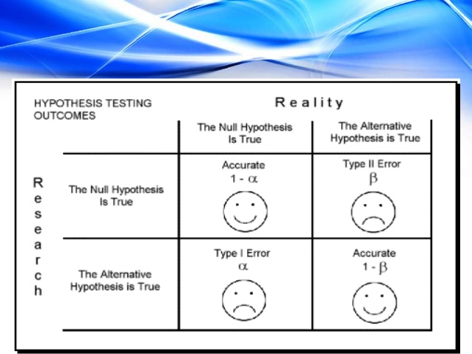

Slide 208


Slide 209


Slide 210


Slide 211


Slide 212


Slide 213


Slide 214
References
1.Sundaram KR, Dewivedi SN, Sreenivas V. Medical statistics, Principles and Methods;BI Publications New Delhi1.
2. Chandraiah,.P. (2010).Nursing Research and statistics., Florence publication.
3.https://byjus.com/maths/graphical-representation/.

