Slide 1
INTRODUCTION
Sampling is a complex and technical topic. It helps to get information, make decisions, and develop predictions through sampling, come to conclusions about phenomena based on exposure to a limited portion of those phenomena.

Slide 2
How doctor examines a few drops of blood and draws conclusions about the blood constitution of the whole body etc. We all come to conclusions about phenomena based on exposure to a limited position of those phenomena.

Slide 3
A population is the entire aggregation of cases in which a researcher is interested. make a distinction between target and accessible populations.
The accessible population is the aggregate of cases that conform to the designated criteria and that are accessible as a pool of subjects for a study.

Slide 4
Sampling
The target population needs to be clearly defined
Sometimes the entire population is surveyed-Census
Usually population too large for researcher to conduct census
A sample truly representative of population-that reflects the characteristics of the population
Slide 4

Slide 5
The target population is the aggregate of cases about which the researcher would like to make generalizations.
The criteria that specify population characteristics are referred to as eligibility criteria or inclusion criteria.
a population is deﬁned in terms of characteristics that people must not possess (i.e., stipulating the exclusion criteria). For example, the population may be deﬁned to exclude people who cannot speak English.

Slide 6
SAMPLING FRAME
Sampling frame consists of a list of items
Or elements from which the sample is to be drawn.
(Ex) Telephone Directory, Name list of the students, voters list, etc.

Slide 7
Samples and Sampling
Sampling is the process of selecting a portion of the population to represent the entire population.
A sample, then, is a subset of population elements. An element is the most basic unit about which in- formation is collected. In nursing research, the elements are usually humans. Samples and sampling plans vary in quality. The overriding /key consideration consideration in assessing a sample in a quantitative study is its representativeness and size
A representative sample is one whose key characteristics closely approximate those of the population.
Sampling bias refers to the systematic over-representation or under-representation of some segment of the population in terms of a characteristic relevant to the research question.

Slide 8
 Eligibility Criteria
The criteria that specify population characteristics are referred to as eligibility criteria ( or ) inclusion criteria
Ex:  School children who belonged to the age group of 13-16 yrs

Slide 9
 School children who were studying 8th
and 9th std in Bharathi matric. Hr.
Sec. School, Maduravoyal.
 Who know to read and write English
 School children who were willing to
participate in the study.

Slide 10
Exclusion Criteria
A Population is defined in terms of characteristic that people must not possess.
❑ School Children who did not belong to the age group of 13 – 16 yrs in Bharathi Matric Hr. Sec. School
The School children were not from 8th and 9th standard studying in Bharathi matric Hr. Sec. School
Who were not willing to participate in the study.

Slide 11
SAMPLING DESIGNS
A sampling design is a definite plan for obtaining a sample from the sampling frame.
It refers to the technique or the procedure the researcher would adopt in selecting some sampling units from which inferences about the population is drawn.
Sampling designs are classified either Probability sampling and Non-probability sampling.

Slide 12
ADVANTAGES AND
DISADVANTAGES OF SAMPLING
Economy in Expenditure
Economy in Time
Greater Scope
Greater accuracy
Organisation of Convenience
Intensive and exhaustive data
Suitable in limited resources
Better report
DISADVANTAGES
Chance of bias
Difficulty in getting representative supply
Need for specialized knowledge
Changeability of unit
Impossibility of sampling

Slide 13
CHARACTERISTICS OF GOOD SAMPLE
Should not be any substitution of originally selected unit
Should not suffer from incomplete coverage of the units selected for the study.
Relatively small samples properly selected may be much more reliable than large samples poorly selected.

Slide 14
STEPS (PROCESS )OF SAMPLING
Sampling is a process of selecting a portion of the designated population to represent its entire population and it contains seven sequential steps.
Identify the population
Specify the eligibility criteria
Specify sampling plan
Recruit the sample

Slide 15
SAMPLING DESIGNS [METHODS OF SAMPLING]
PROBABILITY
NON PROBABILITY

Slide 16
PROBABILITY SAMPLING
Probability sampling involves the random selection of elements from a population.
Random assignment refers to the process of allocating subjects to different treatment conditions at random.
Random assignment has no bearing on how subjects in an experiment were selected in the ﬁrst place.
Random sampling involves a selection process in which each element in the population has an equal, independent chance of being selected.
The four most commonly used probability sampling methods are simple random, stratiﬁed random, cluster and systematic sampling.

Slide 17
Probability Sampling -cont
This uses a technique by which the researcher ensures the probability that each element of the population will be included in the sample.
- It utilizes some form of random selection because of which greater confidence can be placed more representativeness of the samples.

Slide 18
PROBABILITY SAMPLING METHODS
Simple Random
Sampling
Stratified Random
Sampling
Cluster
Sampling
Systematic
Sampling

Slide 19
Simple Random Sampling
It is the most basic probability sampling design .
Because the more complex probability sampling design incorporate features of simple random sampling.

Slide 20

Simple random sampling
Each and every individual in the population has an equal chance of being selected in the sample
Method
  Prepare a list of all members in the population
  Assign unique numbers to all members
  Use random number tables to select the required samples

Slide 21
Sampling frame
1 | ANNAPURNA Y.
2 | APARNA GOPI
3 | A.PULLAMMA
4 | B.B.BHAVANA
5 | CH.SUMATHI
6 | C.PADMASREE
7 | G.PAVITHRA
8 | INDU S.
9 | JEENA MARY
10 | JISMI THERISIA
21 | NAYANA NIRMAL
22 | NAYANA SURESH
23 | N.ANJANI DEVI
24 | NELBY VERGHESE
25 | P.KEERTHI
26 | P.JAHNAVI
27 | RAJI RAMACHANDRAN
28 | SARASWATHI SOUMYA
29 | SAYANA SURESH
30 | SEENA ELASA MATHAI
31 | SEENA ELASA MATHAI
32 | SHEBE GEORGE
33 | SHERIN SIMON
34 | SIMI SUSAN JOHN
35 | S.ARUNDHATHI
36 | SOMI JOSEPH
37 | SUMI T.ABRAHAM
38 | I.SWAPNA
39 | TINJU K.NINAN
40 | V.SWATHI
11 | JULIT.P.
12 | K.MANJULA
13 | M.LAVANYA
14 | M.BHAGYA
15 | M.SOUBHAGYA
16 | MEGHASARA
17 | MERLIN
18 | MERLIN
19 | N.SUBHASHINI
20 | N.SWAPNA

Slide 22
Once a sampling frame has been developed,
elements are numbered consecutively.
 A table of random number would then be used to
draw a sample of desired size .
An example of a sampling frame for a n population of
400 people is presented in that , select randomly a sample of 20 people.
 Stating place in a table of random numbers by blindly placing our figure at some point on the page this process would continue until 20 subjects were chosen.

Slide 23
Simple Random sampling
Advantages
  Simple and easy
  Yields a representative and unbiased sample
Disadvantages
  Needs sampling frame
  Efficient, only when we have homogeneous population

Slide 24

Stratified random sampling
Useful when all subgroups of the group are to be adequately represented
Method
  Divide the population into groups / strata's
  Draw a simple random sample from each strata
  SRS can be drawn either proportionally to the size or in a constant way

Slide 25
Example
Suppose the researcher wants to assess patient satisfaction
Population can be divided on basis of economic status as low / Middle / High
With SRS, the number in the low and High could be very few
Stratification can do better
  Divide the population into three groups
  Take a SRS from each of the three groups

Slide 26
Stratified sampling
Advantages
  Better coverage and representation of the population
Disadvantages
  Difficult to identify the strata's (knowledge?)

Slide 27
Systematic random sampling
Method
  Prepare a list of all members in the population
  Assign unique numbers to all members
  Divide N/n to get sampling ratio (r)‏
  Choose a number from 1 to r randomly
  From then on, choose every rth sample

Slide 28
Example
Suppose if 8 houses are to selected from a 120 houses in a street.
  List the houses and assign numbers
  Divide 120/8 =15 (sampling ratio 'r')‏
  Choose a number from 1 to 15 randomly, say 5
  From 5, chose every 15th number (5, 20, 35, 50, 65,80,95,110)‏

Slide 29
Systematic sampling
Advantages
  Less time consuming and simpler (exit polls)
  Representative and unbiased sample
  No need for random number tables (sometimes may not require frame)
Disadvantages
  Availability of sampling frame
  The physical arrangement should not have any inherent order (Periodicity)

Slide 30
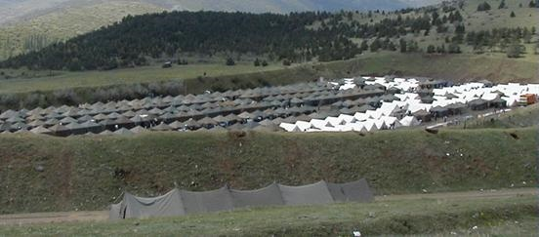
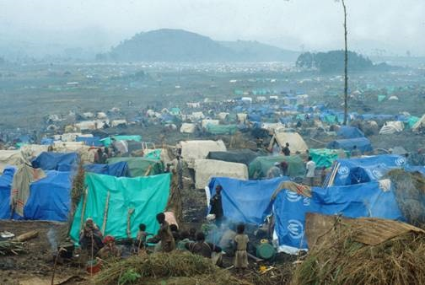
A or B?

Slide 31
Cluster sampling
Method
  The unit of sampling is cluster or group of individuals
  Use naturally occurring groups to form 'clusters'
    Districts, villages and blocks
    Schools, Hospitals, Industries (quarries)‏
  Take a simple random sample of the clusters
  Survey all members in the cluster

Slide 32
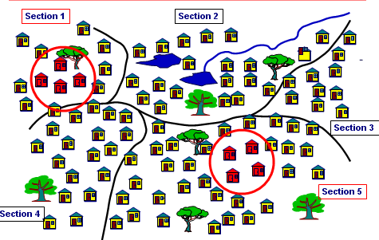

Slide 33
Example
Suppose if a researcher is interested in selecting school children in Vellore (for studying life style factors)
  SRS: sample might be scattered all over Vellore
  Alternatively, consider each school as a 'cluster' and randomly select schools
  survey all children within that school

Slide 34
Cluster sampling
Advantages
  Saves a lot of time
  Avoids contamination (in trials)
Disadvantages
  Samples within each cluster may be similar

Slide 35

Points to remember
  The major goal of sampling is to estimate some indicator of a larger population
  Regardless of the sampling method, if the sample is not representative then the results are invalid
  There could be different ways of doing sampling
  Choose the one, which can maximize the representativeness and optimize feasibility

Slide 36
Sample size- introduction
Calculation of the numbers required to do a study
Usually done at the start of the study
  (after deciding the primary objective and design of the study)
To ensure adequate numbers are studied
  Not too many (wasteful) or too small (under-power)
Based on a few parameters and not a magical number !!!

Slide 37
Non - probability sampling
Non-probability samples use non-random methods (i.e.,) there is bias in the selection.
- There is no assurance that every element has a chance of being included or the researcher cannot estimate the probability that each element will be included in the sample.

Slide 38
Non probability sampling
Convenience sampling:
  convenience of the researcher forms the basis for selection (right place at right time!)(budget)
Judgemental sampling:
  researcher decides (judges) whether the sample will be representative of the population (CPI)
Quota sampling:
  sampling continues till a pre-specified number is achieved in each of the groups of the population (College / School selections)

Slide 39
NONPROBABILITY SAMPLING
Nonprobability sampling is less likely than probabilIty sampling to produce accurate and representative
Convenience Sampling
Convenience sampling entails using the most conveniently available people as study participants.
A faculty member who distributes questionnaires to nursing students in a class is using a convenience sample, or an accidental sample, as it is sometimes called.
The nurse who conducts an observational study of women delivering twins at the local hospital is also relying on a convenience sample. The problem with convenience sampling is that available subjects might be atypical of the population of interest with regard to critical variables.
Convenience samples do not necessarily comprise individuals known to the researchers. Stopping people at a street corner to conduct an interview is sampling by convenience. Sometimes, researchers seeking people with certain characteristics place an advertisement in a newspaper, put up signs in clinics or supermarkets, or post messages in chat rooms on the Internet. These approaches are subject to bias because people select themselves as pedestrians on certain streets or as volunteers in response to posted notices.

Slide 40
Snowball sampling (also called network sampling or chain sampling) is a variant of conve- nience sampling. With this approach, early sample members are asked to identify and refer other peo- ple who meet the eligibility criteria. This method of sampling is often used when the research popula- tion is people with speciﬁc traits who might other- wise be difﬁcult to identify (e.g., people who are afraid of hospitals). Snowballing begins with a few eligible study participants and then continues on the basis of referrals from those participants until the desired sample size has been obtained.
Convenience sampling is the weakest form of sampling. It is also the most commonly used sampling method in many disciplines. In heterogeneous populations, there is no other sampling approach in which the risk of sampling bias is greater.

Slide 41
Quota Sampling
A quota sample is one in which the researcher identiﬁes population strata and determines how many participants are needed from each stratum. By using information about population characteristics, researchers can ensure that diverse segments are represented in the sample, preferably in the proportion in which they occur in the population.
Suppose we were interested in studying nursing students’ attitude toward working with AIDS patients. The accessible population is a school of nursing with an undergraduate enrollment of 1000 students; a sample of 200 students is desired
The easiest procedure would be to use a convenience sample by distributing questionnaires in classrooms or catching students as they enter or leave the library. Suppose, however, we suspect that male and female students have different attitudes toward working with AIDS victims quota sampling represents an important improvement over convenience sampling and should be considered by quantitative researchers whose resources prevent the use of probability sampling.

Slide 42
Consecutive sampling
Involves recruiting all of the people from an accessible populations who met the eligibility criteria over a specific time interval or for a specified sample size eg ventilator associated pts in ICU, if the accessible population were patients in an ICU of a specific hospital CS sample might consists of all eligible pts admitted in ICU over period of 6months.
It is better deal with potential bias with sufficient longer time than convenience sampling

Slide 43
Purposive Sampling
Purposive sampling or judgmental sampling is based on the belief that researchers’ knowledge about the population can be used to hand-pick sample members. Researchers might decide purposely to select subjects who are judged to be typical of the population or particularly knowledgeable about the issues under study. Sampling in this subjective manner, however, provides no external, objective method for assessing the typicalness of the selected subjects. Nevertheless, this method can be used to advantage in certain situations. Newly developed instruments can be effectively pretested and evalu- ated with a purposive sample of diverse types of people. Purposive sampling is often used when

Slide 44
researchers want a sample of experts, as in the case of a needs assessment using the key informant approach or in Delphi surveys. purposive sampling is frequently used by qualitative researchers.

Slide 45
Cluster Sampling
For many populations, it is impossible to obtain a listing of all elements. For example, the population of full-time nursing students in the United States would be difﬁcult to list and enumerate for the purpose of drawing a simple or stratiﬁed random sample. It might also be prohibitively expensive to sample students in this way because the resulting sample would include only one or two students per
institution.
If personal interviews were involved, the interviewers would have to travel to students scattered throughout the country. Large scale surveys almost never use simple or stratiﬁed random sampling; they usually rely on cluster sampling.

Slide 46
In cluster sampling, there is a successive random sampling of units. The ﬁrst unit is large groupings, or clusters. In drawing a sample of nursing students, we might ﬁrst draw a random sample of nursing schools and then draw a sample of students from the selected schools. The usual procedure for selecting samples from a general population is to sample successively such administrative units as states, cities, census tracts, and then households. Because of the successive stages in cluster sampling, this approach is often called multistage sampling.
The resulting design is usually described in terms of the number of stages (e.g., three-stage cluster sampling).
The clusters can be selected either by simple or stratiﬁed methods. For instance, in selecting clusters of nursing schools, it may be advisable to stratify on program type.
The ﬁnal selection from within a cluster may also be performed by simple or stratiﬁed random sampling.
For a speciﬁed number of cases, cluster sampling tends to be less accurate than simple or stratiﬁed random sampling. Despite this disadvantage, cluster sampling is more economical and practical than other types of probability sampling, particularly when the population is large and widely dispersed.

Slide 47
CLUSTER SAMPLING
(or multistage sampling ) moves the successive selection of random sample from large to smallest unit by either simple random or stratified random methods. The randomized selection continues through several stages and is then referred as multistage sampling.

Slide 48
CLUSTER SAMPLING
It does not require a complete frame of the whole population
It in more economical and pretrial then other sampling
The first unit is large grouping or cluster , In drawing a sample of nursing students , he might first draw a random sample of nursing school and then draw a sample of students from the selected school
States – Cities – Institutions/Organisation

Slide 49
Example: 1
“Customer satisfaction of patients attending O.P Dept of Christian MISSION Hospital”
Population – 800 per day
Sample required – 100

Slide 50
SAMPLE SIZE IN
QUANTITATIVE STUDIES
Quantitative researchers need to pay careful attention to the number of subjects needed to test research hy- potheses adequately. A sophisticated procedure known as power analysis can be used to estimate sample size needs, but some statistical knowledge is needed before this procedure can be explained. In this section we offer guidelines to beginning researchers;

Slide 51
There are no simple formulas that can tell you how large a sample is needed in a given quantitative study, but we can offer a simple piece of advice: You should use the largest sample possible. The larger the sample, the more representative of the population it is likely to be. Every time researchers calculate a percentage or an average based on sam- ple data, they are estimating a population value. Smaller samples tend to produce less accurate esti- mates than larger ones. In other words, the larger the sample, the smaller the sampling error.

Slide 52
Attrition
In longitudinal studies, the number of subjects usu- ally declines over time. This is most likely to occur if the time lag between data collection points is great; if the population is mobile or hard to locate; or if the population is a vulnerable one at risk of death or disability. If resources are devoted to trac- ing subjects, or if the researcher has an ongoing re- lationship with them (as might be true in clinical studies), then the rate of attrition might be low. It is a rare longitudinal study, however, that maintains the full research sample. Therefore, in estimating sample size needs, researchers should factor in anticipated loss of subjects over time.
Attrition problems are not restricted to longitu- dinal studies. People who initially agree to cooperate in a study may be subsequently unable or unwilling to participate for various reasons, such as death, deteriorating health, early discharge, discontinued need for an intervention, or simply a change of heart. Researchers should expect a certain amount of sub- ject loss and recruit accordingly.

Slide 53
Effect Size
Power analysis builds on the concept of an effect size, which expresses the strength of relationships among research variables. If there is reason to ex- pect that the independent and dependent variables will be strongly related, then a relatively small sam- ple should be adequate to demonstrate the relation- ship statistically. For example, if we were testing a powerful new drug to treat AIDS, it might be possi- ble to demonstrate its effectiveness with a small sample. Typically, however, interventions have modest effects, and variables are usually only mod- erately correlated with one another. When there is no a priori reason for believing that relationships will be strong (i.e., when the effect size is expected to be modest), then small samples are risky.

Slide 54
Sample size -Deciding Factors
Type of study design
  Descriptive (surveys)
  Comparative (experimental, cohort or case-control study)‏
Outcome variable
  Numerical
  (non) – Numerical (Dichotomous)

Slide 55
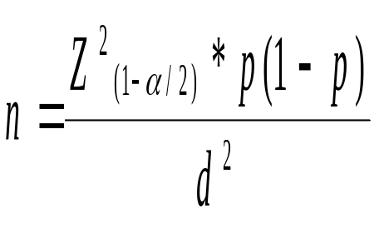
Sample size for surveys
  n – required sample size
  p – expected prevalence
  d – precision or width of 95 % CI

Slide 56
Example
Suppose a researcher wants to find the prevalence of TB infection among children of 0-9 years of age.
What sample size does he need?
  Outcome ?
    Numerical or Non numerical
  Study design ?
    Descriptive or Comparative

Slide 57
Formula for prevalence surveys
  Prevalence (p) =10 % ;
  q = 90%
  Precision =5%
  Sample size = (4 x 10x 90)/5 x 5 = 144 children

Slide 58
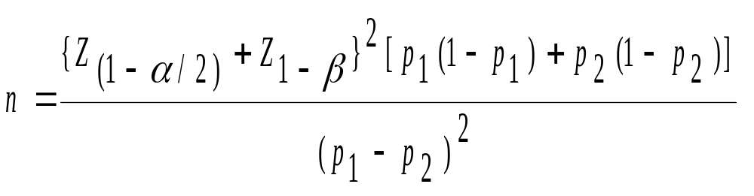
Sample size for comparative studies
  n – required sample size
  p ₁– prevalence in the group 1
  p ₂ – prevalence in the group 2

Slide 59
Example
Suppose a researcher wants to compare the prevalence of anaemia in children who are malnourished and well nourished.
What sample size would he require?
  Outcome ?
    Prevalence of anaemia
  Study design?
    Descriptive or comparative

Slide 60
  Prevalence of anaemia in under-nourished group
  = 50%(p1)‏
  Prevalence of anaemia in well-nourished group =34% (p2)‏
  Expected difference
  =0.16 (p1-p2)
  Power=0.80 (Z = 0.849);
  Alpha=0.05 (Z = 1.96);
  Sample size required in each arm = 146

Slide 61
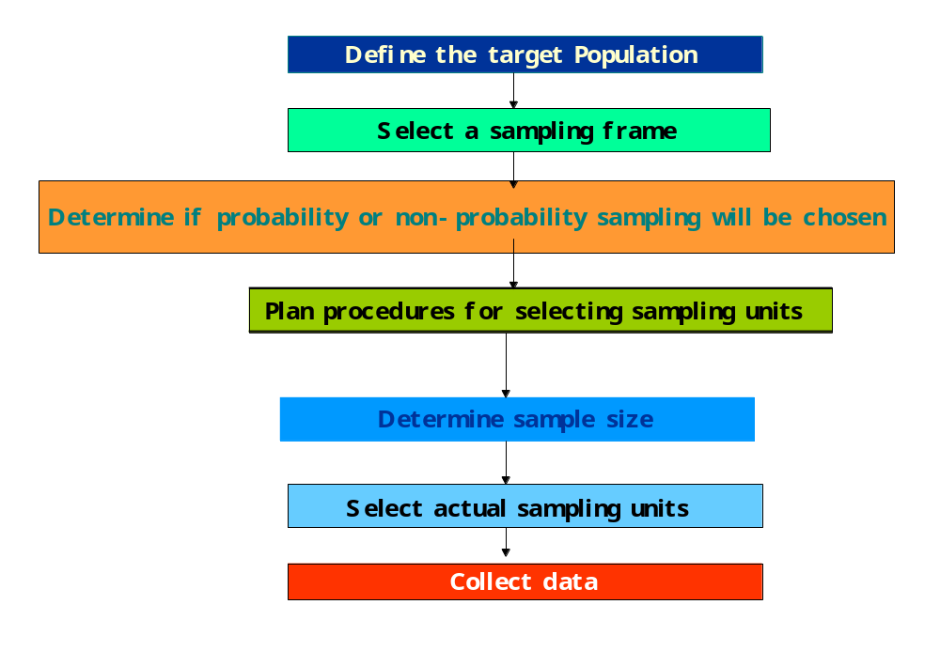

Slide 62
Random assignment / selection
Random selection is obtaining random sample from a defined population
Random assignment is done to obtain two equal group (treatment and placebo)‏

Slide 63


Two research strategies
No sample size calculation
Small studies and Meta analysis
Estimate sample size and if its big- network with colleagues

Slide 64
Checklist
Size
  Was the size adequate for the study
Representative
  Was the sample selected randomly
Implementation
  Was the plan carried out efficiently

Slide 65
Sample size
Qualitative studies –not guided by rules
Depends on several purposes of study, quality of informants, sampling strategy used
Ethnography-25-50
Phenomenology-10
Grounded theory 20-30
Quantitative studies
Power analysis

Slide 66
Factors influenzing sampling
Nature of researcher
In experienced investigator
Lack of inetrest
Lack of honesty
Intensive workload
Inadequate supervision
Nature of sample
Inappropriate sampling technique

Slide 67
Sample size
Defective sampling frame
Circumstances
Lack of time
Large geographic area
Lack of cooperation
Natural calamities

Slide 68
Sample size
Qualitative studies –not guided by rules
Depends on several purposes of study,quality of informants,sampling stratagy used
Ethnography-25-50
Phenomenology-10
Grounded theory 20-30
Quantitative studies
Power analysis

Slide 69
Sampling error
Deviation of selected sample from true
characteristics ,traits,behaviors,qualities or
Qualities or figures of the entire population
Reasons of sampling error
Drawing different subjects from the same population
Cause is biased sampling procedure
Second one is chance

Slide 70
Types of sampling bias
Self selection bias
Exclusion bias
Healthy user bias
How to minimize sampling error
Avoid convenient sampling
Target population should be well defined and the sample frame should match it
Excluded population is not taking away the desired features which were supposed to be measured

Slide 71
Problems of sampling
Samplig error
Lack of sample representativeness
Difficulty in estimation of sample size
Lack of awareness about sampling process
Lack of resources,cooperation
Lack of existing appropriate sampling frames for larger poplution
Callous approach of researcher towards sampling process

Slide 72
Denise.f . Polit2017, chery tatno beck “ the text book on nursing research , published by wolters kluwer , 10th edition,pg no 249- 264.

Slide 73




Your questions?

