Slide 1
PHYSIOLOGY OF PUERPERIUM, ASSESSMENT OF POSTNATAL WOMEN
Mrs. Preeti Bahuguna

Slide 2
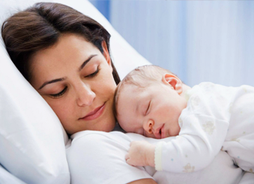
INTRODUCTION
Postnatal period is usually considered the interval extending from the birth of baby until 6 weeks after. In this period dramatic changes begin to occur in women’s body system . As soon as a baby’s born the processes that occurred during pregnancy are reversed.

Slide 3
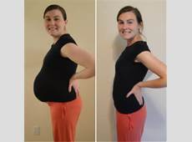
DEFINITION
Puerperium is the period following childbirth during which the body tissues ,specially the pelvic organs revert back approximately to the pre-pregnant state both anatomically and physiologically.
Involution is the process where by the reproductive organs return to their non pregnant state .

Slide 4
DURATION :-
Puerperium begins as soon as placenta is expelled and lasts for approximately 6 weeks when the uterus becomes regressed almost to the non pregnant size.
The period is divided into –
Immediate period: within 24 hrs
Early period: upto 7 days
Remote period: upto 6 weeks

Slide 5
ANATOMICAL AND PHYSIOLOGICAL CHANGES OF THE PUERPERIUM
ANATOMICAL CONSIDERATION
Uterus:-Immediately after delivery uterus is hard, reduced in size and fundus is generally felt about 10-12cm above the symphysis pubis.
Uterus weigh 500gm by the end of the first post –partal week, 300-350 by the end of second post-partal week and 100gm by the sixth partal week.

Slide 6
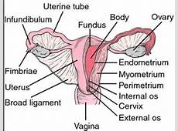

Slide 7
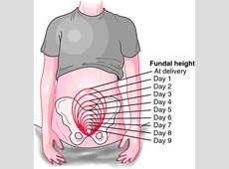
Immediately after delivery the top of fundus is approximately 2/3 to ¾ above the umbilicus, after few hour it then rises to the level of umbilicus.
For 1 day or 2 it remains at 1 finger breadth below the umbilicus and gradually descends into pelvis.

Slide 8
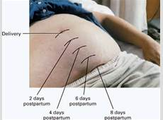
INVOLUTION OF UTERUS :-It is process whereby the genital organs revert back approximately to the state as they were before pregnancy.
An arrest or retardation or delay of involution is called sub involution.
The causes of sub involution include retained placental fragments and pelvic infection.

Slide 9
CLINICAL FEATURE OF SUBINVOLUTION
Prolongation of lochia discharge and irregular and excessive uterine bleeding.
On examination uterus is larger and softer for the period of puerperium.

Slide 10
UTERINE ATONY :-
Failure of the uterus to remain firmly contracted ,can lead to postpartum haemorrhage.
A full bladder is a major cause of uterine atony.

Slide 11
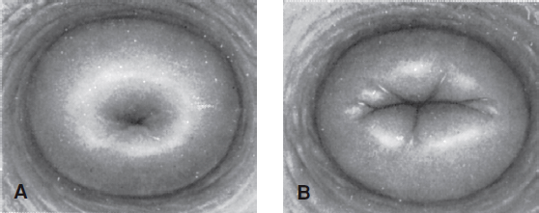
CERVIX:-
Lower Uterine segment and cervix remains loose, thin and stretched.
Immediately after birth ,the cervix is extremely soft, flabby.

Slide 12
It looks congested and rarely admit 2-3 fingers.
The cervix contracts slowly ,the external OS admits 2 fingers for a few days and by the end of the first week narrows down to admit the tip of finger.
External OS never revert to nulliparous state.

Slide 13
PHYSIOLOGICAL CONSIDERATION
The physiological process of involution is most marked in the body of the uterus .Changes occur in the following components :
Muscles
Blood Vessels
Endometrium

Slide 14
MUSCLES
During puerperium ,the number of muscles fibres is not decreased but there is substantial reduction of the myometrium cell size .
Withdrawal of the steroid hormones, oestrogen and progesterone may lead to increase in the activity of the uterine collagenase and the release of the proteolytic enzyme.

Slide 15
BLOOD VESSELS
The changes of the blood vessels are pronounced at the placental site.
The arteries are constricted by contraction of its wall and thickening of intima followed by thrombosis .
New blood vessels grow inside thrombi .

Slide 16
ENDMETRIUM
Following delivery , the major part of the decidua cast off with the expulsion of the placenta and membrane.
Regeneration of the epithelium is completed by the 10th day and the entire endometrium is restored by the 16th ,except at the placental size where its takes about 6 weeks.

Slide 17
PLACENATL SITE INVOLUTION
Complete extrusion of the placental site takes up to 6 weeks .
When this process is defective ,late onset puerperal hemorrhage may occur.
SIZE OF PLACENTAL SITE
Immediately after delivery : approx. the size of the palm ,but it rapidly decreases thereafter.

Slide 18
INVOLUTION OF OTHER PELVIC STRUCTURE
VAGINA
Takes a long time (4-8 weeks ) to involute .
It regains its tone but never to the virginal state .
The mucosa remains delicate for the first few weeks and sub mucous venous congestion persists even longer .
Rugae partially reappear at third week .
The introits remains permanently larger than the virginal state.

Slide 19
LOCHIA
It is the vaginal discharge for the first fortnight during puerperium.
The discharge originates from the uterine body, cervix and vagina.
Odour and reaction :-It has got a peculiar offensive fishy smell.
Colour :- Depending upon colour
lochia rubra
lochia serosa
lochia alba

Slide 20
Lochia rubra:-
It is red in color as it contains blood shreds of fetal membrane ,decidua ,vernix caseosa,lanugo and meconium. It starts immediately after the delivery and continues for the 3-4 days.

Slide 21
Lochia serosa:-
It is pale than rubra and is serous and pink. It
contain less RBC’s but more leukocytes, wound exudates ,decidual tissues and mucus from the cervix. It last for 5-9 days.

Slide 22
Lochia alba:-
It starts about the 10th post partum day till week. It is pale creamy white and contains leukocytes, decidual cells & mucus.
Amount :- for the first 5-6 days ,is estimated to be 250 ml
Normal duration :- may extend up to 3 weeks.

Slide 23
CLINICAL IMPORTANCE:
Odor-If malodorous ,indicates infection.
Amount-scanty or absent- signifies infection or lochiometra,if excessive indicates infection.
Color:-red color beyond normal limits signifies sub involution or retained bits of concepts.
Duration:-lochia alba beyond 3 weeks suggests local genital lesion.

Slide 24
COMPLICATION
Any offensive odour or change to a greenish colour indicates contamination by organisms such as chlamydia or saprophytic.
Lochia that is retained within the uterus is known as lochiostasis or lochioschesis and can result in lochiometra (distension of the uterus –pushing it out of shape).
Lochiorrhea describes an excessive flow of lochia and indicate infection.

Slide 25
SOME OF THE OTHER PHYSIOLOGICAL CHANGES
PULSE :- For a few hours after normal delivery ,the pulse rate is likely to be raised, which settle down to normal during the second day.
TEMPERATURE :- The temperature should not be above 37.2 ˚ with the first 24 hrs.
On the 3rd day ,there may be slight rise if temperature due to breast engorgement which should not last for more than 24 hrs.

Slide 26
WEIGHT LOSS:- In addition to the weight loss (5-6 kg) as a consequence of the expulsion of the fetus ,placentae, liquor and blood loss .The weight loss may continue upto 6 months of delivery.
FLUID LOSS :- There is a net fluid loss of about 2 litters during the 1st week and an additional 1.5 litres during the next 5weeks.

Slide 27
ABDOMINAL WALL :-The abdominal striae are never eradicated completely but they do change to fine,silvery white lines.
Women who take exercise regain their abdominal muscle tone and close the diastasis to some extent , however regaining complete muscle tone becomes difficult with increasing parity.

Slide 28
MENSTRUATION AND OVULATION:-
If the woman does not breast fed her baby, the menstruation returns by 6th week following delivery in about 40% and by 12th week in 80% of cases.

Slide 29
Integumentary system
Melanocyte-stimulating hormone is responsible for the hyperpigmentation that occurs during pregnancy MSH levels rapidly decreased after delivery and the skin changes that occurred as a result of pregnancy revert to the pre-pregnant state

Slide 30
Respiratory system-
During pregnancy, the diaphragm is slightly elevate as
The fetus nears term
This along with other respiratory changes , causes thoracic versus abdominal breathing in the third trimester.
After delivery the diaphragm descends and postpartum women’s respirations normally return to the pregnant state

Slide 31
Cardiovascular system-
As the pregnant body prepares for blood loss at birth, there is an increase in circulating blood volume during pregnancy. women may up to 500 ml of blood during a vaginal delivery and between 800 and 1000 ml of blood during a cesarean section. however due to the increase in the circulating blood volume that occurs during pregnancy, blood loss at delivery can easily be managed by the postpartum women who does not have cardiovascular disorders.

Slide 32
ENDOCRINE SYSTEM
With the sharp decrease of estrogen and progesterone levels following delivery of the placenta, lactation begins and menstruation return. Estrogen is a prolactin-inhibiting hormone.
When mothers choose to bottol-feed,prolactin levels dimish and estrogen levels begin to rise.menstruation return in approximately 6 to 8 weeks for these women. However ,ovulation can return within 4 weeks when women breastfeed, prolactin

Slide 33
Urinary system-
The bladder,urethra,and urinary meatus are edematous after delivery as a result of the fetal head passing through the birth canal. Bladder tone is diminished and many women are unable to feel the need to void despite the rapid diuresis that occurs following delivery

Slide 34
Gastrointestinal system-
Women are generally hungry and thirsty after delivery due to the amount of energy expended during labour.food and fluid intake is usually restricted during labor, and many women may not have eaten for a number of
Hours prior to delivery. the diaphoresis that occurs during the postpartum period may also lead to increased thirst. it is important for nurses to provide nourishment and hydration upon delivery many women experience constipation.

Slide 35
Immune system-
There are few changes in the immune system during the postpartum period. However it is important for Rh-negative patient to receive Rh immune globulin within 72 hours of delivery to prevent maternal antibody production in response to the Rh-positive antigen received from infants during pregnancy or birth

Slide 36
In non lactating mothers ,ovulation may occur as early as 4 weeks and in lactating mothers about 10 weeks after delivery .
Non lactating mother should use contraceptive measures after 3 weeks and the lactating mothers after 3 months of delivery .

Slide 37
ASSESSMENT OF POSTNATAL WOMEN
Breasts
Uterus
Bowel function
Bladder
Episiotomy
Emotion

Slide 38
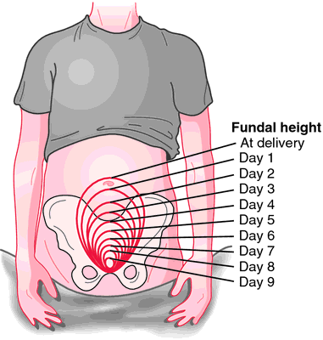

Slide 39
BUBBLEHE Assessment
  Breasts – Soft, filling, firm, Nipples
  Uterus – consistency, position, height, C/S
  Bladder – voiding pattern
  Bowels – bowel sounds, hemorrhoids,
  Lochia – type, amount, clots, odor
  Episiotomy – laceration, bruising, swelling
  Homan sign – present or not
  Emotional status – bonding, blues

Slide 40
BREASTS
Assess the breast for sign of engorgement, including fullness,around postpartum day 3 and 4
Hot,red,painful,and edematous areas, which could indicate mastitis
Nipple condition and latch- on techniques of women who are breastfeeding
Breast feeding women should wear a comfortable well-fitted support bra
Instruct them to gently rub colostrum or breast milk into their nipples

Slide 41
UTERUS
Assess the fundus- by approximately one hour post delivery, the fundus is firm and at the level of the umbilicus
The fundus continues to descend into the pelvis at the rate of approximately 1 cm or finger breadth per day and should be no palpable by 10 days postpartum
In addition, assess patient for uterine cramping and treat for pain as needed

Slide 42
BOWEL FUNCTION
Assessment of the bowel is important in all postpartum patient It is especially vital for patient following C-section assess for the following-
Bowel sounds
Return of bowel function
Flatus
Color and consistency of stool
Administer prescribed stool softer or laxative as needed to treat constipation and ease perineal discomfort.

Slide 43
BLADDER
Assess urination and bladder function for the following-
Return of urination which should occur within 6 to 8 hours of delivery
For approximately 8 hours after delivery amount of urine at each void. Patient should void a minimum of 150 ml per void less than 150 ml per void could indicated urinary retention due to decrease bladder tone post delivery
Sign and symptom of a urinary tract infection

Slide 44
CONTD…..
The bladder should be non palpable above the symphysis pubis
Encourage patient to drink adequate fluid each day and to report signs and symptoms of a urinary tract infection
Urgency
Painful urination
Hematuria

Slide 45
LOCHIA
Assess lochia during the postpartum period saturating one pad in less than an hour a constant trickle of lochia or the presence of large (golf ball sized) blood clots is indicated of more serious complication
Retained placenta
Hemorrhage
And should be investigated immediately

Slide 46
Episiotomy/perineum
the acronym REEDA is often used to assess an episiotomy or laceration of perineum REEDA stands for-

Slide 47
REEDA Scale for Incisions
Redness
Edema
Ecchymosis
Discharge
Approximation

Slide 48
Lower extremities/ homan’s sign-
To assess for deep vein thrombosis the lower extremities should be examined for the presence of hot, red, painful and edematous areas.
Assess the legs for adequate circulation by checking the pedal pulse and noting temperature and color
In addition, the lower extremities should be assessed for edema

Slide 49
Emotion-
Emotion are an essential elements of the postpartum assessment
Postpartum patient typically exhibit symptom of the “baby blues” or “postpartum blues” demonstrated by tearfulness, irritability and sometime insomnia

Slide 50
Other assessments-
Vital signs
Pain-
Head
Chest
Breast
Back

Slide 51
Limbs
Abdomen
Uterus
Perineum
Extremities
Cesarean section issues

Slide 52
Breast engorgement
Postnatal diuresis
Constipation
Lactation suppression
Postpartum depression
Post traumatic stress disorder
Postpartum psychosis

Slide 53
SUMMARY
So today we have discussed about:-
Definition of Puerperium
Duration of Puerperium
Anatomical and physiological changes during puerperium
General physiological changes
Assessment of the postnatal women

Slide 54
BIBLIOGRAPHY
Dutta Dc Textbook of obstetrics, ‘and gynecology 7th edition , new central agency page no
Jacob Anamma , Textbook of obstetrics and gynecology 3rd edition Jaypee brother publisher
Kamari Neelam , Textbook of obstetrics and gynecology 7th edition page no
Myles ,Textbook for Midwives ,15th edition CHURCHILL living stone Elsevier page no

Slide 55


