Slide 1
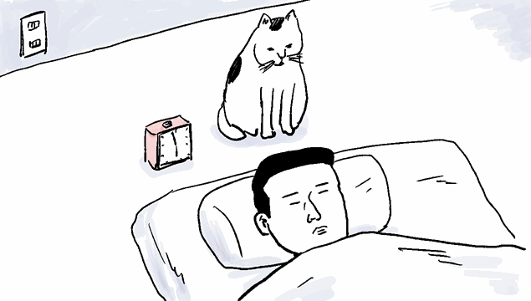


Slide 2

PAROTITIS
MR. DINESH SINGH
P.G. NURSING TUTOR
ROHILKHAND COLLEGE OF NURSING

Slide 3
OBJECTIVES
Introduction of the Parotitis.
Define the Parotitis.
Explain the causes of Parotitis.
State the clinical manifestations of Parotitis.
Elaborate the diagnostic evaluation of Parotitis.
Discuss the management of Parotitis.
Describe the prevention of Parotitis.

Slide 4
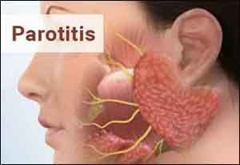

Slide 5
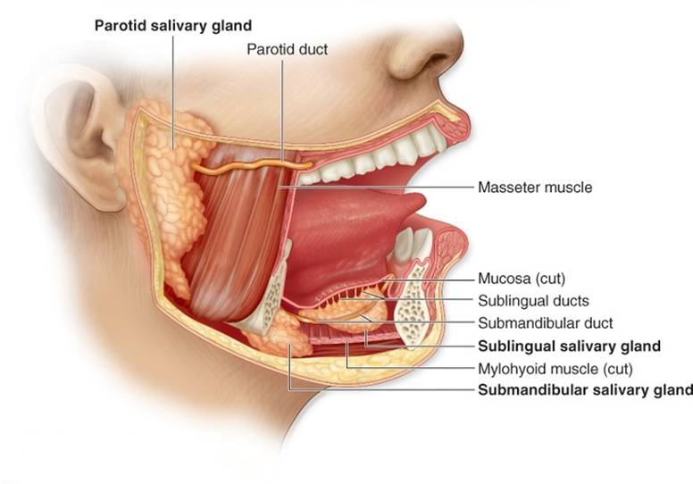
INTRODUCTION
Salivary glands: are composed of 4 major glands, in addition to minor glands.
Major:
2 Parotid glands.
2 Submand-ibular gland
Minor:
Sublingual.
Multiple minor glands

Slide 6
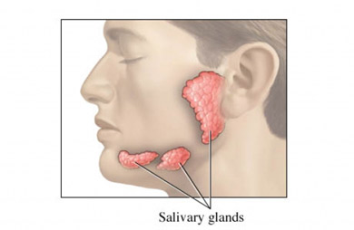
DEFINITION
Parotitis is swelling in one or both parotid glands. These are 2 large salivary glands that are between each ear and jaw.
The problem can be:
Acute: -Gets better in a short period of time with or without treatment
Chronic: -Causes long-term swelling or periods when things are worse and then better

Slide 7
ETIOLOGICAL FACTORS
There are many causes. It depends whether the illness is acute or chronic. The most common causes are:
Bacterial infection
A viral infection, such as mumps
Blockage of saliva flow
Poor oral hygiene

Slide 8
RISK FACTORS
This illness is more common in older adults and newborns. Other things that may raise the risk are:
Dehydration
Close contact with a person infected with the mumps
Certain health problems, such as: Diabetes, HIV infection

Slide 9
CLINICAL MANIFESTATION
Acute parotitis may cause:
Sudden pain and swelling that worsens with eating
Redness
Pus that may drain into the mouth
Chronic parotitis may cause:
Swelling around the parotid gland
Dry mouth
Milky discharge in the mouth

Slide 10
DIAGNOSTIC EVALUATION
History collection
Physical examination
Ultrasound
Sialography to view the ducts in and around the parotid gland
X-rays
CT scan
MRI scan

Slide 11
MANAGEMENT
Supportive care, such as warm water rinses and good oral hygiene
Medicines, such as:
  Antibiotics to treat infection
  Anti-inflammatory drugs to manage swelling and pain
Surgery to remove anything that may be blocking saliva flow

Slide 12
PREVENTION
Good oral hygiene may lower the risk of acute parotitis.

Slide 13
REFERENCES
Brunner and Suddarth’s “textbook of medical-surgical nursing” “10th edition, published by “Suzanne C. Smeltzer Brenda Bare”.
PR Ashalatha, G. Deepa “textbook of Anatomy and physiology” Fourth edition” published by “Jaypee Brothers”.
Linda S. Williams, Paula D. Hopper “textbook of Medical Surgical Nursing” “Third edition” Published by F.A. Davis 2007.
Priscilla LeMone, Karen Burke, Gerene Bauldoff “textbook of Medical Surgical Nursing” “Fifth edition” “published by Julie Levin Alexander”.
Lewis Dirksen Heitkemper Bucher, textbook of medical surgical nursing second south Asia edition, volume 1.

Slide 14


