Slide 1

TEERTHANKER MAHAVEER COLLEGE OF NURSING
TEACHING PRACTICE
ON
“NEPHROTIC SYNDROME”
PRESENTED BY
DINESH SINGH
M.SC. NURSING 1st YEAR
TMCON

Slide 2
NEPHROTIC
SYNDROME

Slide 3
INTRODUCTION
Nephrotic syndrome is a kidney disorder that causes the body to pass too much protein in the urine.
Nephrotic syndrome is usually caused by damage to the clusters of small blood vessels in the kidneys that filter waste and excess water from the blood.

Slide 4
DEFINITION
Nephrotic syndrome is a clinical disorder characterized by marked increase of protein in the urine (proteinuria), decrease in albumin in the blood (hypoalbuminemia), edema and excess lipids in the blood (hyperlipidemia).
Nephrotic syndrome is characterized by the loss of plasma protein, particularly albumin, in the urine.

Slide 5
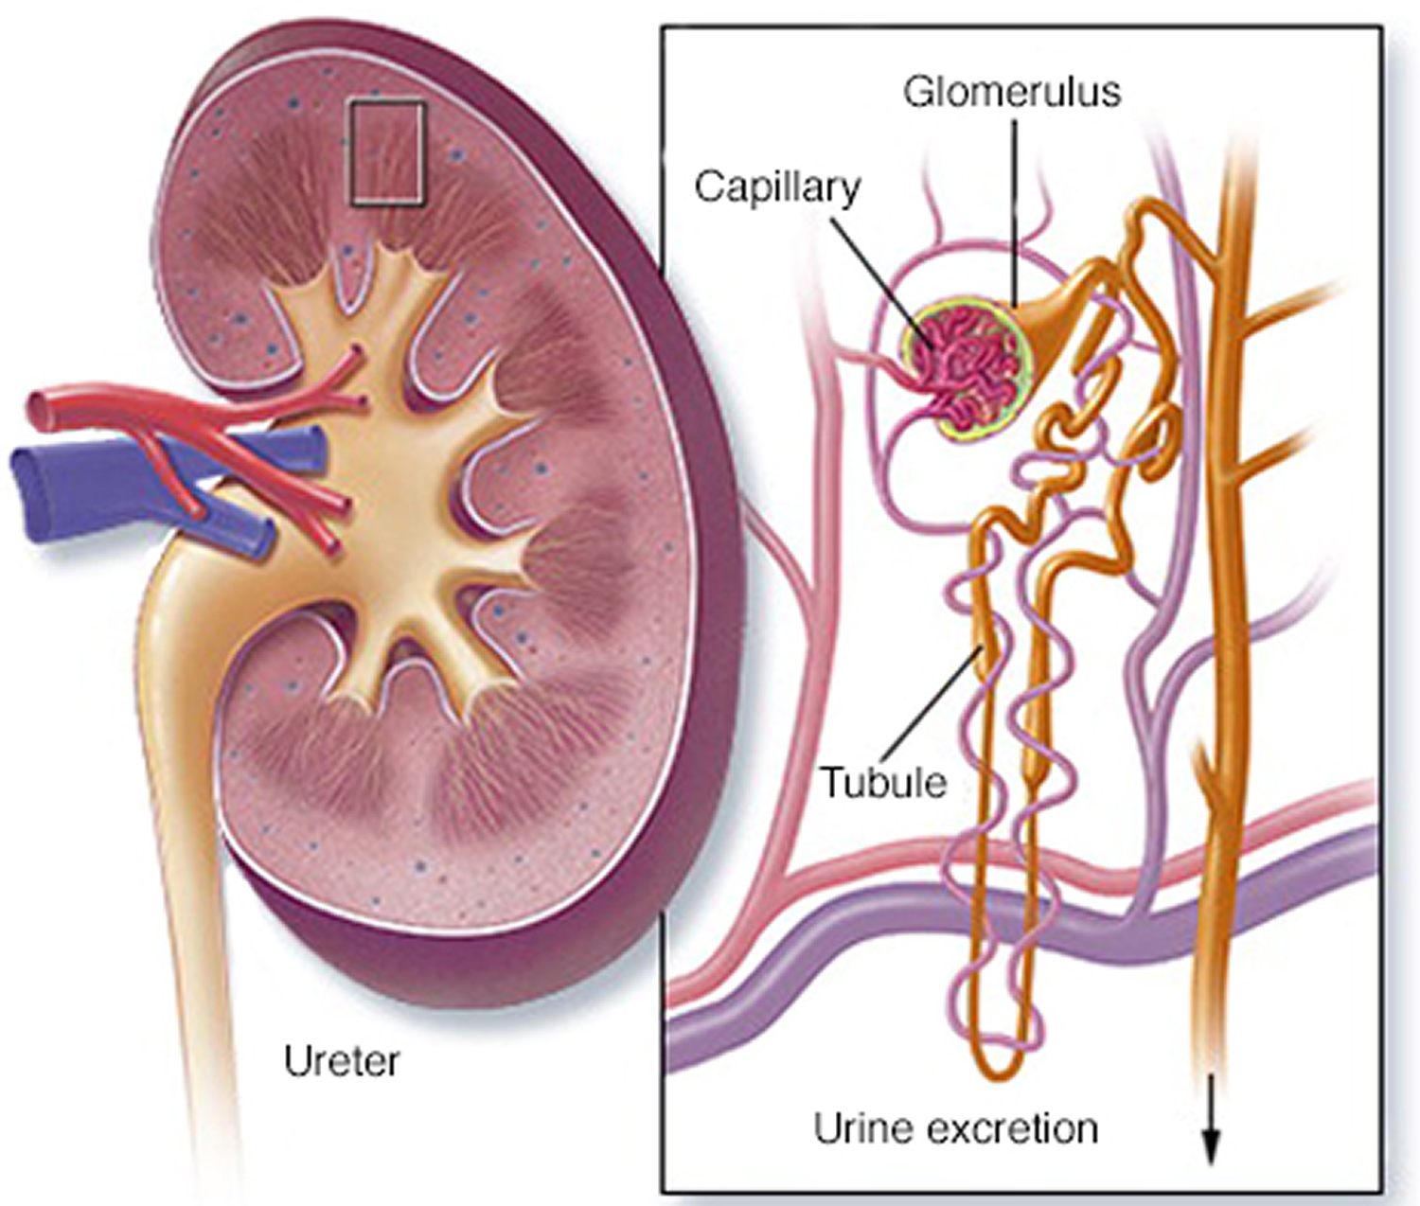

Slide 6
CAUSES
Auto immune reaction due to antigen
Antibody reaction
Streptococcal infection
Renal disorders
Drugs/toxins, eg. D-penicillin or captopril.

Slide 7
PATHOPHYSIOLOGY
Due to inflammation of glomerular capillaries
Abnormal permeability of glomerular basal membrane
Then protein (albumin) is filtrate in urine (proteinuria)
Decrease serum albumin level (hypoalbuminemia)
Liver synthesis more lipo-protein (triglycerides)

Slide 8
Hyperlipidemia
Due to albumin decrease in blood, oncotic pressure in blood vessels also decrease.
So, fluid come out to extracellular space
Oedema

Slide 9
CLINICAL MANIFESTATION
Four main symptoms of nephrotic syndrome
Proteinuria:- the presence of abnormal quantities of protein in the urine.
Hypoalbuminemia:- when you don't have enough of the protein albumin in the bloodstream.
Hyperlipidemia:- increase amount of circulating fatty acids, triglycerides and cholesterol.
Oedema:- accumulation of fluid in subcutaneous tissue.

Slide 10
OTHER SYMPTOMS
Shortness of breath
Mild headache
Weakness
Anorexia (loss of appetite)
Weight gain
Irritability
Hypertension

Slide 11
DIAGNOSTIC EVALUATION
Urine test
A urinalysis can reveal abnormalities in the urine, such as large amounts of proteins. You might be asked to collect urine samples over 24 hours.
Blood test
A blood test can show low levels of the protein albumin and often decreased levels of blood proteins overall. Loss of albumin is often associated with an increase in blood cholesterol and blood triglycerides. The creatinine and urea nitrogen levels in the blood also might be measured to assess the overall kidney function.

Slide 12
CONTI…
Kidney biopsy
Your doctor might recommend removing a small sample of kidney tissue for testing. During a kidney biopsy, a needle is inserted through the skin and into the kidney. Kidney tissue is collected and send a lab for testing.

Slide 13


Slide 14
MEDICAL MANAGEMENT
Blood pressure medications
Drug called angiotensin-converting enzyme (ACE) inhibitors reduce blood pressure and the amount of protein released in urine. Medications in this category include
Lisinopril (prinvil, qbrelis, Zestril)
Benzepril (Lotensin)
Captopril and enalapril (Vasotec)

Slide 15
CONTI…
Diuretics
Control swelling by increasing your kidneys’ fluid output diuretic medications typically include furosemide (Lasix).
Cholesterol-reducing medications
Statins are a group of medicines that can help lower the level of low-density lipoprotein (LDL) cholesterol in the blood. LDL cholesterol is often referred to as "bad cholesterol", and statins reduce the production of it inside the liver.
Eg. Atorvastatin (Lipitor), Lovastatin (Altoprev).

Slide 16
CONTI…
Blood thinners (anticoagulants)
These might be prescribed to decrease the blood’s ability to clot, especially if patient have a blood clot.
Eg. Anticoagulants includes Heparin, Warfarin, Dabigatran, Apixaban.
Immune system suppressing medications
Medication to control the immune system, such as corticosteroids, can decrease the inflammation that accompanies some of the conditions that can cause nephrotic syndrome medications include rituximab (Rituxan) cyclosporine and cyclophosphamide.

Slide 17
DIETARY MANAGEMENT
Provide high protein and high carbohydrates diet to patient.
In condition of oedema, no restriction of diet.
If disease in advance stage then avoid protein intake because it is affected to kidney.

Slide 18
NURSING MANAGEMENT
Assessment
Find the cause of nephritis
Assess skin integrity
Assess fluid volume level
Assess kidneys functions

Slide 19
NURSING DIAGNOSIS
Risk for infection related to immunosuppressive drugs.
Fluid and electrolyte imbalanced related to oedema.
Impaired skin integrity related to disease process.
Altered nutrition related to anorexia.
Altered kidney function related to disease condition.
Knowledge deficit related to disease process.

Slide 20
REFERENCE
Lwis. Dirksen. Heitkemper. Textbook of medical surgical nursing, second south asia edition, volume1. page no.
Brunner and suddarth’s textbook of medical surgical nursing 13th south Asian edition, volume 2 page no. 1532 to 1533.

Slide 21


