Slide 1
UMBLICAL CORD & TWINNIG
Dr. Sarangdhar kumar
Department of anatomy
Rohilkhand medical college
Bareilly

Slide 2
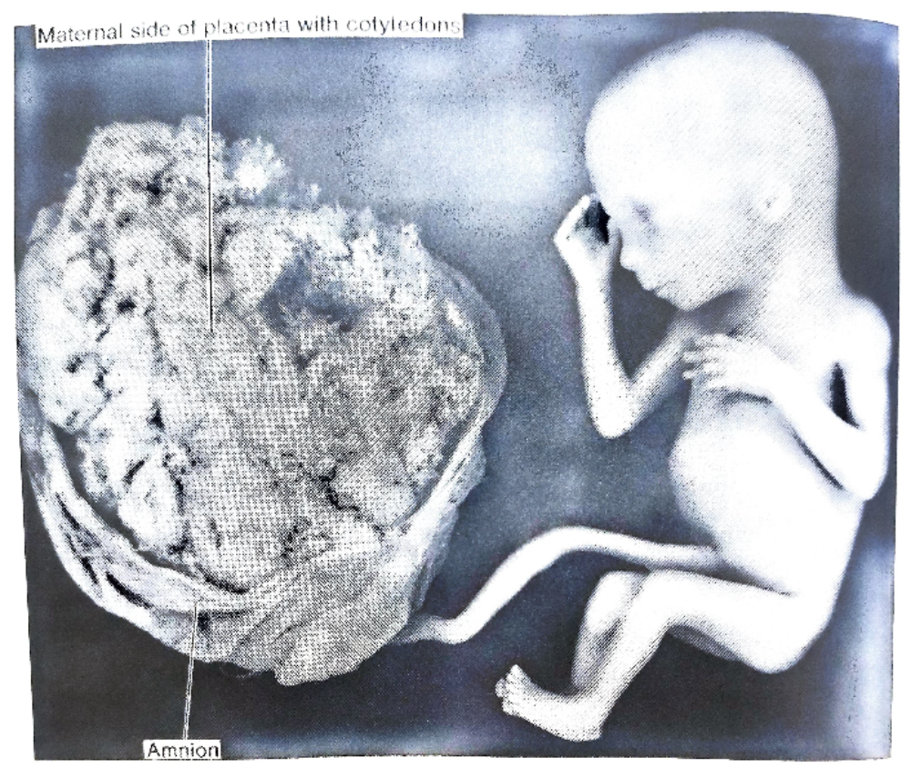
TUBULAR CORD LIKE STRUCTURE
FOETUS IS CONNECTED WITH THE PLACENTA
IT IS COVERED BY AN AMNIOTIC MEMBRABE
IT HAS TWO END :-
  PLACENTAL END
  FOETAL END

Slide 3
MEASURMENTS –
  LENGTH – 50-55 CM
  THICKNESS – 2 CM

Slide 4
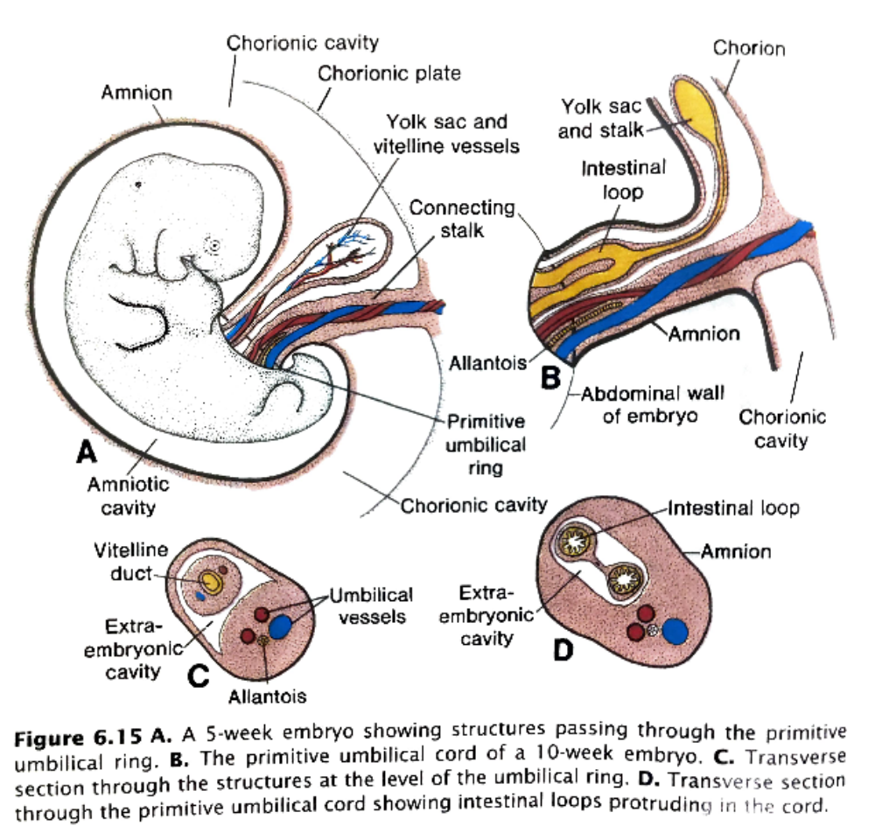
FORMATION OF UMBLICAL CORD –
  As the formation of embryo fold, the yolk sac and connecting stalk come to lie on ventral surface of the foetus
  Amino- ectodermal junction comes to lie on ventral surface of the foetus and forms umbilical ring through which vitellointestinal duct and allantois protrude
  Extraembryonic mesodermal tissue of connecting stalk gets vascularised to form two umbilical arteries & two umbilical veins (3rd & 4th wk)
  During later part of pregnancy right umbilical vein gets obliterated
  Mesodermal connective tissue of connecting stalk forms mucoid tissue called wharton’s jelly

Slide 5
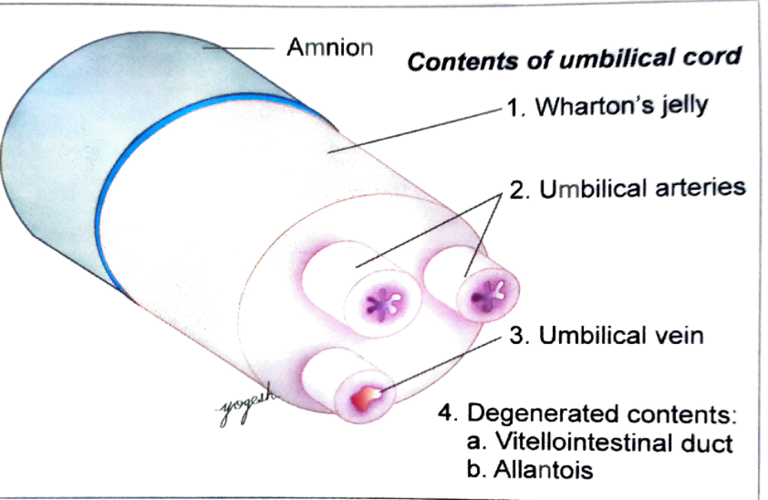
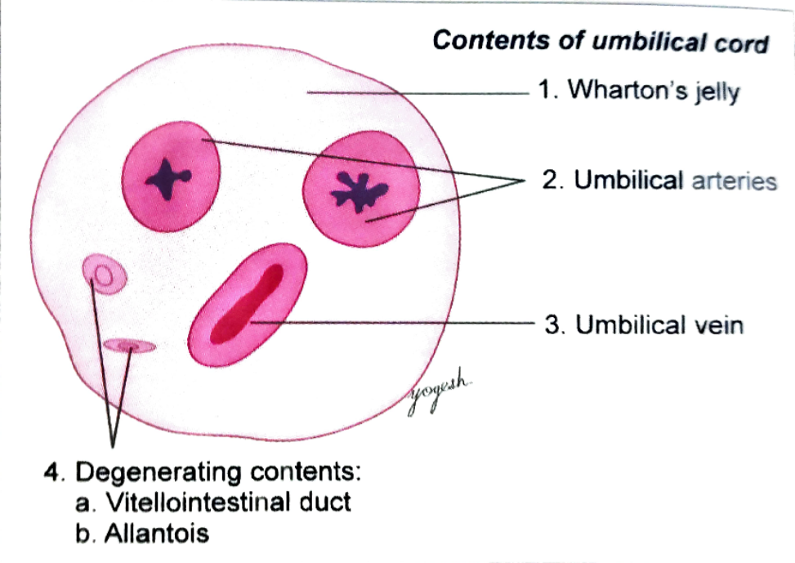
Contents of umbilical cord –
Umbilical vessels
Wharton’s jelly –
  mucoid connective tissue
  Twisting of umbilical vessels produces beaded appearance of umbilical cord
Parts of allantois –
  It fibroses to form urachus
  Remaining part forms urinary bladder
Vitellointestinal duct & umbilical vesicle

Slide 6
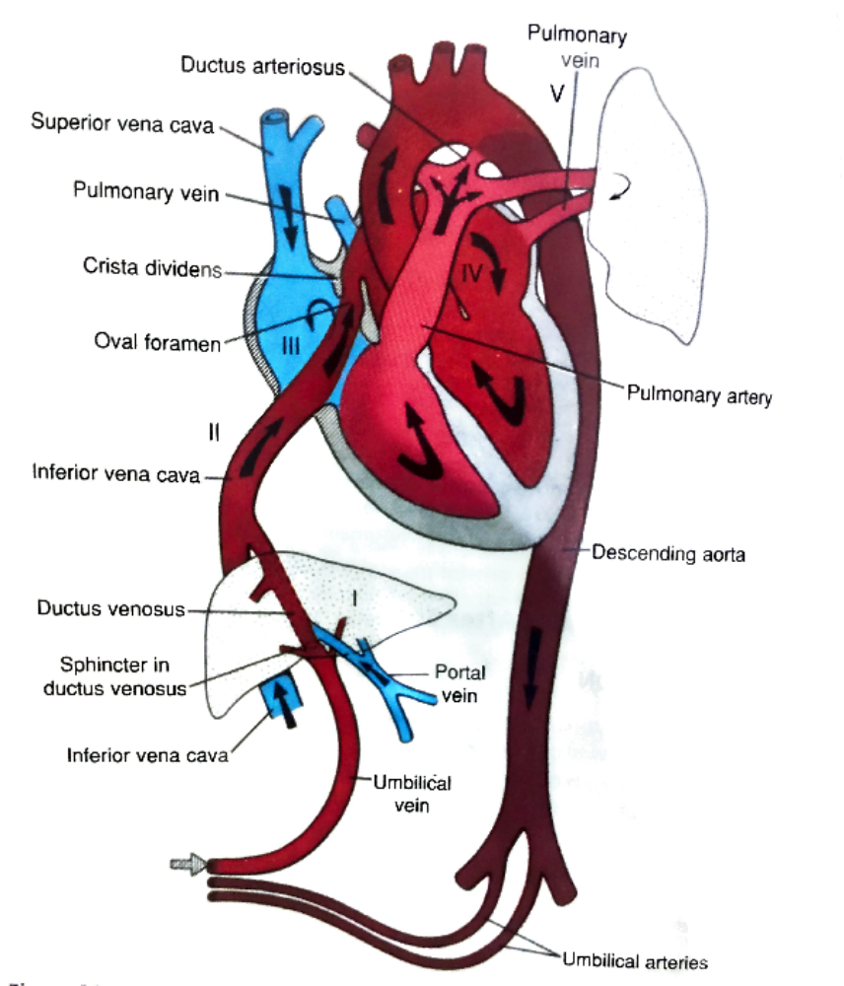
Umbilical vessels –
  Two umbilical arteries & one (left) umbilical vein
  Right umbilical vein disappears
  Umbilical arteries carry deoxygenated blood from internal iliac arteries of foetus to placenta
  Left umbilical vein covey oxygenated blood from placenta to foetus
  Left umbilical vein joins the left branch of portal vein that convey the blood to inferior vena cava via ductus venosus

Slide 7
Some interesting facts
Umbilical cord contains two umbilical arteries & one (Left) umbilical vein
Hyrtl’s anastomosis –
Left umbilical vein gets obliterated after birth & forms ligamentum teres hepatis
After birth umbilical arteries undergo muscle spasm earlier than umbilical vein hence newborn receives blood from placenta & does not give blood to placenta

Slide 8
MULTIPLE PREGNANCY(TWINNING)
As in human , usually only one ovum is released in one menstrual cycle (Singleton pregnancy)
Multiple pregnancy - mother gives two or more offspring in single pregnancy
Twinning – mother gives two offspring in a single pregnancy
IVF enhances the chances of multiple pregnancy
(21 twins per 1000 births)

Slide 9
In twin - birth
  Most common – Boys
  Next common – Boy & Girl
  Least common - Girls

Slide 10
Classification of twins
As per number of offspring born –
    Twins – 2 offspring
    Triplets – 3 offspring
    Quadruplets – 4 offspring
    Quintuplets – 5 offspring
    Sextuplets - 6 offspring

Slide 11
According to genetic relationship of offspring –
Monozygotic twins
  Fertilization of single ovum by one sperm
Dizygotic twins
  Fertilization of two different ovum by two different sperm
Trizygotic twins
  Fertilization of multiple ova by different sperm

Slide 12
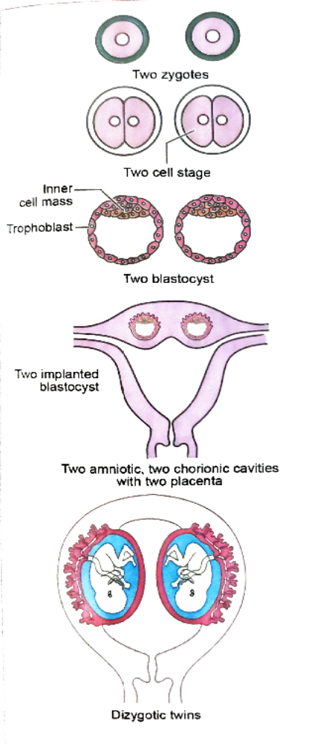
Dizygotic twins
Produced by fertilization of two different ova by two different sperms
Two zygotes
Fraternal (unlike sex)
Incidence – 7-10 per 1000 births
  ( Incidence increases with age)

Slide 13
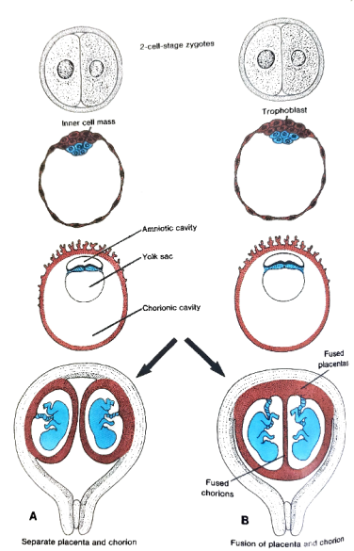
Features –
  Phenotypically & may have different gender
  Genetically dissimilar
  Do not share placenta , chorion & amnion
  They have two different gestational sacs
  Occasionally fused placenta may be seen
  2/3rd of human twins are dizygotic

Slide 14
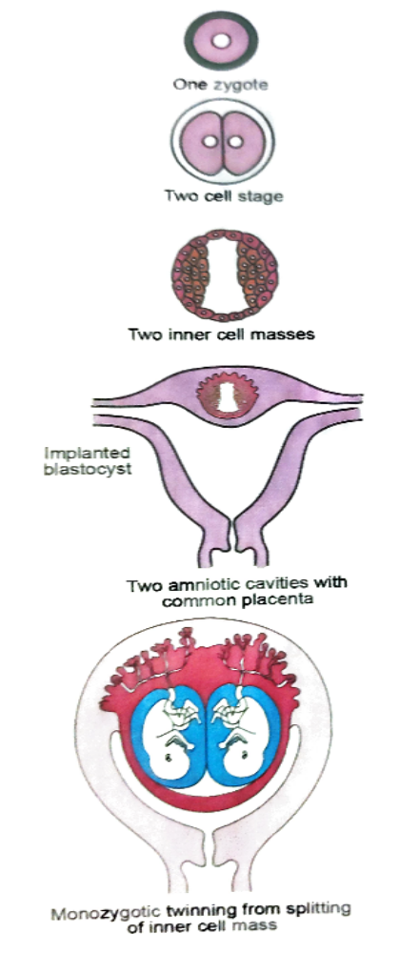
Monozygotic twins
Produced by fertilization of one oocyte by one sperm
Single zygote
Zygote forms blastocyst with inner cell mass(embryoblast)
This inner cell mass divides into two parts & produced monozygotic twins
Incidence – 3 in 1000 births

Slide 15
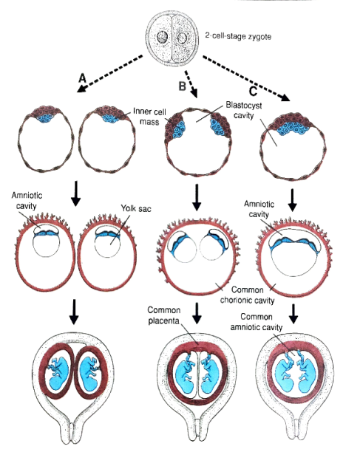
Features –
  Phenotypically similar (same gender)
  Genetically similar
  They have share placenta , amniotic cavity and chorionic sac
  About 1/3rd of human twins are monozygotic twins

Slide 16
Classification of monozygotic twins according to degree of separation –
  Diamniotic –dichorionic twins
  Diamniotic – monochorionic twins
  Monoamniotic – monochorionic twins
  Conjoined (Siamese) twins

Slide 17
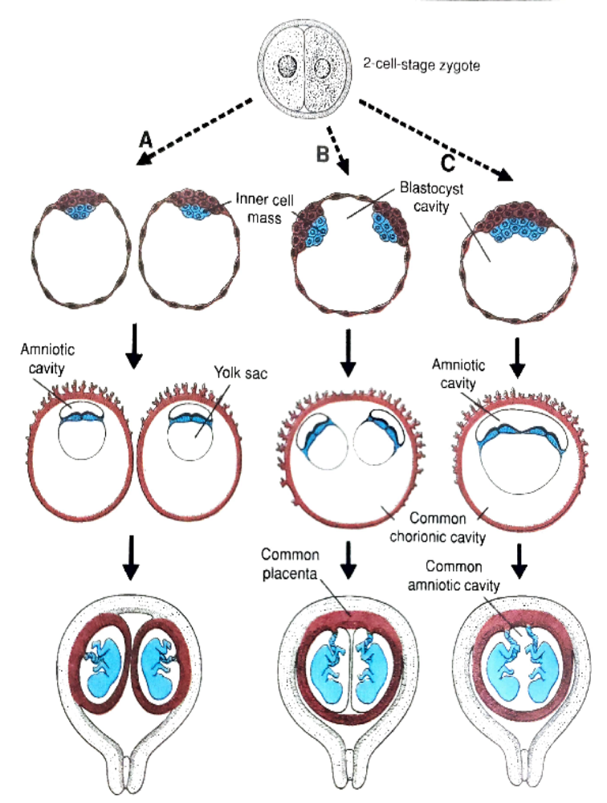
Diamniotic – dichorionic twins –
  Incidence – 25 – 30 %
  At two cell stage of cleavage division
  Blastomere cell develops two separate zygote within common zona pellucida
  Separate placenta, chorionic sac & amniotic sac
  Up-to 3rd day of fertilization

Slide 18


Diamniotic – monochorionic twins -
  At blastocyst stage
  Incidence – 70- 75 %
  Inner cell mass is completely separated in two equal parts
  Each part develops into separate embryo
  Single placenta
  Two amniotic sac
  Common chorionic sac
  Separation occurs 4 to 7 days after fertilization

Slide 19
Monoamniotic- monochorionic
  When bilaminar germ disc is formed within the blastocyst cavity
  Sometimes two organizing centres appear in the disc & differentiate into two embryos
  Common placenta , chorionic cavity & amniotic sac
  Separation occurs 9th day
  Incidence – 1-2 %

Slide 20
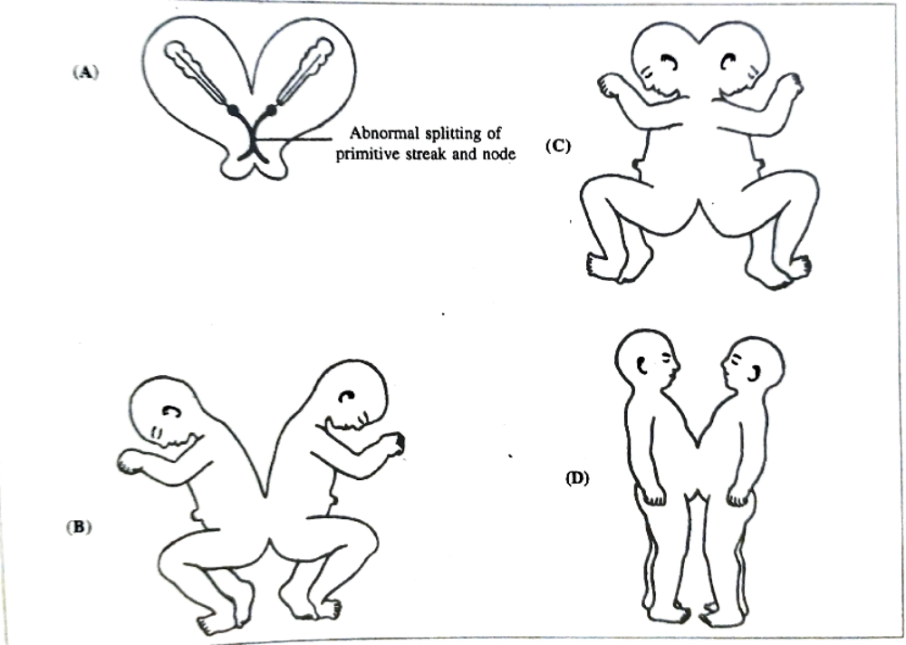
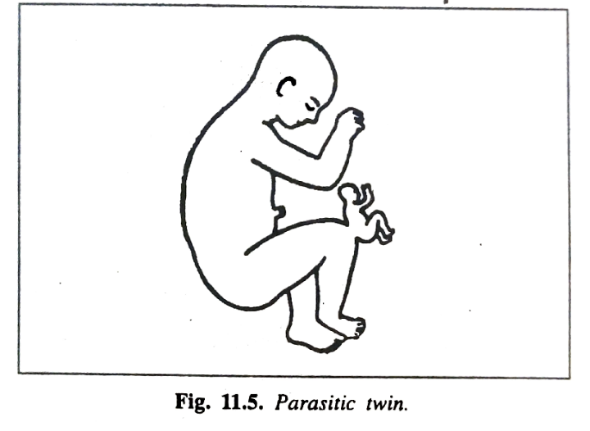
Twins defect -
Conjoint (Siamese ) twins-
  Separation occurs 12th after fertilization
  It is encountered in Monoamniotic – monochorionic twins
  Have joined bodies
  Twins are equal in size
  Most of conjoint twins do not survive due to complication at parturition
Parasitic twins –
  One partner may be rudimentary due to diminished blood supply

Slide 21
Classification of conjoined twins –
  Based on site & extent of fusion
    Craniopagus
    Thoracopagus
    Cephalo-thoracopagus
    Omphalopagus
    Pyopagus
    Ischiopagus

Slide 22
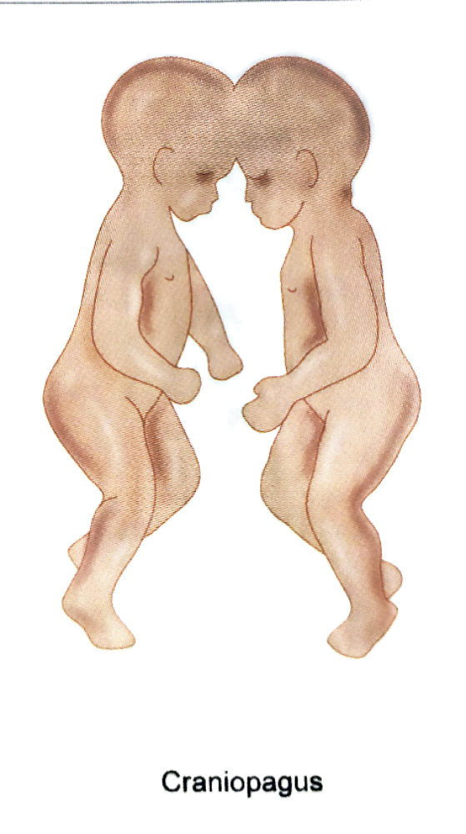
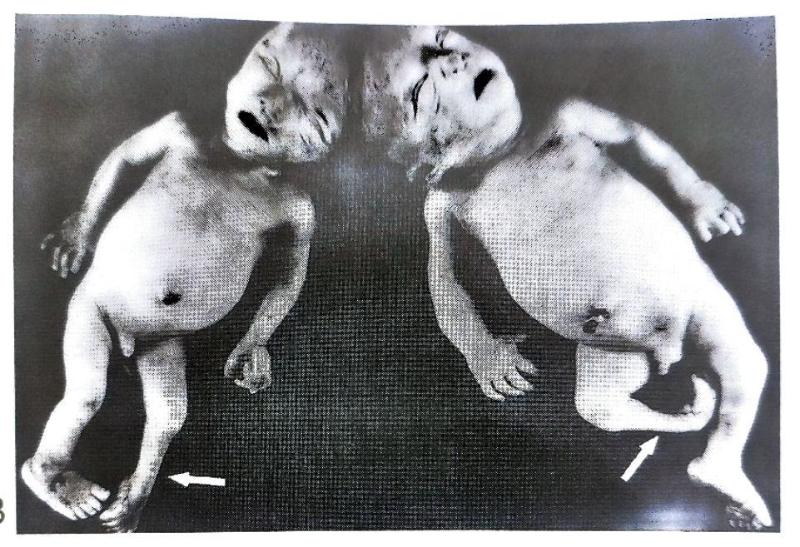

Slide 23
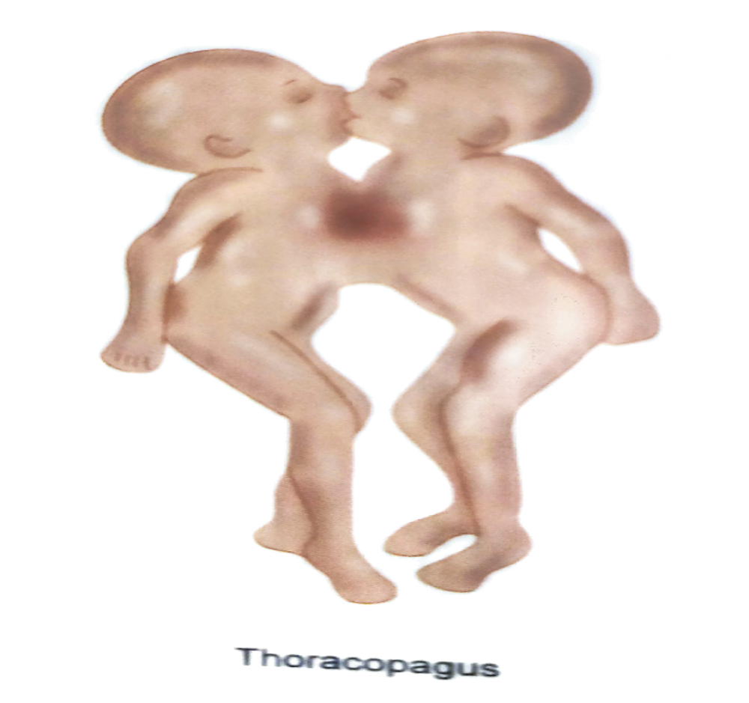

Slide 24
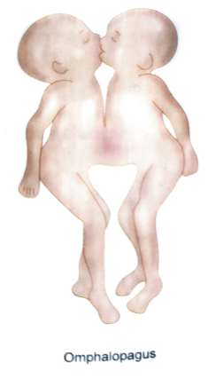

Slide 25
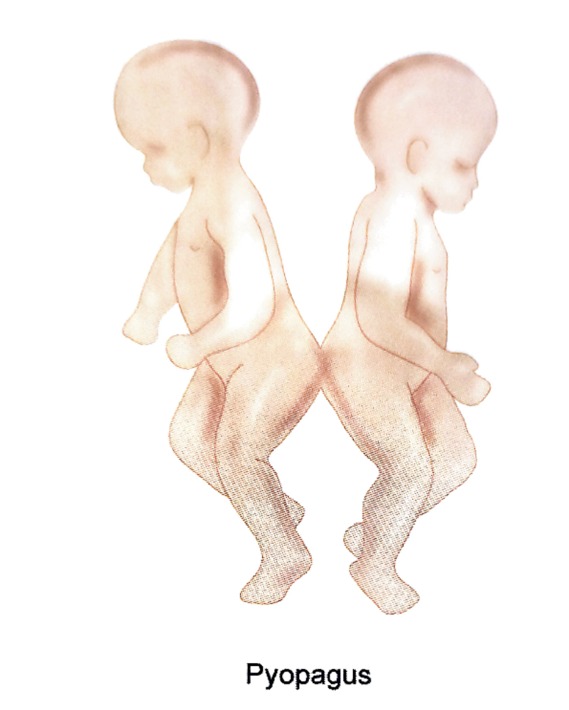

Slide 26
