Slide 1
Triangles of neck
Dr. SARANGDHAR KUMAR
DEPARTMENT OF ANATOMY
RMCH, BAREILLY

Slide 2
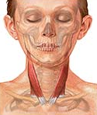
Neck
More or less cylindrical region
Joins head to trunk & limbs
Serves as a major conduit for structures passing between them
Bounded
  Superiorly
    Base of mandible, mastoid process, superior nuchal line, external occipital protuberance
  Inferiorly
    Manubrium, clavicle, acromian process, spine of scapula
Median line divides neck into right and left half

Slide 3
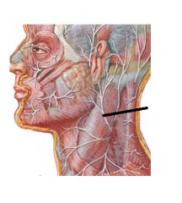
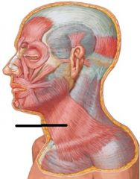
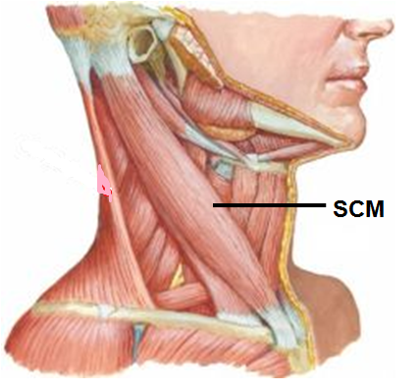
Skin
Supplied by
  Great occipital nerve
  Lesser occipital nerve
  Great auricular nerve
  Transverse cervical nerve
  Supraclavicular nerve
Superficial fascia
  Platysma muscle
Deep fascia
  Sternocleidomastoid muscle
Great occipital n.
Lesser occipital n.
Great auricular n.
Transverse cervical n.
Supraclavicular n.
Platysma

Slide 4
Platysma
Origin
  Deltoid and pectoral fascia (upto the 2nd rib)
Insertion
  Base of mandible, angle of mouth
Nerve supply
  Cervical branch of facial nerve
Action
  Depresses mandible and angle of mouth
Platysma

Slide 5
Sternocleidomastoid
Key muscle of neck
Origin
  Manubrium sterni and medial third of clavicle
Insertion
  Mastoid process of temporal bone and lateral half of superior nuchal line of occipital bone
Nerve supply
  Spinal part of accessory nerve and C2 and C3
Action
  Two muscles acting together extend head and flex neck; one muscle rotates head to opposite side
Notes:
Clavicular head and sternal heads are separated from one another at their origins by a triangular interval (supraclavicular fossa)

Slide 6
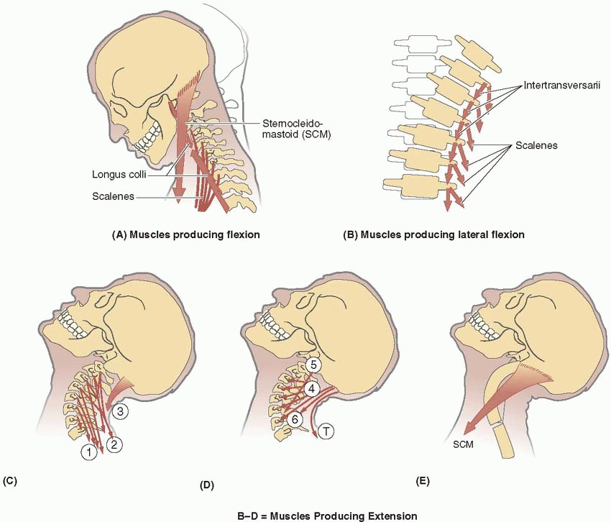
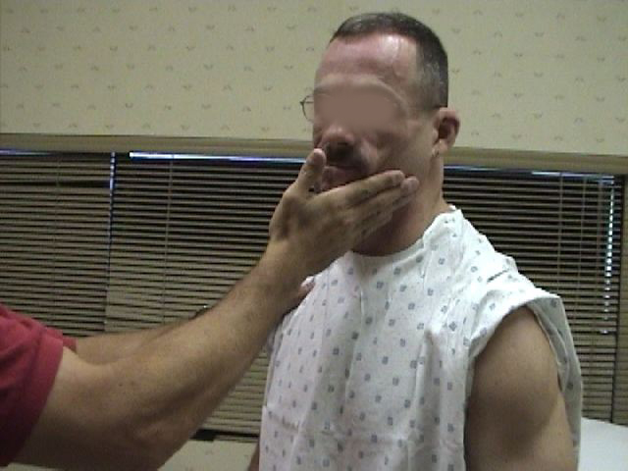
Notes:
Bilateral contraction of the SCMs (especially their more posterior fibers) will cause extension of the head at the Atlanto-occipital (AO) joints, elevating the chin.
Head is flexed anteriorly at the AO joints by the prevertebral muscles (and/or the suprahyoid and infrahyoid muscles) against resistance, the SCMs (especially the anterior fibers) flex the entire cervical vertebral column so that the chin approaches the manubrium, However, gravity is usually the prime mover for this movement when standing erect

Slide 7
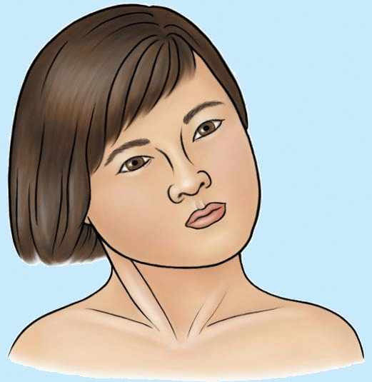
Applied
Torticolis
  A twisted neck in which the head is tipped to one side, while the chin is turned to the other
Congenital torticolis
  Most cases are due to excessive stretching during difficult labor
  Hemorrhage followed by fibrosis occur in muscle, which result in shortening of muscle
Spasmodic torticolis
  Due to repeated tonic contractions of muscle
Notes:
a twisted neck in which the head is tipped to one side, while the chin is turned to the other.

Slide 8
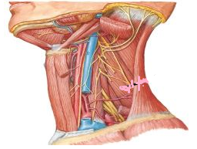
Relations
Great occipital n.
Muscle is covered superficially by skin, fascia, platysma, external jugular vein, cutaneous nerves
Anterior border covers the carotid sheath, thyroid gland
Posterior border is related to cervical plexus, phrenic nerve, upper part of brachial plexus
Lesser occipital n.
Great auricular n.
Transverse cervical n.
Supraclavicular n.

Slide 9
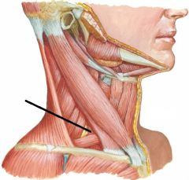
Divisions of neck
Sternocleidomastoid muscle is key superficial muscle of neck
Divides neck into
  Posterior triangle (PT)
  Anterior triangle (AT)
PT
AT
sternocleidomastoid
Trapezius
clavicle

Slide 10
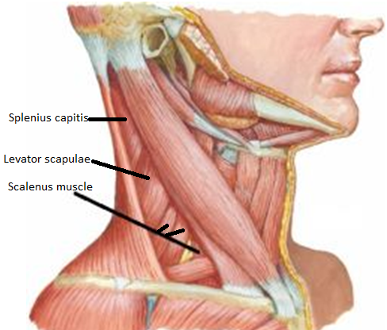
Posterior triangle
Boundaries
  Anteriorly
    Sternocleidomastoid muscle (posterior border)
  Posteriorly
    Trapezius muscle (anterior border)
  Inferiorly
    Clavicle (middle 1/3rd )
  Roof
    Skin , Superficial fascia
    Investing layer of deep cervical fascia & platysma muscle
  Floor
    Muscles of neck covered by prevertebral fascia
    The following muscles formed floor (above downward)
      - Parts of semispinalis capitis (occasional)
      - Splenius capitis
      Levator scapulae
      Scalenus muscle (medius & posterior )
sternocleidomastoid
Trapezius
clavicle

Slide 11
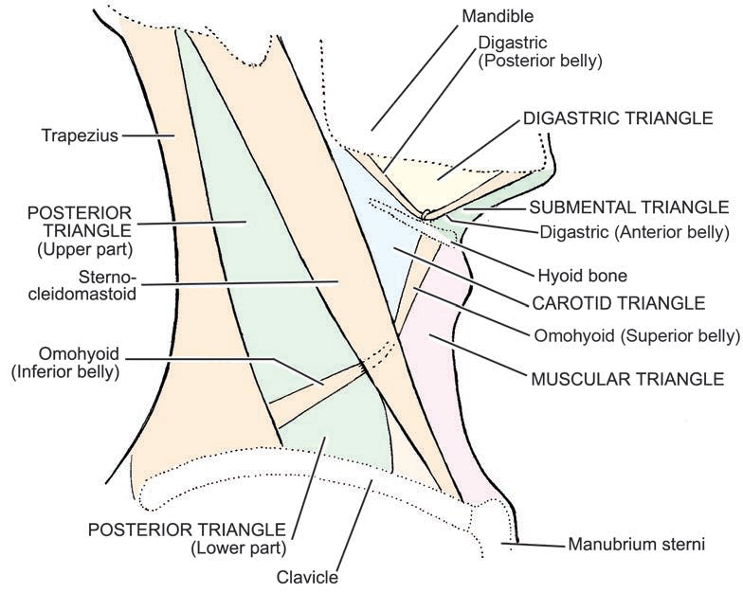
Subdivision of posterior triangle
About 2.5 cm above the clavicle
Inferior belly of omohyoid divides it into upper large occipital triangle & lower small supraclavicular/ subclavian triangle
Occipital triangle-
Boundaries
  In front by- Sternocleidomastiod muscle
  Behind by – Trapezius muscle
  Below by – Inferior belly of Omohyoid
  Floor – formed by part of semispinalis capitis, splenius capitis, levator scapulae,scalenus medius and posterior

Slide 12
Contents of posterior triangle
Nerves
Arteries
Veins
Lymph nodes

Slide 13
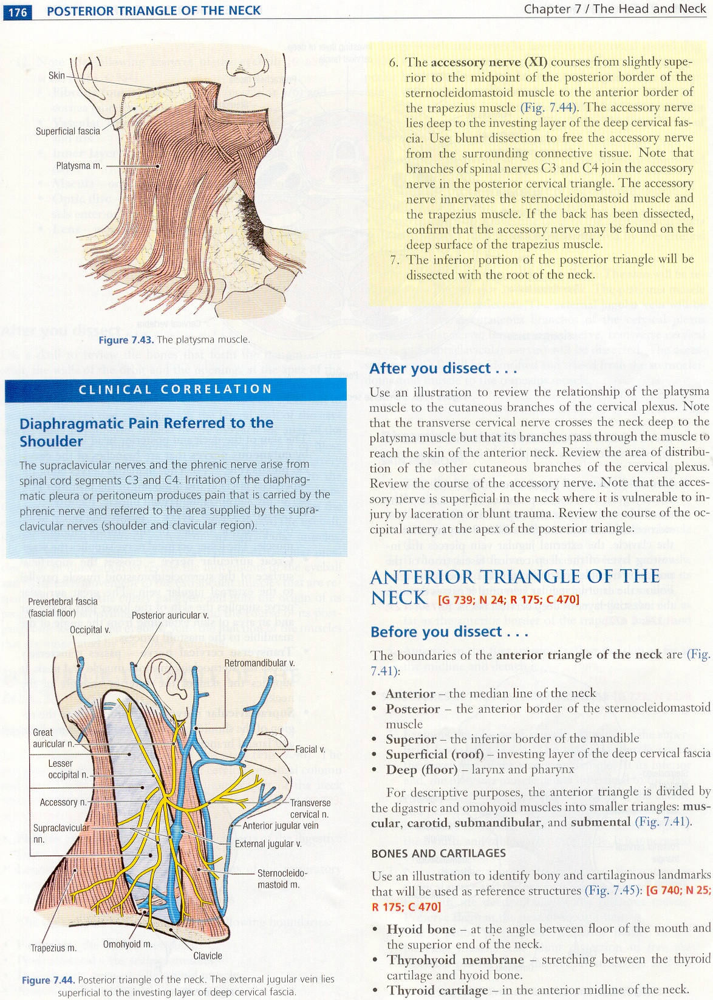
Nerves present in posterior triangle
Spinal accessory nerve
Cutaneous branches of cervical plexus
  Great auricular nerve (C2,C3)
  Lesser occipital nerve (C2)
  Transverse cervical nerve (C2,C3)
  Supraclavicular nerves (C3,C4)
Roots and trunks of the brachial plexus with their branches (long thoracic nerve, dorsal scapular nerve; suprascapular nerve, nerve to subclavius)
Notes:
transverse cervical nerve (transverse cutaneous nerve of neck)
Nerve to serratus anterior – Long thoracic nerve

Slide 14
Nerve point of the neck
Mid point on posterior border of SCM
Following nerves emerge at this point:
  Spinal Accessory nerve
  Lesser occipital nerve (C2)
  Great auricular nerve (C2,C3)
  Transverse cervical nerve (C2,C3)
  Supraclavicular nerves (C3,C4)

Slide 15
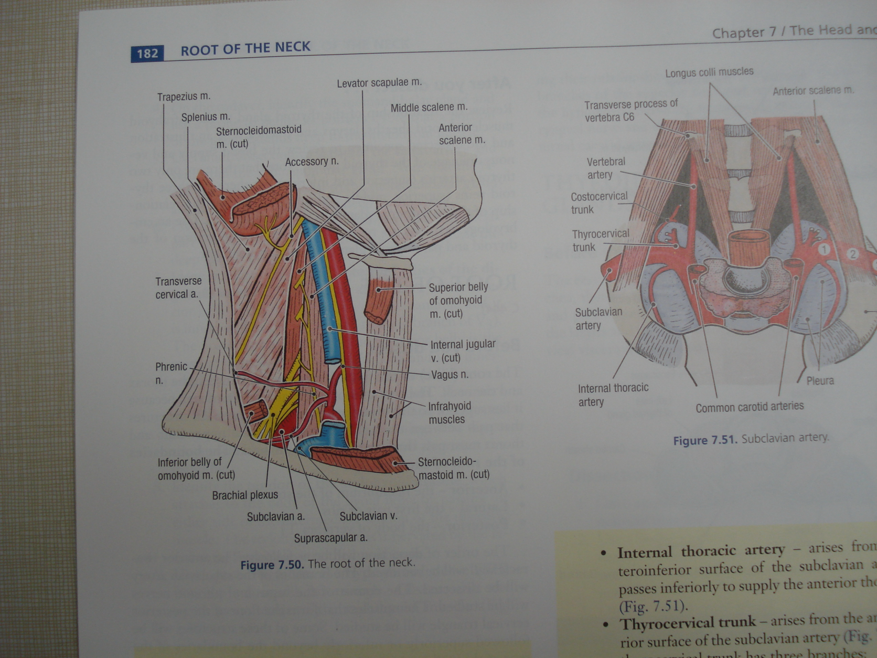
Arteries present in posterior triangle
Subclavian artery (3rd part)
Suprascapular artery
Transverse cervical artery
Occipital artery

Slide 16
Veins present in posterior triangle
External jugular vein and its tributaries
  Suprascapular vein
  Anterior jugular vein
  Transverse cervical vein
Subclavian vein

Slide 17
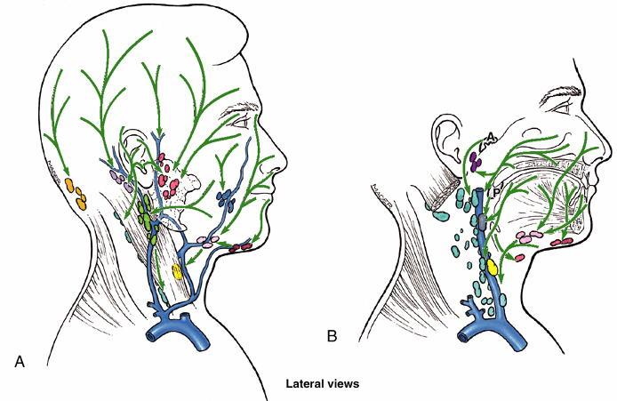
Lymph nodes present in posterior triangle
Lymph nodes are situated along the external jugular vein - superficial cervical lymph nodes
These nodes extend laterally along the spinal part of the accessory nerve
These nodes might get matted in tuberculosis or enlarged and malignant in cancer
In such case when nodes are being removed, a great care has to be exercised to retain the accessory nerve

Slide 18
Applied anatomy
The third part of the subclavian artery can be compressed against the first rib in the supraclavicular fossa. This is the way the bleeding is controlled when a major vessel bleeds in the upper limb
Cervical plexus block: For regional anesthesia along the midpoint posterior border of sternocleidomastoid
Supraclavicular brachial plexus block: superior to the midpoint of the clavicle
Subclavian vein puncture for central line placement (parenteral fluids & medications)
Lesion of Accessory nerve in the posterior triangle: drooping of the shoulder and inability to elevate and retract the shoulder and abduction above 90º

Slide 19
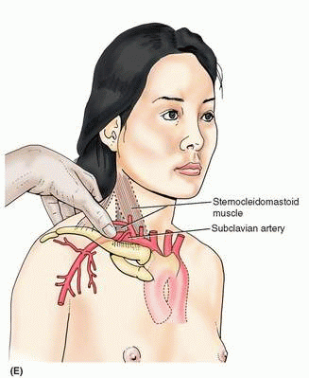
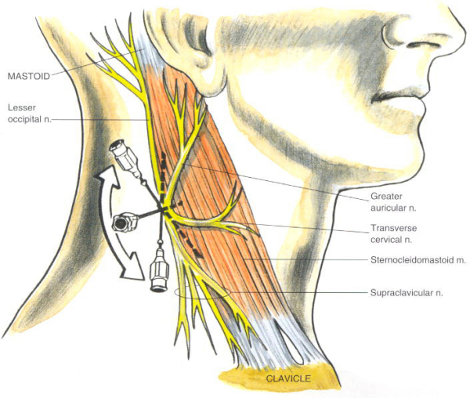
Compression of subclavian artery
to stop bleeding of upper limb
Cervical plexus block

Slide 20
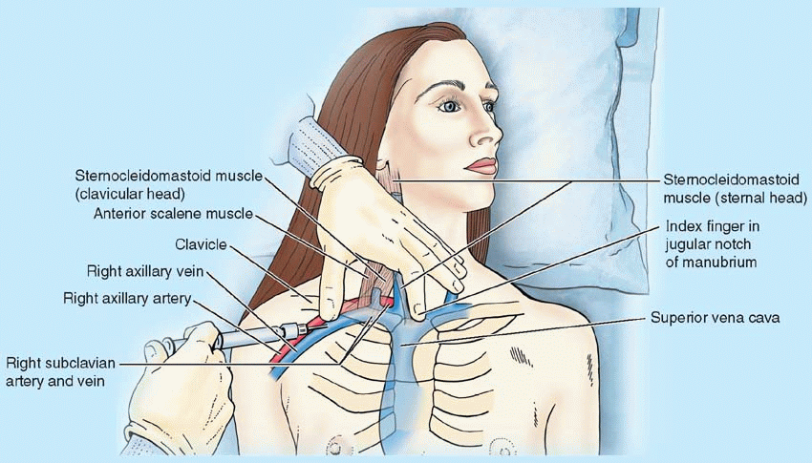
Central vein catheterization
Infraclavicular subclavian vein approach
Notes:
Central vein catheterization – SUBCLAVIAN VEIN, IJV are used to administer medicine, fluid, obtain blood, measure central venous pressure
The thumb of one hand on the middle part of the clavicle and the index finger on the jugular notch in the manubrium.
The needle punctures the skin inferior to the thumb (middle of the clavicle) and is advanced medially toward the tip of the index finger (jugular notch) until the tip enters the right venous angle, posterior to the sternoclavicular joint.
Here the internal jugular and subclavian veins merge to form the brachiocephalic vein.
If the needle is not inserted carefully, it may puncture the pleura and lung, resulting in pneumothorax.
Furthermore, if the needle is inserted too far posteriorly, it may enter the subclavian artery.
When the needle has been inserted correctly, a soft, flexible catheter is inserted into the subclavian vein, using the needle as a guide.

Slide 21
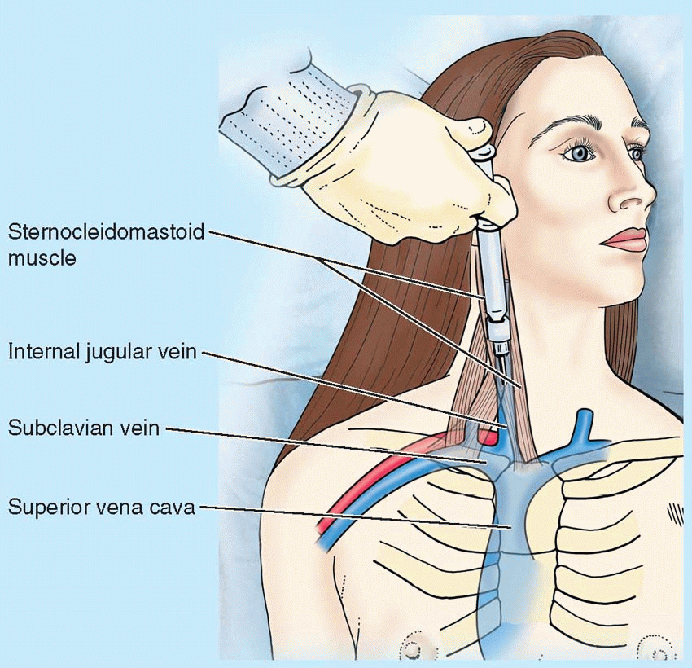
Internal jugular vein puncture
Notes:
A needle and catheter may be inserted into the IJV for diagnostic or therapeutic purposes.
The right internal jugular is preferable because it is usually larger and straighter.
During this procedure, the clinician palpates the common carotid artery and inserts the needle into the IJV just lateral to it at a 30° angle, aiming at the apex of the triangle between the sternal and the clavicular heads of the SCM, the lesser supraclavicular fossa
The needle is then directed inferolaterally toward the ipsilateral nipple.

Slide 22
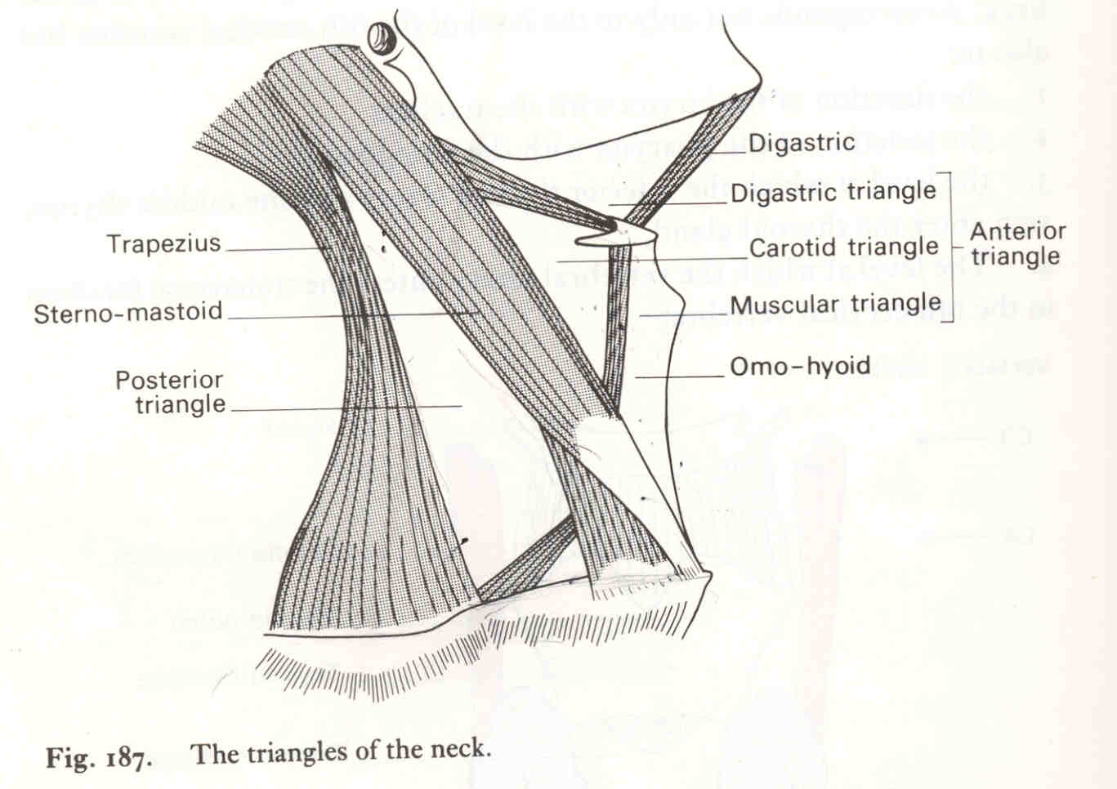
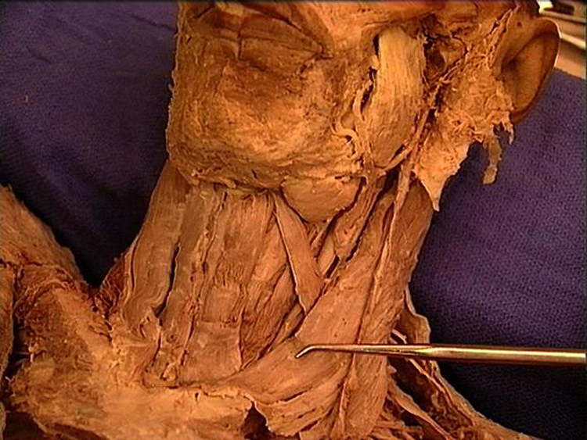
Anterior cervical region
(anterior triangle)
Boundary
  Anterior
    Median line of the neck
  Posterior
    Anterior border of the SCM
  Superior
    Base of mandible
  Apex
    Jugular notch of manubrium
  Roof
    Superficial and deep fascia of neck
  Floor
    Pharynx, larynx, and thyroid gland

Slide 23
Subdivision of anterior triangle
Superior belly of omohyoid and two bellies of digastric muscle divides anterior triangle into four sub triangle
  Submental
  Digastric
  Carotid
  Muscular triangle

Slide 24
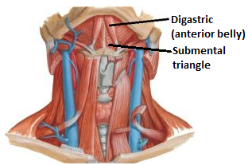
Submental triangle (suprahyoid triangle)
Boundaries
  On each side
    Anterior belly of digastric
  Base
    Body of hyoid bone
  Apex
    Chin
  Floor
    Two mylohyoid muscles with their median raphe
Contents
  Submental nodes
  Small veins that unite to form the anterior jugular vein

Slide 25
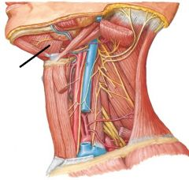
Digastric (submandibular) triangle
Boundaries
  Anteroinferior
    Anterior belly of digastric
  Posteroinferior
    Posterior belly of digastric and stylohyoid muscle
  Apex
    Intermediate tendon of digastric muscle at hyoid bone
  Base
    Lower border of mandible
    Floor
      Mylohyoid, hyoglossus, middle constrictor
Digastric triangle

Slide 26

Contents of digastric triangle
Facial vessels
Submandibular gland and Submandibular lymph nodes
Facial vessels
Nerve to mylohyoid and mylohyoid vessels
Hypoglossal nerve and veins accompanying it
Submandibular gland
Nerve to mylohyoid
Notes:
Facial artery deeply grooves the posterior border of the submandibular gland and later lies between the gland and mandible before it winds around the lower border of the body of the mandible. Facial vein lies superficial to the submandibular gland

Slide 27
Carotid triangle
Anterosuperior
  Posterior belly of digastric and stylohyoid muscles
Anteroinferior
  Superior belly of omohyoid
Posteroinferior
  Anterior border of lower SCM
Floor
  Thyrohyoid, hyoglossus, inferior & middle constrictor
Diagstric (posterior belly)
SH
Sup. belly
Omohyoid
Notes:
Muscles on hyoid bone - Sternohyoid, omohyoid, thyrohyoid

Slide 28
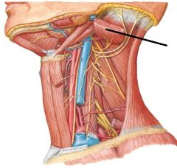
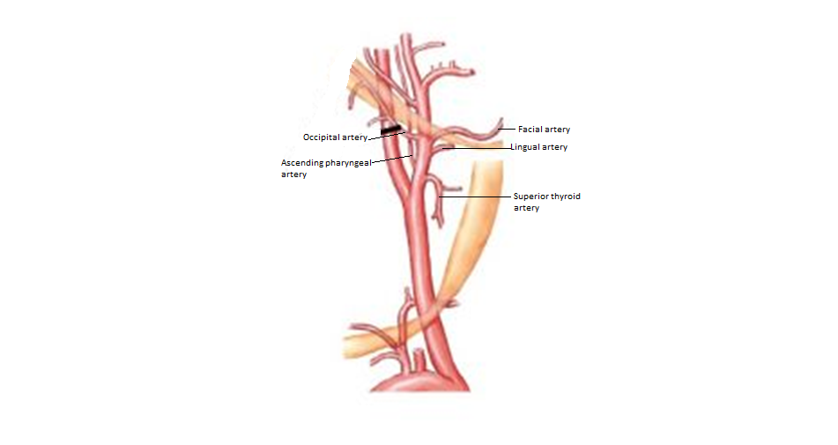
Contents of carotid triangle
Carotid sheath containing common carotid artery, internal jugular vein, vagus nerve
Ansa cervicalis lie anterior to carotid sheath; cervical part of sympathetic trunk lies posterior to the sheath
External carotid artery and 5 out of its 8 branches
  Ascending pharyngeal artery
  Superior thyroid artery
  Lingual artery
  Facial artery
  Occipital artery
SCM
CT
Notes:
Common carotid artery divides at the level of the upper border of the thyroid cartilage (disc between C₃ & C₄ vertebrae) into external and internal carotid arteries

Slide 29
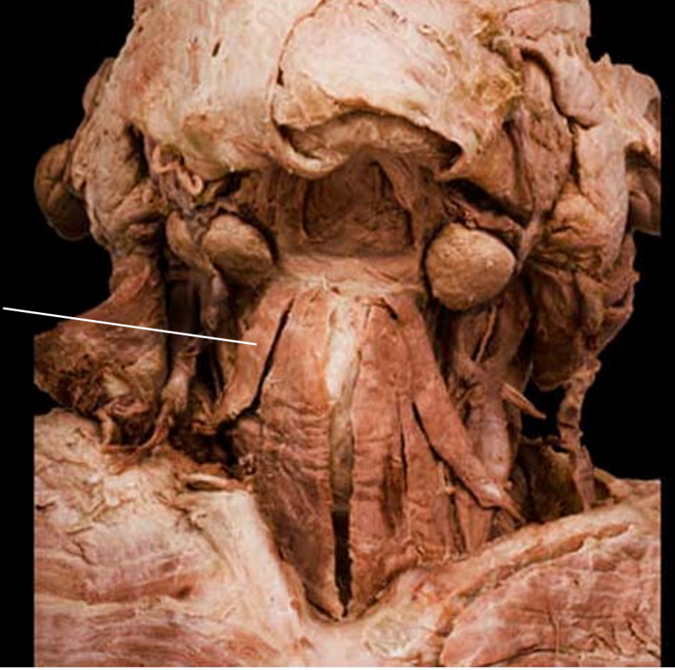
Muscular triangle
Posterosuperior
  Superior belly of omohyoid
Posteroinferior
  Sternocleidomastoid
Anterior
  Midline of neck
Contents
  Infrahyoid muscles; thyroid and parathyroid glands
Omohyoid
MT
SCM

Slide 30
Muscles in anterior cervical region
Suprahyoid muscles
  Superior to hyoid bone
Infrahyoid muscles
  Inferior to hyoid bone
These hyoid muscles steady or move the hyoid and larynx

Slide 31
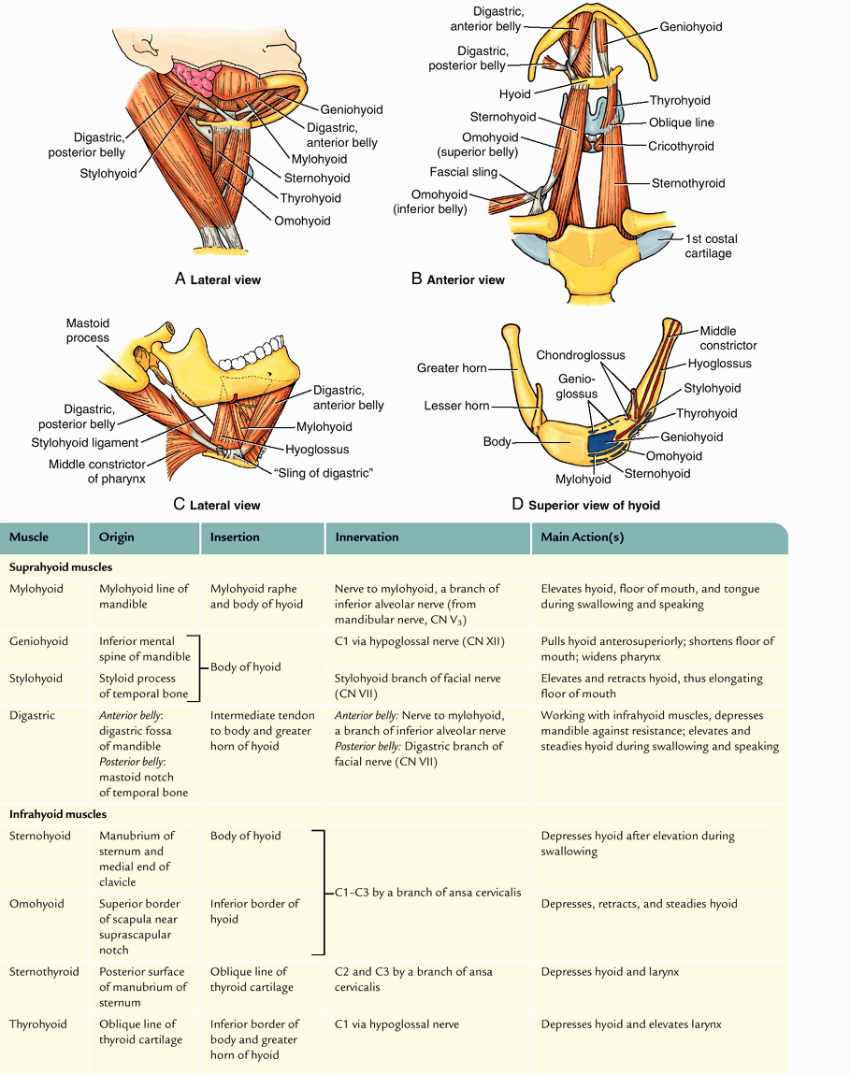
Supra and infrahyoid muscles

Slide 32
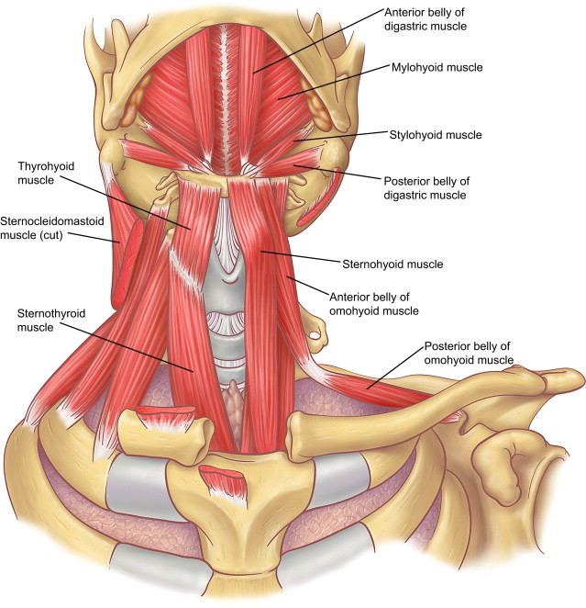
Supra and infrahyoid muscles

Slide 33
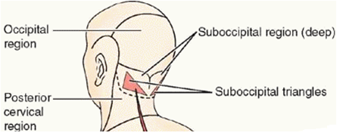
Suboccipital region
Muscle “compartment” deep to superior part of posterior cervical region
Lie deep to trapezius, sternocleidomastoid, splenius, and semispinalis muscles
Consists of four small muscles
  Two rectus capitis posterior (major and minor)
  Two obliquus muscles
Suboccipital triangle is present in this region
Notes:
Lie posterior to C1 and C2 vertebra

Slide 34
Suboccipital Muscles
Muscle | Origin | Insertion
Rectus capitis posterior major | Spinous process of vertebra C2 | Lateral part of inferior nuchal line of occipital bone
Rectus capitis posterior minor | Posterior tubercle of posterior arch of vertebra C1 | Medial part of inferior nuchal line of occipital bone
Obliquus capitis inferior | Spinous process of vertebra C2 | Transverse process of vertebra C1
Obliquus capitis superior | Transverse process of vertebra C1 | Occipital bone between superior and inferior nuchal lines
All four muscles are innervated by the posterior (dorsal) ramus of C1, suboccipital nerve
Act on the head directly or indirectly by extending it on vertebra C1 and rotating it on vertebrae C1 and C2

Slide 35
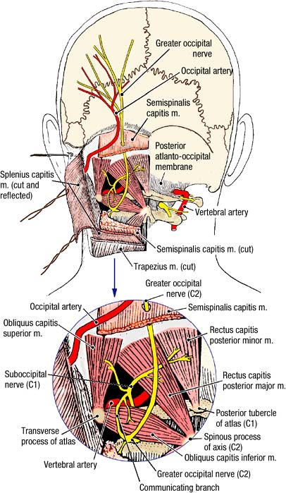
Suboccipital muscles
Inferior nuchal line

Slide 36
Suboccipital triangle
Placed very deeply in the back below the occipital bone
Following structures have to be reflected before the suboccipital triangle is approached:
  Skin
  Superficial fascia (greater occipital nerve, occipital artery)
  Deep fascia
  Trapezius muscle
  Splenius capitis
  Semispinalis capitis

Slide 37
Suboccipital triangle
Bounded
  Medially
    Rectus capitis posterior major
  Laterally
    Obliquus capitis superior
  Inferiorly
    Obliquus capitis inferior
  Roof
    Semispinalis
  Floor
    Posterior arch of C1 and posterior atlantooccipital membrane
Contents
    3rd part of vertebral artery, suboccipital nerve (dorsal rami of C1), suboccipital venous plexus

Slide 38
Applied anatomy
Suboccipital triangle is used to approach the posterior cranial fossa in the operation connected with that fossa and cerebellum
This is also used in cisternal puncture of cisternal magna to withdraw CSF
  This is done when lumbar puncture is contraindicated as in the case of a block between the cranial and spinal subarachnoid spaces
Notes:
The cisterna magna is located between the cerebellum and the dorsal surface of the medulla oblongata. Cerebrospinal fluid produced in the fourth ventricle drains into the cisterna magna via the lateral apertures and median aperture.

