Slide 1
THORACIC DUCT
Dr. Sarangdhar kumar
Department of anatomy
Rohilkhand medical college
Bareilly

Slide 2
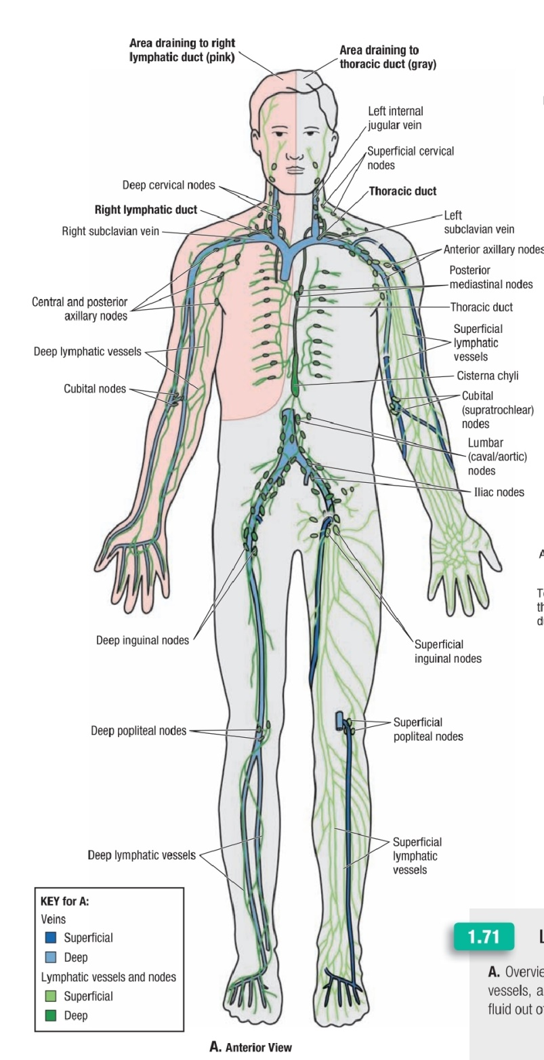
Largest lymphatic trunk
Thin walled & usually white in living person
Convey chyle & most of lymph of the body into blood stream
Drains the lymphatic from whole body except
  Right side of head & neck
  Right upper limb
  Right lung & thoracic wall
  Right half of heart
  Right surface of liver

Slide 3
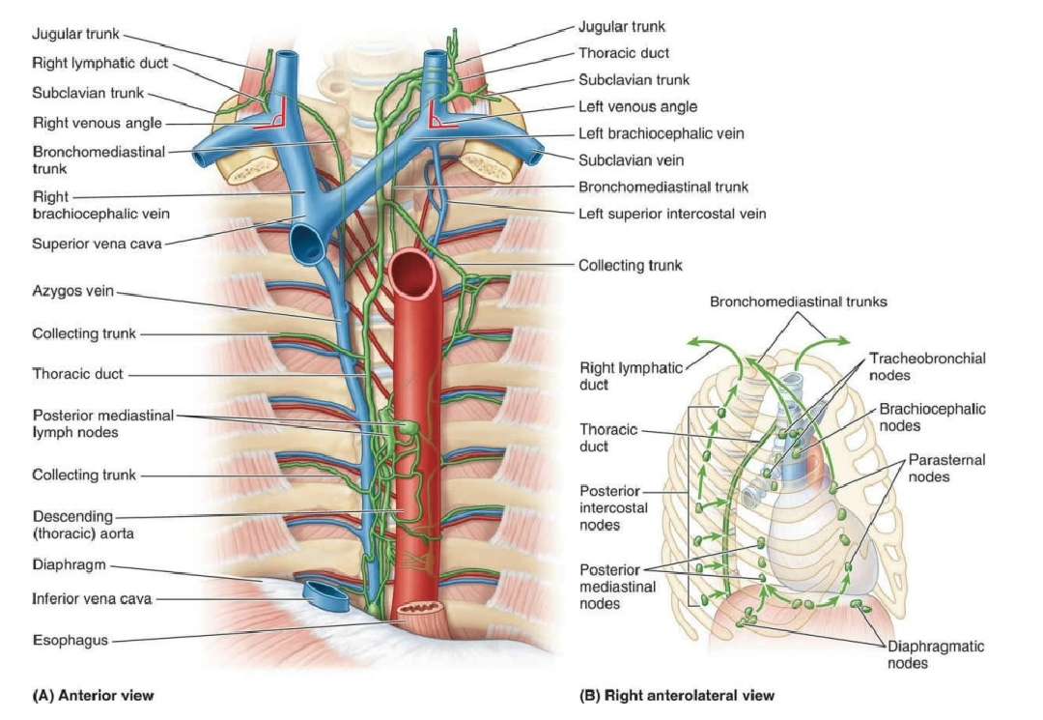

Slide 4
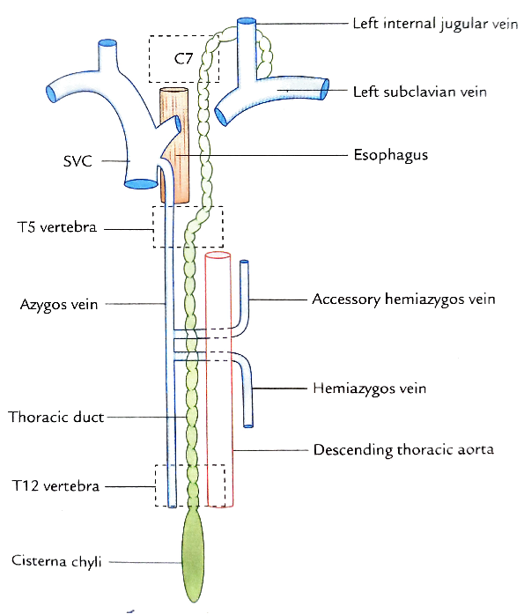
Extent -
  Upper end of cisterna chyli on posterior abdominal wall to junction of left internal jugular & left subclavian veins at the base of neck
Length – 45 cm
Width - 0.5 cm
Appearance –
  Beaded

Slide 5
Course –
  Begins from upper end of cisterna chyli at lower border of T12
  Enters into thorax usually through aortic opening of diaphragm
  Then it passes upwards in posterior mediastinum
  Opposite to T5 it inclines from right to left
  And reaches to superior mediastinum
  At the root of the neck, it arches laterally opposite to TP of C7
  Finally ends at the junction b/w left internal jugular vein & left subclavian vein

Slide 6
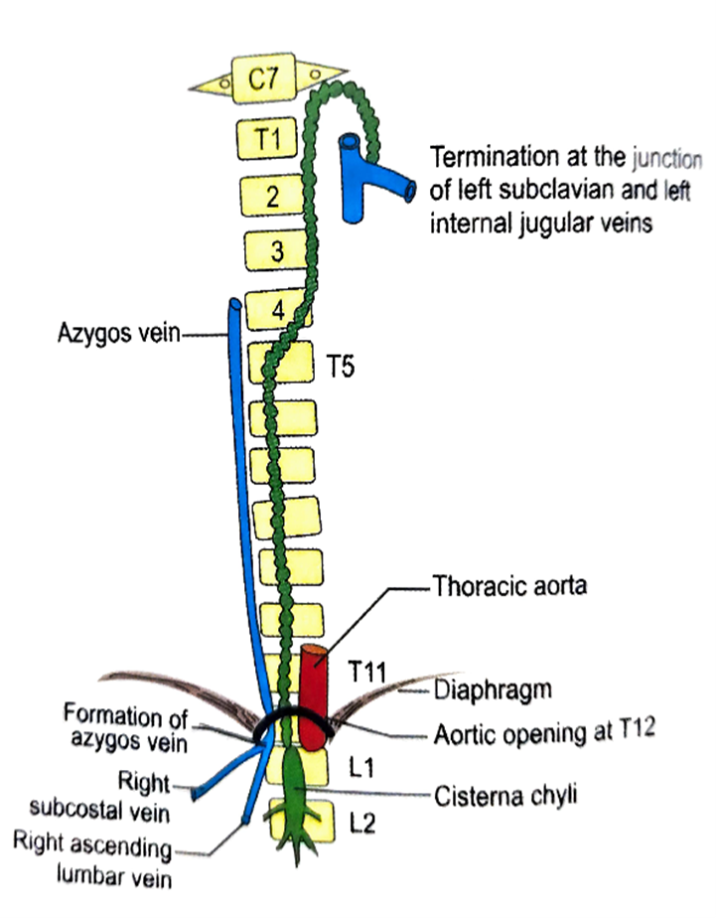
Relations
At the aortic opening –
  Infront –
    Median arcuate ligament
  Behind –
    T12 vertebra
  Right side –
    Azygos vein
  Left side –
    Aorta

Slide 7

In the posterior mediastinum –
  Infront –
    Oesophagus
    Posterior sloping surface of diaphragm
  Behind -
    Thoracic vertebrae
    Terminal part of hemiazygos & accessory hemiazygos vein
  Right side -
    Azygos vein
  Left side –
    Descending thoracic aorta

Slide 8
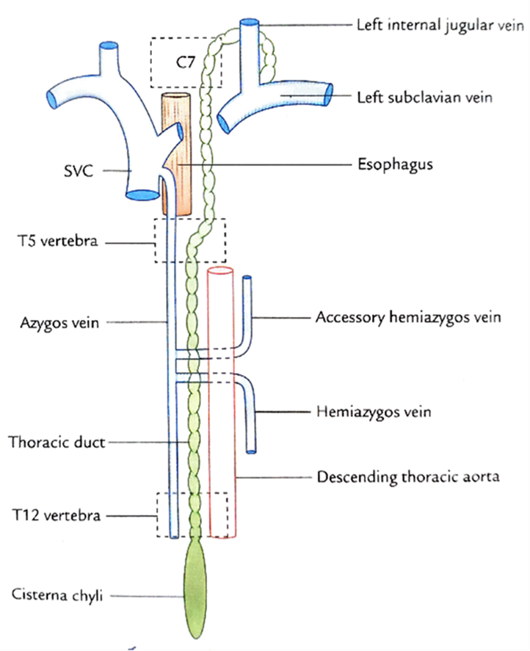
In the superior mediastinum –
  Infront –
    In lower part – arch of aorta
    In upper part – left subclavian artery
  Behind –
    Upper four thoracic vertebrae
  Right side –
    oesophagus
  Left side –
    left lung & pleura

Slide 9
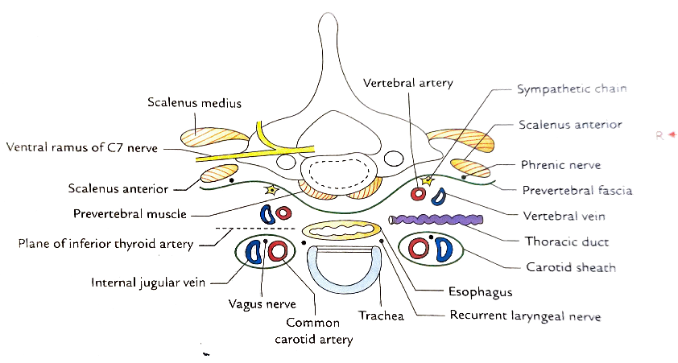
At the root of the neck-
  Infront –
    left carotid sheath
  Behind –
    left sympathetic trunk
    1st part of vertebral artery
    Branches of thyro-cervical trunk
    Left scalenus anterior muscle
    Left phrenic nerve
    1st part of left subclavian artery

Slide 10
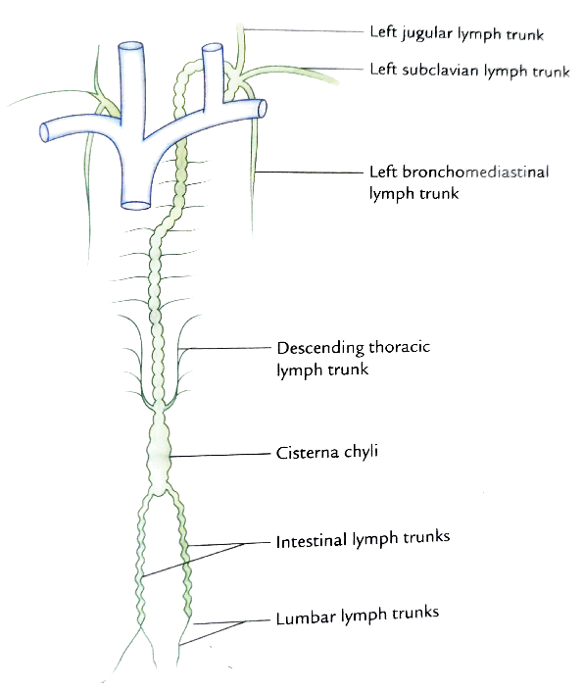
Tributaries –
    Pair of descending lymph trunk
    Pair of ascending lymph trunk
    Left jugular lymph trunk
    Left subclavian lymph trunk
    Left Broncho- mediastinal lymph trunk (occasionally)

Slide 11
Applied anatomy
Laceration of thoracic duct –
  Due to obstruction of filarial parasite
  Due to surgical procedure in posterior mediastinum
  Also during accident & lung surgery
  As a result lymph escape into thoracic cavity at rates ranging from 75 to 200 ml/ hour
    Chylothorax
    Chyloperitoneum
    chyluria

Slide 12
THANK YOU

Slide 13
