Slide 1
THE SPLEEN
Dr. Sarangdhar kumar
Department of anatomy
Rohilkhand medical college
Bareilly

Slide 2
Introduction
Haemo-lymph organ
  It filters blood by taking out worn-out erythrocytes
  In foetal life it manufacture erythrocytes & after birth it manufacture lymphocytes
It is highly vascular, friable & elastic
Purple in colour
Moving with respiration
Belongs to reticulo-endothelial system

Slide 3
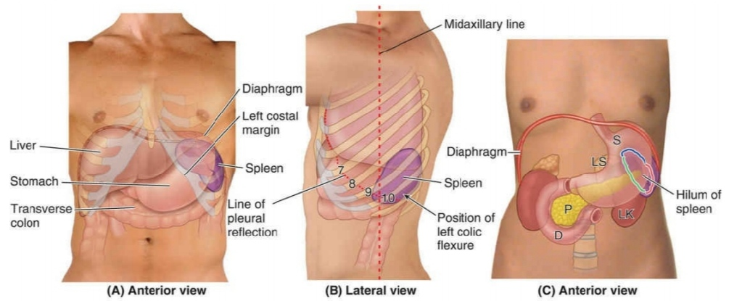
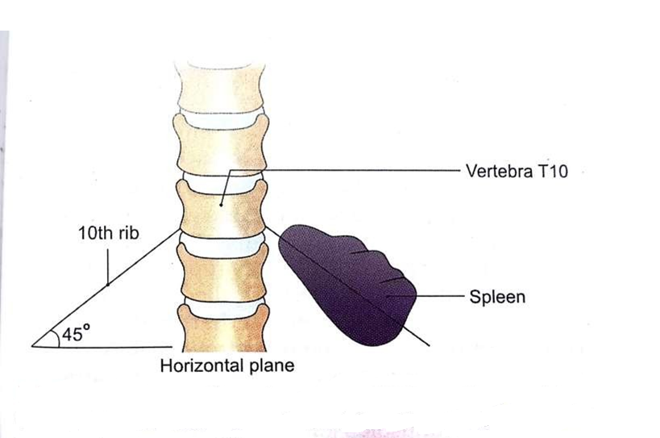
Situation
  Upper & left part of abdomen
  b/w fundus of stomach & the diaphragm
  Mainly in Left hypochondrium & partly in epigastrium
Axis
  Oblique & is directed downwards , forwards & laterally
  Coinciding with left 10th rib

Slide 4
Measurement
  Length
    12 cm (5 inches)
  Breadth
    7 cm (3 inches)
  Thickness
    3 cm (1 inch)
  Weight
    150 gm (7 oz)
    Normal range – 80 – 300 gm)
Harris’s dictum – odd numbers of spleen

Slide 5
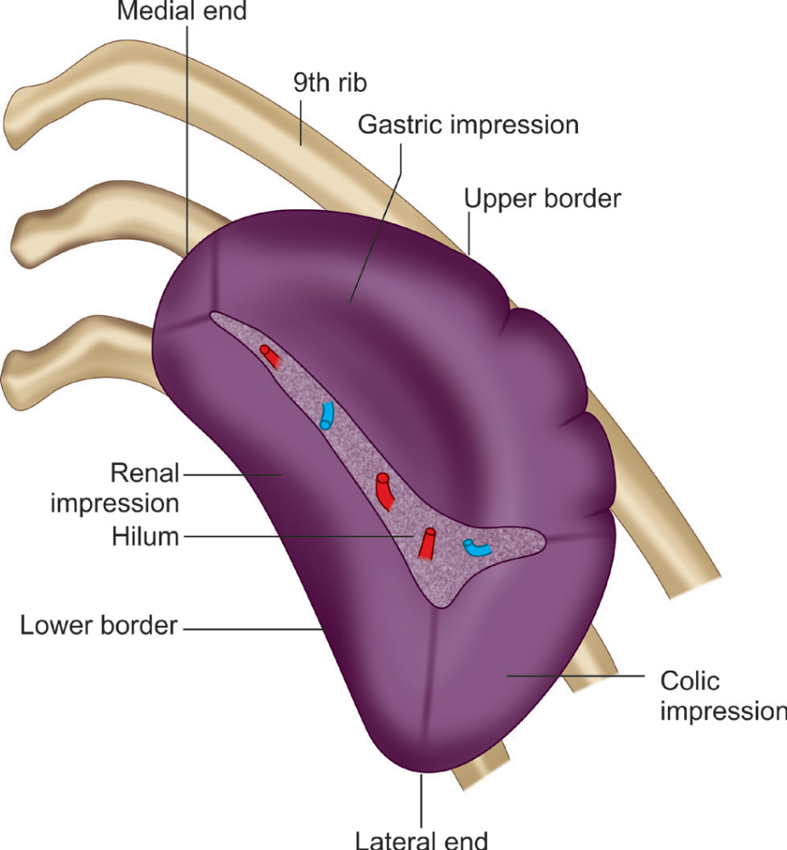
Presenting parts
  Two ends
    Medial
    Lateral
  Two surfaces
    Diaphragmatic
    Visceral
  Two borders
    Superior
    Inferior
  Two angles
    Anterior basal
    Posterior basal

Slide 6
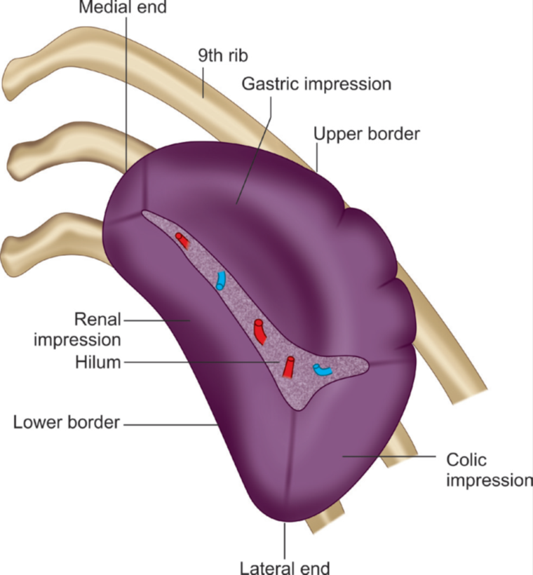
Ends
Medial end
  Blunt & rounded
  Directed upwards, backwards & medially
  Situated 3-4cm left opposite to spine of 10th vertebra
Lateral end
  Broad
  Extends b/w superior & inferior border
  Directed downwards , forwards & to the left

Slide 7
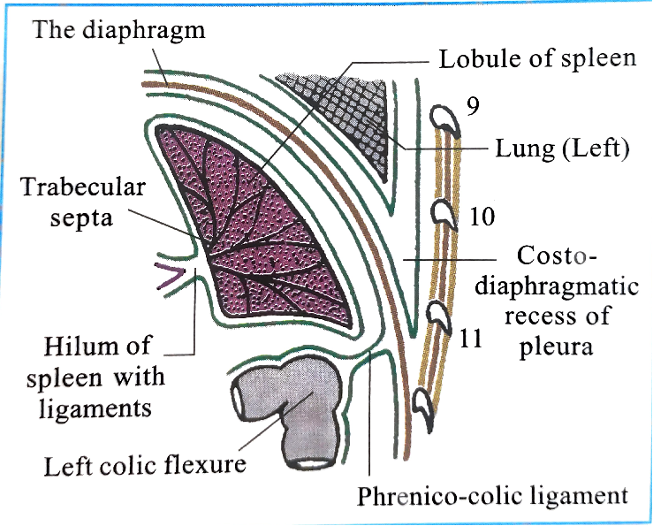
Surfaces
Diaphragmatic surface
  Smooth & convex
  Directed upwards ,backwards & to the left
  Related with –
    The diaphragm
    Lower border of left lung & left pleural sac
    9th , 10th & 11th ribs of left sides

Slide 8
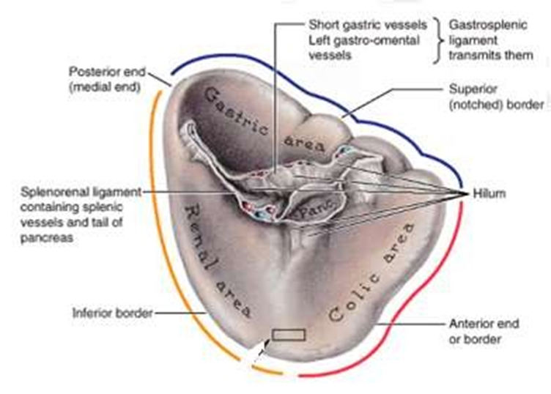
Visceral surface
  Presents four impressions
    Gastric
    Renal
    Colic
    Pancreatic

Slide 9
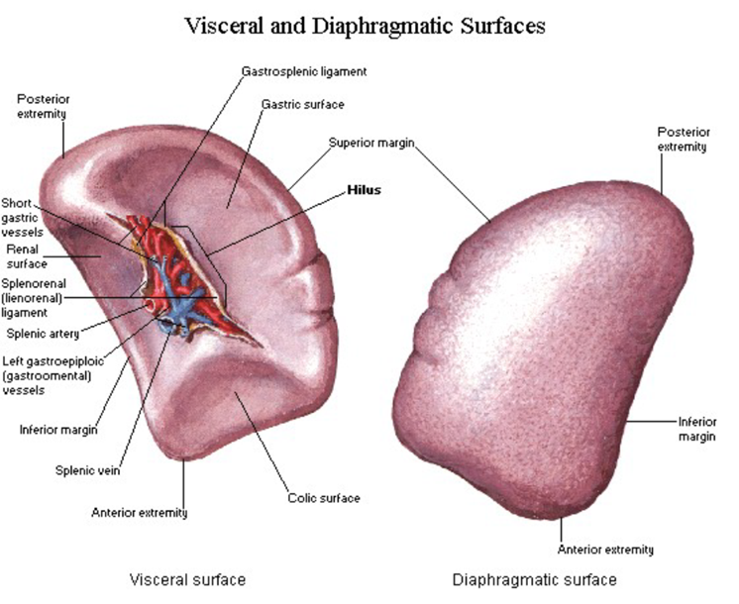

Slide 10
Borders
Superior border
  Thin & convex
  It separates gastric impression from diaphragmatic surface
  Present notch (1 or 2)
Inferior border
  It separates renal impression from diaphragmatic surface
  Coinciding with left 11th rib

Slide 11

Anterior basal angle
  It is the junction of superior border and lateral end of spleen
  It lies 9th intercostal space (or slightly behind the left mid axillary line )
  Also called clinical angle of spleen
Posterior basal angle
  Junction of inferior border & lateral end of spleen

Slide 12
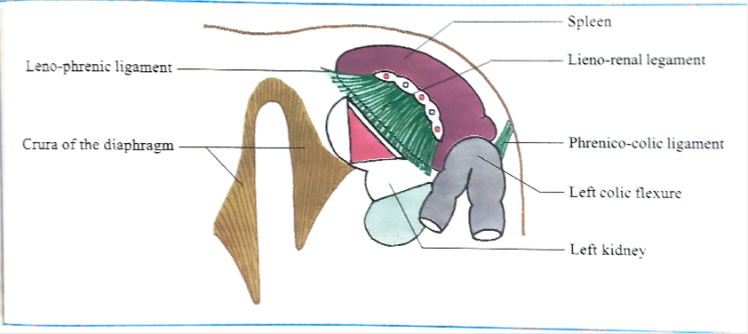
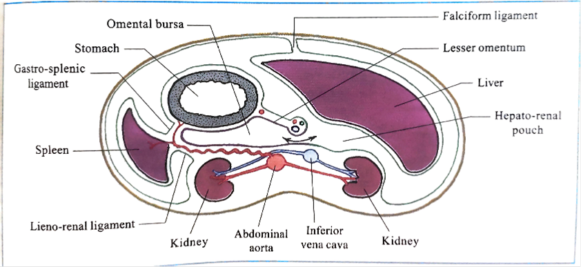
Ligament of spleen
  Gastrosplenic
  Lienorenal
  Phrenicocolic
    Sustentaculum lienis
  Lienophrenic or phrenicosplenic (sometimes)
    Suspensory ligament of spleen

Slide 13
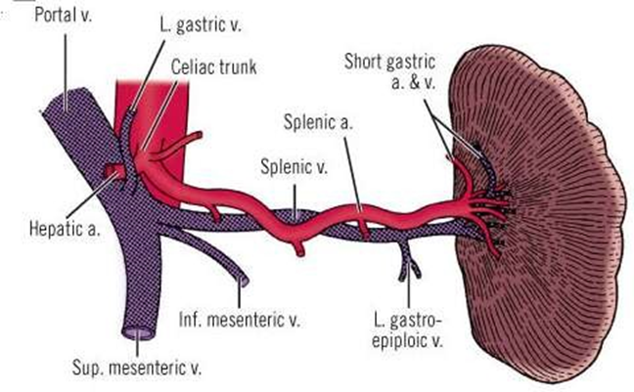
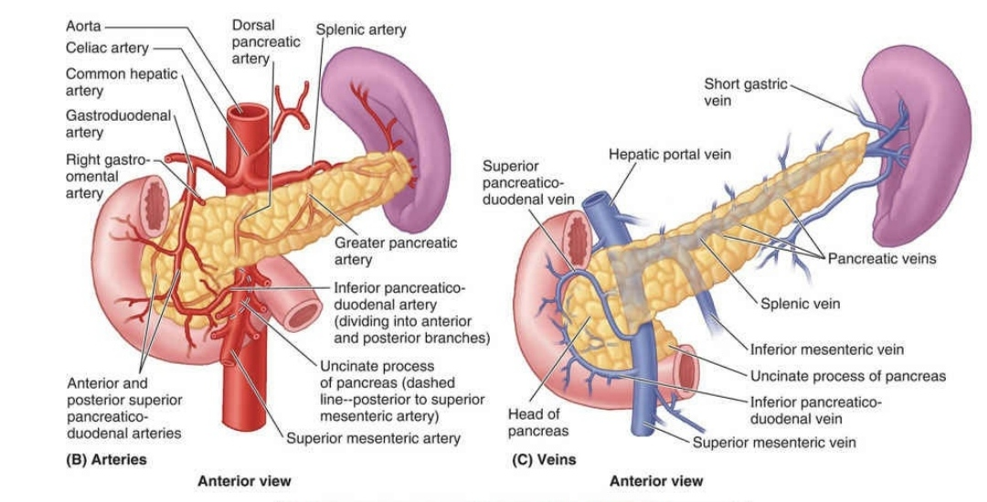
Arterial supply
  Splenic artery
Venous drainage
  Splenic vein

Slide 14
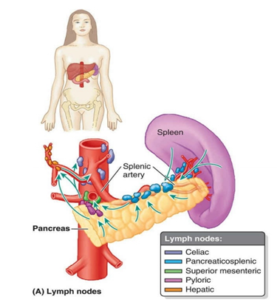
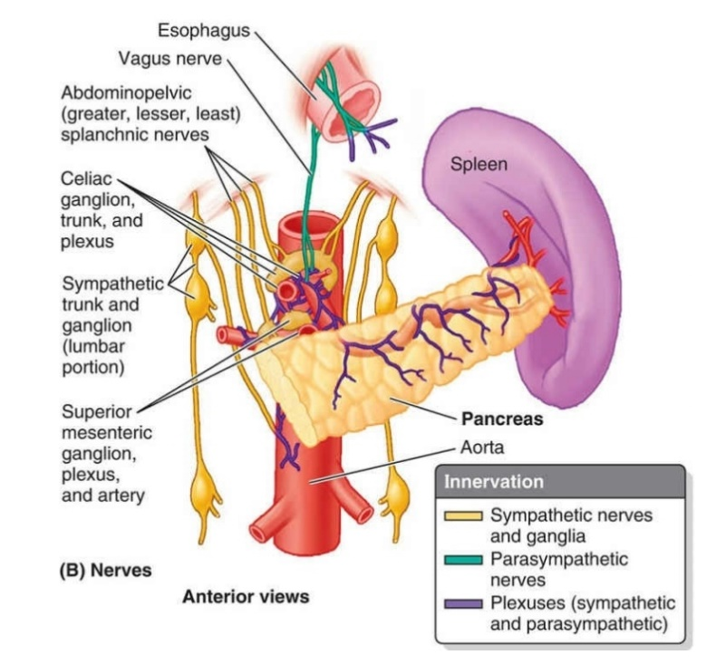
Lymphatic drainage
  Pancreaticosplenic group of lymphnodes
Nerve supply
  Predominantly supplied by Sympathetic (coeliac plexus )

Slide 15
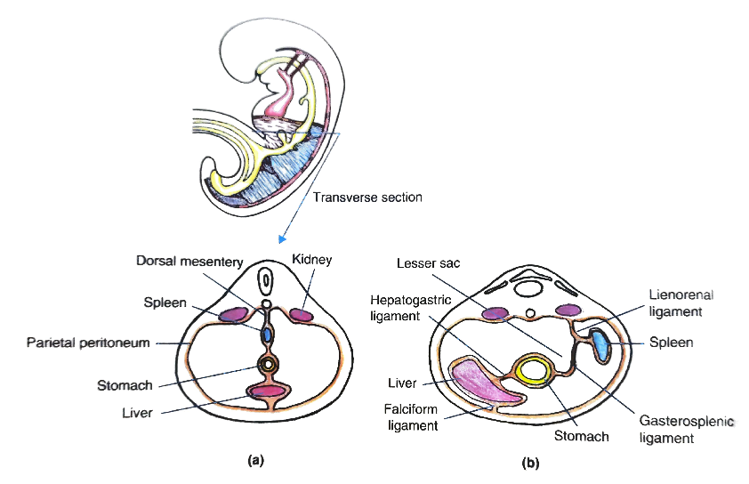
Development
    5th week of IUL
    Developed as lobulated masses
    By mesenchymal condensation of upper part of dorsal mesentery
Accessory spleen
  Found within
    The gastrosplenic ligament
    Greater omentum
    Spermatic cord (rarely)

Slide 16
Applied
Splenomegaly
Splenectomy

